Slide 1

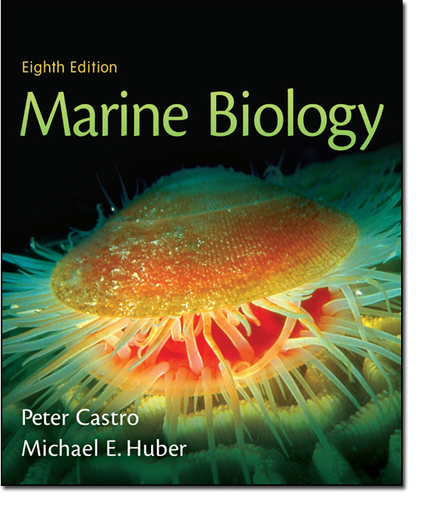
Chapter 16
Lecture
Slides
Copyright © The McGraw-Hill Companies, Inc. Permission required for reproduction or display.

Slide 2
Chapter 16
The Ocean Depths

Slide 3

Divisions of the Deep Sea
Mesopelagic – 200 to 1000 meters
Bathypelagic – 1000 to 4000 meters
Abyssopelagic – 4000 to 6000 meters
Hadopelagic – 6000 to benthic community (can be as deep as 11,000 meters in trenches)

Slide 4

Life in the Deep Sea
Life in the deep sea is reduced compared to life in other marine communities
This reduction is primarily due to a reduction in the amount of food available
The amount of food available is low due to the lack of photosynthesis in this perpetually dark environment

Slide 5
Life in the Deep Sea
While food is limited in this environment, the amount of oxygen is not limited in most areas due to exchange with surface waters via ocean currents
There is an area called the oxygen minimum zone (OMZ) where oxygen levels are reduced due to a greater degree of respiration in this area and lack of photosynthesis to replace the oxygen

Slide 6
Life in the Mesopelagic
The mesopelagic lies just below the well lit epipelagic
In the epipelagic, the primary production is abundant and phytoplankton and zooplankton abound
Due to this, many species that reside in the mesopelagic take part in vertical migrations
Days are spent in the mesopelagic and nights are spent feeding in the epipelagic

Slide 7
Life in the Mesopelagic
The main thermocline (rapid temp change) occurs in the mesopelagic, so migrators must tolerate these changes
Changes in pressure must also be tolerated as well

Slide 8

Migrating Vs. Non Migrating Fish of the Mesopelagic
To the right is a comparison of fish that migrate versus those that do not

Slide 9

Adaptations of Non-Migrating Mesopelagic Fish
Tend to have weak bones and flabby, watery muscles
This adaptation helps to make them neutrally buoyant and requires less energy
These fish also tend to be small (less energy required)
These fish normally have long sharp teeth and large jaws – this allows for them to feed on most any prey (even if the prey is larger than they are!)

Slide 10
Adaptations of Non-Migrating Mesopelagic Fish
Many of these fish lack a swim bladder as adjusting the pressure in the swim bladder takes precious energy
Like fish in the epipelagic, these fish have countershading or transparency to escape notice from prey or predators
These fish normally have large sensitive eyes for seeing in the extremely low light conditions
Bioluminescence is also common, via photophores or other specialized organs
The presence of photophores on only the ventral surface results in a type of camouflage sometimes referred to as counterillumination
Their hemoglobin is modified to operate at low levels

Slide 11

Examples of Mesopelagic Fish

Slide 12

Other Animals of the Mesopelagic
Zooplankton such as krill and copepods as well as larger crustacean such as shrimp, ostracods, amphipods and isopods
Cephalopods such as octopus and squid (pictured at right) are also found here

Slide 13
Conditions in the Bathy-, Abysso- and Hadopelagic
Uniformly dark
Uniformly cold (about 35 degrees F)
Uniform salinity
Water chemistry is also relatively consistent

Slide 14
Organisms of the Bathy-, Abysso- and Hadopelagic
No countershading needed as no light is present
Bioluminescence is also present in the upper portions of the deep sea; however, the occurrence of this decreases with increasing depth
Bioluminescence is thought to be used for courtship, communication or prey attraction
Unlike the organisms in the epipelagic, the photophores are normally located near or on the head as opposed to on the ventral side
The eyes of these organisms are small or may be absent (eyes only used to detect bioluminescence)
Pressure resistant enzymes for metabolism

Slide 15

Organisms of the Bathy-, Abysso- and Hadopelagic
Fish in this area are similar to those in the mesopelagic in lack of swim bladders and flabby, watery muscles and light, weak skeletons
The mouth is also large with long, pointed teeth

Slide 16
Example of a Deep Sea Fish
The angler fish (one species seen at right) is one of the more interesting fish of the deep sea
Anglerfish possess a “lure” on the head that contains symbiotic bioluminescent bacteria to attract prey
Another interesting adaptation is male parasitism
In male parasitism, a male angler fish (which are much smaller than the females) attach to the females and receive their nutrition from them and fertilize the eggs of the female

Slide 17
Other Reproductive Strategies
Many other species are hermaphrodites – this strategy ensures that reproduction can occur if encounters occur between members of the same species (chemical cues, phermones, help attract these fish together)
This is important in an environment where the number of organisms is very low!
For unknown reasons, these type of strategies are not common in deep sea invertebrates

Slide 18

Deep Sea Benthos
One benefit of the benthos is that food that falls from above can become trapped on the bottom
This allows these organisms to have a greater chance at finding food

Slide 19
Deep Sea Benthos
Other organisms such as pteropods, snails and worms can also be found in this area
Decomposing bacteria can be found in the deep sea sediments, but they decompose at a much slower rate than bacteria at the surface (as much as 1000 times slower)
This is likely due to the extreme pressure present in the deep sea

Slide 20

Deep Sea Benthos
Bacteria are not the only organisms in the sediments
A wide variety of meiofauna also live here
Due to the bacteria and meiofauna, deposit feeding organisms are common
Many organisms are quite large compared to their counterparts in other marine communities (such as the amphipod at the right – amphipods are about the size of lady-bugs or smaller in other communities
This phenomenon is known as deep sea gigantism

Slide 21
Deep Sea Benthos
Not only do organisms tend to grow larger but they also tend to grow slow and have an exceptionally long life
They tend to reproduce late in life and have few, large well developed eggs

Slide 22
Hydrothermal Vent Communities
These communities are an oasis in the otherwise nutrient poor deep sea
The chemical laden water escaping from cracks in the seafloor around the mid ocean ridges “feed” chemoautotrophic bacteria

Slide 23
Hydrothermal Vent Communities
These vents contain large amounts of hydrogen sulfide that serve as the energy source for these bacteria
These bacteria are the first link in the food chain in this unique community
Not only can they utilize this normally toxin substance, but they can withstand temps up to 250 degrees F

Slide 24

Hydrothermal Vent Communities
These “black smoker” vents and the cooler “white smokers” support a WIDE variety of organisms besides bacteria such as fish, shrimp, tube worms, clams, crabs, snails, barnacles, sponges, corals, etc.

Slide 25

Hydrothermal Vent Communities
Interesting, one group of these organisms – the tube worm seen at the right – actually harbors the chemoautotrophic bacteria in their body to support their metabolic needs

Slide 26
Hydrothermal Vent Communities
These vents may come and go as geologic activity in any given area may change
For as long as they last, the vents support a level of life not seen elsewhere in the deep sea

