Slide 1

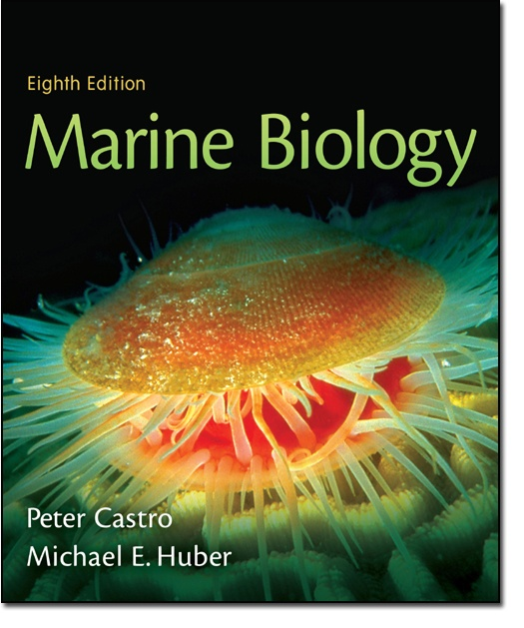
Chapter 19
Lecture
Slides
Copyright © The McGraw-Hill Companies, Inc. Permission required for reproduction or display.

Slide 2
Chapter Nineteen
The Oceans and Human Affairs

Slide 3
Ancient Oceanic Explorers
Ancient oceanic explorers include:
  Arab sailors who sailed across the Indian Ocean
  Vikings sailing across the North Atlantic
  Polynesians sailed the Pacific Ocean
  Chinese sailors sailed Indian Ocean and may have reached Pacific shores

Slide 4
European Explorers
Quest to discover new lands was pioneered by the Portuguese
They sailed around the tip of Africa to India by the late 15th century
Columbus “discovered” the New World in 1492 (earlier voyages by the Vikings to the New World had never been shared)
Between 1480 and 1780, explorers from all over Europe sailed all over the world with few coastlines left explored

Slide 5
Other Exploration
England, Netherlands and Portugal emerged as leading nations during the modern time due to their sea trade and power
“Those who rule the sea, rule the land” became the prevailing motto of the day

Slide 6
Maritime Cultures
Maritime cultures are defined as having an intimate relationship with the sea
Example of traditional maritime cultures: Native Americans from Southern Alaska to Northern California
  This culture was dependent on salmon, marine mammals and shellfish
  This culture recognized and followed migration patterns
  Marine life was basis for religious beliefs

Slide 7
Maritime Cultures
Some maritime cultures still exist such as:
  Bajaus or “sea gypsies of the Philippines and Borneo
  Kuna Indians of the Caribbean coast of Panama

Slide 8
Modern Uses of Ocean
Shipping (this is still the cheapest way to transport large quantities)
Tourism – cruise anyone?
Recreation (whale-watching, snorkeling, diving, sailing, water-skiing, etc)
Food – fish, shellfish, kelp, etc.

Slide 9
Protecting the Future
The ocean is under constant threat from pollution, global warming, sea level rise, habitat destruction, overfishing and other dangers
To help protect oceanic resources, a treaty was developed in 1982 called the United Nations Convention on the Law of the Sea (UNCLOS)

Slide 10
Protecting the Future
This treaty has several provisions:
  Establishment of the Exclusive Economic Zone (EEZ) that extends a nation’s economic interests 200 nautical miles from the coast
  Establishment of free passage through waters 12 miles or more from a nation’s shores
  Establishment of unimpeded surface and submarine travel through straits within the territorial sea of more than one nation

Slide 11
Protecting the Future
United Nations Conference on Environment and Development
  This was developed in 1992 as an agreement to preserve biodiversity
While some progress has been made, additional protections are needed to ensure the long-term health of the oceans and its inhabitants

