Slide 1
QM69A Inline Auto Diagnostic
F10 Data Scientists

Slide 2
Agenda
Project Scope
QM69A overall Architecture
Data Engineering
Teradata Data Transformation
TDCH
Hadoop Data Transformation
Sigma Reader
Non sigma Reader
Combiner
Data Analytics
Data Visualization
Project Deployment Status
Future Enhancement

Slide 3
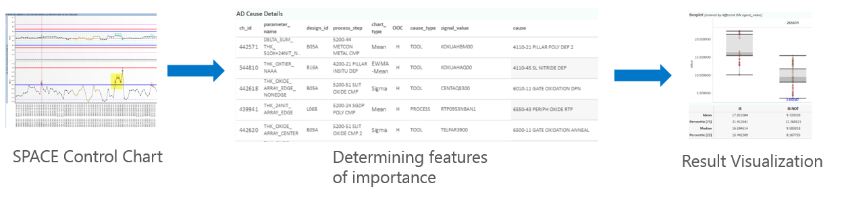
Project Scope
This project aims to provide engineers with the most probable root cause(s) of a Out of Control (OOC) point in the SPACE (Inline) control chart.
Upon result validation, engineers can act in order to mitigate the cause of the OOC.

Slide 4
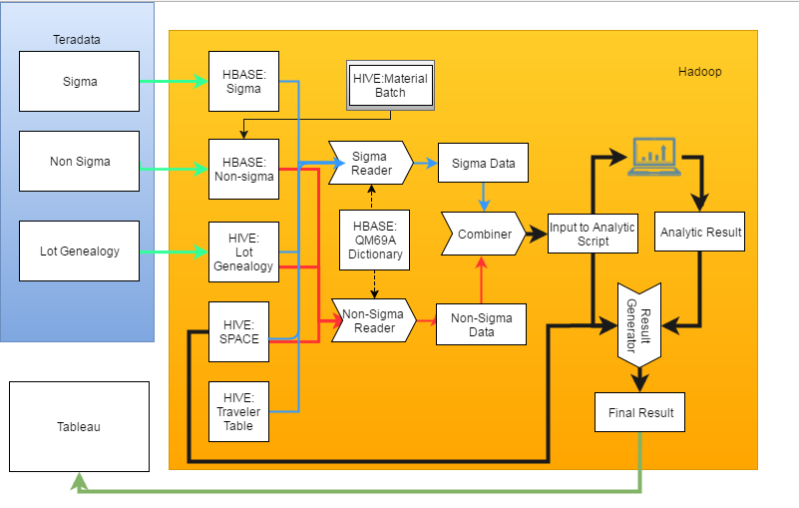
QM69A overall Architecture

Slide 5
Data Preparation

Slide 6
Teradata to Hadoop: TDCH

Slide 7
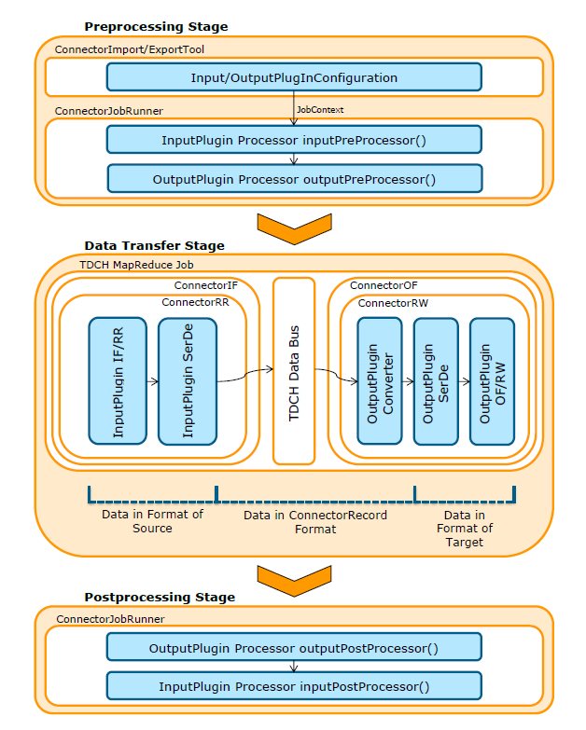
TDCH
TeraData Connector for Hadoop
High-performance parallel bi-directional data movements
TDCH utilizes MapReduce as its execution engine
3 stages
Preprocessing - setup for source and target system
Data Transfer - MapReduce
Post-processing - Clean up source and target system

Slide 8






Work Flow
Update the timestamp
BTEQ
Teradata query
Read the last
loaded timestamp
Temp tables
TDCH
QM69A
Read the timestamp as start time
Get the latest datetime of specific dataset as end time
Query data from start time to end time in Teradata
Load data into Hbase via TDCH
Update the timestamp file
Iterate

Slide 9
Sigma Data Ingest
TDCH
Table Name | Column Family | Row Key | Column Design | Table desc
eng_mti_${site}_fab_${fab_no}_GenericQueryData : sigma_lot_v3 | 1 | Lot ID | Run_complete_datetime+step_no+attribute Run_complete_datetime+step_no+test_dwid

Slide 10
Sigma Data Ingest(cont)
TDCH
Table Name | Column Family | Row Key | Column Design | Table desc
eng_mti_${site}_fab_${fab_no}_GenericQueryData : sigma_wafer_v3 | 1 | Lot ID + Wafer ID | Run_complete_datetime+step_no+attribute Run_complete_datetime+step_no+test_dwid | Contains All the wafer level information as listed above

Slide 11
Non-Sigma Data Ingest
Table Name | Column Family | Row Key | Column Design | Table desc
eng_mti_${site}_fab_${fab_no}_GenericQueryData : lot_v5 | 1 | Lot ID | AQT+From_step+To_step+AQT_item CT+Step_name+CT_item QT+From_step+To_step+AQT_item LA+corr_item_desc+sequence_no MB+Traveler_step+Chemical+sequence_no | Contains lot level information of AQT, CT, QT, LA & MB

Slide 12
Non-Sigma Data Ingest(cont)
Table Name | Column Family | Row Key | Column Design | Table desc
eng_mti_${site}_fab_${fab_no}_GenericQueryData : wafer_v4 | 1 | Lot ID + Wafer ID | WA+corr_item_desc QDR+QDR_item+step_no SWR+SWR_item+step no | Contains All the wafer level information as listed above

Slide 13
Non-Sigma Data Ingest(cont)
Table Name | Column Family | Row Key | Column Design | Table desc
eng_mti_${site}_fab_${fab_no}_GenericQueryData : qm69_report_v1 | 1 | QDR ID SWR ID | QDR SWR_STEPS | Contains All the report information as listed above

Slide 14
Teradata to Hadoop: TDCH

Slide 15

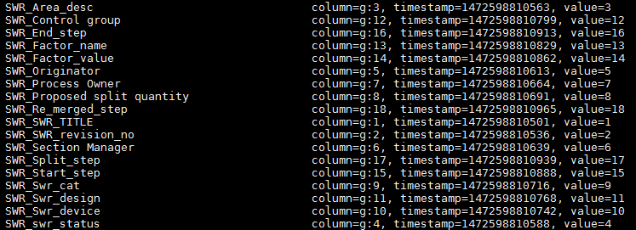
What is QM69A Dictionary (lookup)
Reference table for
Process Step (Daily Update)
Material Batch Attributes (One Time Ingestion)
SWR / QDR Attributes (One Time Ingestion)
CT / QT Attributes (One Time Ingestion)
To optimize the cost of column qualifier storage

Slide 16
HIVE SPACE OOC

Slide 17
HIVE SPACE OOC
space_bad_charts_new
Headers | Data Type | Example Values
fab | string | 10
module | string | CVD, PVD, IMPLANT, PHOTO, WET PROCESS, DIFFUSION, CMP, DRY ETCH, METRO
design_id | string | B16A
ch_id | int | 436476
current_step | string | 1210-23 PERIPH PHOTO SEM CD
process_step | string | 3010-23 PERIPH PHOTO
parameter_name | string | CD1_SPACE_BOT
lot_id | string | 8064111.001
wafer_id | string | 4111-25 (for lot level chart this column is '-' or '.')
label | int | space_ooc_label: 0,1
value | double | measurement_value
sample_date | timestamp | some_date
ucl | double | upper_control_limit
lcl | double | lower_control_limit
col_type | string | Production,Qual
channel_type | string | Area,PML,Engineering
chart_type | string | Mean,Sigma,Range,EWMA
clusterid | string | 1,2,3…
clusterlabel | string | B/G
last_ooc_date | timestamp | some_date
ooc_property | string | NA,H,L
session_id | string | 20160703-2200

Slide 18
Non-Sigma Reader

Slide 19
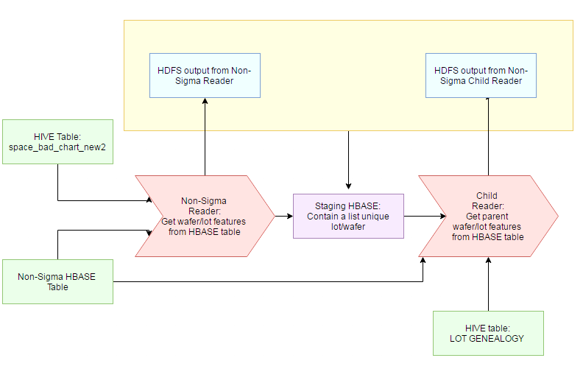
Non-Sigma Reader
Column Names | Description | Example
Module | Eg. CMP, CVD | PHOTO
Ch_id | SPACE chart channel ID | 82331
Current_step | Measurement Step | 1200-53 PERIPH PHOTO RINSE REG
Process_Step | Process Step | 3010-53 PERIPH PHOTO
Lot_id |  | 7454007.027
Wafer_id |  | 4007-08
Label | OOC cluster label (1 for BAD 0 for GOOD) | 0
Value | SPACE chart measurement value | 1.27292375182328
Sample_date | Sampling date | 2016-10-15 23:37:26
UCL | (Upper control Limit) | 3.4
LCL | (Lower Control Limit) | 0.521503453
Chart_type | Chart Type, i.e.Mean , EWMA | Sigma
Cluster_id | OOC cluster ID | 36
Cluster_label | B – Bad ; G – Good | G
Last_ooc_date | Last OOC date of the SPACE chart | 2016-10-17 00:12:11
Signal (Features) | Features from the HBASE (QT, CT, Process, Tool) | QDR:XXXXXXX
Signal value (Feature value) | Feature value from the HBASE | 1

Slide 20
Sigma Reader

Slide 21
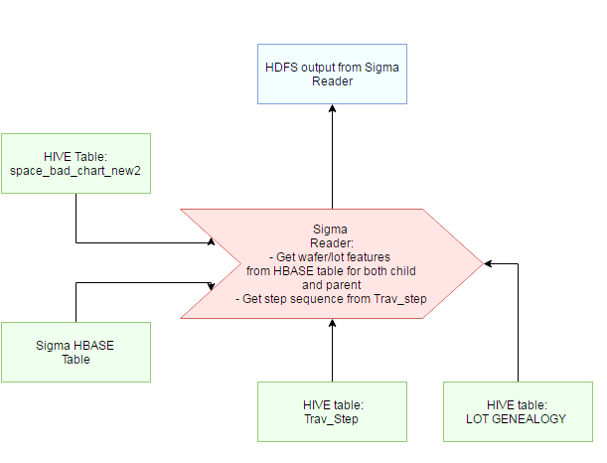
Sigma Reader
Column Names | Description | Example
Module | Eg. CMP, CVD | PHOTO
Ch_id | SPACE chart channel ID | 82331
Current_step | Measurement Step | 1200-53 PERIPH PHOTO RINSE REG
Process_Step | Process Step | 3010-53 PERIPH PHOTO
Lot_id |  | 7454007.027
Wafer_id |  | 4007-08
Label | OOC cluster label (1 for BAD 0 for GOOD) | 0
Value | SPACE chart measurement value | 1.27292375182328
Sample_date | Sampling date | 2016-10-15 23:37:26
UCL | (Upper control Limit) | 3.4
LCL | (Lower Control Limit) | 0.521503453
Chart_type | Chart Type, i.e.Mean , EWMA | Sigma
Cluster_id | OOC cluster ID | 36
Cluster_label | B – Bad ; G – Good | G
Last_ooc_date | Last OOC date of the SPACE chart | 2016-10-17 00:12:11
Signal (Features) | Features from the HBASE (QT, CT, Process, Tool) | process::4800-00 PWELL OXIDATION::GeRM PROCESS - RUN_ATTR::1
Signal value (Feature value) | Feature value from the HBASE | OX_THERMAL_95A_900C_600T_DRY_no_Cl_REVD
Violation Direction | Refers to the location of the OOC point | 1
Step Seq | This is the step sequence of the entire traveler flow. | 3600

Slide 22
Combiner Reader

Slide 23
Combiner Reader
Column Names | Description | Example
Module | Eg. CMP, CVD | PHOTO
Ch_id | SPACE chart channel ID | 82331
Current_step | Measurement Step | 1200-53 PERIPH PHOTO RINSE REG
Process_Step | Process Step | 3010-53 PERIPH PHOTO
Lot_id |  | 7454007.027
Wafer_id |  | 4007-08
Label | OOC cluster label (1 for BAD 0 for GOOD) | 0
Value | SPACE chart measurement value | 1.27292375182328
Sample_date | Sampling date | 2016-10-15 23:37:26
UCL | (Upper control Limit) | 3.4
LCL | (Lower Control Limit) | 0.521503453
Chart_type | Chart Type, i.e.Mean , EWMA | Sigma
Cluster_id | OOC cluster ID | 36
Cluster_label | B – Bad ; G – Good | G
Last_ooc_date | Last OOC date of the SPACE chart | 2016-10-17 00:12:11
Signal (Features) | Features from the HBASE (QT, CT, Process, Tool) | process::4800-00 PWELL OXIDATION::GeRM PROCESS - RUN_ATTR::1
Signal value (Feature value) | Feature value from the HBASE | OX_THERMAL_95A_900C_600T_DRY_no_Cl_REVD
Violation Direction | Refers to the location of the OOC point | 1
Step Seq | This is the step sequence of the entire traveler flow. | 3600

Slide 24
Analytic and Report

Slide 25
Data Analysis

Slide 26
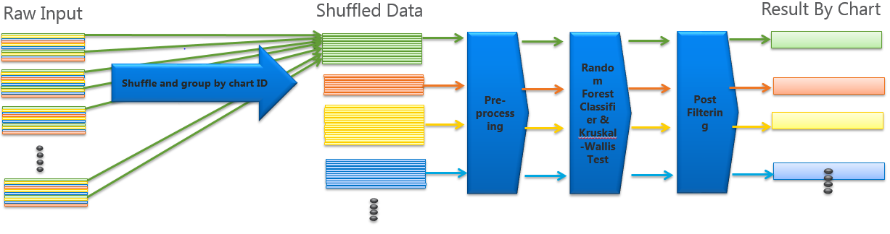
Data Analysis
Overall Flow

Slide 27
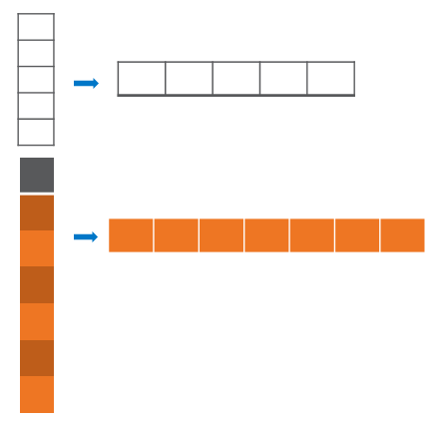
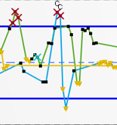
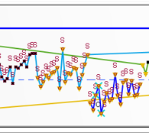
Data Analysis(cont)
Pre-process
Pivot chart information locally
Reclassify OOC points with loose criteria
Filter charts without enough OOC points
Filter Features with zero variance

Slide 28
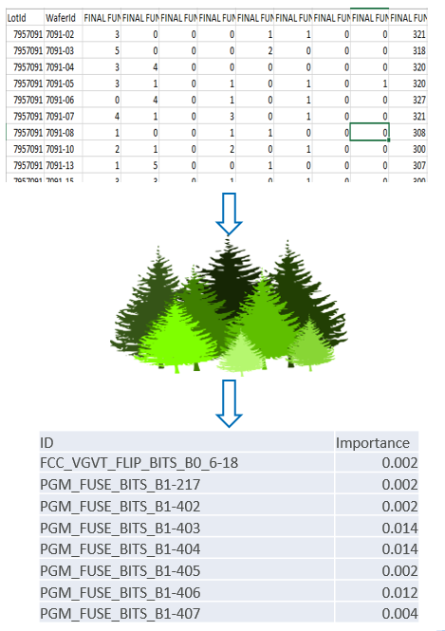
Data Analysis(cont)
Why Random Forest
Feature importance can be easily interpreted compared with other supervised learning model (neural network, SVM…)
With comparable prediction power, the training is faster compare with other method.
Parameters tuning is more robust.
Always return result based on the relative importance no matter how weak the correlation is

Slide 29
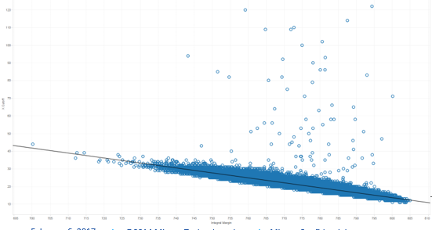
Data Analysis(cont)
Why Classifier
We are more interested in OOC and almost OOC points than the correlation between target SPACE measurement and signals.
Regression correlation detected may not be the cause of the OOC instance

Slide 30
Data Analysis(cont)
Why Kruskal Wallis Test (a.k.a H test)
Random Forest Classifier always returns results, since the feature important list is a ranking of relative importance.
Kruskal Wallis Test is a non-parametric hypothesis test
Does not assume your data comes from a particular distribution
No minimum sample size is required
Compare the ranking of value in each group, hence minimize the impact of outliers

Slide 31
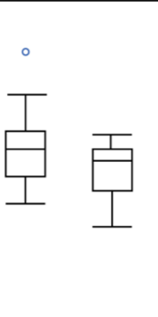
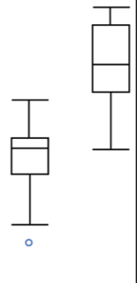
Data Analysis(cont)
Post-process
Further filter result by checking the percentile of the flagged features
Higher group’s 25 percentile must be greater than lower group’s 75 percentile
SPC measurement
SPC measurement
IS IS NOT
IS IS NOT

Slide 32
Reporting Report Generator

Slide 33
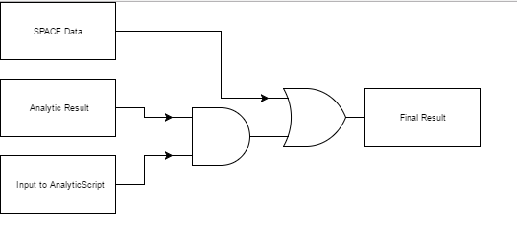
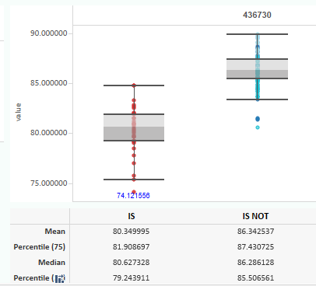
Reporting Report Generator
Analytic Result only contains the important features of the successfully diagnosed charts
More raw data are required for visualization.
Report should contain result for all charts
Output Schema from Random Forest Analytics
Ch_Id
Chart Type
Module
Importance_Score
Signal (Feature of Importance)
Status
Violation Direction

Slide 34
Final Tableau Report

Slide 35
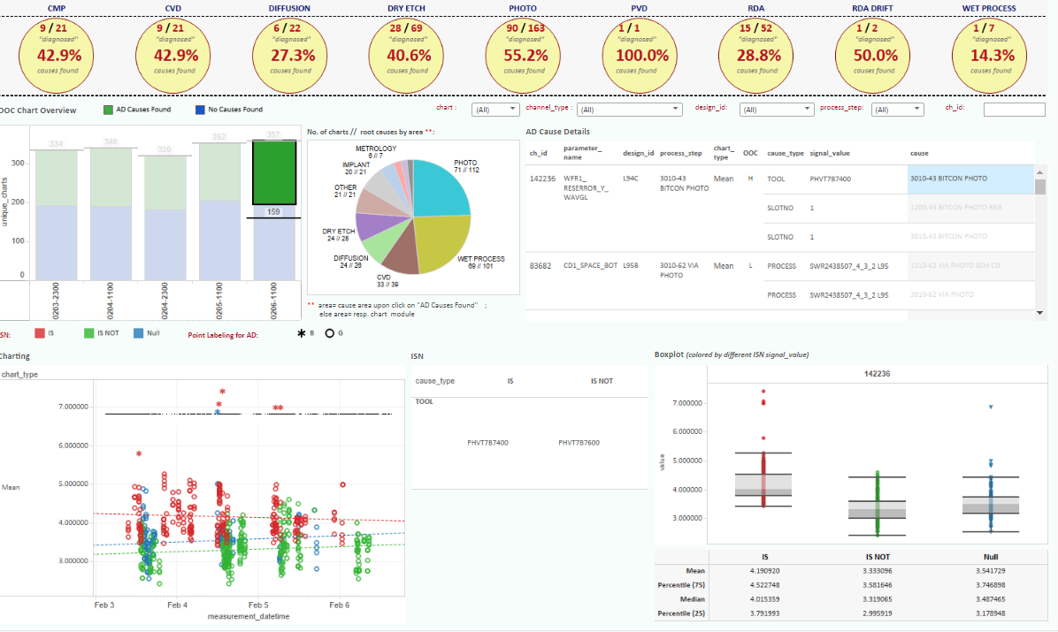
Final Tableau Report

Slide 36
Deployment Status
Site | Data Ingestion | Analytic | Reporting
Fab 10W | Up & Running | Up & Running | Up & Running
Fab 10N | Up & Running | Up & Running | Up & Running
Fab 15 | Up & Running | Not Started | Not Started
Fab 16 | Up & Running | Not Started | Not Started

Slide 37
Package Availability
Package is ready for deployment at stash:
https://stash.micron.com/bbdc/projects/QM69/repos/qm69a/browse

Slide 38
Future optimization
Replace the heavily Hbase put method to bulk loading when feeding data into Hbase to release the load of zookeeper
Move the quantile check to pre-processing to minimize the data for local pivot, so that improve the memory efficiency and speed.
Replace random forest by other well distributed algorithm with comparable accuracy. (in experiment phase)
Tier 2 Implemetation

Slide 39


Slide 41
Appendix

Slide 42
Issues and Error Encountered

Slide 43
Cluster Dependent Problem
Hbase Connection Reset Issue
Cause: Still open for IT to further investigate
Action: Raise remedy if encountered
Server returns error 12
Cause: Too many process running on the edge node
Action: Remedy to the UNIX team
HBASE region server slowness Mapper jobs are not given containers to start.
Cause: Normally caused be overloaded Cluster.
Action: Submit remedy to report the problem and re-run the session when cluster is back to normal

Slide 44
Analytic related Problem
Status of record starts with “Error: ”
Cause: Unexpected data detected in the analytic script/ defect in the script
Action: Validate the input data to analytic script
Failed to connect to certain executor/Failed to write/Missing output location for shuffle
Cause: Cluster condition dependent
Action: Submit remedy to report the problem and re-run the session when cluster is back to normal

Slide 45
Table Schema

Slide 46
Datasets (AQT)
Column Design : AQT+From_step+To_step+AQT_item
FAB_${FAB}_FT_DM.FAB_LOT_HIST
FAB_${FAB}_TRV_DM.TRAV_STEP
FAB_${FAB}_QTL_DM.QTL_STEP_GROUP
FAB_${FAB}_REF_DM.STEP
Lot_id
Trav_step_oid
Tracked_in_datetime
Tracked_out_datetime
Trav_step_oid
Step_oid
step_group_name
Step_oid
Step_name

Slide 47

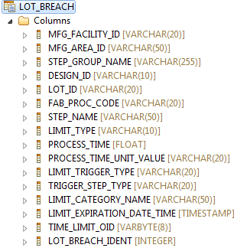
Datasets (QT)
FAB_${FAB}_QTL_DM.LOT_BREACH

Slide 48
Datasets (CT)
RPT = track_out_datetime – track_in_datetime
Cycle_Time = track_out_datetime – stage_datetime
Waiting_Time = track_in_datetime – stage_datetime
Stage_datetime = Previous Step Track out Time
FAB_${FAB}_FT_DM.FAB_LOT_HIST
FAB_${FAB}_REF_DM.STEP
FAB_${FAB}_TRV_DM.TRAV_STEP
Lot_id
Stage_datetime
Track_in_datetime
Track_out_datetime
Trav_step_oid
Updated_datetime
Step_name
Step_oid
Trav_step_oid
Step_oid

Slide 49
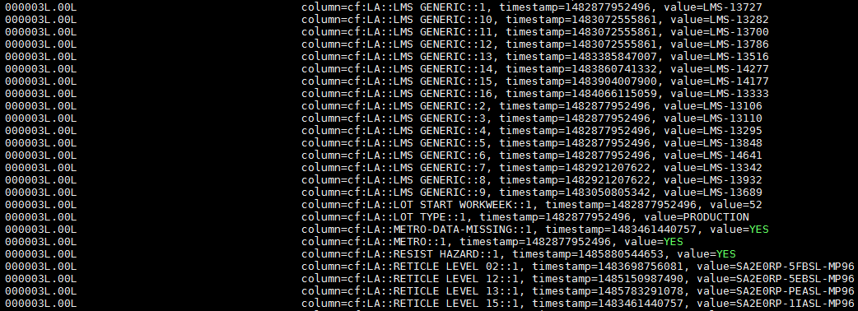
Datasets (LA)
Column Design: LA+corr_item_desc+sequence_no
FAB_${FAB}_FT_DM.FAB_LOT_ATTR_LOG
FAB_${FAB}_REF_DM.CORR_ITEM
Lot_id
…
Corr_item_oid
Seq_no
Corr_item_value
Corr_item_desc
Corr_item_oid

Slide 50
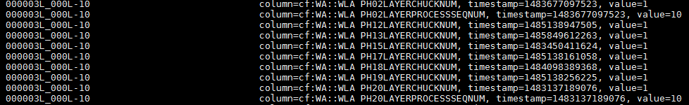
Dataset (WA)
Column Design: WA+corr_item_desc
FAB_16_FT_DM.WAFER_ATTR
FAB_16_FT_DM.WAFER_STATUS
FAB_16_REF_DM.CORR_ITEM
Wafer_scribe
Wafer_attr_value
Updated_datetime
Corr_item_oid
Lot_id
Wafer_id
Wafer_scribe
Corr_item_desc
Corr_item_oid

Slide 51
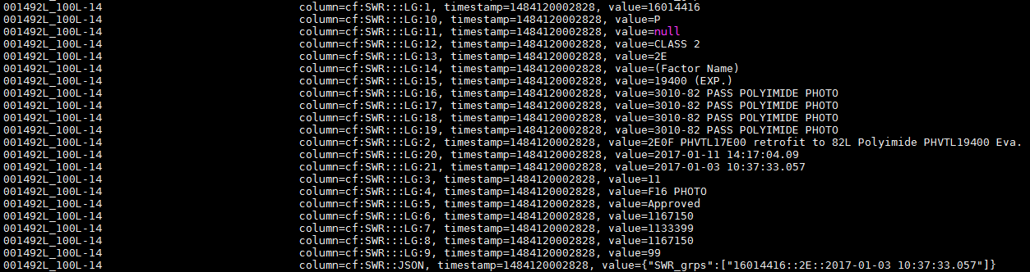
Datasets (SWR)
Column Design: SWR+SWR_item+step no

Slide 52
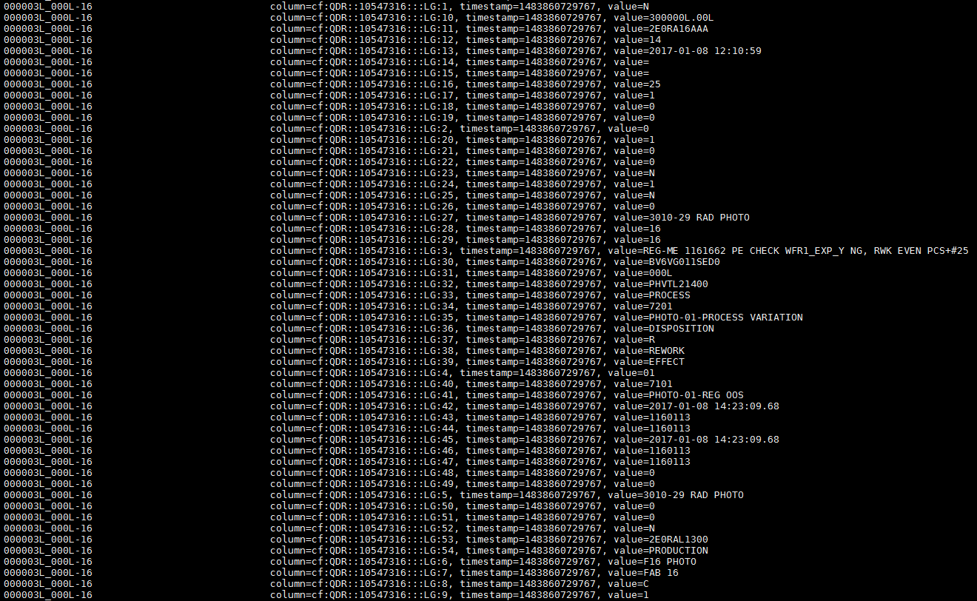
Datasets (QDR)
Column Design: QDR+QDR_item+step_no

Slide 53
Datasets (SWR_report)
Column Design: SWR_STEPS

Slide 54
Datasets (QDR_report)
Column Design: QDR

Slide 55
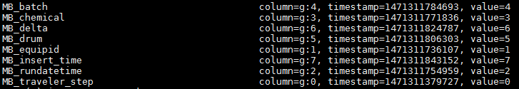
Datasets (MB)
Column Design: MB+Traveler_step+Chemical+sequence_no

Slide 56
Datasets (Sigma)
1
2
1.
2.
lot_ID | Run_complete_datetime | Step_no | Attribute | timestamp | value
Lookup in HBase lookup table
lot_ID | Run_complete_datetime | Step_no | Test_dwid | timestamp | value
Lookup in HBase lookup table
Lookup in sigma_test_def table

Slide 57
eng_mti_singapore_fab_10_autodiagnostic.space_ooc_summary_qm69a_new
Input
Output
Table Name | Extracted Info
idl_t_channel_def | basic channel background info
idl_samples_viol | violation details
space_ooc_summary_qm69a_new
Column Name | Format
fab | string
module | string
ch_id | int
col_type | string
channel_type | string
chart_type | string
ooc | int
session_id | string

Slide 58
eng_mti_singapore_fab_10_autodiagnostic.space_clustering_data_qm69a_new
Input
Output
space_clustering_data_qm69a_new
Column Name | Format
fab | string
module | string
design_id | string
ch_id | int
current_step | string
process_step | string
parameter_name | string
lot_id | string
wafer_id | string
label | string
value | string
sample_date | string
ucl | string
lcl | string
col_type | string
channel_type | string
chart_type | string
session_id | string
Table Name | Extracted Info
space_ooc_summary_qm69a_new | Which channel and chart to query
Table Name | Extracted Info
idl_t_channel_def | basic channel background info
idl_samples_calc | ewma data, ucl, lcl
idl_samples_viol | violation details
idl_samples_wafer | wafer level mean chart data
idl_samples_lot | wafer level mean chart data

Slide 59
eng_mti_singapore_fab_10_autodiagnostic.space_clustering_result_qm69a_new
Input
Output
space_bad_charts_new
Headers | Data Type
fab | string
module | string
design_id | string
ch_id | string
current_step | string
process_step | string
parameter_name | string
lot_id | string
wafer_id | string
label | string
value | string
sample_date | string
ucl | string
lcl | string
col_type | string
channel_type | string
chart_type | string
clusterid | string
clusterlabel | string
last_ooc_date | string
ooc_property | string
session_id | string
Table Name
space_clustering_data_qm69a_new
Application Name
OOC clustering (Jane)

Slide 60
eng_mti_singapore_fab_10_autodiagnostic.space_clustering_result_qm69a_new_trunc
Input
Output
space_bad_charts_new
Headers | Data Type
fab | string
module | string
design_id | string
ch_id | string
current_step | string
process_step | string
parameter_name | string
lot_id | string
wafer_id | string
label | string
value | string
sample_date | string
ucl | string
lcl | string
col_type | string
channel_type | string
chart_type | string
clusterid | string
clusterlabel | string
last_ooc_date | string
ooc_property | string
session_id | string
Table Name
space_clustering_result_qm69a_new
Application Name
OOC Truncation pyspark

Slide 61
eng_mti_singapore_fab_10_autodiagnostic.space_bad_charts_new
Input
Final Output
space_bad_charts_new
Headers | Data Type | Example Values
fab | string | 10
module | string | CVD, PVD, IMPLANT, PHOTO, WET PROCESS, DIFFUSION, CMP, DRY ETCH, METRO
design_id | string | B16A
ch_id | int | 436476
current_step | string | 1210-23 PERIPH PHOTO SEM CD
process_step | string | 3010-23 PERIPH PHOTO
parameter_name | string | CD1_SPACE_BOT
lot_id | string | 8064111.001
wafer_id | string | 4111-25 (for lot level chart this column is '-' or '.')
label | int | space_ooc_label: 0,1
value | double | measurement_value
sample_date | timestamp | some_date
ucl | double | upper_control_limit
lcl | double | lower_control_limit
col_type | string | Production,Qual
channel_type | string | Area,PML,Engineering
chart_type | string | Mean,Sigma,Range,EWMA
clusterid | string | 1,2,3…
clusterlabel | string | B/G
last_ooc_date | timestamp | some_date
ooc_property | string | NA,H,L
session_id | string | 20160703-2200
Table Name
space_clustering_result_qm69a_new

