Slide 1

WELCOME
3NF
team
DATABASE MANAGEMENT SYSTEM
2NF
1NF
about
definition
PRESENTING BY ULTIMATE SLEEPING

Slide 2

3NF
1NF
team
2NF
timeline
about
LECTURER
Afjal Hossain Sorwar
Depetment of SWE
Here Write a Short Message About Your Company Objectives and Previous Years Projects that may have Influence over Your Audience and It will Bring a Good Impression

Slide 3



01
02
03
04
3NF
team
2NF
1NF
about
definition
Md. Neamoth
SM Sifat Amin
Radoun Rifat
Ridwan Ahmed
Department of CSE
Department of CSE
Department of CSE
Department of CSE
ID: 162-15-8202
ID: 162-15-8202
ID: 162-15-8202
ID: 162-15-8202

Slide 4



Normalization is a database design technique that reduces data redundancy and eliminates undesirable characteristics
3NF
team
2NF
1NF
definition
about
1st
2nd
3rd
Normal Form
Normal Form
Normal Form
Eliminate repeating group
Identify with primary key
Must obey 1NF rules
Non-key attributes are functional dependant on the primary key
Must be in 2NF
No transitive partial dependancy

Slide 5
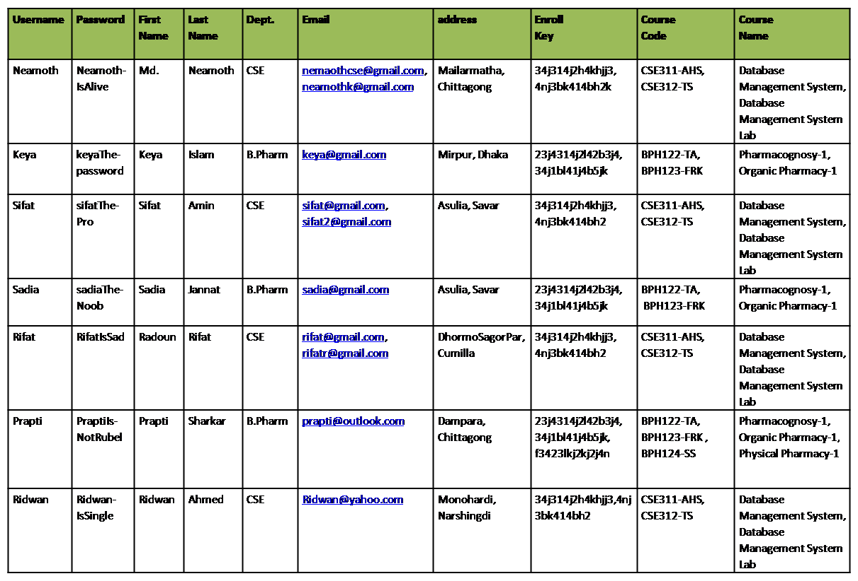
3NF
history
2NF
database
about
definition

Slide 6
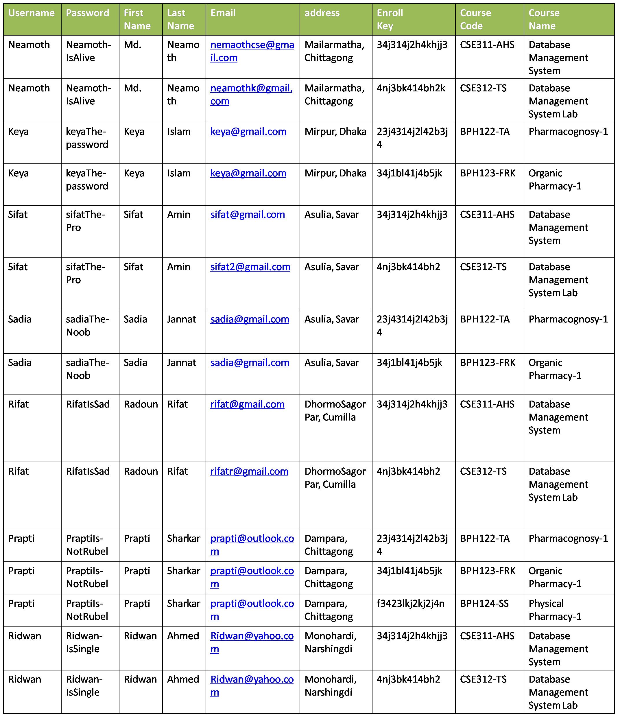
3NF
team
2NF
1NF
about
definition

Slide 7






Web Design
Web Design
Here you need to add some brief about the service that your company is providing currently
Here you need to add some brief about the service that your company is providing currently
Web Design
Web Design
team
3NF
2NF
1NF
about
Here you need to add some brief about the service that your company is providing currently
Here you need to add some brief about the service that your company is providing currently
definition
Web Design
Web Design
Here you need to add some brief about the service that your company is providing currently
Here you need to add some brief about the service that your company is providing currently

Slide 8
3NF
team
2NF
1NF
about
definition

Slide 9
3NF
history
2NF
1NF
about
definition

