Slide 1

WELCOME
3NF
2NF
team
DATABASE MANAGEMENT SYSTEM
1NF
about
definition
PRESENTING BY ULTIMATE SLEEPING

Slide 2

3NF
1NF
team
2NF
timeline
about
LECTURER
Afjal Hossain Sarowar
Department of CSE
Daffodil International University

Slide 3




01
02
03
04
3NF
team
2NF
1NF
about
definition
Md. Neamoth
SM Sifat Amin
Radoun Rifat
Ridwan Ahmed
Department of CSE
Department of CSE
Department of CSE
Department of CSE
ID: 162-15-8202
ID: 201-15-3635
ID: 201-15-3542
ID: 201-15-3254

Slide 4



Normalization is a database design technique that reduces data redundancy and eliminates undesirable characteristics
3NF
team
2NF
1NF
definition
about
1st
2nd
3rd
Normal Form
Normal Form
Normal Form
Eliminate repeating group
Identify with primary key
Must obey 1NF rules
Non-key attributes are functional dependant on the primary key
Must be in 2NF
No transitive partial dependency

Slide 5
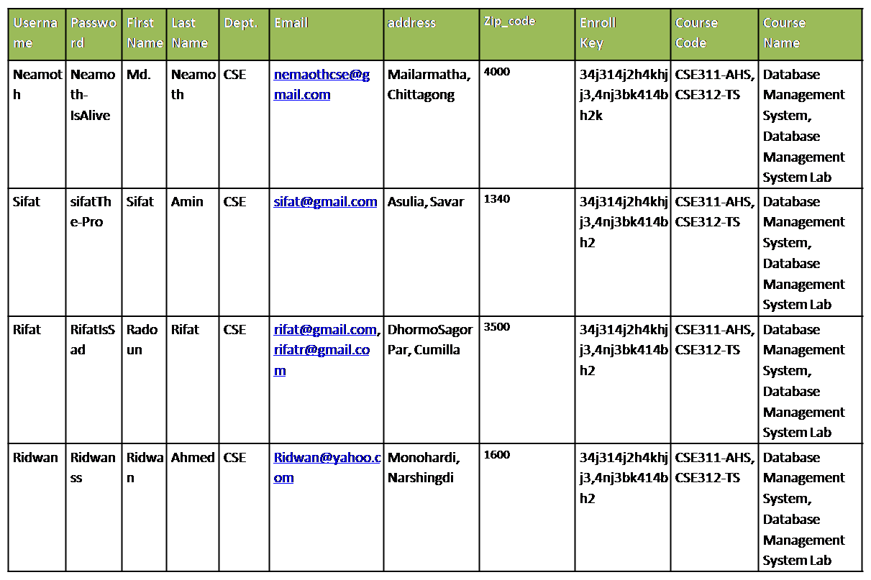
DIU BLC Database
3NF
history
2NF
database
about
definition

Slide 6


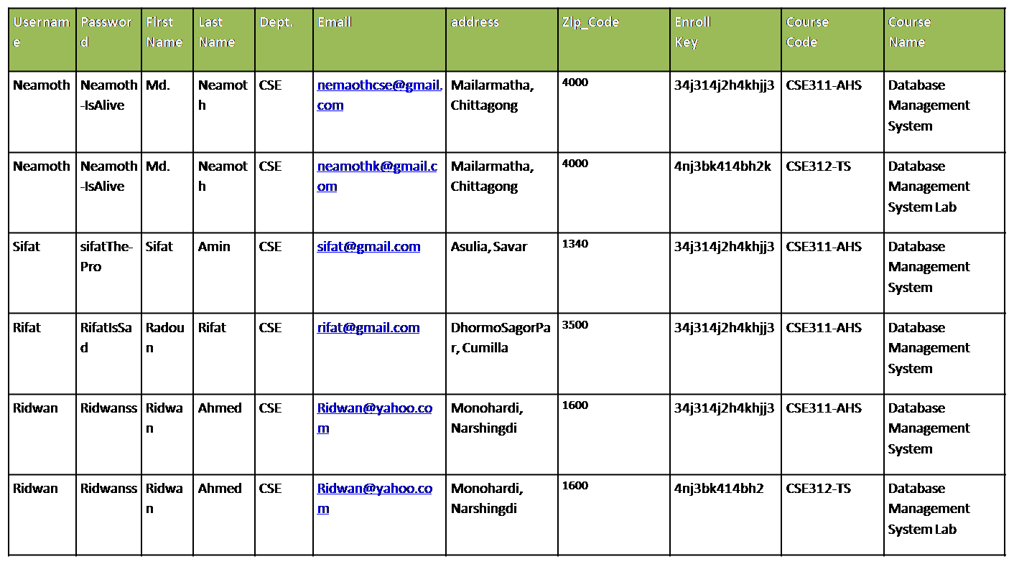
3NF
team
2NF
1NF
about
definition

Slide 7


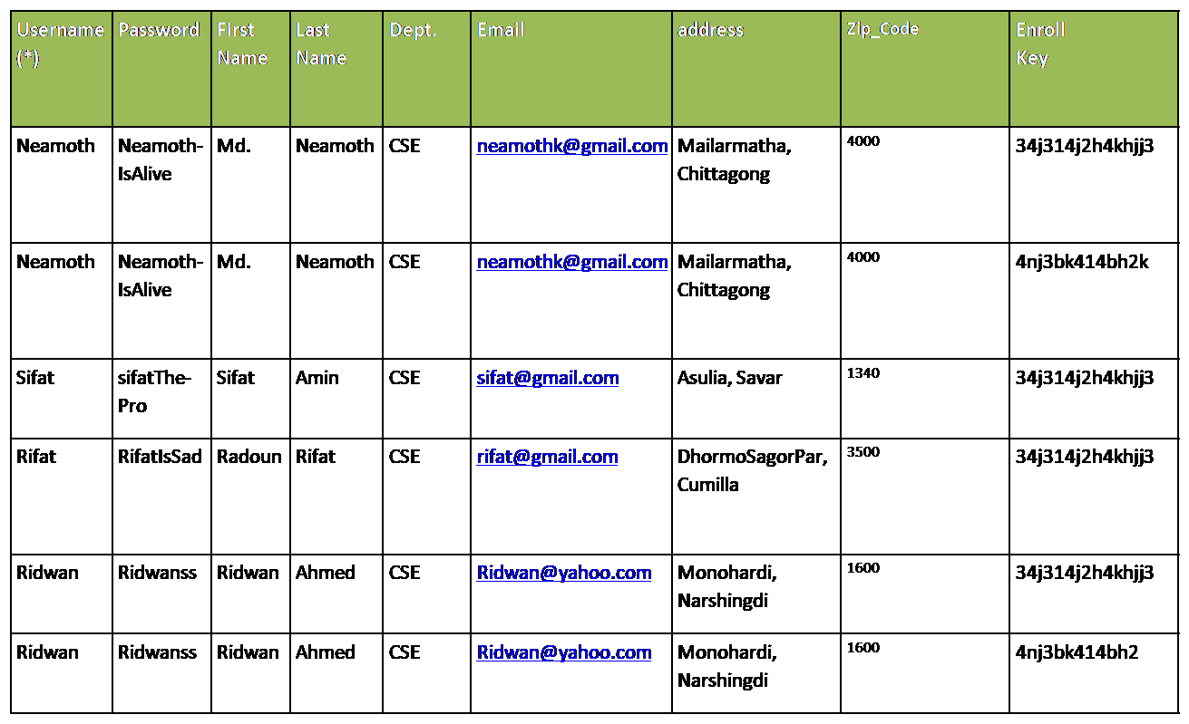
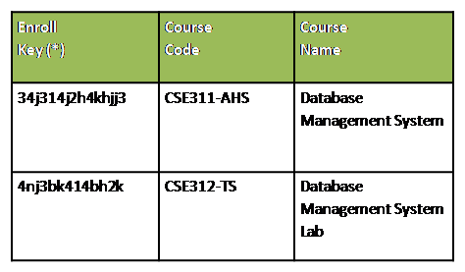
3NF
2NF
team
1NF
about
definition

Slide 8



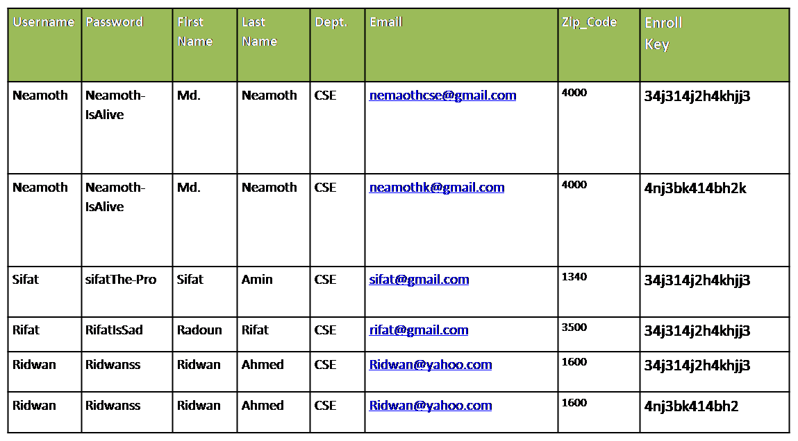
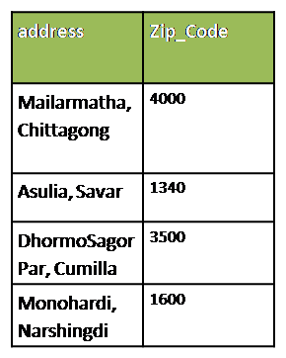
3NF
history
2NF
1NF
about
definition

Slide 9
Ask if you have any question,
Thank you.
3NF
history
2NF
End
1NF
about
definition

