Slide 1

Cyprus Water
Christos Amyrotos, Nicos Kasenides, Nearchos Paspallis
https://cyprus-water.appspot.com

Slide 2
Scope
Problem: climate change affects everyone – many places like Cyprus suffer from low rainfall and scarce water resources...
Our contribution: raise awareness about the size of the problem and encourage more responsible use of water resources
Our approach: develop a mobile-first Web app and Backend using existing Open Data, to understand water quantities and also have fun
http://cyprus-water.appspot.com

Slide 3




Technical details
/api/dams
/api/percentages
/api/historic-inflow
/api/quiz
/api/leaderboard
Access
Sync
Store
http://cyprus-water.appspot.com

Slide 4

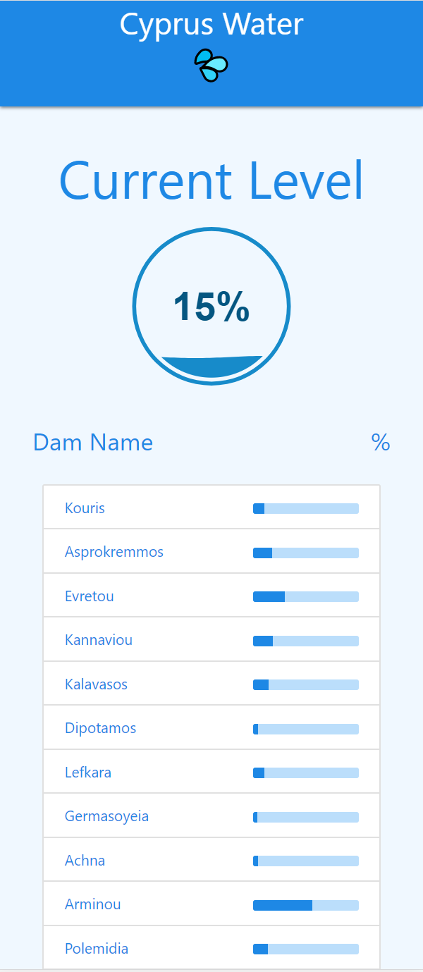

Implementation
An HTML5 cross-platform app is available at
http://cyprus-water.appspot.com

Slide 5



Achievements
Developed a long-term open source project to collect and maintain important data regarding water resources in Cyprus and make them available Visually and as Open Data
All the code is publicly available at https://github.com/nearchos/cyprus-water (79 commits last 48hrs)
Adopted open source MIT License as specified at https://choosealicense.com/licenses/mit/
Developed a fun-facts quiz for engaging teenagers with understanding water quantities and the potential impact of simple water saving actions
How much volume does a small elephant have?
~ 6 cubic meters
What is the capacity of Kouris, the largest dam in Cyprus?
~ 115 million cubic meters
Or, ~19.67 million elephants!
http://cyprus-water.appspot.com

Slide 6
Live Demo
...
http://cyprus-water.appspot.com

