Slide 1
Cyprus Water
Christos Amyrotos, Nicos Kasenides, Nearchos Paspallis
https://cyprus-water.appspot.com

Slide 2
Scope
Problem: climate change affects everyone – many places like Cyprus suffer from low rainfall and scarce water resources...
Our contribution: raise awareness about the size of the problem and encourage more responsible use of water resources
Our approach: develop a mobile-first Web app using existing Open Data, to understand water quantities and also have fun
http://cyprus-water.appspot.com

Slide 3




Technical details
/api/dams
/api/percentages
/api/historic-inflow
/api/quiz
/api/leaderboard
Access
Sync
Store
http://cyprus-water.appspot.com

Slide 4

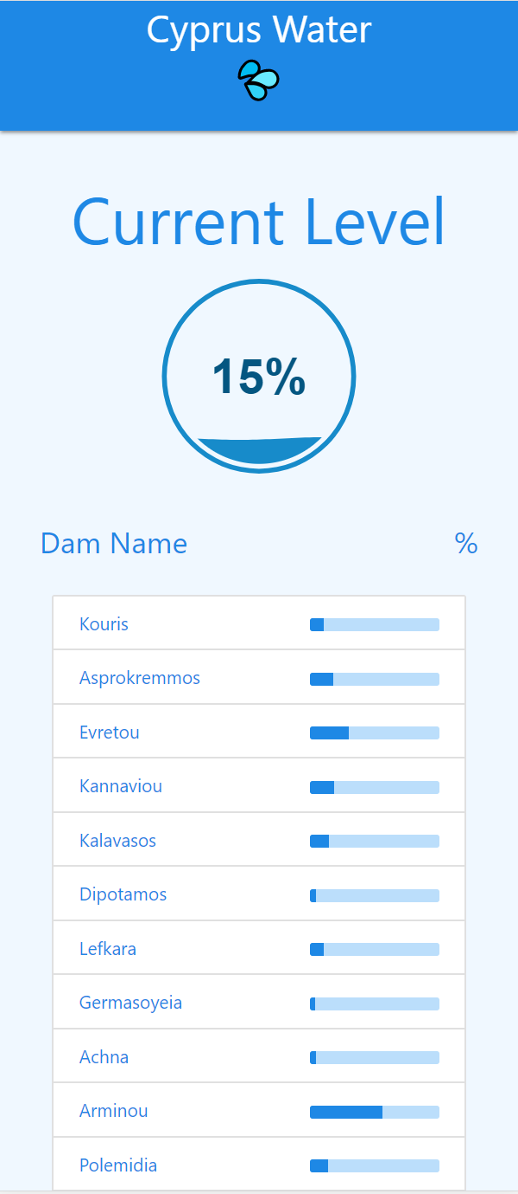

Implementation
An HTML5 cross-platform app is available at
http://cyprus-water.appspot.com

Slide 5



Achievements
Developed a long-term open source project to collect and maintain important data regarding water resources in Cyprus and make them available as Open Data
All the code is publicly available at https://github.com/nearchos/cyprus-water
Adopted open source MIT License as specified at https://choosealicense.com/licenses/mit/
Developed a fun-facts quiz for engaging teenagers with understanding water quantities and the potential impact of saving actions
How much volume does a small elephant have?
~ 6 cubic meters
What is the capacity of Kouris, the largest dam in Cyprus?
~ 115 million cubic meters
Or, ~19.67 million elephants!
http://cyprus-water.appspot.com

