Slide 1

Middleware-based Development of Context-aware Applications with Reusable Components
PhD Thesis Defense
Wednesday, September 30th 2009
Nearchos Paspallis
Department of Computer Science
University of Cyprus
nearchos@cs.ucy.ac.cy
http://www.cs.ucy.ac.cy/~paspalli
Copyright © by Nearchos Paspallis – All rights reserved 2009

Slide 2
About the presenter
Studies
BSc in Computer Engineering & Informatics (Univ. of Patras)
MSc in Computer Science (Univ. of California, Santa Barbara)
Work experience
Software Engineer at “Eternal Systems, Inc” (Santa Barbara, CA)
Software Analyst at “TSYS Cardtech Services Ltd” (Nicosia, CY)
Research experience
Research Associate at UCY (IST-MADAM)
Research Associate and Manager of WP2 (Context) at UCY (IST-MUSIC)
Notes:
I did my undergraduate studies in Computer Engineering and Informatics at the University of Patras, in Greece (Thesis: “Implementation and Experimental Evaluation of Routing Algorithms for Ad-hoc Mobile Networks”).
Then, I moved to Santa Barbara where I did my Masters in Computer Science at UCSB (Thesis: “Live Upgrades for the Java RMI System”).
While in Santa Barbara, I spent two years working for Eternal Systems, Inc, a spinoff from UCSB specializing in enabling highly-available software.
After returning to Cyprus I worked briefly for TSYS Cardtech Services Ltd, who specializes in credit card management software.
My next stop was the University of Cyprus, where I hold the position of Research Associate while also working on my PhD.
From 2004 to 2007 I worked on IST-MADAM and from 2006 till now I work in IST-MUSIC (a successor of the former).

Slide 3
Presentation outline
Introduction
Foundations and related work
Development methodology
Pluggable and modular middleware architecture
Model-driven development of context plug-ins
Evaluation
Conclusions and future work

Slide 4
Presentation outline
Introduction
  What is context-awareness?
  Motivation
  Challenges
  Thesis statement
  Approach
Foundations and related work
Development methodology
Pluggable and modular middleware architecture
Model-driven development of context plug-ins
Evaluation
Conclusions and future work

Slide 5
What is context-awareness?
Context
“[…] any information that can be used to characterize the situation of an entity. An entity is a person, place, or object that is considered relevant to the interaction between a user and an application, including the user and application themselves.” [DEY 2000, DEY 2001]
Context-awareness
The ability of a system to sense the context in runtime and use it
- Some systems use context for presentation purposes only (e.g., “where is the nearest restaurant?”)
- Others explicitly act upon their knowledge on context with the aim of optimizing themselves towards a specific goal, adapting either of their functional or extra-functional behavior accordingly”
DEY, A. K. “Providing architectural support for building context-aware applications”, PhD thesis, Georgia Institute of Technology, 2000.
DEY, A. K. “Understanding and using context”, Personal Ubiquitous Computing 5, 1 (2001), 4–7.

Slide 6
Motivation
Weiser’s vision of ubiquitous computing
  Technologies that “[…] weave themselves into the fabric of everyday life until they are indistinguishable from it”. [WEISER 1991, WEISER 1993]
Significant progress and widespread adoption of mobile and embedded devices
  Significant progress and widespread adoption of mobile and embedded devices
  Modern vehicles, as well as home and office appliances commonly feature numerous embedded microprocessors (ABS, climate and light control, etc)
  Mobile phones have already penetrated 61% of the world population (more than 4.1 billion people) [ITU 2009]
WEISER, M. “The computer for the 21st century”, Scientific American (Feb. 1991).
WEISER, M. “Hot topics: ubiquitous computing”, Computer 26, 10 (Oct. 1993), 71–72.
ITU. “Measuring the Information Society: The ICT Development Index”, International Telecommunication Union, 2009.
Notes:
Today we are closer than ever before to realizing Weiser’s vision of ubiquitous computing.

Slide 7
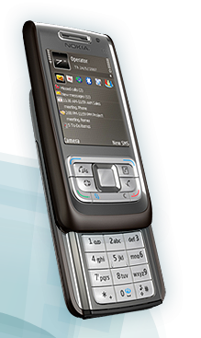
Motivation – commercial and research applications
Context-aware profile manager for smart-phones
  Automatically switching to the most suitable profile (offline, silent, room, open environment, etc) according to the context
  Input
    location via GSM cell id, WiFi id, or GPS (at home, driving, at office, etc)
    time and day of the week (sleeping, at work, at home)
    user agenda (at the theater, on a flight, at a business meeting)
www.smartphoneware.com/profiles-for-s60-3rd-edition-product.php

Slide 8

Motivation – commercial and research applications
Context-aware profile manager for smart-phones
Context-aware umbrella
  The handle of the umbrella blinks in different colors based on the actual weather forecast
  Input
    Weather data (over GPRS)
http://www.ambientdevices.com/products/umbrella.html

Slide 9
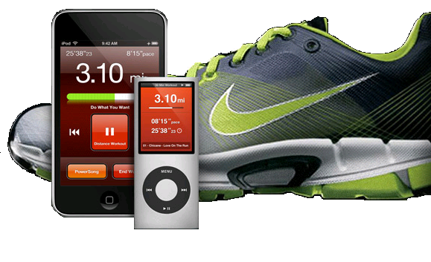
Motivation – commercial and research applications
Context-aware profile manager for smart-phones
Ambient umbrella
Personalized exercise monitoring
  Transparently monitoring your runs and communicating data back to you (e.g., pace, distance, calories, personal and group records, etc)
  Input
    Simple beats transmitted from an embedded sensor counting the athlete’s steps and rhythm
http://www.apple.com/ipod/nike

Slide 10

Motivation – commercial and research applications
Context-aware profile manager for smart-phones
Ambient umbrella
Personalized exercise monitoring
Context-aware media player
  A media player which resumes/suspends playback
  automatically as you enter/exit your office or cubicle
  Input
    List of Bluetooth devices in the area
    (via a fixed Bluetooth adapter)
    Motion detected in the area (via a webcam)
http://www.cs.ucy.ac.cy/~paspalli/CaMP

Slide 11
Motivation – commercial and research applications
Context-aware profile manager for smart-phones
Ambient umbrella
Personalized exercise monitoring
Context-aware media player
Signal strength predictor
  An application that preemptively syncs with a server based on its prediction of network availability (i.e., signal strength, bandwidth, cost, etc)
  Input
    Location (via an indoor sensor or GPS)
    Signal strength (via the WiFi network interface’s driver)

Slide 12
Motivation – commercial and research applications
Context-aware profile manager for smart-phones
Ambient umbrella
Personalized exercise monitoring
Context-aware media player
Signal strength predictor
PRM Travel assistant
  Helps passengers with disabilities navigate RATP’s Metro network and receive assistance as needed while also dynamically adapting its UI to compensate for user disabilities.
  Input
    Location (via an indoor sensor or GPS)
    Network properties (via the WiFi/GPRS network interfaces’ drivers)
    Various device resources (battery, CPU and memory use)
http://www.ist-music.eu

Slide 13

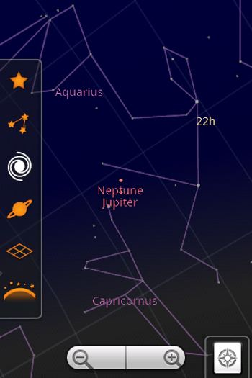
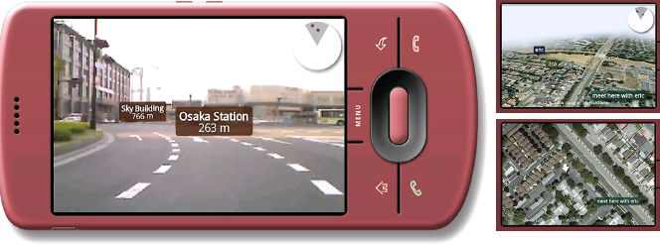
Motivation – commercial and research applications
Context-aware profile manager for smart-phones
Ambient umbrella
Personalized exercise monitoring
Context-aware media player
Signal strength predictor
PRM Travel assistant
Context-aware immersive live video
  Various applications (e.g., Sky Map, Enkin, etc) aim
  to provide informative annotations linked
  to actual objects displayed in live video
  Input
    Location (via GPS)
    Direction (via compass)
    http://www.enkin.net and http://www.google.com/sky/skymap.html
Notes:
Apparently, the sky is the limit!

Slide 14
Challenges
Enabling autonomic and proactive behavior in mobile and ubiquitous computing environments is a multidisciplinary issue
Scientists (systems theory), Economists (negotiation & supply webs), Psychologists (trust in autonomic systems), HCI Researchers (new UIs)
  “… bridging the cultural and language divides among these disciplines […] is perhaps the greatest challenge” [KEPHART 2005]
What are the software engineering challenges faced by the developers of such systems?
KEPHART J. O., “Research challenges of autonomic computing,” 27th International Conference on Software Engineering (ICSE’05) (St. Louis, Missuri, USA), 2005, pp. 15-22.
Notes:
Of course the disciplines include also “Computer Scientists” for software development and Artificial Intelligence (AI), “Economists” also for microeconomics-inspired utility functions, etc.
While the general problem of enabling autonomic and proactive context-aware applications in the domains of mobile and pervasive computing is a large multidisciplinary problem, in this thesis the problem was viewed from a “software developer’s” perspective!

Slide 15
Challenges
What are the software engineering challenges faced by the developers of such systems?
Software complexity
  A common challenge in most large software projects: “[…] dealing with [software complexity] is the single most important challenge faced by the IT industry. It is our next Grand Challenge.” [HORN 2001]
  The advanced features anticipated in complex context-aware applications render the underlying code significantly more complex (i.e., error-prone, expensive development and maintenance)
HORN, P. Autonomic computing: IBM’s perspective on the state of information technology, 2001.

Slide 16
Challenges
What are the software engineering challenges faced by the developers of such systems?
Software complexity
Heterogeneity and interoperability
  Mobile and ubiquitous computing implies widespread adoption of mobile and embedded devices
  Commonly, such systems are based on various heterogeneous platforms
  To reach their maximum potential, such devices must be capable of interoperating for sharing data (e.g., context information) and for coordinating their actions
  To leverage software development on such platforms, appropriate solutions must be designed with heterogeneity and interoperability support in mind

Slide 17
Challenges
What are the software engineering challenges faced by the developers of such systems?
Software complexity
Heterogeneity and interoperability
Resource limitations
  Evolving beyond the stereotypical desktop model introduces noteworthy resource constraints, such as battery, size and weight limitations
  The software realizing the context-aware behavior of applications should be designed to operate under these constraints

Slide 18
Challenges
What are the software engineering challenges faced by the developers of such systems?
Software complexity
Heterogeneity and interoperability
Resource limitations
Modularity
  As a result of the heterogeneity, interoperability and resource constraints challenges, it is unlikely that a single software solution will fit all scenarios
  Modularity is required to allow for custom-tailoring individual configurations of the software to the capabilities and the limitations of the target devices, also better matching the requirements of the aimed applications

Slide 19
Thesis statement
Traditional approaches for developing software applications are insufficient for meeting the software engineering challenges faced by the developers of
context-aware systems, targeting mobile and ubiquitous computing environments.
Appropriate software, methods and tools are needed to render the development of context-aware applications easier, faster and more efficient.

Slide 20
Approach
Development methodology
  Separation of concerns
  Software reuse
  Flexible and extensible context model and query language
  Model-driven development
Middleware architecture
  Pluggability
  Modularity
  Automatic and autonomic resource management
Notes:
This thesis has both theoretical and practical aspects:

Slide 21
Presentation outline
Introduction
Foundations and related work
  Basic concepts
  Related work
  Foundations
Development methodology
Pluggable and modular middleware architecture
Model-driven development of context plug-ins
Evaluation
Conclusions and future work

Slide 22
Basic concepts
Context
  Quite general definition [DEY 2000, DEY 2001]: “any information affecting the interaction between a user and an application”.
Modeled as a multidimensional space
  Context is assumed to consist of multiple orthogonal dimensions
    Each dimensions corresponds to a specific context type (e.g., temperature, location, user occupation, etc)
    The value domain of each context type is the set of real numbers ℝ
    Assuming a context space mapping d dimensions, it can be modeled as ℝ^{d}.
    At any time, the context c_{t} can be modeled as a point in this space
      c_{t} ≡ (c_{t}¹, c_{t}², …, c_{t}^{d}) ∈ ℝ^{d}, where c_{t}^{k} ∈ ℝ ∀ k in [1..d]

Slide 23
Basic concepts
Adaptation
  A process by which software changes its behavior in order to better match the changing environment.
Classifications
  Parameter-based: A predefined parameter is configured by the developer/user with a value in a given range (e.g., polling interval)
  Compositional adaptation: The system architecture is subject to change, possibly incorporating new components and thus new (or improved) functionality.
Variants
  An application variant is any parameter-based or compositional-based configuration of the application, maintaining its original functional properties
MCKINLEY, P. K., SADJADI, S. M., KASTEN, E. P., AND CHENG, B. H. C. “Composing adaptive software”, IEEE Computer 37, 7 (2004), 56–64.
Notes:
It is assumed that the set of possible variants is finite and thus can be exhaustively analyzed. This is achieved by assuming that a parameter-based configuration takes values from a finite set/range.

Slide 24
Basic concepts
Self-adaptive, context-aware behavior
  The ability of a system to sense its environment and react accordingly in order to shape it, aiming for a predefined goal
Perceived utility
  A function U_{p} that for any context point c_{t} it maps any two variants v_{x} and v_{y} to scalar values (e.g., in the range [0, 1]) so that
  U_{p}(c_{t}, v_{x}) > U_{p}(c_{t}, v_{y}) if and only if the user prefers v_{x} to v_{y} from her or his point of perception
  Based on a perceived utility function U_{p}, the set of available variants can be totally ordered (v_{i1}, v_{i2}, …, v_{iN}) and thus enable self-adaptive, context-aware behavior where the selected variant is chosen using U_{p}
Notes:
This thesis is primarily concerned with utility-based approaches for realizing context-aware, self-adaptive behavior.

Slide 25
Related work
Challenges
  “… lack of supporting infrastructure for capturing and processing context …”
  [PASCOE 1997]
  “… context is handled in an improvised manner” [DEY 2001]
  “… high application development overheads, social barriers associated with privacy and usability, and an imperfect understanding of [context use]” [HENRICKSEN 2003, HENRICKSEN 2006]
PASCOE, J. “The stick-e note architecture: extending the interface beyond the user”, 2nd International Conference on Intelligent User Interfaces (Orlando, Florida, USA, 1997), ACM, pp. 261–264.
DEY, A. K., ABOWD, G. D., AND SALBER, D.” A conceptual framework and a toolkit for supporting the rapid prototyping of context-aware applications”, Human-Computer Interaction 16, 2 (2001), 97–166.
HENRICKSEN, K. “A framework for context-aware pervasive computing applications”, PhD thesis, The University of Queensland (Sept. 2003).
HENRICKSEN, K., AND INDULSKA, J. “Developing context-aware pervasive computing applications: models and approach”, Pervasive and Mobile Computing 2, 1 (Feb. 2006), 37–64.

Slide 26
Related work: Requirements from the literature
Functional
  Application specific context acquisition, analysis and detection
  Context-triggered action
  Heterogeneity
  Uncertainty
  Context histories
  Inference of inter-dependencies
  Multiple concurrent applications
  Transparent distribution
  Privacy
  Traceability and control
  Interoperability and standards
Extra-functional
  Ease of building
  Modularity
  Separation of concerns
  Code reuse
  Uniform development support
  Evolution
  Scalability
  Dynamic behavior
  Platform independence
  Lightweight architecture
  Adoption of existing patterns and standards
  Support for mobility
  Fault-tolerance
  Ease of deployment and configuration
  Resource efficiency

Slide 27
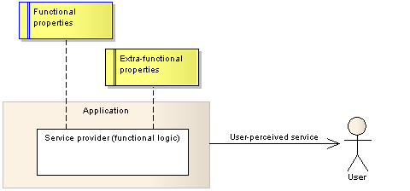
Foundations
Self-adaptive, context-aware behavior
  User-perspective
    The user perceives the service of an application as the combined result of the application logic and its extra-functional behavior
    As the context changes, so does the perception of its extra-functional behavior
    Using appropriate utility functions, it is possible to continuously adapt the application with the purpose of maximizing the perceived utility
Notes:
Examples of extra-functional properties perception:
Time it takes to download an email
Battery life span
Clarity and latency of video communication
Examples of adaptation
User a faster/cheaper/with less latency network
Use a more battery efficient configuration (i.e., light codec)
Switch to a mode that downloads email headers only

Slide 28
Foundations
Middleware as an enabling technology
  Component-based design
  Computational reflection
  Separation of concerns
Domain-specific middleware requirements
  Component support
  Application composition (i.e., variability)
  Context management
  Adaptation reasoning (i.e., autonomic behavior)
Notes:
Explain the big picture (i.e., the vision of a greater solution where software is designed so that it can be context-aware and self-adaptive while at the same time it can be constructed as compositions of individually developed and configured components)

Slide 29
Presentation outline
Introduction
Foundations and related work
Development methodology
  High-level view of context management
  Separation of concerns
  Proposed methodology
  Context model and context query language (CQL)
Pluggable and modular middleware architecture
Model-driven development of context plug-ins
Evaluation
Conclusions and future work

Slide 30
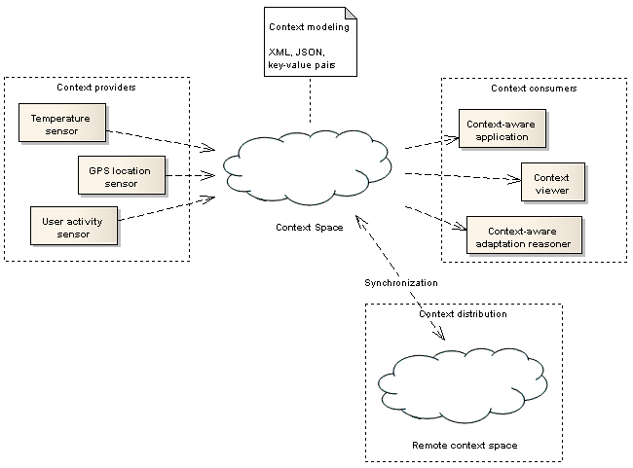
High-level view of context management
Acquisition
Storage
Access
Distribution

Slide 31
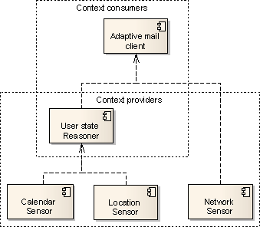
Separation of concerns: context providers & consumers
Context providers and context consumers
  Sensors have no context dependencies
    Pure context providers
      Location sensor
      Network sensor
      Calendar sensor
  Reasoners have context dependencies
    Act as context providers and context consumers at the same time
      User status reasoner
      Location predictor
      Signal strength predictor

Slide 32
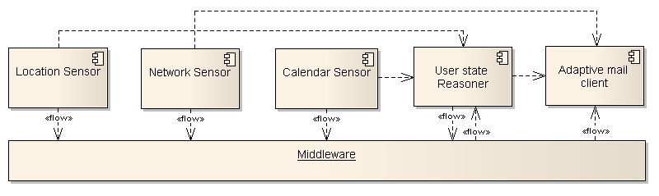
Separation of concerns: context providers & consumers
Middleware-based mediation
  Centralization of commonly used functionality
  Enables interoperability
  Ability for default, bundled context types
  Support for multiple concurrent applications
  Better resource management
Logical bindings
Notes:
Explain advantages
Centralization of commonly used functionality
Context histories, query language support, context distribution, etc
Interoperability among context providers

Slide 33
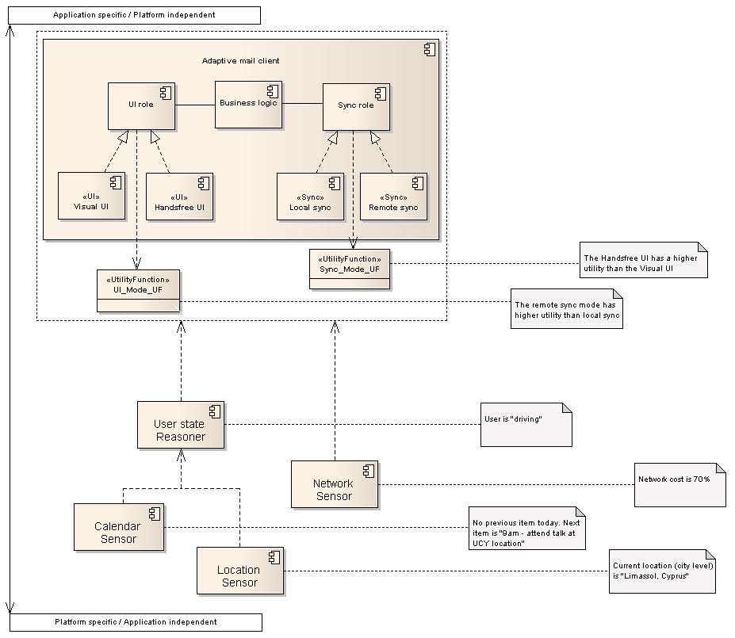
Context-awareness and adaptation reasoning

Slide 34
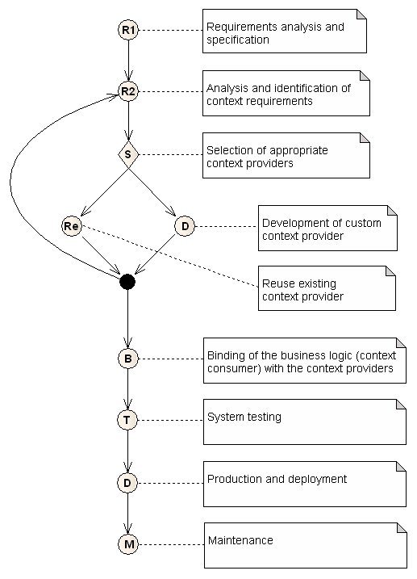
Development methodology
Identify the required context types
  E.g., “User state”
Select an appropriate provider
  1. Reuse an existing provider
  2. Develop a custom one
If needed, update the context requirements
  E.g., if the selected plug-in has additional context dependencies (e.g., “Location” and “Calendar”)
Repeat until resolved
Notes:
Also mention the need for component repositories as means for developers to share reusable context plug-ins.
The repository can be realized either as a repository of free, open source plug-ins (e.g., the MUSIC repository) or as a paid-for marketplace of context plug-ins

Slide 35
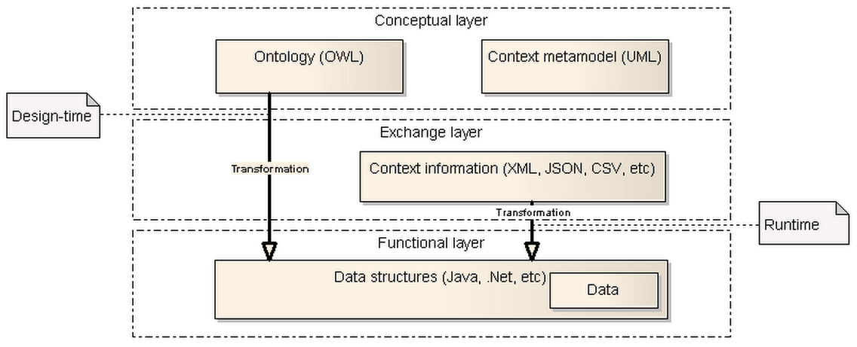
Context model
Layered context model
  Conceptual layer
  Exchange layer
  Functional layer

Slide 36
Context ontology
Used in design-time
  Semantic consistency
    Common core context types
    Extensible
  Automatic generation of code using MDD
    Data structures, Serialization/de-serialization code, IRO templates
… and also in run-time
  Automatic relation inferring
    Extraction of context data from complex structures
Notes:
In design-time
Allows the developers to view the available context types and extend it with new types
Allows the developers to extend the ontology with new types
Facilitates semantic consistency as it allows independent development of context providers and context consumers
In run-time (not implemented)
Allows for automatic relation inferring
Allows for automatic inter-representation transformation
The inter-representation transformation can be either realized by a general purpose component which interprets the ontology in run-time
…or by special-purpose code that automatically creates the appropriate transformation routines using MDD

Slide 37
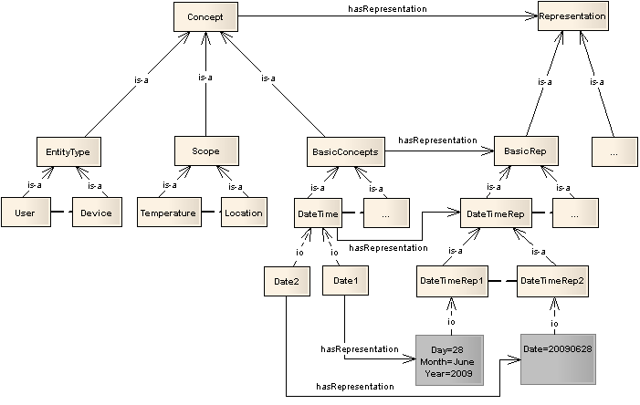
Context ontology: example

Slide 38
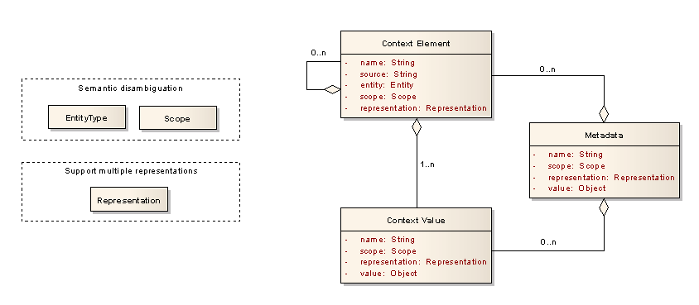
Context meta-model
Basic concepts
  Context elements
  Context values
  Metadata

Slide 39
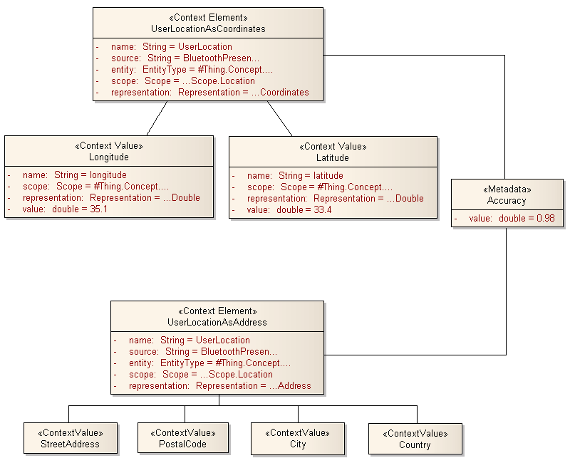
Context model: example

Slide 40
Context access
Two main methods for accessing context
  Simple queries
    Access latest value(s) of context type X
      E.g., what is the latest recorded location?
    Subscribe for notification of context type Y changes
      E.g., notify me whenever a change occurs in the set of nearby Bluetooth devices
  Extensive query language
    Access latest value(s) of context type X under condition C
      E.g., what are the last temperature recordings in the last 1 hour?
    Subscribe for notification of context type Y changes when condition C is satisfied
      E.g., notify me whenever my location is within 1000m of location <lon, lat>

Slide 41
Context query language
Programmatic API
XML-based syntax
<ctxQuery resultName="nearbyLocation">
<entity ontConcept="#Thing.Concept.EntityType.Device"> this </entity>
<scope
ontConcept="#Thing.Concept.Scope.Location"
ontRep="#Thing.Concept.Representation.Coordinates"> location </scope>
<action type="SELECT">
<conds>
<cond type="ONVALUE">
<logical op="AND">
<constraint par="location.#Longitude" op="EQ" value="11.2" delta="0.05"/>
<constraint par="location.#Latitude" op="EQ" value="20.9" delta="0.05"/>
</logical>
</cond>
</conds>
</action>
</ctxQuery>

Slide 42
Presentation outline
Introduction
Foundations and related work
Development methodology
Pluggable and modular middleware architecture
  Specific requirements
  Pluggable architecture
  Modular architecture
Model-driven development of context plug-ins
Evaluation
Conclusions and future work

Slide 43
Middleware architecture-specific requirements
Dynamic behavior
Modularity
Platform independence
Lightweightness
Adoption of existing patterns and standards

Slide 44
Component-based middleware
OSGi framework
  Modularity
    Independently deployed modules
    Modules define static dependencies and contain components
    Dynamic variability (added/removed in run-time)
  Service registry
    Services are provided (and required) by components
    Components interact with each other via required/provided services
    Services are discoverable and accessible via a common registry
  Application lifecycle
    Components can be installed, resolved and activated
Declarative services
  Automated management of service dependencies
    Define the “type” and the “granularity” of the required service
    An underlying middleware automatically monitors and resolves the service dependencies

Slide 45
Context plug-ins
Implemented as OSGi components
Associated with metadata
  Provided context type (mandatory)
  Required context type (optional)
Typical context sensor plug-ins
  Wrappers around physical sensors (e.g., GPS sensor, Bluetooth sensor) or OS calls (e.g., CPU and memory utilization sensors)
Typical context reasoner plug-ins
  User status, Location predictor, WiFi signal-strength predictor

Slide 46
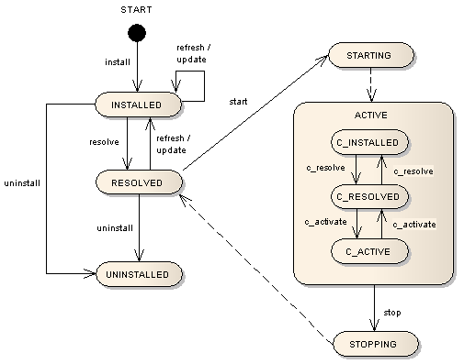
Extended component lifecycle
INSTALLED
RESOLVED
ACTIVE
  C_INSTALLED
  C_RESOLVED
  C_ACTIVE

Slide 47
Dynamic resolution and activation
The middleware monitors
  Required context types (i.e., from context-aware applications, context reasoner plug-ins and other middleware components)
  Provided context types (i.e., as reported by the installed/available plug-ins)
Resolution mechanism
  Identify resolved context plug-ins
Activation mechanism
  Selects plug-ins for activation

Slide 48
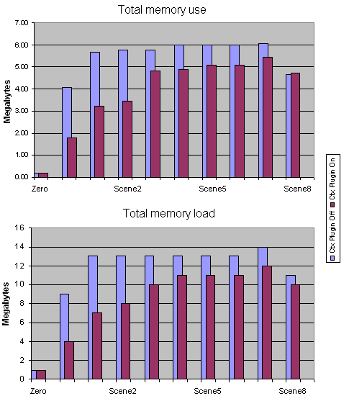
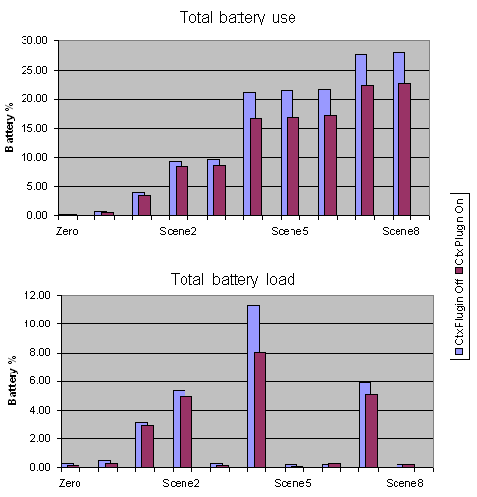
Experimental evaluation
Predefined scenario using a PDA
Combined set of real and simulated plug-ins
Measure battery/memory use with/out the dynamic activation mechanism
Notes:
HP iPAQ 6910 running Windows 5.0

Slide 49
Modular architecture: core services
Provided services
  Context access
  Context management
  Context simulation
Required services
  Context repository
  Context query
  Context model
Notes:
Besides a deployment platform, this middleware naturally also serves as a research test-bed. For this purpose, it puts high value in features such as simulation, visualization, extensibility, etc.

Slide 50
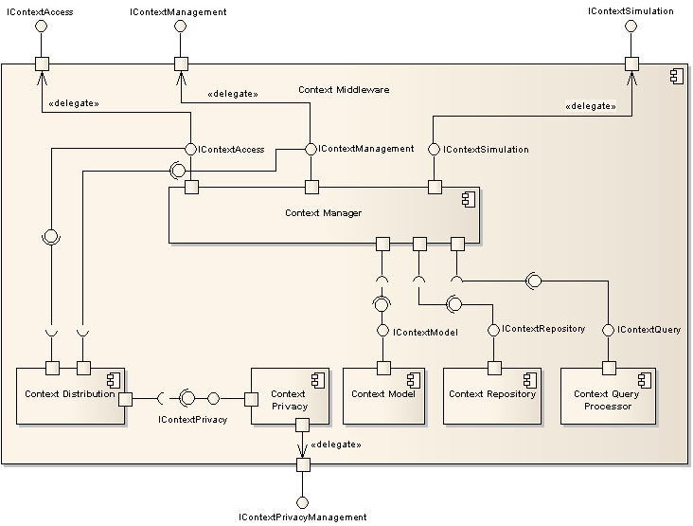
Modular architecture: high-level architecture
Notes:
The context management allows for the extension of the middleware, allowing access to even internal data.
For example, a distribution module can be developed by utilizing context manager’s internal data on “which context types are–locally–available and which ones are needed”.
This allows for multiple realization of the context distribution module, perhaps featuring various properties (e.g., more suitable for powerful or resource constrained devices).
Furthermore, the context query processor is optional, allowing for lightweight implementations when no support for complex queries is needed.

Slide 51
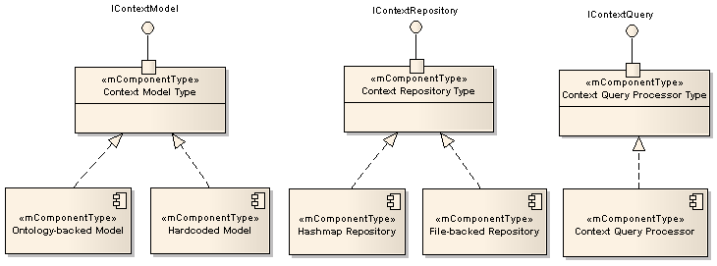
Modular architecture: variability
Adding/removing optional components
  Context distribution
  Context query processor
Substituting components
  Hardcoded model for simple applications
  Hashmap-based versus DBMS-based context repository
Notes:
It should be noted that

Slide 52
Implementation status
Latest version: 0.4.0 (July 15, 2009)
  http://developer.berlios.de/projects/ist-music
  http://www.ist-music.eu/MUSIC/developer-zone
Use
  PRM Travel assistant
    Assists users of the RATP metro system
    Special provisions for assisting people with disabilities
  SatMotion
    Assists with the installation of satellite antennas
  CaMP
    Automatically starts and stops media playback
    Demo application
Notes:
Of course, the context middleware is a core component of the MUSIC middleware, providing the access to context values

Slide 53
Presentation outline
Introduction
Foundations and related work
Development methodology
Pluggable and modular middleware architecture
Model-driven development of context plug-ins
  Line 1
  Line 2
  Line 3
Evaluation
Conclusions and future work

Slide 54
TODO

Slide 55
Presentation outline
Introduction
Foundations and related work
Development methodology
Pluggable and modular middleware architecture
Model-driven development of context plug-ins
Evaluation
  Case-study applications
  Experimental evaluation
  Analysis of requirements
Conclusions and future work

Slide 56
TODO

Slide 57
Presentation outline
Introduction
Foundations and related work
Development methodology
Pluggable and modular middleware architecture
Model-driven development of context plug-ins
Evaluation
Conclusions and future work
  Contributions
  Future work
  Acknowledgements

Slide 58
Main contributions
Development methodology
  Separation of concerns
  Reusability
Middleware
  Dynamic activation (resource efficiency)
  Modular architecture
Notes:
Development methodology
Separation of concerns
Reusability
Middleware
Dynamic activation (facilitates resource efficiency while employing autonomic behavior)
Modular architecture (makes it suitable for various deployment environments-i.e., powerful desktop computers, lightweight mobile devices, tiny embedded systems)

Slide 59
Future work
Complete context-aware, self-adaptive applications with reusable components
  General application components annotated with metadata characterizing its extra-functional properties
  Specialized algorithms used to evaluate the available components in run-time
Learning from user feedback
  Ubiquitous computing: getting the user out of the loop
  However, minimal, non-intrusive user feedback can be value-able in training the autonomic (context-aware, self-adaptive behavior) of the application

Slide 60
Acknowledgements
George A. Papadopoulos
Christian Becker, Marios D. Dikaiakos, Jeff Magee and George Samaras
Fani Athienitou, Gabriel Panis, Konstantinos Kakousis and
Pyrros Bratskas
Roland Reichle and Michael Wagner (University of Kassel)
Partners of IST-MADAM & IST-MUSIC projects
The students of the EPL-429 course (Spring 2009)
Christos, Despina, Giorgos, Konstantinos, Marios, Pyrros, and Viki
(a.k.a. the lunch group)
European Commission

Slide 61
Questions …
Thank you!

Slide 62
Publications: Thesis-specific
N. Paspallis, F. Eliassen, S. Hallsteinsen, and G. A. Papadopoulos, Developing Self-Adaptive Mobile Applications and Services with Separation-of-Concerns, At Your Service: Service-Oriented Computing from an EU Perspective, E. Di Nitto, A-M. Sassen, O. Traverso and A. Zwegers (eds), MIT Press, June 2009, chapter 6, pp. 129-158
K. Geihs, P. Barone, F. Eliassen, J. Floch, R. Fricke, E. Gjorven, S. Hallsteinsen, G. Horn, M. U. Khan, A. Mamelli, G. A. Papadopoulos, N. Paspallis, R. Reichle, E. Stav, A Comprehensive Solution for Application-Level Adaptation, Software – Practice and Experience Journal, Online ISSN: 1097-024X, Print ISSN: 0038-0644, Copyright 2008 John Wiley & Sons, Ltd., Published Online: Sep 15 2008, DOI: 10.1002/spe.900
N. Paspallis, R. Rouvoy, P. Barone, G. A. Papadopoulos, F. Eliassen, A. Mamelli, A Pluggable and Reconfigurable Architecture for a Context-aware Enabling Middleware System, 10th International Symposium on Distributed Objects, Middleware, and Applications (DOA'08), Monterrey, Mexico, Nov 10 - 12, 2008, Springer Verlag LNCS 5331, pp. 553-570
N. Paspallis, K. Kakousis, G. A. Papadopoulos, A Multi-dimensional Model Enabling Autonomic Reasoning for Context-aware Pervasive Applications, Workshop for Human Control of Ubiquitous Systems (HUCUBIS 2008) in conjunction with the 5th Annual International Conference on Mobile and Ubiquitous Systems: Computing, Networking and Services (Mobiquitous), Trinity College Dublin, Ireland, July 21-25, 2008, ACM Press

Slide 63
Publications: Thesis-specific
M. Wagner, R. Reichle, M. U. Khan, K. Geihs, J. Lorenzo, M. Valla, C. Fra, N. Paspallis, G. A. Papadopoulos, A Comprehensive Context Modeling Framework for Pervasive Computing Systems, 8th IFIP International Conference on Distributed Applications and Interoperable Systems (DAIS), Oslo, Norway, 4-6 June, 2008, Springer Verlag LNCS 5053, pp. 281-295
R. Reichle, M. Wagner, M. U. Khan, K. Geihs, M. Valla, C. Fra, N. Paspallis, G. A. Papadopoulos, A Context Query Language for Pervasive Computing Environments, 5th IEEE Workshop on Context Modeling and Reasoning (CoMoRea)in conjunction with the 6th IEEE International Conference on Pervasive Computing and Communication (PerCom), Hong Kong, 17–21 March 2008, IEEE Computer Society Press, pp. 434-440
N. Paspallis, G. A. Papadopoulos, An Approach for Developing Adaptive, Mobile Applications with Separation of Concerns, 30th Annual International Computer Software and Applications Conference (COMPSAC), Chicago, IL, USA, September 17-21, 2006, IEEE Computer Society Press, pp. 299-306

Slide 64
Publications: Thesis-related
K. Kakousis, N. Paspallis, G. A. Papadopoulos, Optimizing the Utility Function-based Self-adaptive Behavior of Context-aware Systems using User Feedback, 10th International Symposium on Distributed Objects, Middleware, and Applications (DOA'08), Monterrey, Mexico, Nov 10 - 12, 2008, Springer Verlag LNCS 5331, pp. 657-674
X. Hu, Y. Ding, N. Paspallis, P. Bratskas, G. A. Papadopoulos, Y. Vanrompay, M. K. Pinheiro, Y. Berbers, A Hybrid Peer-to-Peer Solution for Context Distribution in Mobile and Ubiquitous Environments, 17th International Conference on Information Systems Development (ISD2008), Paphos, Cyprus, August 25-27, 2008, Springer Verlag
P. Bratskas, N. Paspallis, K. Kakousis, G. A. Papadopoulos, Applying Utility Functions to Adaptation Planning for Home Automation Applications, 17th International Conference on Information Systems Development (ISD2008), Paphos, Cyprus,August 25-27, 2008, Springer Verlag
N. Paspallis, G. A. Papadopoulos, An Optimization of Context Sharing for Self-adaptive Mobile Applications, 8th International Conference on Algorithms and Architectures for Parallel Processing (ICA3PP), Ayia Napa, Cyprus, 9-11 June, 2008, Springer Verlag LNCS 5022, pp. 157-168
X. Hu, Y. Ding, N. Paspallis, P. Bratskas, G. A Papadopoulos, P. Barone, A. Mamelli, Y. Vanrompay, Y. Berbers, A Peer-to-Peer based Infrastructure for Context Distribution in Mobile and Ubiquitous Environments, 3rd International Workshop on Context-Aware Mobile Services (CAMS) in conjunction with the On The Move to Meaningful Internet Systems (OTM), Vilamoura, Algarve, Portugal, November 25-30, 2007, Springer Verlag LNCS 4805, pp. 236-239
P. Bratskas, N. Paspallis, G. A. Papadopoulos, An Evaluation of the State-of-the-Art in Context Aware Architectures, 16th International Conference on Information Systems Development (ISD), Galway, Ireland, August 29-31, 2007, Springer

Slide 65
Publications: Thesis-related
N. Paspallis, A. Chimaris, G. A. Papadopoulos, Experiences from Developing a Distributed Context Management System for Enabling Adaptivity, 7th IFIP International Conference on Distributed Applications and Interoperable Systems (DAIS), Paphos, Cyprus, June 5-8, 2007, Springer Verlag LNCS 4531, pp. 225-238
M. Alia, S. Hallsteinsen, N. Paspallis, F. Eliassen, Managing Distributed Adaptation of Mobile Applications, 7th IFIP International Conference on Distributed Applications and Interoperable Systems (DAIS), Paphos, Cyprus, June 5-8, 2007, Springer Verlag LNCS 4531, pp. 104-118
M. Alia, V. S. W. Eide, N. Paspallis, F. Eliassen, S. Hallsteinsen, G. A. Papadopoulos, A Utility-based Adaptivity Model for Mobile Applications, 21st International Conference on Advanced Information Networking and Applications Workshops (AINAW'07), Niagara Falls, Ontario, Canada, May 21-23, 2007, IEEE Computer Society Press, pp. 556-563
N. Paspallis, G. A. Papadopoulos, Distributed Adaptation Reasoning for a Mobility and Adaptation Enabling Middleware, 8th International Symposium on Distributed Objects and Applications (DOA), Montpellier, France, Oct 30 - Nov 1, 2006, Springer Verlag LNCS 4277, pp. 17-18
M. Mikalsen, N. Paspallis, J. Floch, G. A. Papadopoulos, P. A. Ruiz, Putting Context in Context: The Role and Design of Context Management in a Mobility and Adaptation Enabling Middleware, International Workshop on Managing Context Information and Semantics in Mobile Environments (MCISME) in conjunction with the 7th International Conference on Mobile Data Management (MDM), Nara, Japan, May 9-12, 2006, IEEE Computer Society Press, pp. 76-83
M. Mikalsen, N. Paspallis, J. Floch, E. Stav, A. Chimaris, G. A. Papadopoulos, Distributed Context Management in a Mobility and Adaptation Enabling Middleware (MADAM), 21st Annual ACM Symposium of Applied Computing, Track of Dependable and Adaptive Systems (SAC), Dijon, France, April 23 -27, 2006, ACM Press, pp. 733-734

Slide 66
Publications: Other work
N. Paspallis, G. A. Papadopoulos, An Architecture for Highly Available and Dynamically Upgradeable Web Services, 15th International Conference on Information Systems Development (ISD), Budapest, Hungary, August 31-September 2, 2006, Springer Verlag, pp. 147-160
I. Chatzigiannakis, S. E. Nikoletseas, N. Paspallis, P. G. Spirakis, C. D. Zaroliagis, An Experimental Study of Basic Communication Protocols in Ad-hoc Mobile Networks, 5th International Workshop on Algorithm Engineering (WAE), Aarhus, Denmark, August 28-30, 2001, Springer Verlag LNCS Vol. 2141, pp.159-171

Slide 67
Additional slides
Notes:
These slides to be displayed only if needed (i.e., in response to specific questions)

Slide 68
Definitions of context-awareness
“[context is] the location of use, nearby people, hosts and accessible devices as well as changes to these things over time”
  SCHILIT, B. N., ADAMS, N., WANT, R. “Context-aware computing applications”, IEEE Workshop on Mobile Computing Systems and Applications (WMCSA'94), Santa Cruz, CA, USA, IEEE Computer Society (1994)
  p. 89-101
“[context is] any information that can be used to characterize the situation of an entity; [where] an entity is a person, place, or object that is considered relevant to the interaction between a user and an application, including the user and the application themselves”
  DEY, A. K., “Understanding and using context”, Personal and Ubiquitous Computing, Vol. 5, 1 (2001) p. 4–7
“… four levels of system awareness: basic context awareness, behavior awareness, activity awareness and intend awareness”
  WRIGHT, A. “Get smart”, Communications of the ACM, Vol. 52, 1 (January 2009) p. 15-16

Slide 69
Pervasive (or ubiquitous) systems
“The most profound technologies are those that disappear. They weave themselves into the fabric of everyday life until they are indistinguishable from it”
  WEISER, M. “The computer for the 21st century”, Scientific American (September 1991)
“The age of ubiquitous computing is here: a computing without computers, where information processing has diffused into everyday life, and virtually disappeared from view”
  GREENFIELD, A. “Everyware: The Dawning Age of Ubiquitous Computing”, New Riders Publishing; 1st edition (March 20, 2006) p. 272
“An evolution of mobile computing with the added concepts of: smart spaces, invisibility, localized scalability, and uneven conditioning”
  SATYANARAYANAN, M. "Pervasive computing: vision and challenges", IEEE Personal Communications, Vol. 8, 4 (Aug 2001) p. 10-17

Slide 70
Software engineering
What is it?
  The application of engineering to software
  The application of a systematic, disciplined, quantifiable approach to the development, operation, and maintenance of software, and the study of these approaches
  Practically, software engineering is a formal, disciplined approach to software development as opposed to direct craftsmanship
When was the term coined?
  The term software engineering has originally appeared in the 1968 NATO Software Engineering Conference and was meant to provoke thought regarding the current software crisis at the time [NAUR 1968]
  NAUR, P., RANDELL, B., "Software engineering: Report of a conference sponsored by the NATO Science Committee", Garmisch, Germany: Scientific Affairs Division, NATO (7–11 October 1968)

Slide 71
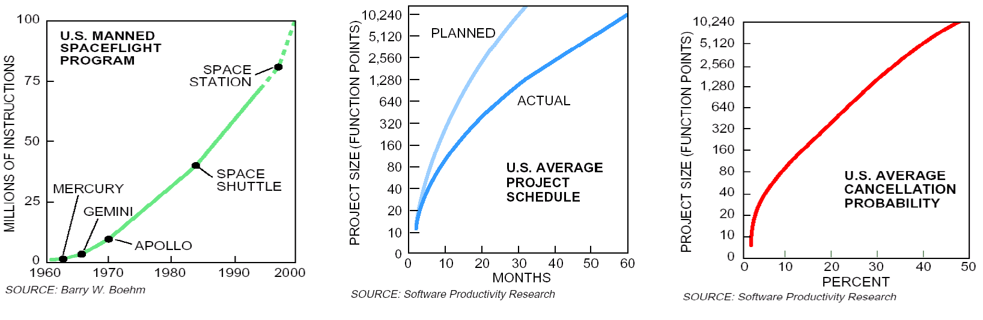
Software engineering
Why is software engineering important?
  Actually, there is still lots of debate regarding this question
  Practically, software engineering is the formalization of the disciplined approach required for the development of complex software systems
  GIBBS W. WAYT, “Software’s Chronic Crisis,” Scientific American, September 1994, p. 86–95
  National Institute of Standards and Technology, “Software Errors Cost U.S. Economy $59.5 Billion Annually, NIST Assesses Technical Needs of Industry to Improve Software-Testing”

Slide 72
Component-based software engineering (CBSE)
Components
“A software component is a unit of composition with contractually specified interfaces and explicit context dependencies only. A software component can be deployed independently and is subject to third-party composition.”
[SZYPERSKI 1997]
Requirements and advantages
  Reusability!
  Fully documented
  More thoroughly tested
  Robust input validity checking
  SZYPERSKI, C., “Component Software: Beyond Object-Oriented Programming”, Addison-Wesley Professional (December 19, 1997), p. 411

Slide 73
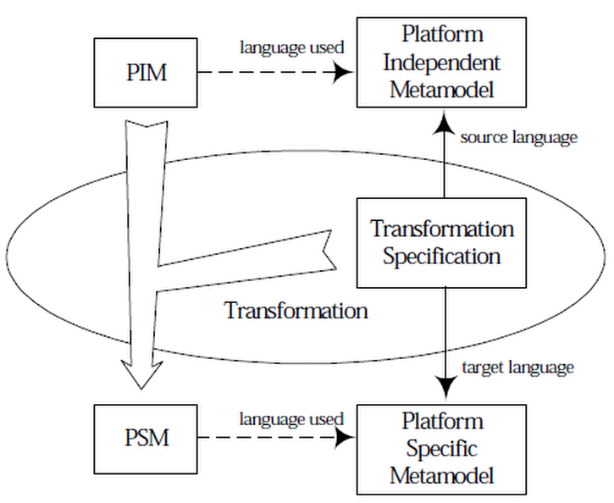
Model-driven development (MDD)
Software development methodology
Focuses on models or abstractions
of the actual system
Provides a common, conceptual
model for communication
between individuals and
teams working on the system
It aims to maximize compatibility
among systems by separating the
system into the PIM and PSM
PIM: Platform Independent Model; high-level model of the system
(e.g., expressed in UML or extended UML)
PSM: Platform Specific Model; custom-tailored to the target platform
Transformation: processes PIM input together with platform-specific properties to generate the PSM

Slide 74
Classification of context-aware applications
context-aware
adaptive
purely context-aware
user-controlled adaptive
context-aware self-adaptive
Context-aware
  Use context information at run-time
Adaptive
  Are able to adjust their behavior (e.g., through parameter or compositional-based adaptation) at run-time
Context-aware, self-adaptive
  Use context information in order to autonomously adapt their behavior at run-time

Slide 75
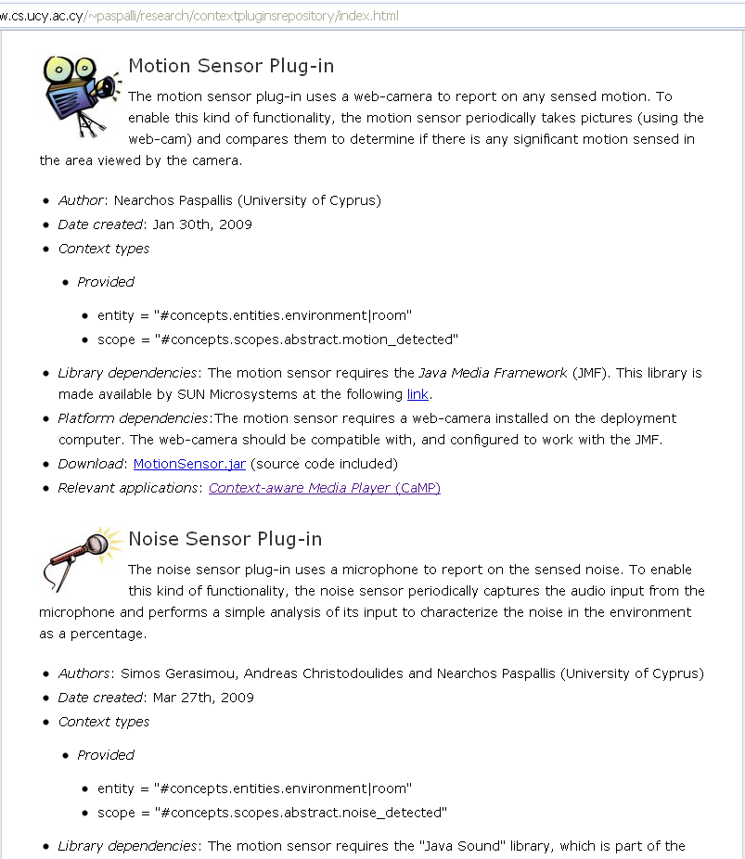
Context plug-in component repository
MUSIC context plug-in repository (of open-source plug-ins)
Current plug-ins
  Motion sensor
  Noise sensor
  Bluetooth sensor
  RFID sensor
  Connectivity sensor
  Location-by-IP sensor
  Location-by-WiFi sensor
  Location-by-GSM sensor
  Calendar sensor
Developed by
  University of Cyprus
  Telefonica
  HP
  Telecom Italia
http://www.ist-music.eu/MUSIC/developer-zone

