Slide 1
Middleware-based Development of Context-aware Applications with Reusable Components
Ph.D. Thesis Defense
Wednesday, September 30th 2009
Nearchos Paspallis
Department of Computer Science
University of Cyprus
nearchos@cs.ucy.ac.cy
http://member.acm.org/~nearchos
Copyright © by Nearchos Paspallis – All rights reserved 2009
Notes:
Middleware-based development of context-aware applications with reusable components
September 30th, 2009
Nearchos Paspallis - Thesis defense presentation

Slide 2
Presentation outline
Introduction
Foundations
Development methodology
Pluggable and modular middleware architecture
Evaluation
Conclusions and future work
September 30th, 2009
Notes:
Middleware-based development of context-aware applications with reusable components
September 30th, 2009
Nearchos Paspallis - Thesis defense presentation

Slide 3
Presentation outline
Introduction
Foundations
Development methodology
Pluggable and modular middleware architecture
Evaluation
Conclusions and future work
September 30th, 2009
Notes:
Middleware-based development of context-aware applications with reusable components
September 30th, 2009
Nearchos Paspallis - Thesis defense presentation

Slide 4
What is context-awareness?
Post-desktop era: the vision of Ubiquitous computing
[WEISER 1991, WEISER 1993]
“[context is] the location of use, nearby people, hosts and accessible devices as well as changes to these things over time” [SCHILIT 1994]
“[context is] any information that can be used to characterize the situation of an entity; [where] an entity is a person, place, or object that is considered relevant to the interaction between a user and an application, including the user and the application themselves” [DEY 2001]
Context-awareness: “The ability of a system to sense the context in run-time and use it”
WEISER, M. “The computer for the 21st century”, Scientific American (Feb. 1991).
WEISER, M. “Hot topics: ubiquitous computing”, Computer 26, 10 (Oct. 1993), 71–72.
SCHILIT, B. N., ADAMS, N., WANT, R. “Context-aware computing applications”, IEEE Workshop on Mobile Computing Systems and Applications (WMCSA'94), Santa Cruz, CA, USA, IEEE Computer Society (1994) p. 89-101
DEY, A. K., “Understanding and using context”, Personal and Ubiquitous Computing, Vol. 5, 1 (2001) p. 4–7
September 30th, 2009
Notes:
Middleware-based development of context-aware applications with reusable components
September 30th, 2009
Nearchos Paspallis - Thesis defense presentation

Slide 5

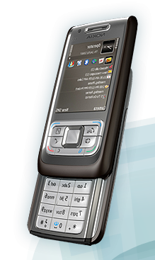
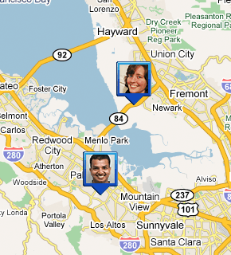

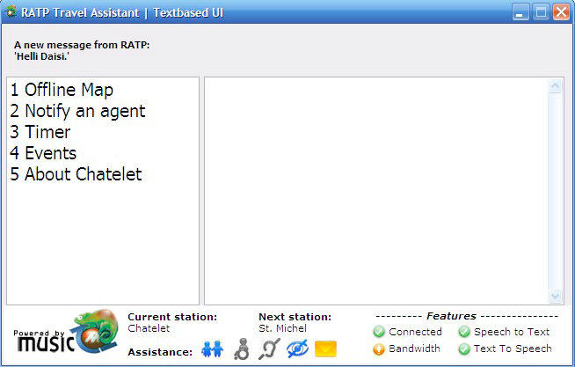
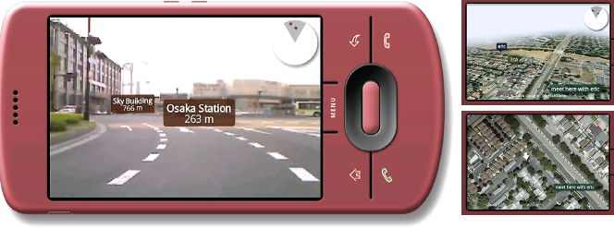
Motivation: context use in applications
Context-aware profile manager for smart-phones
Context-aware augmented reality
Google Latitude
Context-aware media player
& Signal-strength predictor
PRM Travel assistant
September 30th, 2009
Notes:
Middleware-based development of context-aware applications with reusable components
September 30th, 2009
Nearchos Paspallis - Thesis defense presentation

Slide 6
Motivation: potential of context use
Strong mobile phone penetration
  61% of the world population (more than 4.1 billion people)
  [ITU 2009]
Proliferation of embedded computing
  Home and office appliances, modern aircrafts, cars, etc
  [CHARETTE 2009, WRIGHT 2009]
Realizing the vision of ubiquitous computing
  The Singapore and Korea examples
  [BELL & DOURISH 2007]
ITU. “Measuring the Information Society: The ICT Development Index”, International Telecommunication Union, 2009.
CHARETTE, R.N., “This Car Runs on Code,” IEEE Spectrum (Feb. 2009)
WRIGHT, A., “Making sense of sensors,” Communications of the ACM, vol. 52, 2, 2009, pp. 14-15.
BELL, G., DOURISH, P., “Yesterday’s tomorrows: notes on ubiquitous computing’s dominant vision,” Personal Ubiquitous Computing, vol. 11, 2007, pp. 133-143.
September 30th, 2009
Notes:
Middleware-based development of context-aware applications with reusable components
September 30th, 2009
Nearchos Paspallis - Thesis defense presentation

Slide 7
Challenges
What are the software engineering challenges faced by the developers of such systems?
Software complexity
  Common challenge [HORN 2001]
  Context-aware behavior renders the underlying code significantly more complex
Heterogeneity and Interoperability
  Mobile and ubiquitous computing → diverse ecosystem
  Sharing data (e.g., context information) and coordinating their actions
Resource limitations
  Evolving beyond the desktop model → resource constraints (battery, memory, CPU, display size, etc)
Modularity
  Diverse mobile & embedded device ecosystem → modular solutions
HORN, P. “Autonomic computing: IBM’s perspective on the state of information technology”, 2001.
September 30th, 2009
Notes:
Middleware-based development of context-aware applications with reusable components
September 30th, 2009
Nearchos Paspallis - Thesis defense presentation

Slide 8
Challenges in the literature
“… lack of supporting infrastructure for capturing and processing context …”
[PASCOE 1997]
“… context is handled in an improvised manner” [DEY 2001]
“… high application development overheads, social barriers associated with privacy and usability, and an imperfect understanding of [context use]” [HENRICKSEN 2006]
“…what is missing, however, has been the middleware that will enable the applications to juxtapose information about your physical location with data from other applications.” [WRIGHT 2009]
PASCOE, J. “The stick-e note architecture: extending the interface beyond the user”, 2nd International Conference on Intelligent User Interfaces (Orlando, Florida, USA, 1997), ACM, pp. 261–264.
DEY, A. K., ABOWD, G. D., AND SALBER, D. ”A conceptual framework and a toolkit for supporting the rapid prototyping of context-aware applications”, Human-Computer Interaction 16, 2 (2001), 97–166.
HENRICKSEN, K., AND INDULSKA, J. “Developing context-aware pervasive computing applications: models and approach”, Pervasive and Mobile Computing 2, 1 (Feb. 2006), 37–64.
WRIGHT, A. “Get smart”, Communications of the ACM 52, 1 (Jan. 2009), 15–16.
September 30th, 2009
Notes:
Middleware-based development of context-aware applications with reusable components
September 30th, 2009
Nearchos Paspallis - Thesis defense presentation

Slide 9
Thesis statement
Traditional approaches for developing software applications are insufficient for meeting the software engineering challenges faced by the developers of context-aware systems, targeting mobile and ubiquitous computing environments.
Appropriate software, methods and tools are needed to render the development of context-aware applications easier, faster and more cost-efficient.
September 30th, 2009
Notes:
Middleware-based development of context-aware applications with reusable components
September 30th, 2009
Nearchos Paspallis - Thesis defense presentation

Slide 10
Approach
Development methodology
  Separation-of-concerns
  Software reuse
  Context model and query language
  Model-driven development approach
Middleware architecture
  Open/Pluggable
  Modular
  Autonomic resource management
September 30th, 2009
Notes:
Middleware-based development of context-aware applications with reusable components
September 30th, 2009
Nearchos Paspallis - Thesis defense presentation

Slide 11
Presentation outline
Introduction
Foundations
Development methodology
Pluggable and modular middleware architecture
Evaluation
Conclusions and future work
September 30th, 2009
Notes:
Middleware-based development of context-aware applications with reusable components
September 30th, 2009
Nearchos Paspallis - Thesis defense presentation

Slide 12
Basic concepts
Context
  Any information affecting the interaction between a user and an application [DEY 2000, DEY 2001]
Adaptation
  A process by which software changes its behavior in order to better match the changing environment [McKINLEY 2004]
    Parameter-based adaptation
    Compositional adaptation
Variants
  An application variant is any parameter-based or compositional-based configuration of the application, maintaining its original functional properties
McKINLEY, P. K., SADJADI, S. M., KASTEN, E. P., AND CHENG, B. H. C. “Composing adaptive software”, IEEE Computer 37, 7 (2004), 56–64.
September 30th, 2009
Notes:
Middleware-based development of context-aware applications with reusable components
September 30th, 2009
Nearchos Paspallis - Thesis defense presentation

Slide 13
Basic concepts
Self-adaptive, context-aware behavior
  The ability of a system to sense its environment and react accordingly in order to shape it, aiming for a predefined goal
Perceived utility
  A function U_{p} that for any context point c_{t} it maps any two variants v_{x} and v_{y} to scalar values (e.g., in the range [0, 1]) so that U_{p}(c_{t}, v_{x}) > U_{p}(c_{t}, v_{y}) if and only if the user prefers v_{x} to v_{y} from her or his point of perception
  Based on a perceived utility function U_{p}, the set of available variants can be totally ordered (v_{i1}, v_{i2}, …, v_{iN}) and thus enable self-adaptive, context-aware behavior where the selected variant is chosen using U_{p}
PASPALLIS, N., KAKOUSIS, K., PAPADOPOULOS, G. A., “A multi-dimensional model enabling autonomic reasoning for context-aware pervasive applications”, Workshop for Human Control of Ubiquitous Systems (HUCUBIS 2008) in conjunction with the 5th Annual International Conference on Mobile and Ubiquitous Systems: Computing, Networking and Services (Mobiquitous), Trinity College Dublin, Ireland, July 21-25, 2008, ACM Press
September 30th, 2009
Notes:
Middleware-based development of context-aware applications with reusable components
September 30th, 2009
Nearchos Paspallis - Thesis defense presentation

Slide 14
Classification of context-aware applications
context-aware
adaptive
purely context-aware
user-controlled adaptive
context-aware self-adaptive
Context-aware
  Use context information in run-time
Adaptive
  Are able to adjust their behavior (e.g., through parameter or compositional-based adaptation) in run-time
Context-aware, self-adaptive
  Use context information in order to autonomously adapt their behavior at run-time
September 30th, 2009
Notes:
Middleware-based development of context-aware applications with reusable components
September 30th, 2009
Nearchos Paspallis - Thesis defense presentation

Slide 15
Presentation outline
Introduction
Foundations
Development methodology
Pluggable and modular middleware architecture
Evaluation
Conclusions and future work
September 30th, 2009
Notes:
Middleware-based development of context-aware applications with reusable components
September 30th, 2009
Nearchos Paspallis - Thesis defense presentation

Slide 16
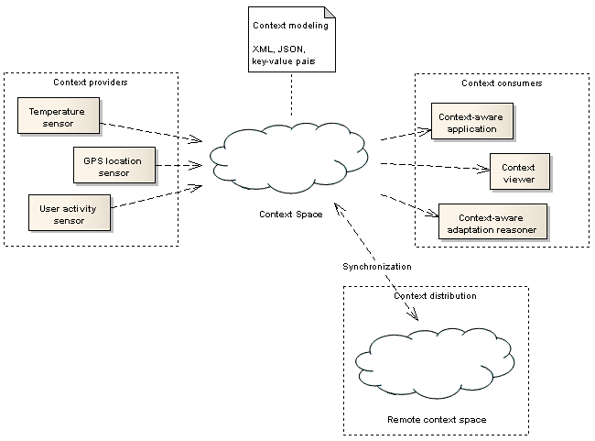
High-level view of context management
Required features
Acquisition
Storage
Access
Distribution
Proposed approach
Individual context provider and context consumer components (pluggable)
Common functionality provided by specialized components
  Replaceable
  Optional
September 30th, 2009
Notes:
Middleware-based development of context-aware applications with reusable components
September 30th, 2009
Nearchos Paspallis - Thesis defense presentation

Slide 17
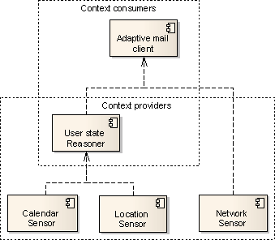
Separation of concerns: context providers & consumers
Context provider and context consumer roles
Plug-ins
  Sensors have no context dependencies
    Pure context providers
      Location sensor
      Network sensor
      Calendar sensor
  Reasoners have context dependencies
    Act as context providers and as
    context consumers at the same time
      User status reasoner
  Context clients
    Pure context consumers
      Adaptive mail client
September 30th, 2009
Notes:
Middleware-based development of context-aware applications with reusable components
September 30th, 2009
Nearchos Paspallis - Thesis defense presentation

Slide 18
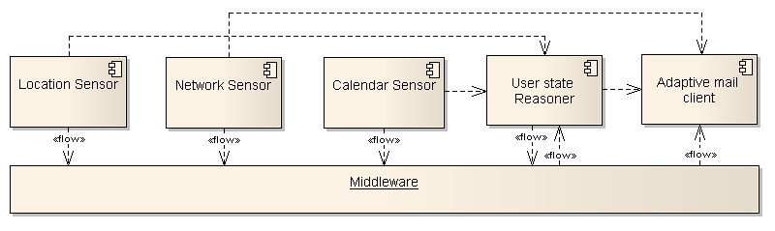
Separation of concerns: context providers & consumers
Why middleware?
  Coordinated life-cycle control
  Centralization of commonly used functionality
  Can facilitate interoperability
  Support for multiple concurrent applications
  Support for multiple context providers
Logical bindings
September 30th, 2009
Notes:
Middleware-based development of context-aware applications with reusable components
September 30th, 2009
Nearchos Paspallis - Thesis defense presentation

Slide 19
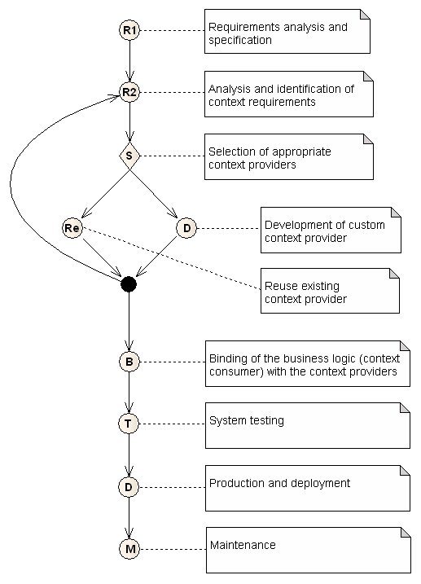
Development methodology
Identify the required context types
  E.g., “User state”
Select an appropriate provider
  1. Reuse an existing provider
  2. Develop a custom one
If needed, update the context requirements
  E.g., if the selected plug-in has additional context dependencies (e.g., “Location” and “Calendar”)
Repeat until all context requirements are resolved
September 30th, 2009
Notes:
Middleware-based development of context-aware applications with reusable components
September 30th, 2009
Nearchos Paspallis - Thesis defense presentation

Slide 20
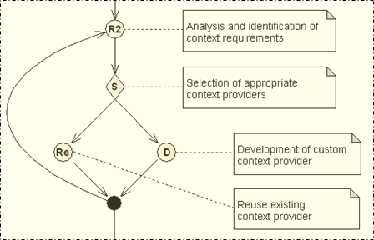
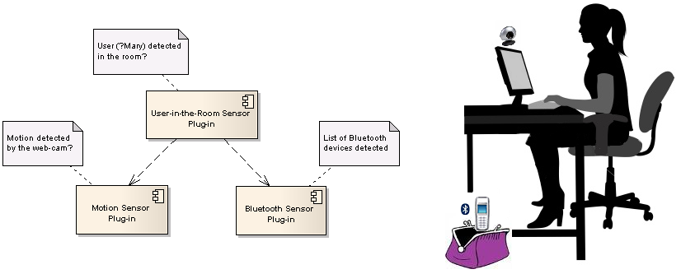
Example: Context-aware Media Player (CaMP)
Motion sensor plug-in
Bluetooth sensor plug-in
User-in-the-room sensor plug-in
September 30th, 2009

Slide 21
Developing context plug-ins
Programmatic development
  Define metadata
    Provided context types
    Needed context types (optional)
  Realize the internal mechanism
    Respond to input context events
    Wrap an underlying hardware sensor
    Explicitly poll data (e.g., memory sensor)
  Package
    Create the reusable component
Model-driven development (MDD)
September 30th, 2009
Notes:
Middleware-based development of context-aware applications with reusable components
September 30th, 2009
Nearchos Paspallis - Thesis defense presentation

Slide 22
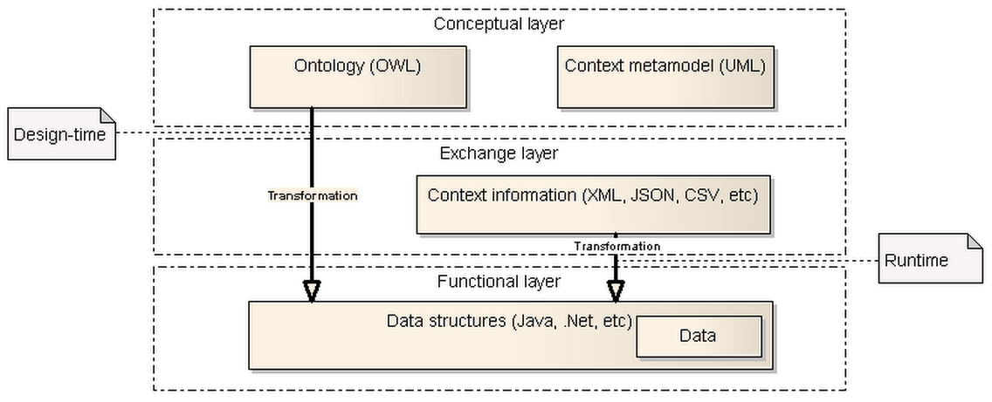
Context model
Layered context model
  Conceptual layer
  Exchange layer
  Functional layer
WAGNER, M., REICHLE, R., KHAN, M. U., GEIHS, K., LORENZO, J., VALLA, M., FRA, C., PASPALLIS, N., PAPADOPOULOS, G. A., “A Comprehensive Context Modeling Framework for Pervasive Computing Systems”, 8th IFIP International Conference on Distributed Applications and Interoperable Systems (DAIS), 4-6 June, 2008, Oslo, Norway, Springer Verlag LNCS 5053, pp. 281-295
September 30th, 2009
Notes:
Middleware-based development of context-aware applications with reusable components
September 30th, 2009
Nearchos Paspallis - Thesis defense presentation

Slide 23
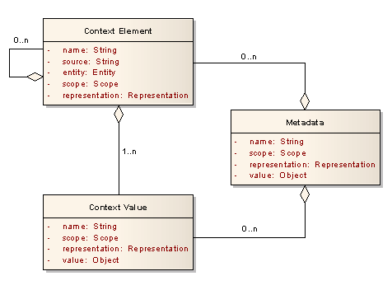
Context ontology and context metamodel
Context ontology
  Design-time
    Semantic consistency
    Automatic generation of code using MDD
      Data structures, Serialization/de-serialization code, IRO templates
  Run-time
    Relation inferring
    Inter-representation transformation (IRO)
Context metamodel
  Context elements
  Context values
  Metadata
September 30th, 2009
Notes:
Middleware-based development of context-aware applications with reusable components
September 30th, 2009
Nearchos Paspallis - Thesis defense presentation

Slide 24
Context access
Two main methods for accessing context
  Simple queries
    Access latest value (or values) of context type X
      E.g., what is the latest recorded location?
    Subscribe for notification of context type Y changes
      E.g., notify whenever a change occurs in the set of nearby Bluetooth devices
  Context query language
    Access latest value(s) of context type X under condition C
      E.g., what are the temperature recordings in the last 1 hour?
    Subscribe for notification of context type Y when condition C is satisfied
      E.g., notify me whenever my location is within 1000m of location <lon, lat>
REICHLE, R., WAGNER, M., KHAN, M. U., GEIHS, K., VALLA, M., FRA, C., PASPALLIS, N., PAPADOPOULOS, G. A., “A Context Query Language for Pervasive Computing Environments”, 5th IEEE Workshop on Context Modeling and Reasoning (CoMoRea)in conjunction with the 6th IEEE International Conference on Pervasive Computing and Communication (PerCom), Hong Kong, 17–21 March 2008, IEEE Computer Society Press, pp. 434-440
September 30th, 2009

Slide 25
Presentation outline
Introduction
Foundations
Development methodology
Pluggable and modular middleware architecture
Evaluation
Conclusions and future work
September 30th, 2009
Notes:
Middleware-based development of context-aware applications with reusable components
September 30th, 2009
Nearchos Paspallis - Thesis defense presentation

Slide 26
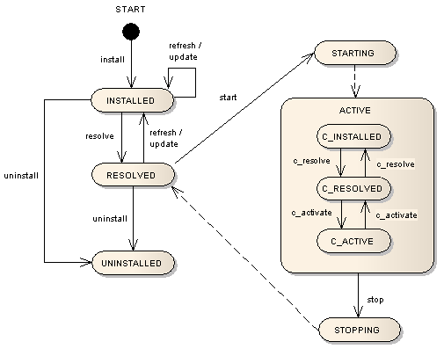
Component-based middleware
Middleware components
  Core components
  Context providers (plug-ins)
  Context consumers (applications)
Based on OSGi
  Application lifecycle
    INSTALLED
    RESOLVED
    ACTIVE
  Extended OSGi
  component lifecycle
    C_INSTALLED
    C_RESOLVED
    C_ACTIVE
September 30th, 2009
Notes:
Middleware-based development of context-aware applications with reusable components
September 30th, 2009
Nearchos Paspallis - Thesis defense presentation

Slide 27
Dynamic resolution and activation
The middleware monitors
  Required context types (i.e., from context-aware applications, context reasoner plug-ins and other middleware components)
  Provided context types (i.e., as reported by the installed/available plug-ins)
Resolution mechanism
  Identify resolved context plug-ins
Activation mechanism
  Selects plug-ins for activation
September 30th, 2009

Slide 28
Experimental evaluation: method
Predefined multi-step scenario using a PDA
  Varying context needs
Combined set of real and simulated plug-ins
  Real: Bluetooth, WiFi, GSM, and GPS sensors
  Simulated: RFID, Light, and Weather sensors
Measure resource consumption
  Battery use
  Memory use
Repeat measurements
  Autonomic activation
  All active
  PASPALLIS, N., ROUVOY, R., BARONE, P., PAPADOPOULOS, G. A., ELIASSEN, F., MAMELLI, A., “A Pluggable and Reconfigurable Architecture for a Context-aware Enabling Middleware System”, 10th International Symposium on Distributed Objects, Middleware, and Applications (DOA'08), Monterrey, Mexico, Nov 10 - 12, 2008, Springer Verlag LNCS 5331, pp. 553-570
September 30th, 2009
Notes:
Middleware-based development of context-aware applications with reusable components
September 30th, 2009
Nearchos Paspallis - Thesis defense presentation

Slide 29
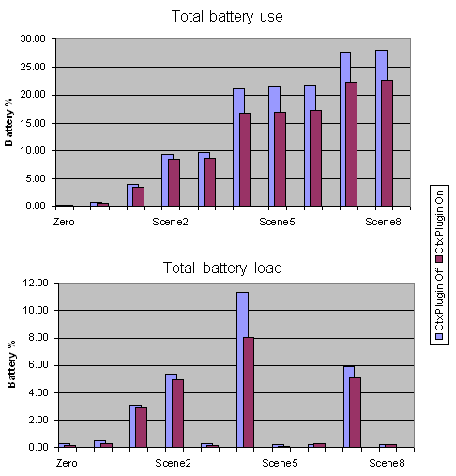
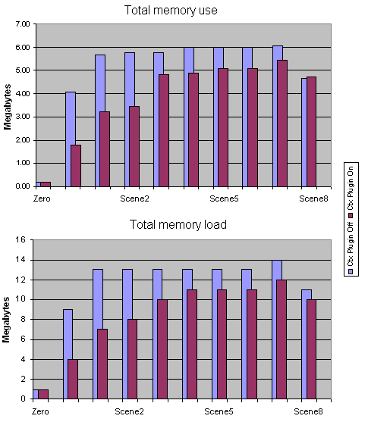
Experimental evaluation: results
Memory utilization: +21.29%
Battery utilization: +20.95%
September 30th, 2009

Slide 30
Modular architecture: core services
Provided services
  Context access
  Context management
  Context simulation
Required services
  Context repository
  Context query
  Context model
September 30th, 2009
Notes:
Middleware-based development of context-aware applications with reusable components
September 30th, 2009
Nearchos Paspallis - Thesis defense presentation

Slide 31
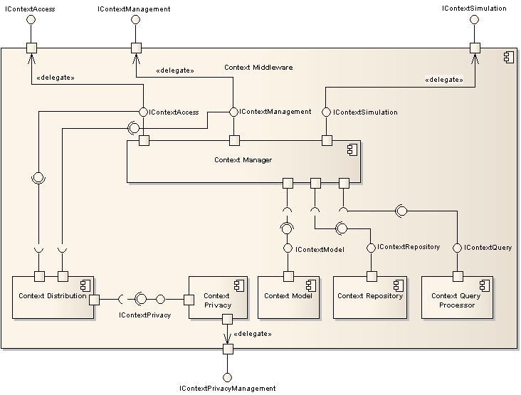
Modular architecture: high-level architecture
September 30th, 2009
Notes:
Middleware-based development of context-aware applications with reusable components
September 30th, 2009
Nearchos Paspallis - Thesis defense presentation

Slide 32
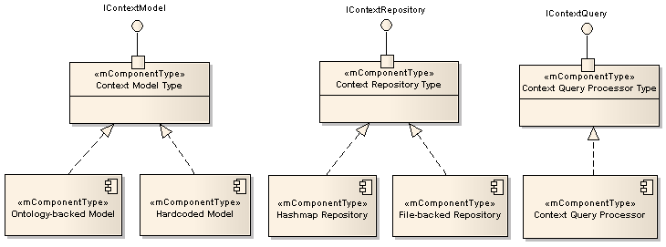
Modular architecture: variability
Adding/removing optional components
  Context distribution
  Context query processor
Substituting components
  Hardcoded model for simple applications
  Hashmap-based versus DBMS-based context repository
September 30th, 2009
Notes:
Middleware-based development of context-aware applications with reusable components
September 30th, 2009
Nearchos Paspallis - Thesis defense presentation

Slide 33
Presentation outline
Introduction
Foundations and related work
Development methodology
Pluggable and modular middleware architecture
Evaluation
Conclusions and future work
September 30th, 2009

Slide 34
Evaluation approach
Quantitative analysis
  Case study-based evaluation
    Context-aware Media Player (CaMP)
    Signal Strength Predictor (SSP)
  MUSIC pilot applications (indirect use)
    PRM Travel Assistant
    SatMotion
  Other plug-in developers
    NTNU (MS thesis: InstantSocial), Telefonica, Integrasys and HP
  EPL-429 course applications
    Training, using, evaluating
    Feedback collected via surveys
Qualitative analysis
  Requirement-driven
September 30th, 2009
Notes:
Middleware-based development of context-aware applications with reusable components
September 30th, 2009
Nearchos Paspallis - Thesis defense presentation

Slide 35
Quantitative evaluation
EPL-429-based evaluation
  Design a context-aware application
    Business logic
    Context-aware logic (required context types)
  Realize the appropriate plug-ins
    Implement from scratch
    Reuse existing plug-ins
  Integrate the application
    Implement the business logic
    Bind with the context middleware
September 30th, 2009

Slide 36
Quantitative evaluation
Results
  Almost all would prefer the proposed methodology to the ad-hoc one
    11 out of 12
  Most tasks were of low-to-medium complexity
    Most complex task: context modeling (medium-to-high complexity)
  Smooth learning curve
    ~23 hours for preparation and ~20 hours for implementation
  Similar results reported by MUSIC developers
September 30th, 2009

Slide 37
Qualitative analysis: Requirements-driven
Functional
  Application specific context acquisition, analysis and detection
  Context-triggered action
  Heterogeneity
  Uncertainty
  Context histories
  Inference of inter-dependencies
  Multiple concurrent applications
  Transparent distribution
  Privacy
  Traceability and control
  Interoperability and standards
Extra-functional
  Ease of building
  Modularity
  Separation of concerns
  Code reuse
  Uniform development support
  Evolution
  Scalability
  Dynamic behavior
  Platform independence
  Lightweight architecture
  Adoption of existing patterns and standards
  Support for mobility
  Fault-tolerance
  Ease of deployment and configuration
  Resource efficiency
September 30th, 2009

Slide 38
Presentation outline
Introduction
Foundations and related work
Development methodology
Pluggable and modular middleware architecture
Evaluation
Conclusions and future work
September 30th, 2009

Slide 39
Main contributions
Development methodology
  Separation-of-concerns
  Code reuse
  Context model and query language
  Model-driven development approach
Middleware architecture
  Open/Pluggable
  Modular
  Autonomic activation with resource optimization
September 30th, 2009
Notes:
Middleware-based development of context-aware applications with reusable components
September 30th, 2009
Nearchos Paspallis - Thesis defense presentation

Slide 40
Future work
Complete context-aware, self-adaptive applications with reusable components [PASPALLIS 2009]
  Application components annotated with metadata characterizing its extra-functional (i.e., self-adaptive) properties
  Specialized algorithms used to evaluate the available components in run-time
Learning from user feedback [KAKOUSIS 2008]
  Ubiquitous computing → getting the user out of the loop
  Minimal, non-intrusive user feedback → train the autonomic (context-aware, self-adaptive behavior) behavior of the application
PASPALLIS, N., ELIASSEN, F., HALLSTEINSEN, F., AND PAPADOPOULOS, G. A., “Developing Self-Adaptive Mobile Applications and Services with Separation-of-Concerns”, At Your Service: Service-Oriented Computing from an EU Perspective, E. Di Nitto, A-M. Sassen, O. Traverso and A. Zwegers (eds), MIT Press, June 2009, chapter 6, pp. 129-158
KAKOUSIS, K., PASPALLIS, N., AND PAPADOPOULOS, G. A., “Optimizing the Utility Function-based Self-adaptive Behavior of Context-aware Systems using User Feedback”,10th International Symposium on Distributed Objects, Middleware, and Applications (DOA'08), Monterrey, Mexico, Nov 10 - 12, 2008, Springer Verlag LNCS 5331, pp. 657-674
September 30th, 2009
Notes:
Middleware-based development of context-aware applications with reusable components
September 30th, 2009
Nearchos Paspallis - Thesis defense presentation

Slide 41
Acknowledgements
George A. Papadopoulos
Christian Becker, Marios D. Dikaiakos, Jeff Magee and George Samaras
Fani Athienitou, Gabriel Panis, Konstantinos Kakousis and
Pyrros Bratskas
Roland & Michael (University of Kassel)
Partners of IST-MADAM & IST-MUSIC projects
The students of the EPL-429 course (Spring 2009)
Aimilia, Christos, Despina, Giorgos, Konstantinos, Marios, Pericles, Pyrros, and Viki (a.k.a. the lunch group) and entire CS.UCY department
European Commission
September 30th, 2009

Slide 42
Questions?
Thank you!
September 30th, 2009

Slide 43
Publications: Thesis-specific
PASPALLIS, N., ELIASSEN, F., HALLSTEINSEN, S., AND PAPADOPOULOS, G. A., “Developing self-adaptive mobile applications and services with separation-of-concerns”, At Your Service: Service-Oriented Computing from an EU Perspective, E. Di Nitto, A-M. Sassen, O. Traverso and A. Zwegers (eds), MIT Press, June 2009, chapter 6, pp. 129-158
GEIHS, K., BARONE, P., ELIASSEN, F., FLOCH, J., FRICKE, R., GJORVEN, E., HALLSTEINSEN, S., HORN, G., KHAN, M. U., MAMELLI, A., PAPADOPOULOS, G. A., PASPALLIS, N., REICHLE, R., STAV, E., “A comprehensive solution for application-level adaptation”, Software – Practice and Experience Journal, Online ISSN: 1097-024X, Print ISSN: 0038-0644, Copyright 2008 John Wiley & Sons, Ltd., Published Online: Sep 15 2008, DOI: 10.1002/spe.900
PASPALLIS, N., ROUVOY, R., BARONE, P., PAPADOPOULOS, G. A., ELIASSEN, F., MAMELLI, A., “A pluggable and reconfigurable architecture for a context-aware enabling middleware system”, 10th International Symposium on Distributed Objects, Middleware, and Applications (DOA'08), Monterrey, Mexico, Nov 10 - 12, 2008, Springer Verlag LNCS 5331, pp. 553-570
PASPALLIS, N., KAKOUSIS, K., PAPADOPOULOS, G. A., “A multi-dimensional model enabling autonomic reasoning for context-aware pervasive applications”, Workshop for Human Control of Ubiquitous Systems (HUCUBIS 2008) in conjunction with the 5th Annual International Conference on Mobile and Ubiquitous Systems: Computing, Networking and Services (Mobiquitous), Trinity College Dublin, Ireland, July 21-25, 2008, ACM Press
September 30th, 2009

Slide 44
Publications: Thesis-specific
WAGNER, M., REICHLE, R., KHAN, M. U., GEIHS, K., LORENZO, J., VALLA, M., FRA, C., PASPALLIS, N., PAPADOPOULOS, G. A., “A comprehensive context modeling framework for pervasive computing systems, 8th IFIP International Conference on Distributed Applications and Interoperable Systems (DAIS), Oslo, Norway, 4-6 June, 2008, Springer Verlag LNCS 5053, pp. 281-295
REICHLE, R., WAGNER, M., KHAN, M. U., GEIHS, K., VALLA, M., FRA, C., PASPALLIS, N., PAPADOPOULOS, G. A., “A context query language for pervasive computing environments, 5th IEEE Workshop on Context Modeling and Reasoning (CoMoRea)in conjunction with the 6th IEEE International Conference on Pervasive Computing and Communication (PerCom), Hong Kong, 17–21 March 2008, IEEE Computer Society Press, pp. 434-440
PASPALLIS, N., PAPADOPOULOS, G. A., “An Approach for Developing Adaptive, Mobile Applications with Separation of Concerns, 30th Annual International Computer Software and Applications Conference (COMPSAC), Chicago, IL, USA, September 17-21, 2006, IEEE Computer Society Press, pp. 299-306
September 30th, 2009

Slide 45
Publications: Thesis-related
KAKOUSIS, K., PASPALLIS, N., PAPADOPOULOS, G. A., “Optimizing the utility function-based self-adaptive behavior of context-aware systems using user feedback”, 10th International Symposium on Distributed Objects, Middleware, and Applications (DOA'08), Monterrey, Mexico, Nov 10 - 12, 2008, Springer Verlag LNCS 5331, pp. 657-674
HU, X., DING, Y., PASPALLIS, N., BRATSKAS, P., PAPADOPOULOS, G. A., VANROMPAY, Y., PINHEIRO, M. K., BERBERS, Y., “A hybrid peer-to-peer solution for context distribution in mobile and ubiquitous environments”, 17th International Conference on Information Systems Development (ISD2008), Paphos, Cyprus, August 25-27, 2008, Springer Verlag
BRATSKAS, P., PASPALLIS, N., KAKOUSIS, K., PAPADOPOULOS, G. A., “Applying utility functions to adaptation planning for home automation applications”, 17th International Conference on Information Systems Development (ISD2008), Paphos, Cyprus,August 25-27, 2008, Springer Verlag
PASPALLIS, N., PAPADOPOULOS, G. A., “An optimization of context sharing for self-adaptive mobile applications”, 8th International Conference on Algorithms and Architectures for Parallel Processing (ICA3PP), Ayia Napa, Cyprus, 9-11 June, 2008, Springer Verlag LNCS 5022, pp. 157-168
HU, X., DING, Y., PASPALLIS, N., BRATSKAS, P., PAPADOPOULOS, G. A., BARONE, P., MAMELLI, A., VANROMPAY, Y., BERBERS, Y., “A peer-to-peer based infrastructure for context distribution in mobile and ubiquitous environments”, 3rd International Workshop on Context-Aware Mobile Services (CAMS) in conjunction with the On The Move to Meaningful Internet Systems (OTM), Vilamoura, Algarve, Portugal, November 25-30, 2007, Springer Verlag LNCS 4805, pp. 236-239
BRATSKAS, P., PASPALLIS, N., PAPADOPOULOS, G. A., “An evaluation of the state-of-the-art in context aware architectures”, 16th International Conference on Information Systems Development (ISD), Galway, Ireland, August 29-31, 2007, Springer
September 30th, 2009

Slide 46
Publications: Thesis-related
PASPALLIS, N., CHIMARIS, A., PAPADOPOULOS, G. A., “Experiences from developing a distributed context management system for enabling adaptivity”, 7th IFIP International Conference on Distributed Applications and Interoperable Systems (DAIS), Paphos, Cyprus, June 5-8, 2007, Springer Verlag LNCS 4531, pp. 225-238
ALIA, M., HALLSTEINSEN, S., PASPALLIS, N., ELIASSEN, F., “Managing distributed adaptation of mobile applications”, 7th IFIP International Conference on Distributed Applications and Interoperable Systems (DAIS), Paphos, Cyprus, June 5-8, 2007, Springer Verlag LNCS 4531, pp. 104-118
ALIA, M., EIDE, V. S. W., PASPALLIS, N., ELIASSEN, F., HALLSTEINSEN, S., PAPADOPOULOS, G. A., “A utility-based adaptivity model for mobile applications”, 21st International Conference on Advanced Information Networking and Applications Workshops (AINAW'07), Niagara Falls, Ontario, Canada, May 21-23, 2007, IEEE Computer Society Press, pp. 556-563
PASPALLIS, N., PAPADOPOULOS, G. A., “Distributed adaptation reasoning for a mobility and adaptation enabling middleware”, 8th International Symposium on Distributed Objects and Applications (DOA), Montpellier, France, Oct 30 - Nov 1, 2006, Springer Verlag LNCS 4277, pp. 17-18
MIKALSEN, M., PASPALLIS, N., FLOCH, J., PAPADOPOULOS, G. A., RUIZ, P. A., “Putting context in context: the role and design of context management in a mobility and adaptation enabling middleware”, International Workshop on Managing Context Information and Semantics in Mobile Environments (MCISME) in conjunction with the 7th International Conference on Mobile Data Management (MDM), Nara, Japan, May 9-12, 2006, IEEE Computer Society Press, pp. 76-83
MIKALSEN, M., PASPALLIS, N., FLOCH, J., STAV, E., CHIMARIS, A., PAPADOPOULOS, G. A., “Distributed context management in a mobility and adaptation enabling middleware (MADAM)”, 21st Annual ACM Symposium of Applied Computing, Track of Dependable and Adaptive Systems (SAC), Dijon, France, April 23 -27, 2006, ACM Press, pp. 733-734
September 30th, 2009

Slide 47
Publications: Other work
PASPALLIS, N., PAPADOPOULOS, G. A., “An architecture for highly available and dynamically upgradeable web services”, 15th International Conference on Information Systems Development (ISD), Budapest, Hungary, August 31-September 2, 2006, Springer Verlag, pp. 147-160
CHATZIGIANNAKIS, I., NIKOLETSEAS, S. E., PASPALLIS, N., SPIRAKIS, P. G., ZAROLIAGIS, C. D., “An experimental study of basic communication protocols in ad-hoc mobile networks”, 5th International Workshop on Algorithm Engineering (WAE), Aarhus, Denmark, August 28-30, 2001, Springer Verlag LNCS Vol. 2141, pp.159-171
September 30th, 2009

