Slide 1
Potential Game based Channel Allocation for Vehicular Edge Computing

Slide 2
01
Introduction
02
Problem Formulation
CONTENTS
03
Potential Game Model
04
Algorithm Design
05
Performance Evaluation

Slide 3

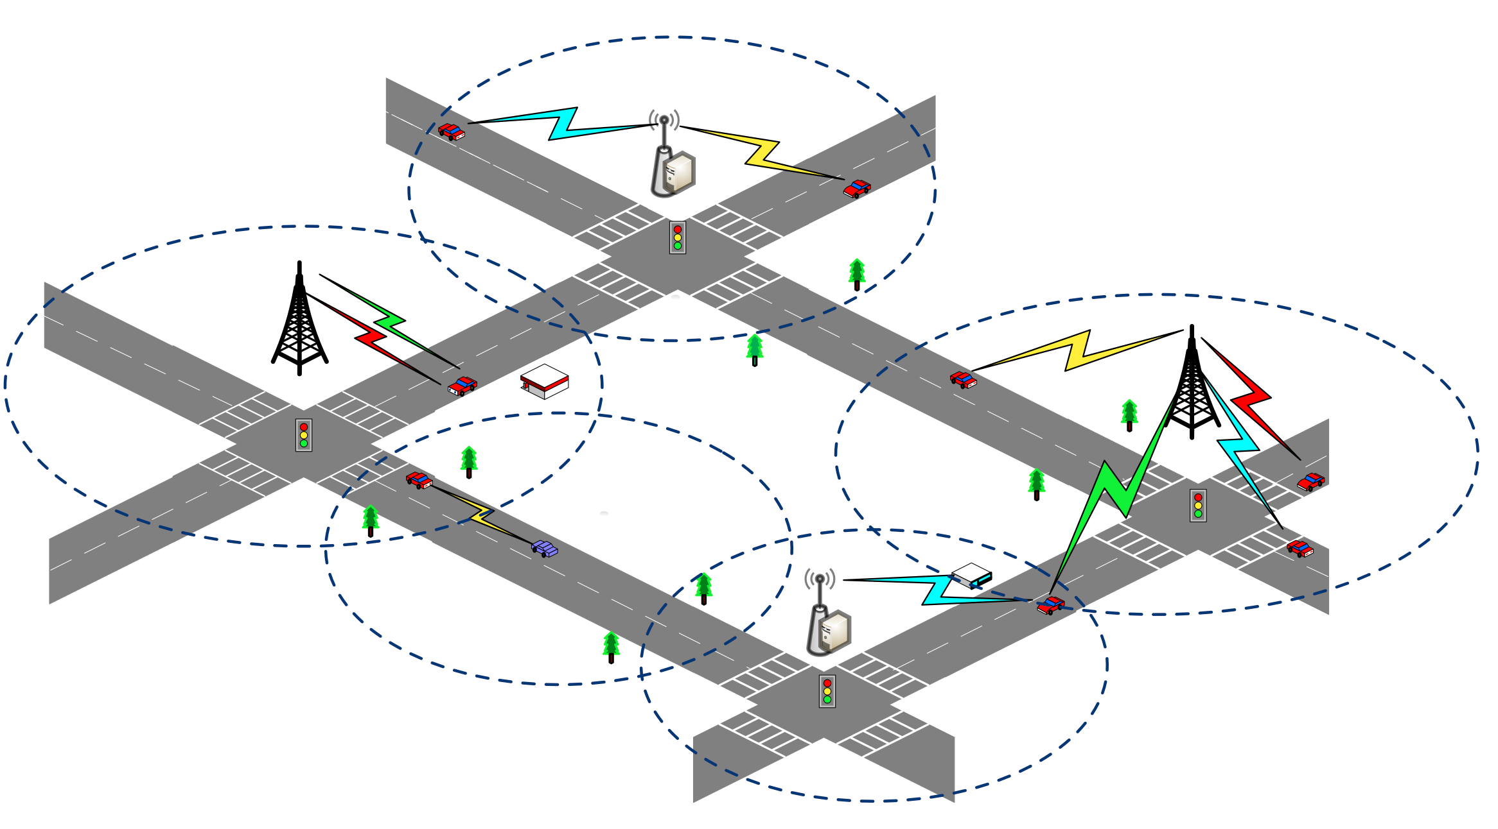





Introduction
Vehicular Edge Computing Architecture
Data Transmission Tasks
Mobility of Vehicles
Task Deadline
Co-channel Interference
Cloud
Co-channel Interference
Objective: Allocating sub-channels for different data transmission tasks
and maximizing the number of completed tasks
Base Station
Roadside Unit (RSU)
Vehicular Edge Node
Channel

Slide 4
01
Introduction
02
Problem Formulation
CONTENTS
03
Potential Game Model
04
Algorithm Design
05
Performance Evaluation

Slide 5
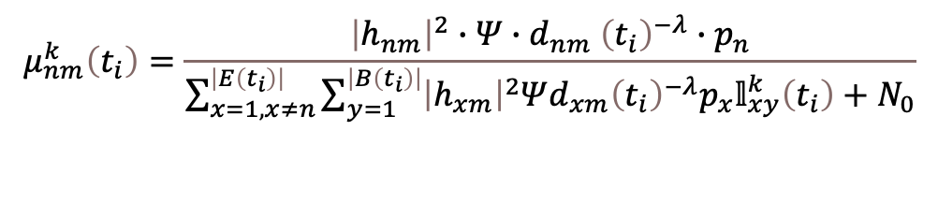
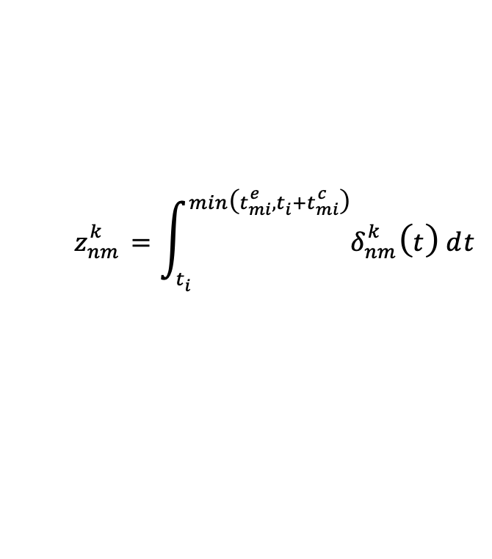

Problem Formulation
Mobility-aware Communication Model
Signal to Interference and Nosie Ratio, SINR
Signal
$$μ_{nm}^{k}\left(t_{i}\right)=\frac{{\left|h_{nm}\right|}^{2}∙Ψ{{{∙d}_{nm}\left(t_{i}\right)}^{−λ}∙p}_{n}}{\sum_{x=1,x≠n}^{\left|E\left(t_{i}\right)\right|}{\sum_{y=1 }^{\left|B\left(t_{i}\right)\right|}{{\left|h_{xm}\right|}^{2}Ψ{d_{xm}\left(t_{i}\right)}^{−λ}p_{x}𝕝_{xy}^{k}\left(t_{i}\right)}}+N_{0}}$$
Co-channel Interference
Transmission Rate
$$δ_{nm}^{k}\left(t_{i}\right)=ω_{n}\log_{2}\left(1+μ_{nm}^{k}\left(t_{i}\right)\right)$$
Transmission Data Size
$$z_{nm}^{k}=\int_{t_{i}}^{min\left(t_{mi}^{e},t_{i}+t_{mi}^{c}\right)}{δ_{nm}^{k}\left(t\right)}ⅆt$$

Slide 6

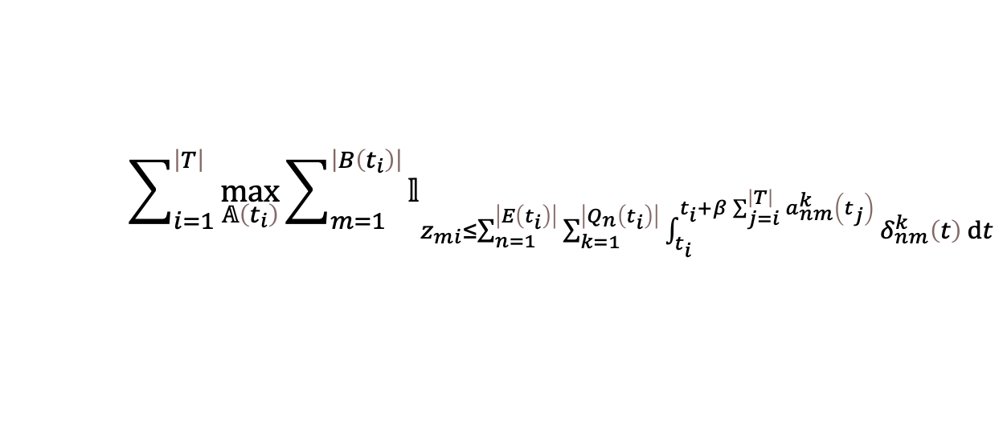
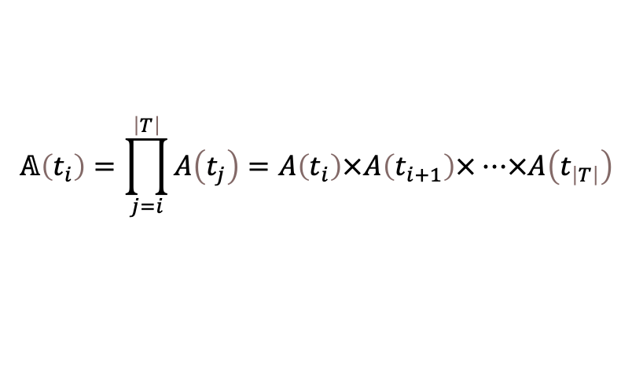





Problem Formulation
Channel Allocation Problem
Allocation Strategy
$$𝔸\left(t_{i}\right)=\prod_{j=i}^{\left|T\right|}{A\left(t_{j}\right)}=A\left(t_{i}\right)×A\left(t_{i+1}\right)×…×A\left(t_{\left|T\right|}\right)$$
$$A\left(t_{i}\right)∈{\left\{0,1\right\}}^{\left|E\left(t_{i}\right)\right|×\left|B\left(t_{i}\right)\right|×\left|Q\right|}$$
$$a_{nm}^{k}\left(t_{i}\right)=1$$
Objective Function
$$\sum_{i=1}^{\left|T\right|}{\max_{𝔸\left(t_{i}\right)}\sum_{m=1}^{\left|B\left(t_{i}\right)\right|}{𝕝_{z_{mi}≤\sum_{n=1}^{\left|E\left(t_{i}\right)\right|}{\sum_{k=1}^{\left|Q_{n}\left(t_{i}\right)\right|}{\int_{t_{i}}^{t_{i}+β\sum_{j=i}^{\left|T\right|}{a_{nm}^{k}\left(t_{j}\right)}}{δ_{nm}^{k}\left(t\right)}ⅆt}}}}}$$
Task Completion Indicator
$$C2$$
Vehicles can only be allocated channels within the coverage of edge nodes
$$C3$$
The channel allocated by the edge node must be the currently available channel
$$C4$$
Each channel of the edge node is assigned to at most one task
$$C5$$
The total length of the channel occupation time slice needs to be less than the task deadline and the channel maintenance time

Slide 7
01
Introduction
02
Problem Formulation
CONTENTS
03
Potential Game Model
04
Algorithm Design
05
Performance Evaluation

Slide 8


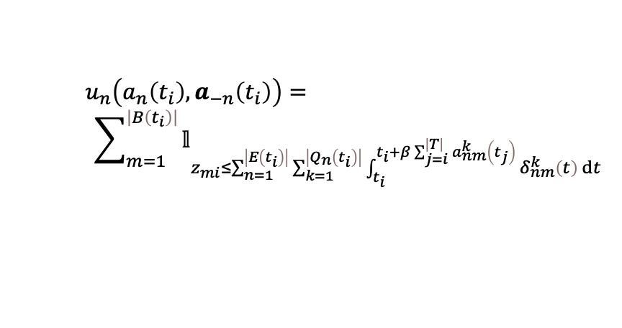
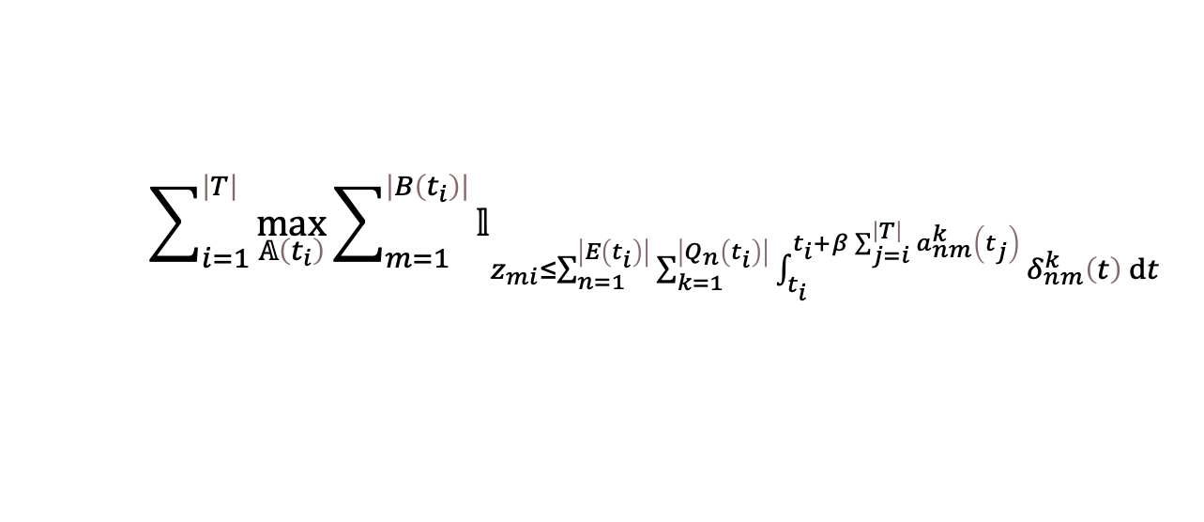

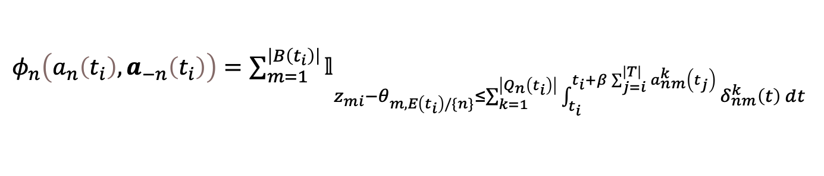
Potential Game Model
Distributed Game Transformation
Edge Nodes
Players
$$A\left(t_{i}\right)∈{\left\{0,1\right\}}^{\left|E\left(t_{i}\right)\right|×\left|B\left(t_{i}\right)\right|×\left|Q\right|}$$
Allocation Strategy
Strategies
$$a_{n}\left(t_{i}\right)∈{\left\{0,1\right\}}^{\left|B\left(t_{i}\right)\right|×\left|Q_{n}\left(t_{i}\right)\right|×\left|\left|T\right|−i+1\right|}$$
$$\sum_{i=1}^{\left|T\right|}{\max_{𝔸\left(t_{i}\right)}\sum_{m=1}^{\left|B\left(t_{i}\right)\right|}{𝕝_{z_{mi}≤\sum_{n=1}^{\left|E\left(t_{i}\right)\right|}{\sum_{k=1}^{\left|Q_{n}\left(t_{i}\right)\right|}{\int_{t_{i}}^{t_{i}+β\sum_{j=i}^{\left|T\right|}{a_{nm}^{k}\left(t_{j}\right)}}{δ_{nm}^{k}\left(t\right)}ⅆt}}}}}$$
$$u_{n}\left(a_{n}\left(t_{i}\right),a_{−n}\left(t_{i}\right)\right)=$$
$$\sum_{m=1}^{\left|B\left(t_{i}\right)\right|}{𝕝_{z_{mi}≤\sum_{n=1}^{\left|E\left(t_{i}\right)\right|}{\sum_{k=1}^{\left|Q_{n}\left(t_{i}\right)\right|}{\int_{t_{i}}^{t_{i}+β\sum_{j=i}^{\left|T\right|}{a_{nm}^{k}\left(t_{j}\right)}}{δ_{nm}^{k}\left(t\right)}ⅆt}}}}$$
Objective Function
Payoff Function
Potential Function
$φ_{n}\left(a_{n}\left(t_{i}\right),a_{−n}\left(t_{i}\right)\right)$ $=\sum_{m=1}^{\left|B\left(t_{i}\right)\right|}{𝕝_{z_{mi}−θ_{m,E\left(t_{i}\right)/\{n\}}≤\sum_{k=1}^{\left|Q_{n}\left(t_{i}\right)\right|}{\int_{t_{i}}^{t_{i}+β\sum_{j=i}^{\left|T\right|}{a_{nm}^{k}\left(t_{j}\right)}}{δ_{nm}^{k}\left(t\right)}ⅆt}}}$
Exact Potential Game
$$u_{n}\left({a_{n}\left(t_{i}\right)}^{∗},a_{−n}\left(t_{i}\right)\right)−u_{n}\left(a_{n}\left(t_{i}\right),a_{−n}\left(t_{i}\right)\right)\begin{matrix}=φ_{n}\left({a_{n}\left(t_{i}\right)}^{∗},a_{−n}\left(t_{i}\right)\right)−φ_{i}\left(a_{n}\left(t_{i}\right),a_{−n}\left(t_{i}\right)\right) & \end{matrix}$$
Theorem: Given the potential function of the game, the channel allocation game is an exact potential game, which possesses at least one Nash Equilibrium

Slide 9
01
Introduction
02
Problem Formulation
CONTENTS
03
Potential Game Model
04
Algorithm Design
05
Performance Evaluation

Slide 10
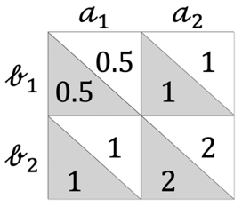
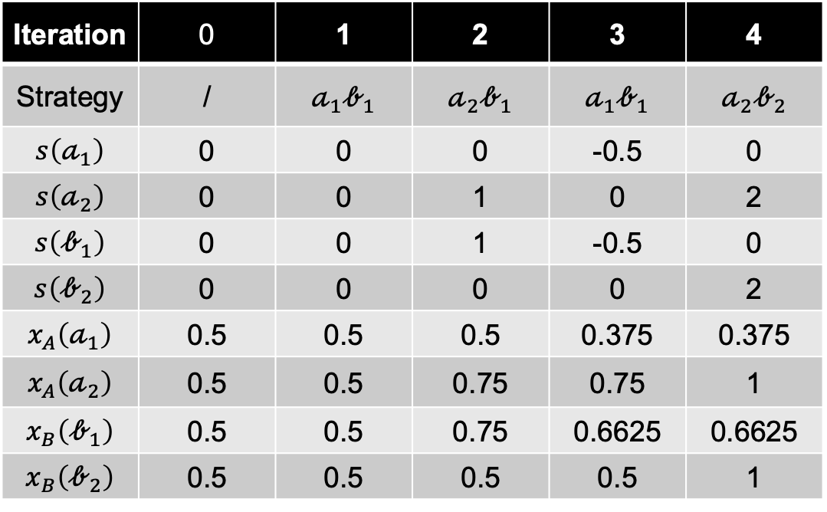
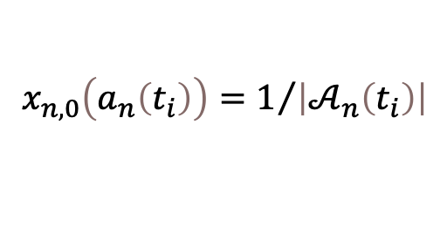
Algorithm Design
Incentive-based Probability Update and Strategy Selection (IPUS²)
Initialization
Strategy Selection Probability
$$x_{n,0}\left(a_{n}\left(t_{i}\right)\right)=1/{\left|𝒜_{n}\left(t_{i}\right)\right|}$$
Iteration | 0 | 1 | 2 | 3 | 4
Strategy | / | $𝒶_{1}𝒷_{1}$ | $𝒶_{2}𝒷_{1}$ | $𝒶_{1}𝒷_{1}$ | $𝒶_{2}𝒷_{2}$
$s\left(𝒶_{1}\right)$ | 0 | 0 | 0 | -0.5 | 0
$s\left(𝒶_{2}\right)$ | 0 | 0 | 1 | 0 | 2
$s\left(𝒷_{1}\right)$ | 0 | 0 | 1 | -0.5 | 0
$s\left(𝒷_{2}\right)$ | 0 | 0 | 0 | 0 | 2
$x_{A}\left(𝒶_{1}\right)$ | 0.5 | 0.5 | 0.5 | 0.375 | 0.375
$x_{A}\left(𝒶_{2}\right)$ | 0.5 | 0.5 | 0.75 | 0.75 | 1
$x_{B}\left(𝒷_{1}\right)$ | 0.5 | 0.5 | 0.75 | 0.6625 | 0.6625
$x_{B}\left(𝒷_{2}\right)$ | 0.5 | 0.5 | 0.5 | 0.5 | 1

Slide 11
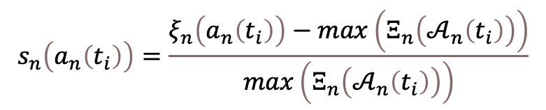
Algorithm Design
Incentive-based Probability Update and Strategy Selection (IPUS²)
Initialization
Probability Update Value
$$s_{n}\left(a_{n}\left(t_{i}\right)\right)=\frac{ξ_{n}\left(a_{n}\left(t_{i}\right)\right)−\max\left(Ξ_{n}\left(𝒜_{n}\left(t_{i}\right)\right)\right)}{\max\left(Ξ_{n}\left(𝒜_{n}\left(t_{i}\right)\right)\right)}$$
Iteration | 0 | 1 | 2 | 3 | 4
Strategy | / | $𝒶_{1}𝒷_{1}$ | $𝒶_{2}𝒷_{1}$ | $𝒶_{1}𝒷_{1}$ | $𝒶_{2}𝒷_{2}$
$s\left(𝒶_{1}\right)$ | 0 | 0 | 0 | -0.5 | 0
$s\left(𝒶_{2}\right)$ | 0 | 0 | 1 | 0 | 2
$s\left(𝒷_{1}\right)$ | 0 | 0 | 1 | -0.5 | 0
$s\left(𝒷_{2}\right)$ | 0 | 0 | 0 | 0 | 2
$x_{A}\left(𝒶_{1}\right)$ | 0.5 | 0.5 | 0.5 | 0.375 | 0.375
$x_{A}\left(𝒶_{2}\right)$ | 0.5 | 0.5 | 0.75 | 0.75 | 1
$x_{B}\left(𝒷_{1}\right)$ | 0.5 | 0.5 | 0.75 | 0.6625 | 0.6625
$x_{B}\left(𝒷_{2}\right)$ | 0.5 | 0.5 | 0.5 | 0.5 | 1
Strategy
Selection
Environmental
Interactions
(0.5-0.5)/0.5
(0.5-0.5)/0.5

Slide 12
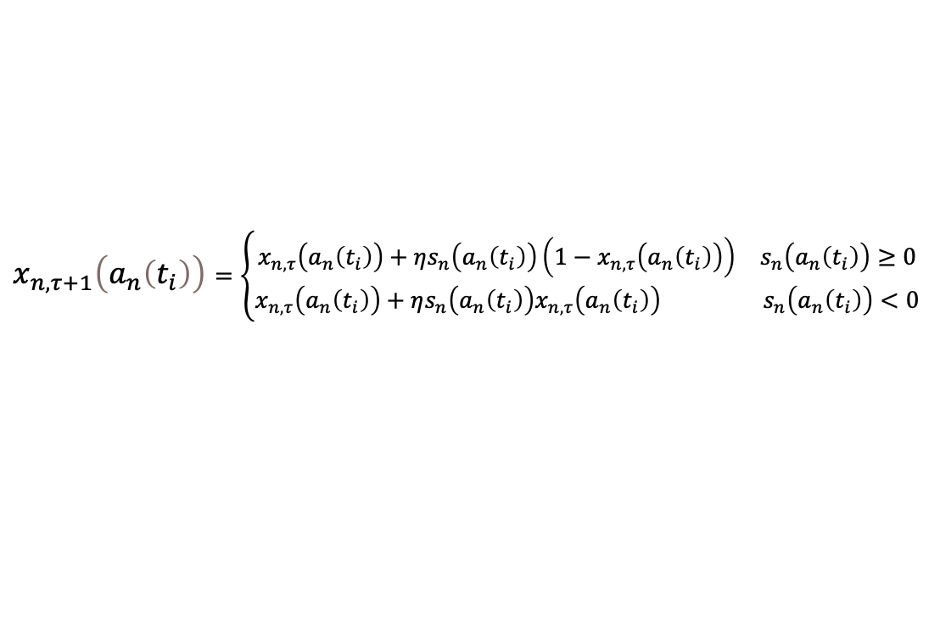
Algorithm Design
Incentive-based Probability Update and Strategy Selection (IPUS²)
Initialization
Probability Update Function
$x_{n,τ+1}\left(a_{n}\left(t_{i}\right)\right)$ $=\left\{\begin{aligned}\begin{matrix}x_{n,τ}\left(a_{n}\left(t_{i}\right)\right)+ηs_{n}\left(a_{n}\left(t_{i}\right)\right)\left(1−x_{n,τ}\left(a_{n}\left(t_{i}\right)\right)\right) & s_{n}\left(a_{n}\left(t_{i}\right)\right)≥0\end{matrix} \\ \begin{matrix}x_{n,τ}\left(a_{n}\left(t_{i}\right)\right)+ηs_{n}\left(a_{n}\left(t_{i}\right)\right)x_{n,τ}\left(a_{n}\left(t_{i}\right)\right) & s_{n}\left(a_{n}\left(t_{i}\right)\right)<0\end{matrix}\end{aligned}\right.$
Iteration | 0 | 1 | 2 | 3 | 4
Strategy | / | $𝒶_{1}𝒷_{1}$ | $𝒶_{2}𝒷_{1}$ | $𝒶_{1}𝒷_{1}$ | $𝒶_{2}𝒷_{2}$
$s\left(𝒶_{1}\right)$ | 0 | 0 | 0 | -0.5 | 0
$s\left(𝒶_{2}\right)$ | 0 | 0 | 1 | 0 | 2
$s\left(𝒷_{1}\right)$ | 0 | 0 | 1 | -0.5 | 0
$s\left(𝒷_{2}\right)$ | 0 | 0 | 0 | 0 | 2
$x_{A}\left(𝒶_{1}\right)$ | 0.5 | 0.5 | 0.5 | 0.375 | 0.375
$x_{A}\left(𝒶_{2}\right)$ | 0.5 | 0.5 | 0.75 | 0.75 | 1
$x_{B}\left(𝒷_{1}\right)$ | 0.5 | 0.5 | 0.75 | 0.6625 | 0.6625
$x_{B}\left(𝒷_{2}\right)$ | 0.5 | 0.5 | 0.5 | 0.5 | 1
Strategy
Selection
Environmental
Interactions
Iteration
Probability
Update

Slide 13

Algorithm Design
Incentive-based Probability Update and Strategy Selection (IPUS²)
Initialization
Probability Update Function
$x_{n,τ+1}\left(a_{n}\left(t_{i}\right)\right)$ $=\left\{\begin{aligned}\begin{matrix}x_{n,τ}\left(a_{n}\left(t_{i}\right)\right)+ηs_{n}\left(a_{n}\left(t_{i}\right)\right)\left(1−x_{n,τ}\left(a_{n}\left(t_{i}\right)\right)\right) & s_{n}\left(a_{n}\left(t_{i}\right)\right)≥0\end{matrix} \\ \begin{matrix}x_{n,τ}\left(a_{n}\left(t_{i}\right)\right)+ηs_{n}\left(a_{n}\left(t_{i}\right)\right)x_{n,τ}\left(a_{n}\left(t_{i}\right)\right) & s_{n}\left(a_{n}\left(t_{i}\right)\right)<0\end{matrix}\end{aligned}\right.$
Iteration | 0 | 1 | 2 | 3 | 4
Strategy | / | $𝒶_{1}𝒷_{1}$ | $𝒶_{2}𝒷_{1}$ | $𝒶_{1}𝒷_{1}$ | $𝒶_{2}𝒷_{2}$
$s\left(𝒶_{1}\right)$ | 0 | 0 | 0 | -0.5 | 0
$s\left(𝒶_{2}\right)$ | 0 | 0 | 1 | 0 | 2
$s\left(𝒷_{1}\right)$ | 0 | 0 | 1 | -0.5 | 0
$s\left(𝒷_{2}\right)$ | 0 | 0 | 0 | 0 | 2
$x_{A}\left(𝒶_{1}\right)$ | 0.5 | 0.5 | 0.5 | 0.375 | 0.375
$x_{A}\left(𝒶_{2}\right)$ | 0.5 | 0.5 | 0.75 | 0.75 | 1
$x_{B}\left(𝒷_{1}\right)$ | 0.5 | 0.5 | 0.75 | 0.6625 | 0.6625
$x_{B}\left(𝒷_{2}\right)$ | 0.5 | 0.5 | 0.5 | 0.5 | 1
Strategy
Selection
Environmental
Interactions
Iteration
Probability
Update
Strategy
$𝒶_{2}𝒷_{2}$

Slide 14
01
Introduction
02
Problem Formulation
CONTENTS
03
Potential Game Model
04
Algorithm Design
05
Performance Evaluation

Slide 15
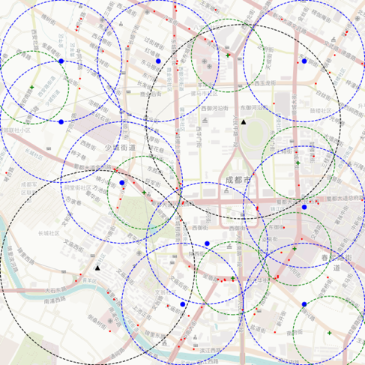







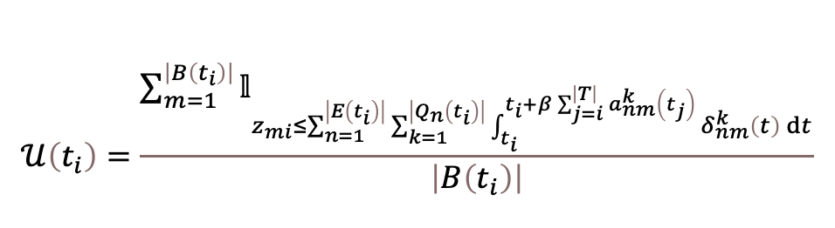

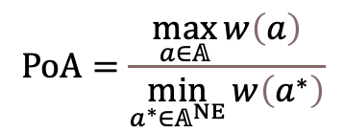






Performance Evaluation
Experiment Settings
Experiment Dataset
Taxi Trajectories in 3x3 km Area of Chengdu City
2 Base Stations, 9 RSUs, 5 Vehicular Edge Nodes
Price of Anarchy, PoA
$$PoA=\frac{\max_{a∈𝔸}{w\left(a\right)}}{\min_{a^{∗}∈𝔸^{NE}}{w\left(a^{∗}\right)}}$$
$$•$$
$$•$$
$$+$$
$$•$$
$$•$$
Task Completion Ratio
▲
$$+$$
$$𝒰\left(t_{i}\right)=\frac{\sum_{m=1}^{\left|B\left(t_{i}\right)\right|}{𝕝_{z_{mi}≤\sum_{n=1}^{\left|E\left(t_{i}\right)\right|}{\sum_{k=1}^{\left|Q_{n}\left(t_{i}\right)\right|}{\int_{t_{i}}^{t_{i}+β\sum_{j=i}^{\left|T\right|}{a_{nm}^{k}\left(t_{j}\right)}}{δ_{nm}^{k}\left(t\right)}ⅆt}}}}}{\left|B\left(t_{i}\right)\right|}$$
$$•$$
$$+$$
$$•$$
$$•$$
$$+$$
▲
$$+$$
$$•$$
$$•$$
Channel Utilization Efficiency
$$+$$
$$ℰ\left(t_{i}\right)={\sum_{m=1}^{\left|B\left(t_{i}\right)\right|}{\frac{\sum_{n=1}^{\left|E\left(t_{i}\right)\right|}{\sum_{k=1}^{\left|Q_{n}\left(t_{i}\right)\right|}{\int_{t_{i}}^{t_{i}+β\sum_{j=i}^{\left|T\right|}{a_{nm}^{k}\left(t_{j}\right)}}{δ_{nm}^{k}\left(t\right)}ⅆt}}}{\sum_{k=1}^{\left|Q_{n}\left(t_{i}\right)\right|}{\sum_{j=i}^{\left|T\right|}{a_{nm}^{k}\left(t_{j}\right)}}}}}/{\left|B\left(t_{i}\right)\right|}$$
▲ Base Station$•$ RSU $+$ Vehicular Edge Node

Slide 16
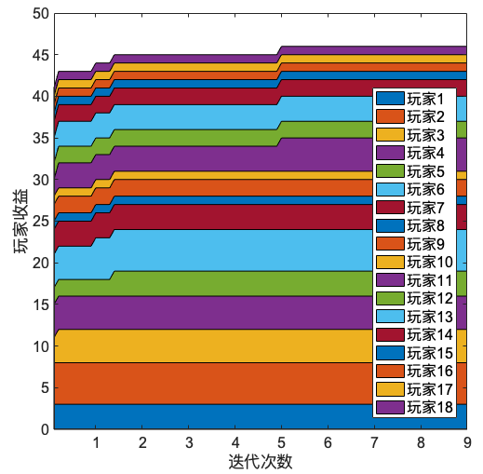
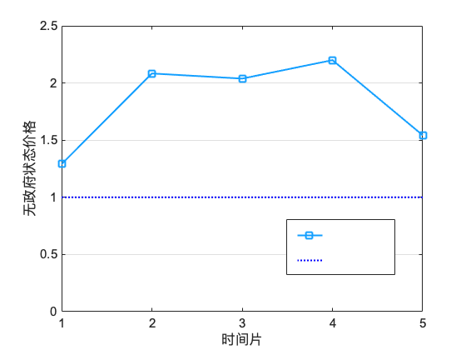

Performance Evaluation
Simulation Results
IPUS²
Optimal
Bound
$$×{10}^{4}$$
The Convergence of The IPUS²
The Effectiveness of The Nash Equilibrium

Slide 17
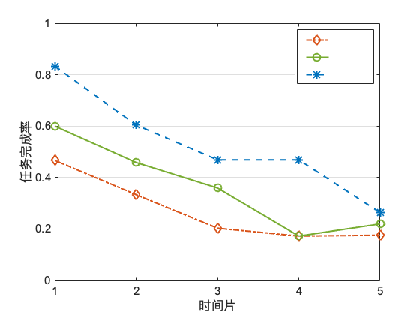
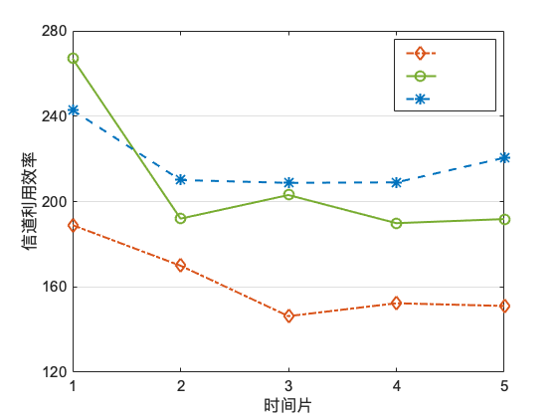

Performance Evaluation
Simulation Results
The Comparative Algorithms
Random Allocation, RA
Water Filling, WF
RA
WF
IPUS²
RA
WF
IPUS²
$$×{10}^{4}$$
Task Completion Ratio
Channel Utilization Efficiency

Slide 18
Conclusion
We formulated the problem of channel allocation in vehicular edge computing, and transformed the global optimization problem into a distributed channel allocation potential game
We proposed an Incentive-based Probability Update and Strategy Selection (IPUS²) algorithm, and verified the convergence of the IPUS² and the effectiveness of the Nash Equilibrium
We give an experiment with real vehicle trajectories, and the results showed IPUS² outperforms existing representative algorithms

Slide 19
Thank You

