Slide 1
Yet Another Way to Collect Android Malicious Behaviour
INFOSEK@Nova Gorica
December 2, 2016
Speaker: Chengyu Zheng
Authors: C. Zheng, M. D. Preda, J. Granjal,
S. Zanero, and F. Maggi

Slide 2


About Me
Name: Chengyu Zheng
Position: 2nd year phd student
Research area: Security in Mobile Environment
Location: NECSTLab at Politecnico di Milano

Slide 3
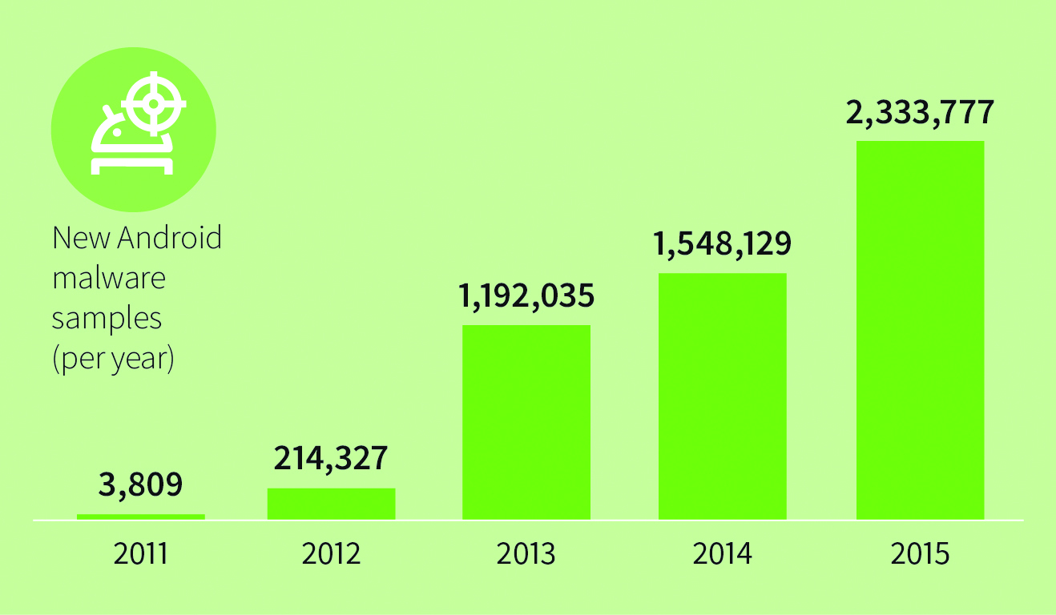
Android Malware Trend (G data)
Notes:
We are going to talk about malware in android environment

Slide 4
Automated App Analysis
Static analysis
parse the application binary code
- obfuscation, encryption, packing
Dynamic analysis
observe the runtime behavior of an app
+ obfuscation, encryption, packing
Notes:
Analogy recepy

Slide 5
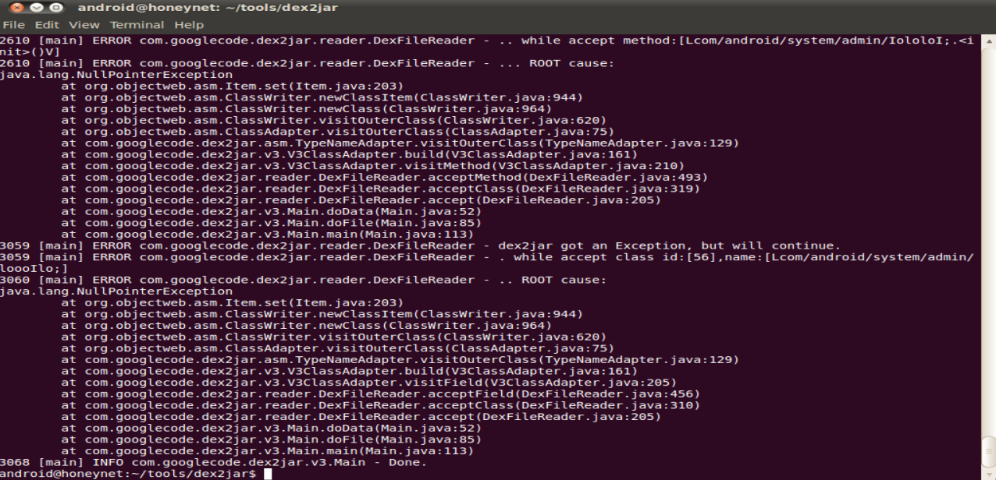
Static Analysis Example
Decompiler: DEX2JAR
Countermeasure: Anti-decompiler techniques

Slide 6
Dynamic Analysis Example (1)
Method: gdb
Countermeasure: Anti-Debug Technique

Slide 7
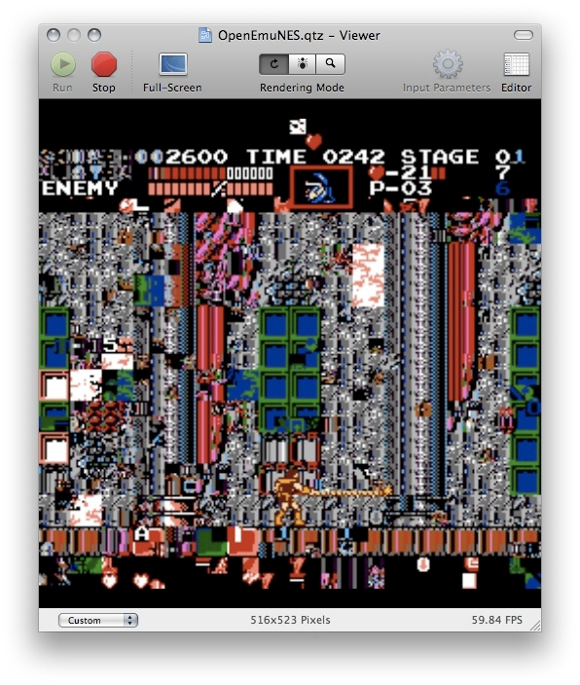
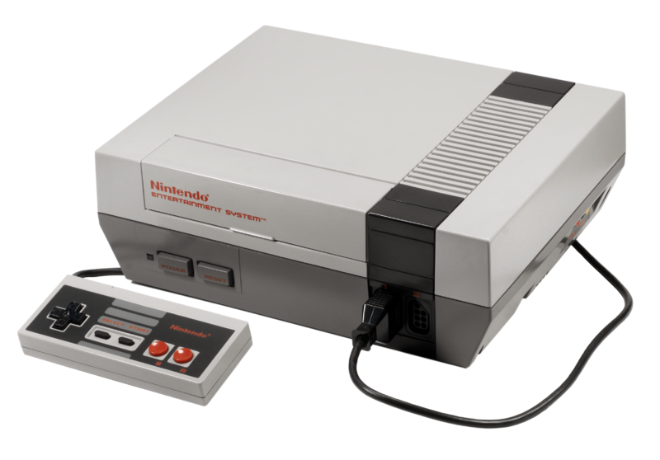

Emulator Glitches

Slide 8
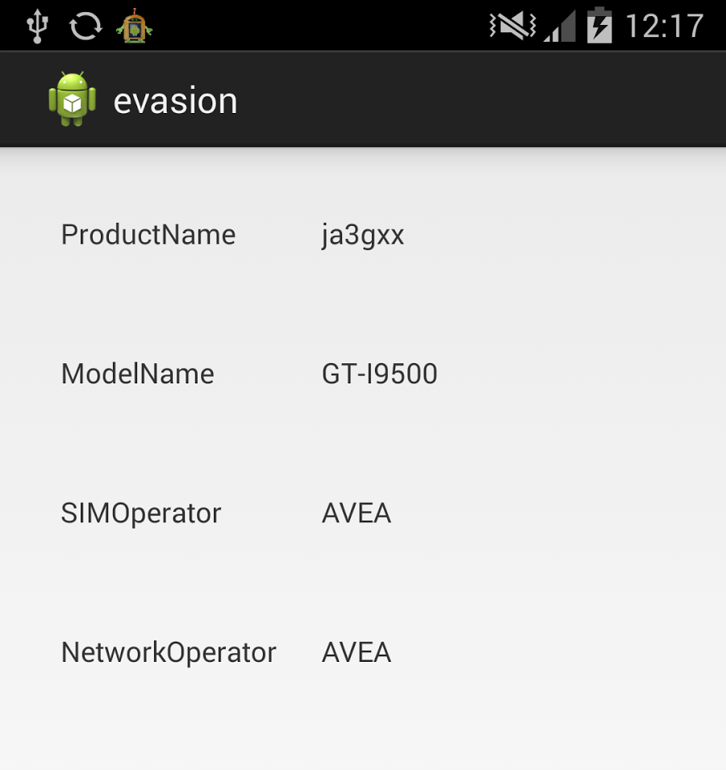
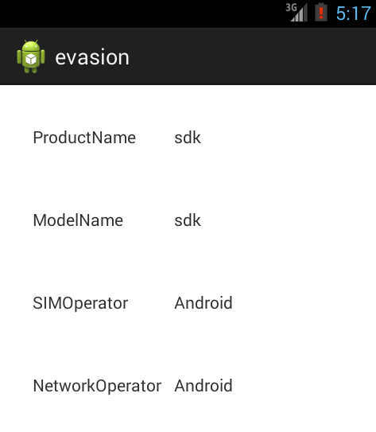
Android Emulator Gliches
Real Device
Emulator

Slide 9
Dynamic Analysis example (2)
Analyzer: Google Bouncer / Emulator
Countermeasure: Fingerprinting

Slide 10
Dynamic Analysis example (3)
Analyzer: OpenST / Hardware-Based
Countermeasure: Timing Attack

Slide 11
Goal
Low artifacts
Highly Transparent
Capture program interaction:
operating system procedures
network-level events
content of memory

Slide 12



How system calls work
Kernel Space
Resource Manager
Syscall
User Space
Application
Notes:
Analogy

Slide 13

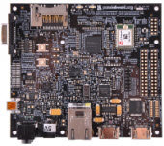
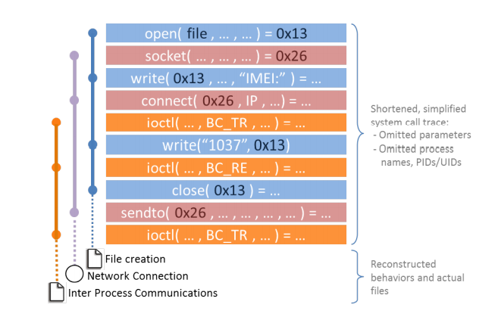
OpenST
External Tracing
Instrumentation the target system calls with the breakpoint
High overhead
High transparent
In-Kernel Tracing
Dynamically instrument the kernel at runtime
Low overhead
Low transparency

Slide 14
External Tracing
Use JTAG Interface
intercept system calls
PID of the caller process
reconstructing its arguments
Open(AAA,BBB)

Slide 15
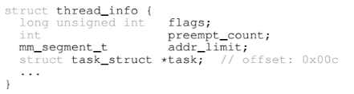
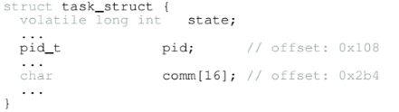
Challenge 1: Find PID
Reconstruct kernel data structure

Slide 16
Challenge 2: Reconstruct System Calls
Every architecture have their convention about the location to store the system call arguments.
In Android:
Simple argument type are stored in registers
Complex arguments type are stored in memory

Slide 17
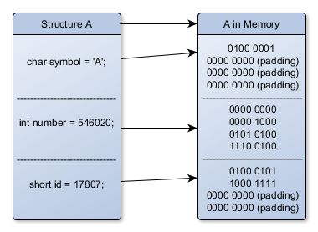
Reconstruct System Calls (2)

Slide 18
Reconstruct System Calls (3)
Parse the kernel image
Collect data about size and offset
Generate the introspection code

Slide 19
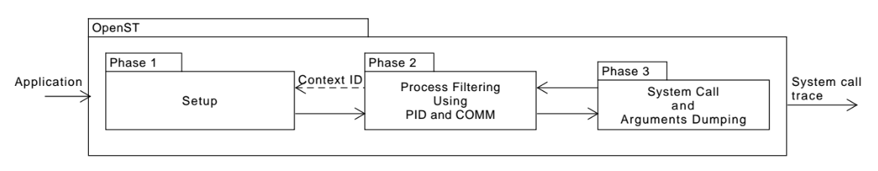
The Architecture

Slide 20
In-Kernel Tracing
Use JTAG Interface
Hot patch the kernel
Trace the system calls and arguments inside the kernel

Slide 21
Patching The Kernel
Allocate memory with execution privileges
Write the introspection code
Hijack the execution flow (Hooking)

Slide 22
Hooking
Kernel Space
Resource Manager
OpenST
Syscall
User Space
Application
Notes:
Analogy

Slide 23
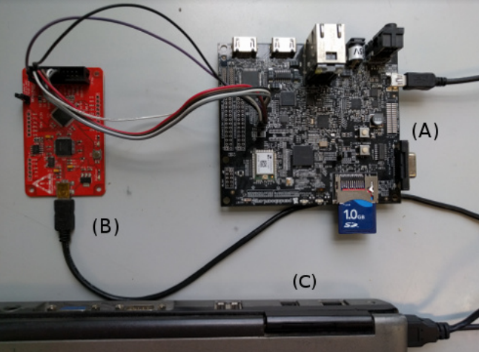
Physical Implementation
Develop Board
JTAG Adapter
PC

Slide 24
Experiment
Evasion
Android.HeHe (6 variants)
Android.Pincer.A
Performance
Micro Benchmark
Macro Benchmark

Slide 25
Evasiveness Comparison
Sample | Emulator (file ops) | OpenST In-Kernel (file ops) | OpenST External (file ops)
Android.HeHe.1 | 3 | 475 | 468
Android.Pincer.A | 3 | 334 | 334

Slide 26
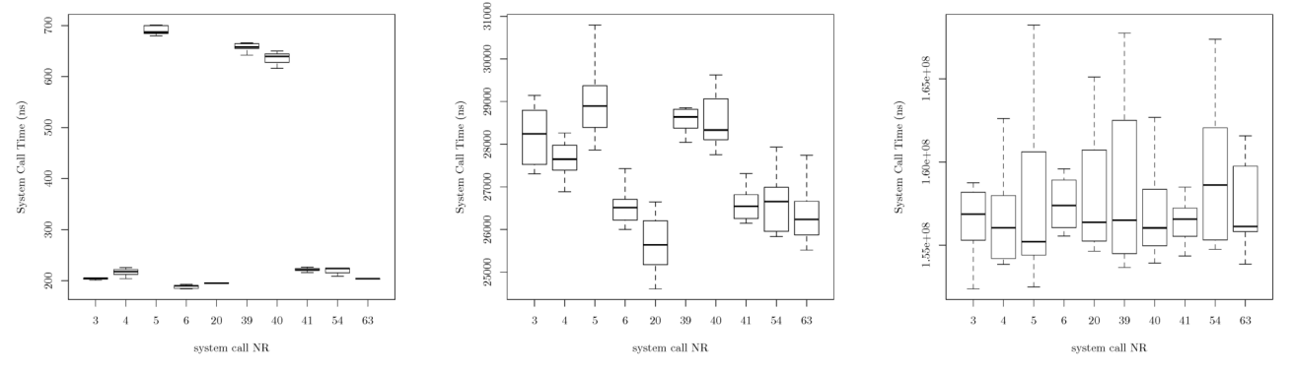
Micro Benckmark
Vanilla
Internal Tracing
External Tracing
0.2-0.7us
x100
25-31us
x10,000
155-165ms

Slide 27
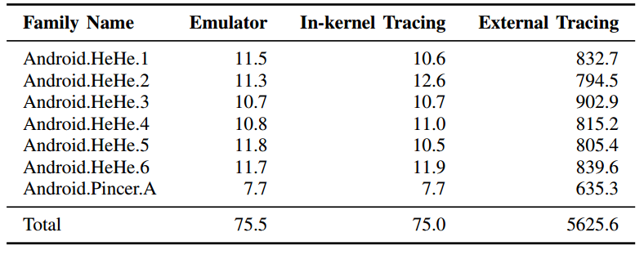
Macro Benckmark

Slide 28
Future Work
Use USB emulated digitizer in order to have better code coverage
Use USB emulated storage to efficiently snapshot

Slide 29

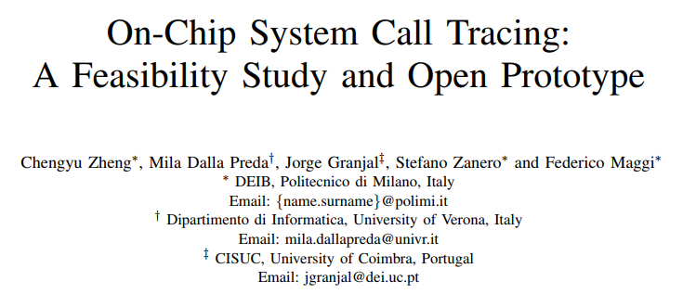
References

Slide 30
Conclusion
Increasing number of malware has forces the security community to use automated analysis tools
Malware in Android started simple without active measure against analyses
Evolved with measure against static analyses
Evolved again to include anti-emulator techniques
Following this trend we propose OpenST as an hardware based a dynamic analysis tool.

