Slide 1

HEADSTART 2.0: MACHINE LEARNING
SPOTIFY SONG RECOMMENDER USING MACHINE LEARNING
ML#15

Slide 2
MEMBERS
Mohammed Eatesam Khan (1604-19-737-108/IT B)
Panakanti Sai Karthik (1604-19-737-089/IT B)
Mohammed Rashid Hussain (1604-19-737-087/IT B)
Abdul Rahman Zuhaib (1604-19-737-081/IT B)
Mohammed Haneef (1604-19-737-112/IT B)
Special thanks to Chella Srinivas (Mentor)

Slide 3
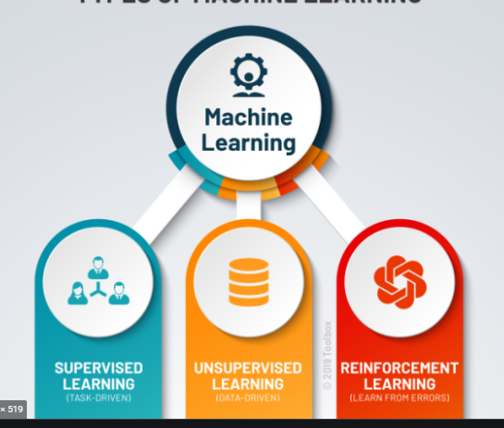
WHAT IS MACHINE LEARNING?
Machine learning (ML) is a type of artificial intelligence (AI) that allows software applications to become more accurate at predicting outcomes without being explicitly programmed to do so.
Since unsupervised learning allows the system to identify patterns within data sets on its own we choose it for our project.

Slide 4
where DID we start
We started with the resources provided by the mentor.
After getting the basic idea of machine learning, we built our knowledge on its algorithms.
We brainstormed ideas on project assigned to us.

Slide 5
STEPS INVOLVED
Extracting song features dataset from spotify API in .csv file. (using tekore library)
Reading .csv file using pandas library.
Cleaning the data by dropping insignicant columns.
Grouping the data using one of the clustering algorithms.
Recommending songs based on the chosen attributes.

Slide 6
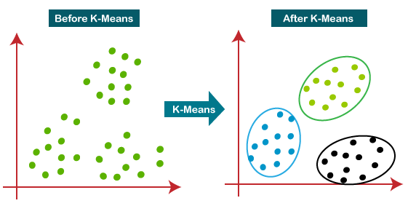
Algorithm used: Scaling followed by k-means clustering
We scale our data to reduce the variation of data from [-∞ , ∞] to [0,1] which is used to make clustering easier and free of error.

Slide 7
why make own data set?
Since we can test our result using songs we know, we use our own dataset.
If the results turn out satisfactory, we can implement this using a universal spotify dataset.

Slide 8
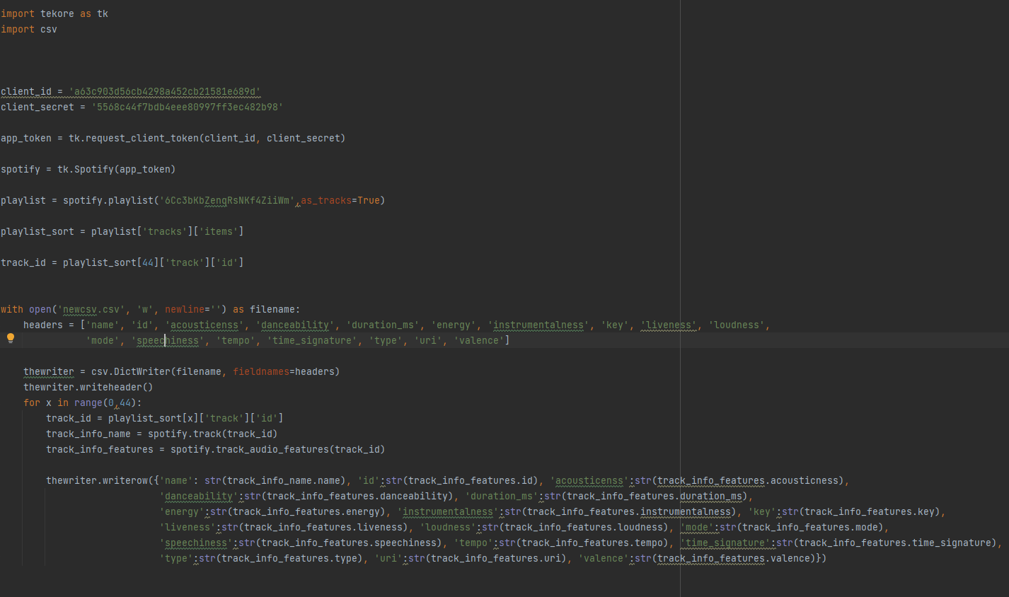
DATA EXTRACTION (CREATING DATASET)

Slide 9
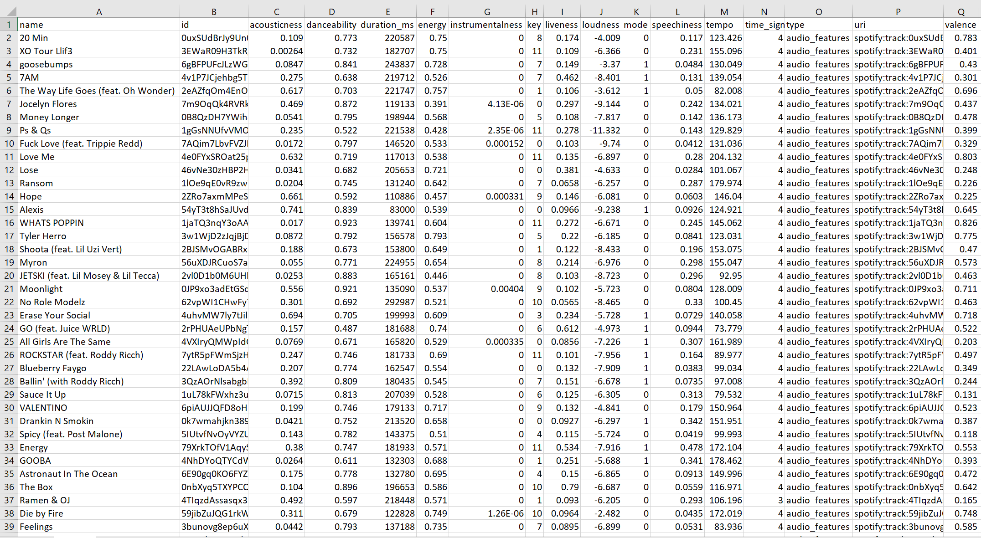
EXTRACTED CSV FILE

Slide 10
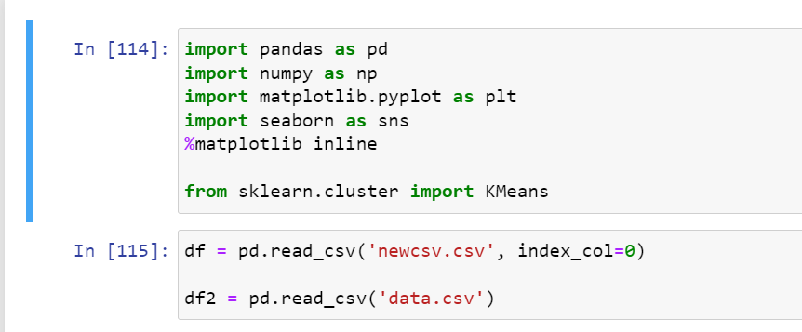
IMPORTING LIBRARIES AND READ .csv FILE

Slide 11
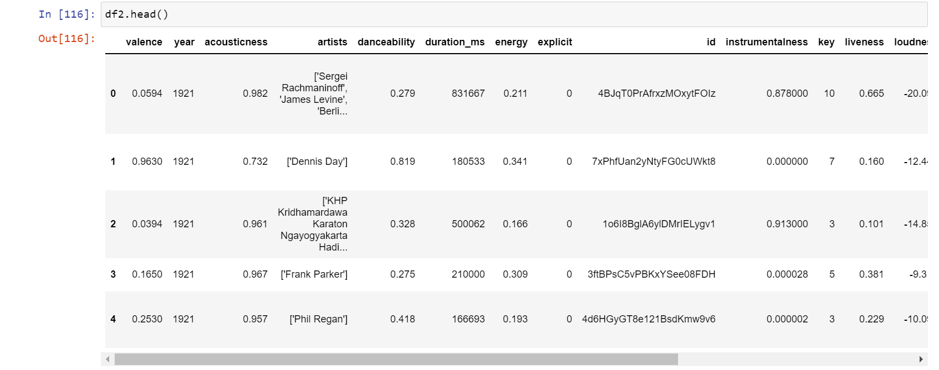

Slide 12
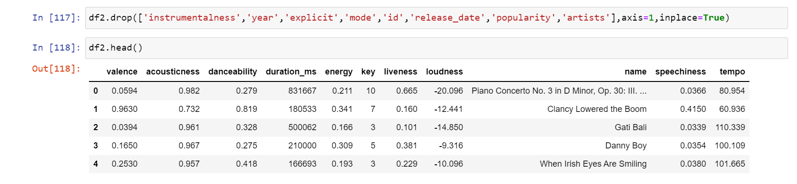
CLEANING THE DATA

Slide 13
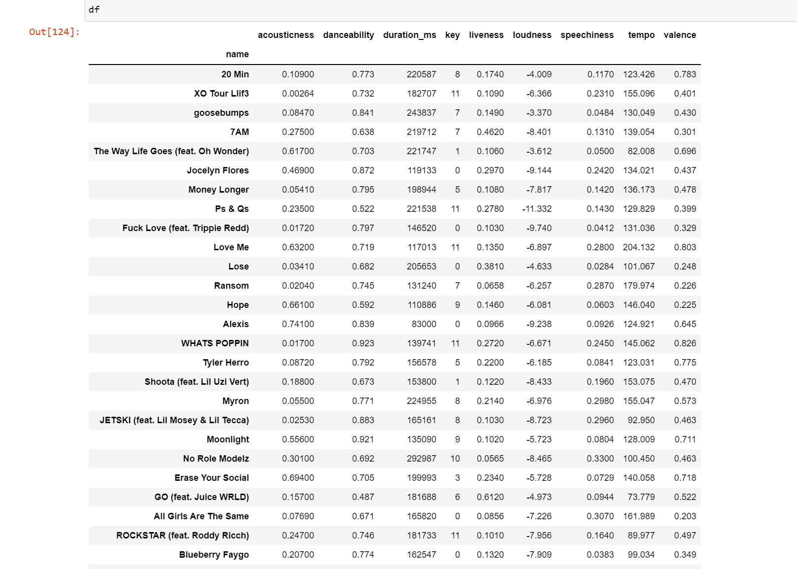

Slide 14
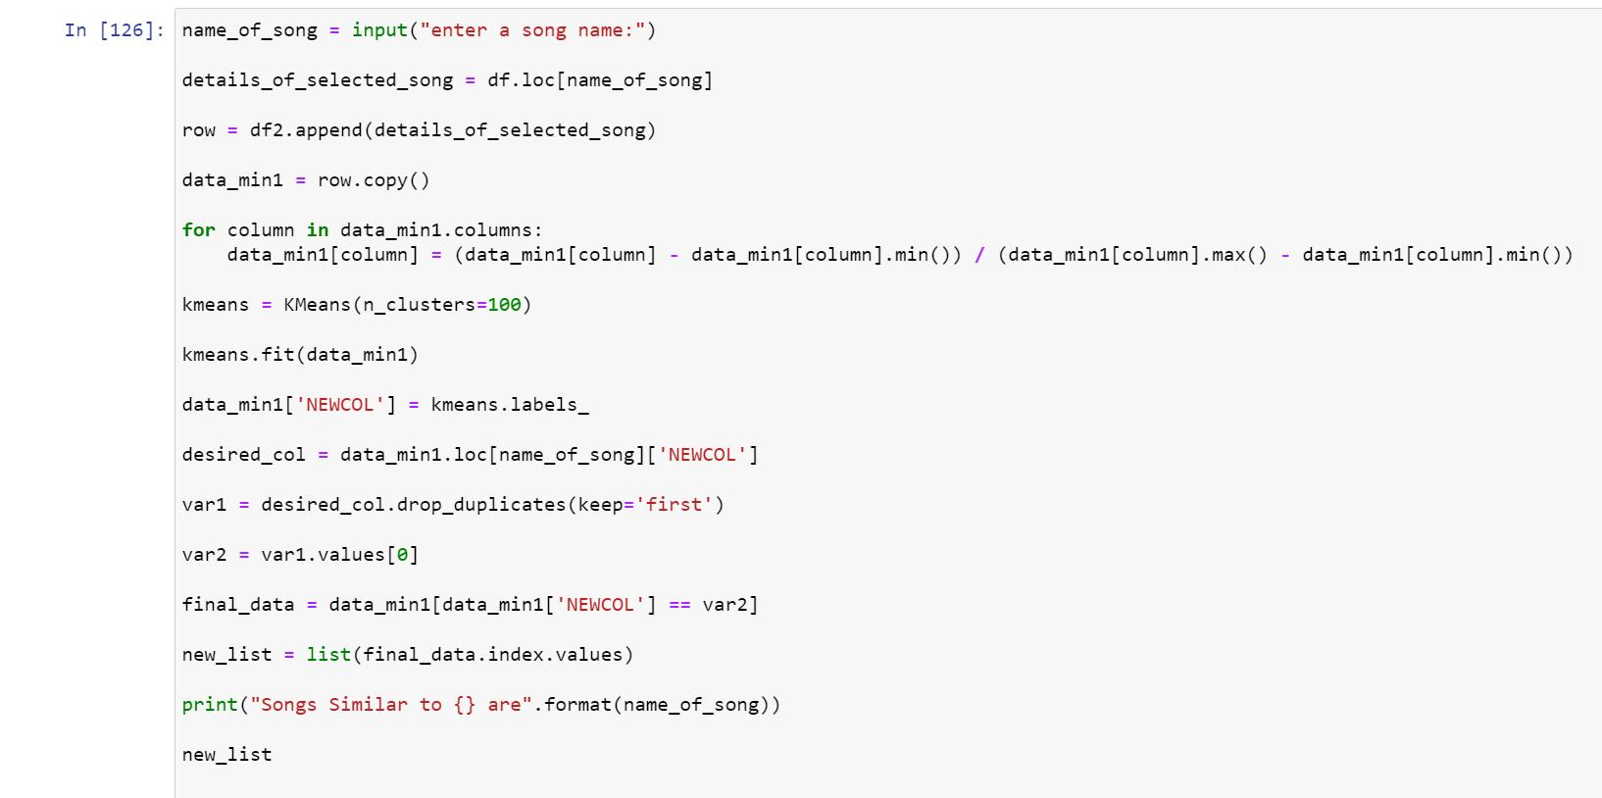
BODY OF CODE

Slide 15
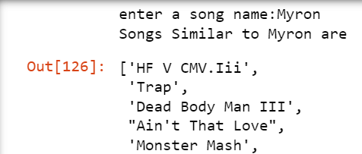
how does it work
It takes the attributes from songs of a playlist and displays the list of similar songs

Slide 16
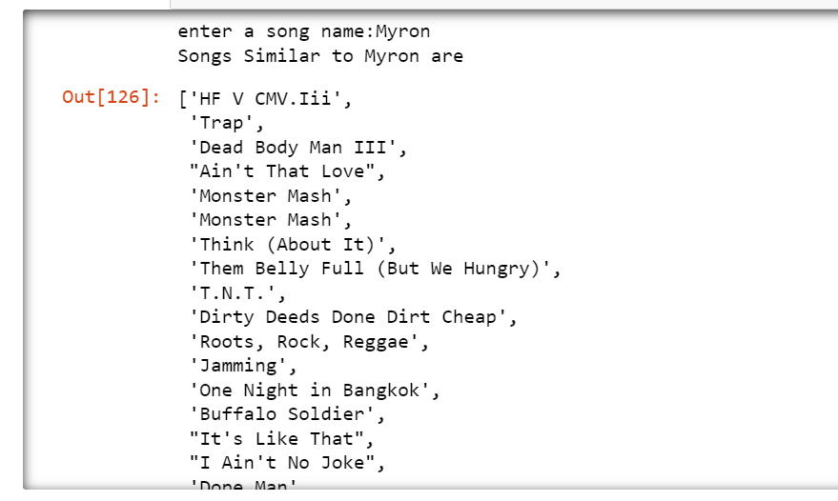
Output

Slide 17

THANK YOU

