Slide 1



Schoewe
Perfect Safety Record
Club
2018
A
V

Slide 2
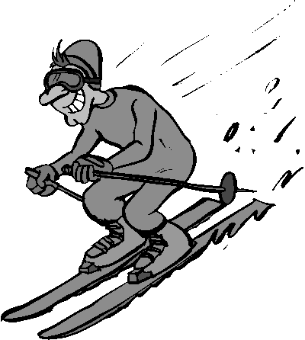


University
et ovium hominum
Bo Peep
Est. 2018 AD

