Slide 1
An Internet Latency Measurement Study
Ben Zhang
In Collaboration with Ahir Reddy
CS294-87 Spring 2013
Notes:
Intro

Slide 2
Problem
We seek to measure and characterize latency as it relates to:
Wide Area Networks
Data Centers*
Cellular Networks
* Not latency inside DC, rather a comparison to WAN

Slide 3
[AS0] 172.20.10.1
~0.7 ms
Mobile Networks
[AS16509] 172.26.236.2
~35 ms
[AS16509] 172.26.241.133
~35 ms
Strategy – Traceroute
from 1 AT&T iPhone (tethering)
to ~1000 top websites
at various time (2013/04/12-2013/04/24)
[AS0] 172.26.96.10/172.26.96.11
172.26.96.3/172.26.96.2
~35 ms
[AS0] 172.26.96.193
~35 ms
What we expect:
Latency on each hop
Routing stability within AT&T cellular backbone
[AS0] 172.16.121.113
~35 ms
[AS7018] 12.249.2.49
~40ms
[AS7018] 12.83.180.82
~50ms
[AS7018]
12.122.200.9/12.122.114.5
12.122.1.118/12.122.8.79…
50ms -
100 ms
[AS7018]
12.122.114.21/12.123.30.5
[AS0]
192.205.33.46/…
50 ms -
100 ms
Possibly Internet…. 50 ms – 200 ms
Notes:
RFC 1918
172.16.0.0 - 172.31.255.255 (172.16/12 prefix)
Quick note on the first hop (iPhone)
Second hop: Packet Data Gateway

Slide 4
Mobile Networks (latency)
Notes:
Arguments to make: 1) fairly stable within cellular.
2) Still latency not too small

Slide 5
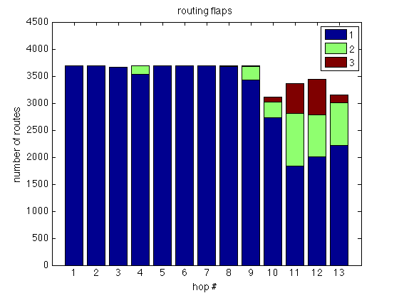
Mobile Networks (route flaps)
Notes:
For each traceroute, the number of responds

Slide 6
Mobile Networks (“mobile”)
Notes:
Fall back to 4G network in this case

Slide 7
iPhone compares with EECS
Notes:
Slide #2: Motivate your project by describing why its solution is important. Who would care if you are successful and why?

Slide 8
iPhone compares with EECS
Notes:
Slide #2: Motivate your project by describing why its solution is important. Who would care if you are successful and why?

Slide 9
Mobile Networks (exit point)
% traceroute -a reference.com
traceroute to reference.com (66.235.120.211), 64 hops max, 52 byte packets
1 [AS0] 172.20.10.1 (172.20.10.1) 0.927 ms 0.642 ms 0.477 ms
2 [AS16509] 172.26.242.133 (172.26.242.133) 36.689 ms 30.317 ms 35.074 ms
3 [AS16509] 172.26.236.2 (172.26.236.2) 25.838 ms 29.971 ms 31.606 ms
4 [AS0] 172.26.96.2 (172.26.96.2) 28.391 ms 27.886 ms 29.280 ms
5 [AS0] 172.26.96.193 (172.26.96.193) 30.280 ms 49.540 ms 28.846 ms
6 [AS0] 172.16.120.50 (172.16.120.50) 35.119 ms 31.004 ms 32.317 ms
7 [AS7018] 12.249.2.53 (12.249.2.53) 26.373 ms 34.862 ms 32.519 ms
8 [AS7018] 12.83.180.94 (12.83.180.94) 103.892 ms 107.387 ms 113.005 ms
9 [AS7018] cr1.sffca.ip.att.net (12.122.3.69) 106.870 ms 95.033 ms 104.060 ms
10 [AS7018] cr1.cgcil.ip.att.net (12.122.4.122) 109.386 ms 106.220 ms 108.469 ms
11 [AS7018] cr2.wswdc.ip.att.net (12.122.18.22) 100.918 ms 102.278 ms 103.591 ms
12 [AS7018] 12.123.10.137 (12.123.10.137) 97.787 ms 104.401 ms 102.540 ms
13 * * *
14 [AS10913] border10.pc1-bbnet1.wdc002.pnap.net (216.52.127.9) 197.034 ms
[AS10913] border10.pc2-bbnet2.wdc002.pnap.net (216.52.127.73) 106.194 ms 105.049 ms
15 * * *

Slide 10
Questions & Feedback?
Thank you!

