Slide 1
NGS reads aligned to genome
Filtering of poor quality reads
Discarded reads
Good reads
Categorize and split/mask reads: Repetitive(red) vs Unique(blue)
Debugging option (produce bam files)
User defined filters and re-assessment of softclips.
Indels
Read Length
Map Quality
Phred score
Softclips
Read 1
1
...
N
Read 2
1
...
N
Table containing positional missmatches

Slide 2
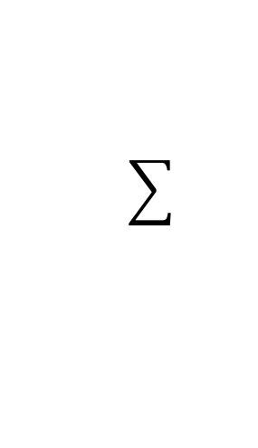
Junction tag
AS:i:76 XS:i:76 RG:Z:TCCATTGC tm:Z:0.76;10001.10469 tc:i:0
read
Genome
Bed fragment
complement tag
AS:i:76 XS:i:76 RG:Z:TCCATTGC tm:Z:43.76;366592.366674 tc:i:75
read
Genome
Bed fragment
read

Slide 3
More fragmentation damage can be observed as curve falling at the extreme on the right due to more adapter trimming. At softclips, using the default, we have no observation of bases in these positions. This contributes to right and left.
BTW: There is a “T” peak @position 9 and a “G” @position 2…

Slide 5
Alignment data (BAM/SAM)
Bed file
Align reads
Categorize reads repetitive vs uniq (delete bed. file) -> image schematic to show what’s repetitive
Include debugging option to write intermediate bam files
Split reads on group selection
(e.g. by repeat class). Tag reads according to the type of intersection with the bed region of interest
Show picture of what’s being masked in each file
…
Discard reads on:
Forced:
CIGAR or MAPQ data unavailable
Chromosome not in reference
Not paired/not mapped in proper pair
Optionals:
Indels
read length
Map-quality value
Softclips *
Filter bases on Phred score
Discard bases on:
Forced:
Masked base (allow soft-unmasking)
Optional:
Phred score below limit
THIS GOES OUT!
Call this figure filtering
GOOD READS OR BAD READS
INSTEAD OF THIS FORCED
* Sofclips are re-analized with a user-defined confidence level.
Count all 16 combinations of reference_to_observed bases grouped by read number and read position into a table.
Tabulation of missmatches

Slide 6
Re-assessment of soft-clips
Identity = reference ~ soft-clipped region of the read
Identity > user defined value
Exclude bases
Include bases
# capture the intersection into a flag called
# 1 read -------------------
# bed a ========= b
# 2 read -----------
# 3 read --------
# 4 read ------
'''
Label type of intersection
DON’T NEED THIS

