Slide 1
🌐
Global Tourism
Intelligence Dashboard
A Data Analytics End-to-End Project | Flights · Hotels · Restaurants · Attractions
73K
16K
5,738
2K
Flight Records
Hotel Listings
Attractions
Restaurants
Coverage: Top 30 Countries · 90 Destination Cities · Europe · Asia · Middle East · Americas · Africa
Data Period: 2026 (Q1 – Q4 quarterly batches)
Python
Playwright
Oracle SQL
Power BI
CSV / ETL
Data Analytics Final Project · 2026 · Baku → Top 30 Global Destinations

Slide 2
Global Tourism Intelligence Dashboard
SLIDE 2 / 6
Data Analytics Final Project | 2026
📌 PROBLEM DEFINITION
▸ Flight prices change daily — travelers cannot predict the best booking time
▸ Hotels in the same city have very different prices and quality levels
▸ Some popular restaurants are 'tourist traps' — high reviews, below-average quality
▸ No single platform combines flights, hotels, restaurants & attractions into one analysis
▸ Travelers and tourism boards lack data-driven guidance for smart decisions
🎯 ANALYSIS OBJECTIVE
👥 TARGET AUDIENCE
▸ Rank global cities using a Composite Tourism Score (hotels + restaurants + attractions)
Audience
Why It Matters
▸ Identify best value-for-money destinations — high quality at low cost
🎒 Travelers & Tourists
Find best destinations for their budget
▸ Detect airline pricing patterns: price volatility, monopoly routes, seasonal peaks
🏨 Hotel & Restaurant Managers
Compare ratings vs. competitors
▸ Expose 'tourist trap' restaurants (popular but below city average rating)
✈️ Airlines & Travel Agencies
Identify pricing trends & route gaps
▸ Estimate minimum trip baseline cost (flight + hotel) for 30 top destinations
🏛️ Tourism Boards
Promote cities using real data insights
▸ Deliver all insights through an interactive, multi-page Power BI dashboard
📊 Data Analysts & Students
Learn a real end-to-end analytics project
Python · SQL (Oracle) · Power BI · Web Scraping · Statistical Analysis

Slide 3
Tools, Data Sources & Research Questions
SLIDE 3 / 6
Data Analytics Final Project | 2026
🔧 TOOLS & TECHNOLOGIES
Layer
Tool / Technology
Purpose
Data Collection
Python + Playwright
Web scraping — Google Flights & TripAdvisor
Data Storage
CSV + Oracle SQL
Structured storage & advanced querying
Data Analysis
SQL (CTEs, Window Funcs)
16 custom queries: IQR, HHI, Moving Avg, Z-score
Visualization
Power BI
5-page interactive dashboard with KPI cards
Scraping Libs
asyncio · csv · re · PIL
Automation, parsing & image handling
❓ KEY RESEARCH QUESTIONS
📂 DATA SOURCES
▸ Which cities offer the best overall tourism experience (composite score)?
Dataset
Records
Source
Key Fields
▸ Which destinations give the best value — high quality at a low price?
Hotels
~16,000
TripAdvisor
Name, Rating, Price, Country
▸ When is the cheapest time to fly? What are peak vs. off-peak windows?
Restaurants
~2,000
TripAdvisor
Name, Rating, Reviews, Price Level
▸ Which airlines are most price-stable? Which routes are monopoly-controlled?
Attractions
~5,738
TripAdvisor
Name, Review Score, Count
▸ What is the estimated minimum trip cost (flight + 3-night hotel) per city?
Flights
~73,000
Google Flights
Airline, Route, Date, Price, Stops
▸ Which restaurants are 'tourist traps' — popular but below city average rating?
▸ How large is the gap between advertised hotel prices and final checkout prices?
Coverage: Top 30 countries · Europe, Asia, Middle East, Americas, Africa · 2026 Q1–Q4
Datasets: hotels_final_countries.csv · restaurants_final_countries.csv · flights.csv · attractions.csv

Slide 4
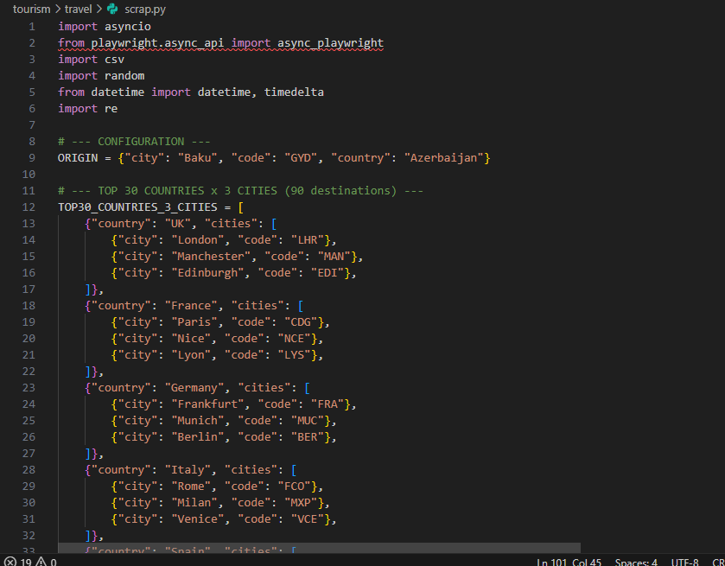
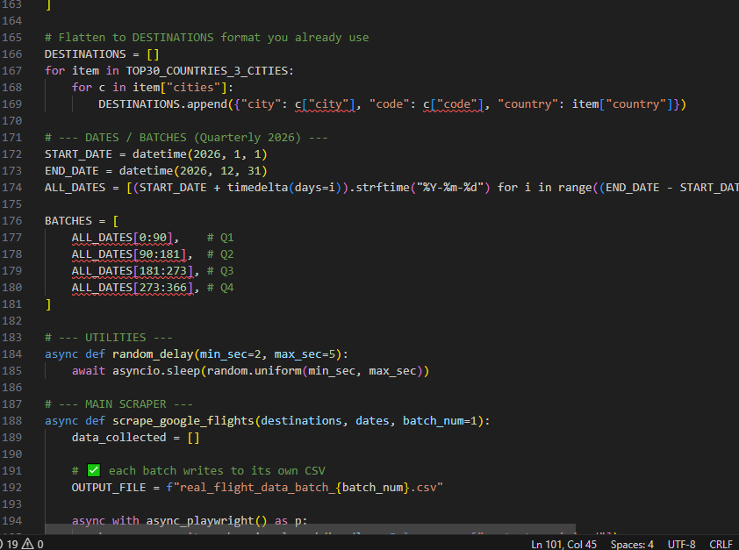
Data Collection — Web Scraping with Python & Playwright
SLIDE 4 / 6
Automated extraction from Google Flights & TripAdvisor | 90 Destinations · 4 Quarterly Batches
🐍 HOW DATA WAS COLLECTED
1
Configure
30 countries × 3 cities = 90 destinations defined
2
Batch
Dates split into Q1–Q4 batches (365 days, 2026)
3
Launch
Playwright opens Chromium, anti-bot headers set
4
Navigate
Google Flights URL built per origin → destination date
5
Extract
Flight cards parsed: airline, price, stops, duration
6
Save
Results appended to per-batch CSV files
90
73K
4
15+
Destinations
Flights Scraped
Quarterly Batches
Fields per Record
Libraries: asyncio · playwright · csv · re · random · datetime
scrap.py — Configuration & Destination Setup
scrap.py — Batch Dates, Scraper Loop & CSV Output
Source: Google Flights · TripAdvisor · Tool: Python (Playwright) · Output: CSV per batch

Slide 5
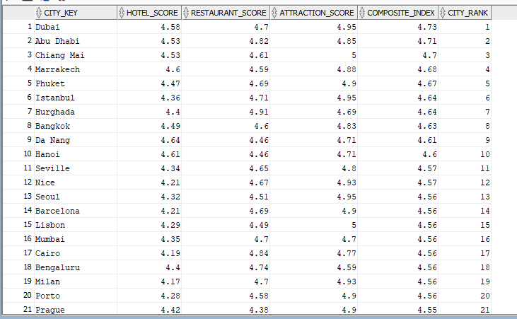
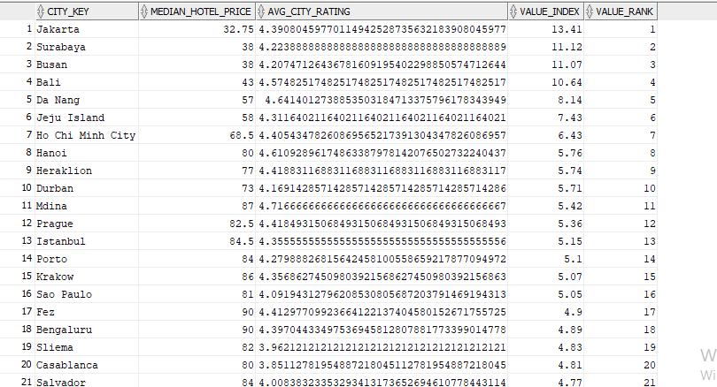
Data Normalization & SQL Analytics
SLIDE 5 / 6
Oracle SQL · 16 Advanced Analytical Queries · Window Functions, CTEs, Statistical Methods
Query #1 — Composite Tourism Performance Index & City Ranking
Query #2 — Best Value Cities: Hotel Quality vs. Median Price (Value Index)
📋 KEY SQL QUERIES — PURPOSE & METHODS
Query
SQL Technique
Business Purpose
#1 Composite Tourism Index
RANK() + weighted avg
Score cities on Hotels+Rest+Attr combined
#2 Best Value City Index
PERCENTILE_CONT + ratio
Quality / median price ratio ranking
#3 HHI Market Concentration
SUM(share²) — HHI formula
How diversified are attraction markets?
#4 Tourist Trap Detector
AVG + JOIN + threshold filter
Popular restaurants below city avg rating
#5 Hotel Price Outliers
IQR method (Q1, Q3, bounds)
Flag hotels priced >1.5x above Q3
#6 Flight Volatility Trends
STDDEV + 7-day Moving Avg
Find airlines/routes with high price swings
SQL Techniques: CTEs · Window Functions · IQR · HHI Index · Z-Score · Moving Average · LAG() / LEAD()
#11 Trip Cost Baseline
PERCENTILE_CONT + JOIN
Min flight + 3-night hotel estimate per city

Slide 6
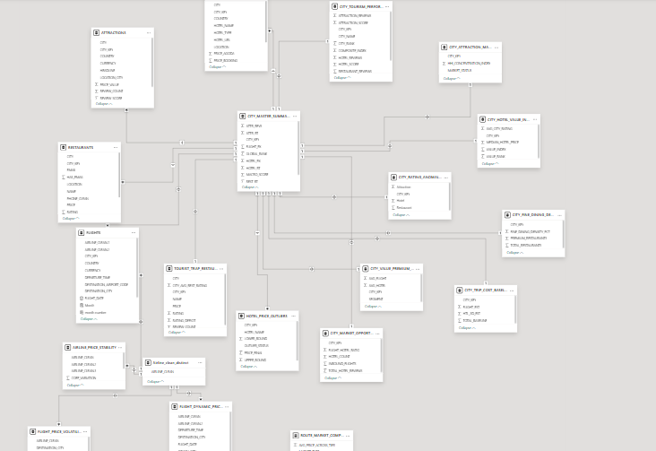
Data Modelling — Power BI Star Schema
SLIDE 6 / 6
Relational data model with 4 core tables and 12 derived analytical tables | Oracle SQL + Power BI
🗄️ CORE TABLES
Table
Size
Key Columns
HOTELS
16K rows
hotel_name, rating, price_*)
RESTAURANTS
2K rows
name, rating, review_count, price
ATTRACTIONS
5.7K rows
headline, review_score, review_count
FLIGHTS
73K rows
airline, route, date, price, stops
📊 DERIVED ANALYTICAL TABLES
▸ CITY_TOURISM_PERFORMANCE_RANK
▸ CITY_HOTEL_VALUE_INDEX
▸ CITY_ATTRACTION_MARKET_CONCENTRATION
▸ TOURIST_TRAP_RESTAURANTS
▸ HOTEL_PRICE_OUTLIERS
▸ FLIGHT_PRICE_VOLATILITY_TRENDS
▸ FLIGHT_DYNAMIC_PRICING_JUMPS
▸ ROUTE_MARKET_COMPETITION_SUMMARY
▸ AIRLINE_PRICE_STABILITY
▸ CITY_FINE_DINING_DENSITY
▸ CITY_TRIP_COST_BASELINE
▸ CITY_MASTER_SUMMARY_DASHBOARD
Data Model: Oracle SQL → Power BI · Star Schema · 4 Core Tables · 12 Derived Analytical Tables · 16 SQL Queries

