Slide 1
Deliverable 2
Langston and Devany

Slide 2
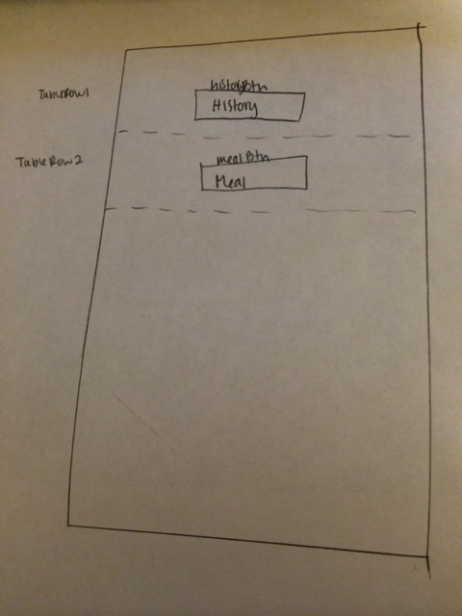
User Interface Design

Slide 3
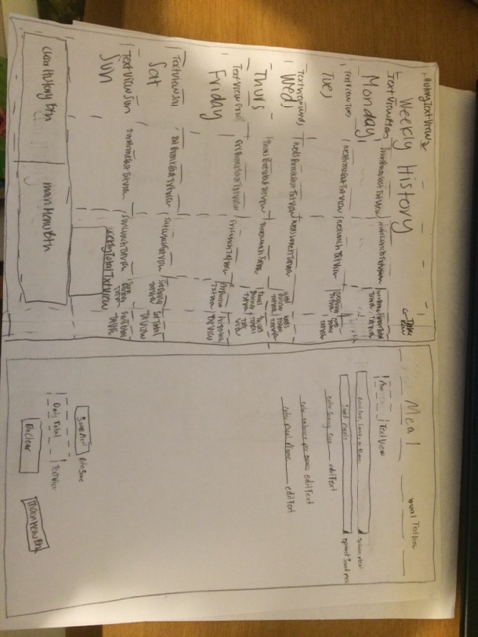
User Interface Design

Slide 4
OnClick Functions:
MenuActivity:
btnHistoryClicked
btnMealClicked
WeeklyHistoryActivity:
clearBtnClicked
mainMenuBtnClicked
DailyMealsActivity:
clearMealclicked
mainMenuClicked
saveBtnClicked

Slide 5
MainActivity.java
Fields:
Private Button btnHistory
Private Button btnMeal
Methods:
Public void btnHistoryClicked
Public void btnMealClicked
Public void onCreate

Slide 6
DailyMealsActivity.java
Fields
Private Text maxCal
private Spinner meal
private Spinner savedMeal
private EditTextsize
private EditText calsPerServing
private EditText mealName
private Button btnSave
private TextView dailyTotal
private Button btnClearMeal
private Button btnMainMenu
private Meal meal
Methods
Public void clearMealClicked
public void mainMenuClicked
public void saveBtnClicked
public void onCreate

Slide 7
WeeklyHistoryActivity.java
Fields
Private TextView history
private TextView weeklyTotal
private Button clearHistoryBtn
private Button mainMenuBtn
private WeeklyHistory week
Methods
pubic void mainMenuBtnClicked
public void onCreate
Public void clearBtnClicked

Slide 8
Meal.java
Fields
private String name
private int servingSize
private int calPerServing
private Date date
Methods
Public String setName()
Public String getName()
Public int setServingSize()
Public int getServingSize()
Public int getCalories()
Public int setCalories()
Pubic Date getDate()
Private int calculateCalories(int size, int calories)

Slide 9
Day.java
Fields
private Meal[] meals = {Meal breakfast, Meal lunch, Meal Dinner, int DailyCalTotal}
Constructor
Public Day(Meal breakfast, Meal lunch, Meal Dinner, int DailyCalTotal )
Methods
Public Meal getBreakfast()
Public Meal getLunch()
Public Meal getDinner()
public int getDailyCalTotal()
Public Meal[] meals

Slide 10
WeeklyHistory.java
Fields
private Day[][] days
private Date date
Methods
public void getDay(Date date)
public Date getDate()
public int getWeeklyTotal

