Slide 1

MediGuard
A Smart Nurse Station
One modular embedded platform for IV fluid monitoring, room temperature regulation and medicine reminders
Embedded Systems · INSA Talent Summer Camp, 5th Batch (2026)
Abigiya Mengistu · Hewan Kifle · Nebiyat Biadglign · Tsion Belete · Yanet Dagne · Yedi Benyam · Zenebwork Wubale
Mentors: Gutember, Salem, Amanuel
Notes:
Introduce the team and the project in one sentence: MediGuard is a modular Smart Nurse Station prototype. Today: the problem, how it works, the market, plan and roadmap.

Slide 2



Nursing checks are manual and scattered
IV fluid
Room temperature
Medication schedule
Checked by visual inspection. A bag running low or a blocked drip is easy to miss between rounds.
Handled by a stand-alone thermostat, separate from every other patient-care tool.
Tracked on separate reminders or by memory, so a dose can be delayed or forgotten.
The gap: three routine tasks, three separate tools, repeated manual checks. Each one adds to a nurse's workload and a chance of something being overlooked.
Notes:
Source: Technical document §1.1–1.2. The problem is not that any single check is hard; it is that nurses juggle several, each on a different device or by hand.

Slide 3

One station, three jobs, one dashboard
IV Fluid Monitoring
Load cell + HX711 weigh the bag; IR sensor checks drip flow
Centralized dashboard
Room Temperature
Sensor, controller, fan and heating compartment hold the set range
Module status and readings in one view
Alerts that stand out from normal operation
Flags lost communication instead of showing stale data
Medicine Reminder
RTC schedule triggers an LCD message and LED alert
Designed to supplement nurses, not replace clinicians or certified medical equipment.
Notes:
Key message: the contribution is the integrated, modular architecture, not any single sensor. Modules can be built and tested independently and new ones added later.

Slide 4




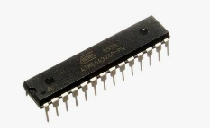
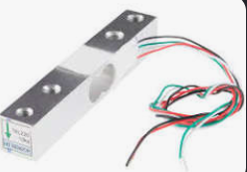
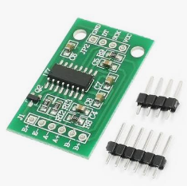
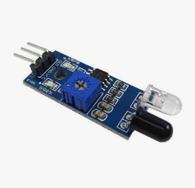
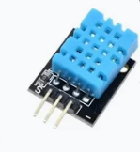
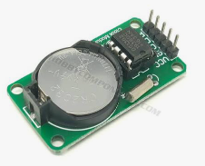
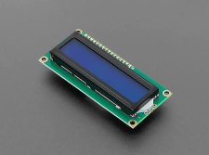
How MediGuard works
1. Sense
2. Process
3. Communicate
4. Alert & display
Load cell, IR, temperature sensor, RTC
ATmega328P firmware in C compares readings to limits
Wi-Fi module sends status to the dashboard
Dashboard, LCD and LED show status and warnings
Hardware building blocks
ATmega328P MCU
Load cell
HX711 amplifier
IR sensor
Temperature sensor
RTC module
LCD (I2C)
Notes:
Walk the four steps left to right. Each module has its own controller and processing, then all modules report through the Wi-Fi module to the dashboard. Components are low-cost and widely available.

Slide 5
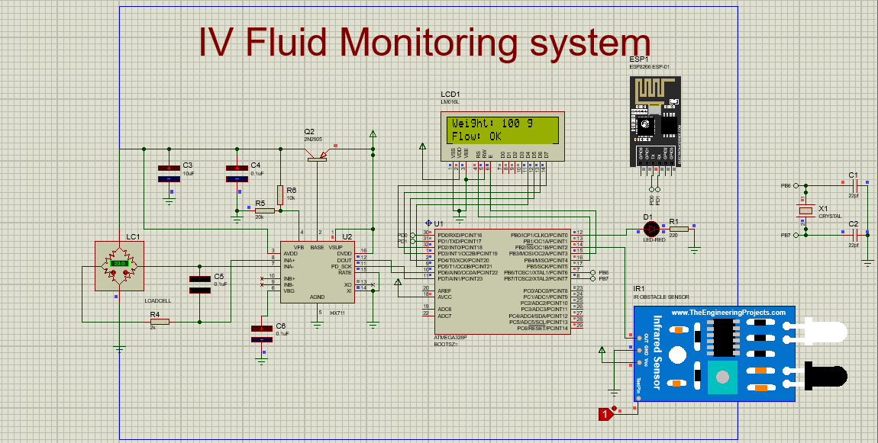
IV monitoring: weight plus flow
1
Weigh
Load cell + HX711 give a digital weight; calibration converts it to fluid weight.
2
Warn
At or below 100 g the firmware sets a low-fluid warning.
3
Watch the drip
IR sensor: HIGH = flow detected, LOW = flow blocked.
4
Report
LED indication locally; status sent to the dashboard.
Proteus simulation of the IV module
Limit: observes level and flow only. It does not measure or control the infusion rate.
Notes:
Why two sensors: weight tells how much is left, the IR sensor tells whether the drip is running. Together they distinguish low fluid from a blocked line. Threshold in the firmware flowchart is 100 g.

Slide 6
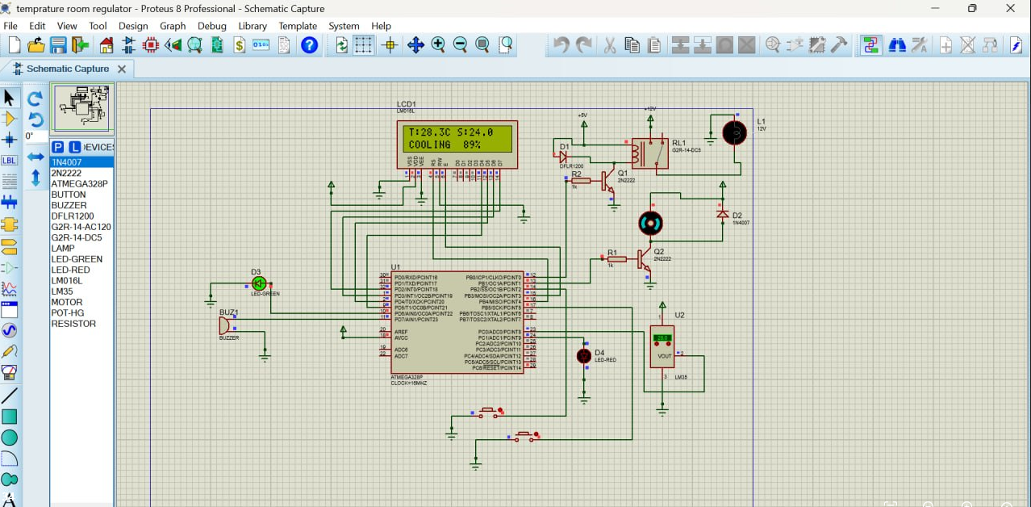
Room temperature regulation
Measure
Temperature sensor reads ambient temperature; invalid readings are flagged as a sensor error.
Compare
Controller checks the reading against configured upper and lower limits.
Act
Fan for cooling or heating compartment, switched through a driver circuit.
Show
Actuator state and temperature on the LCD and dashboard.
Proteus simulation of the temperature module
Notes:
This is closed-loop control: measure, compare, act. Accuracy depends on sensor placement and calibration. Actuator uses a driver circuit because it needs more current than the microcontroller pin can supply.

Slide 7
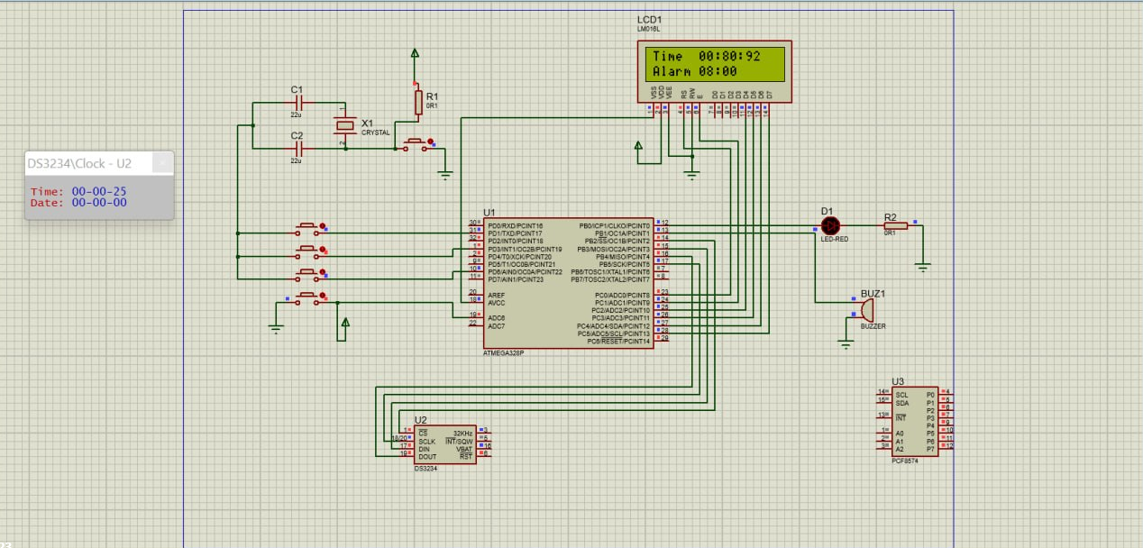
Medicine reminders
Time-based alerts, no clinical decisions
A real-time clock (RTC) keeps accurate time independent of the microcontroller.
Firmware compares the current time with the configured schedule.
When a dose is due: message on the LCD and an LED alert.
Duplicate-trigger handling so one event does not alert repeatedly.
Reminder status is also sent to the dashboard.
Proteus simulation of the reminder module
Limit: schedules reminders only. It does not confirm the medicine was actually taken.
Notes:
Future work: configurable schedules, missed-reminder notifications and an event log. Confirming administration would need a separate verification mechanism.

Slide 8
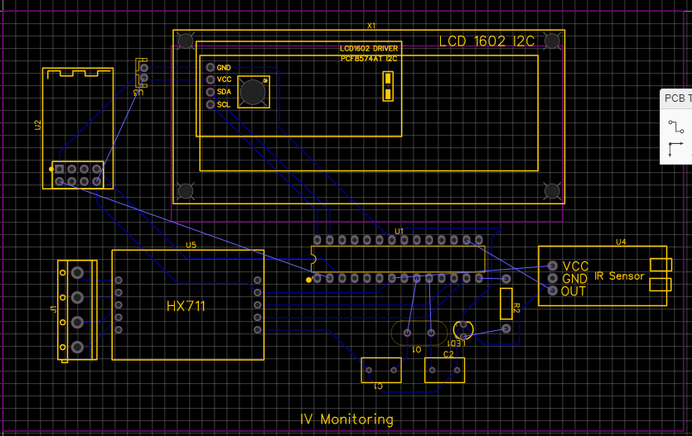
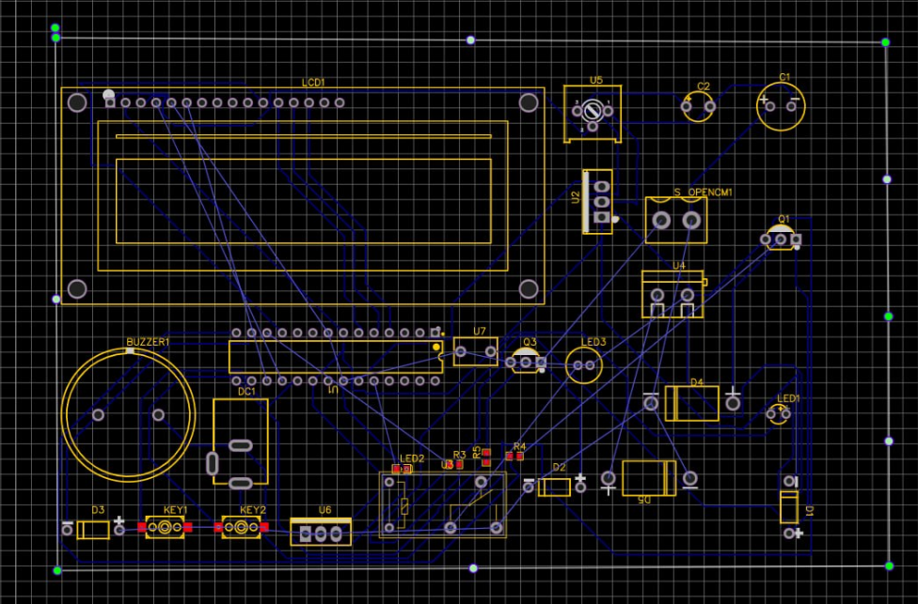
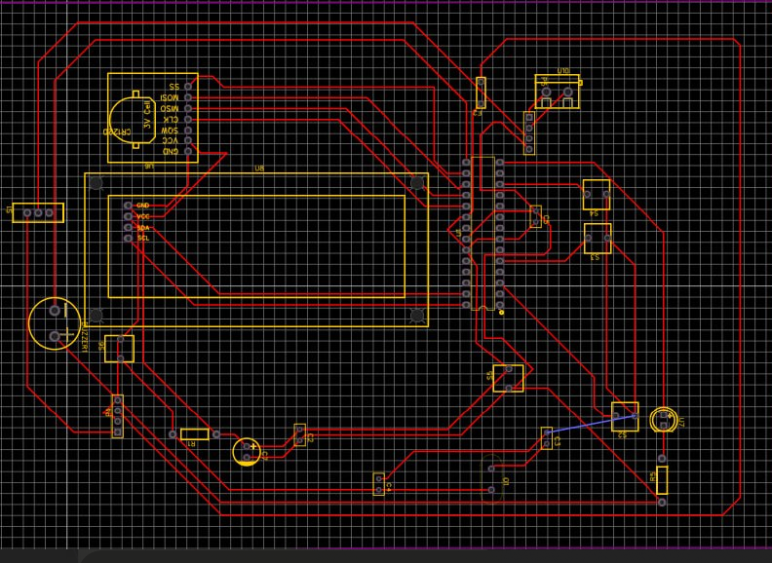
Simulated, then laid out as custom PCBs
IV monitoring PCB
Temperature PCB
Medicine reminder PCB
LCD, HX711 and IR sensor headers
LCD, buzzer, driver and relay stage
RTC, LCD and notification outputs
PCB layouts were designed per module to cover placement, routing, power and sensor connections. Layouts show the design; they do not by themselves prove each function works on hardware.
Notes:
One board per module keeps the system modular: a module can be swapped or debugged on its own. Be explicit that a PCB layout is design evidence, not test evidence.

Slide 9
Where the project stands today
Area | Evidence | Status
Circuit simulation | Proteus schematics, all three modules | Completed
PCB design | Layouts + 3D views, all three modules | Completed (design)
Embedded firmware | C on ATmega328P; flowcharts per module | Developed
Hardware testing | Measured results on physical boards | To be recorded
Dashboard live data | End-to-end Wi-Fi communication test | To be verified
Known limitations
Accuracy depends on calibration and sensor placement
Reminders do not verify intake
IV module does not control infusion rate
Prototype, not a certified medical device
We separate what is simulated, what is designed and what is verified on hardware, and only report verified results as working.
Notes:
Be candid with mentors. Simulation and PCB layout are done; the report's test tables are templates awaiting measured values. UPDATE THIS SLIDE with your actual hardware test and dashboard results before presenting.

Slide 10



Target users and current alternatives
Who it is for
What exists today
Hospitals and health centers
Manual IV inspection
Stand-alone IV monitoring devices
Conventional room thermostats
Separate medication reminder devices
Nursing staff doing routine patient care
Institutions interested in monitoring and automation
Where MediGuard differs: it combines the three functions on one modular platform. That integration is the design objective; it is not yet proof of lower cost or better accuracy.
Developers who extend the platform
Potential future users, not confirmed customers.
Notes:
Source: Project proposal §3.1–3.3. We deliberately avoid claiming MediGuard is cheaper or more accurate than commercial products; that needs verified price data and testing.

Slide 11
The market: nurse-call is priced per bed
Indicative hardware + software cost per bed (US$, 2026 industry estimates)
Established players
Basic nurse call
Ascom
$500–2,000
Nurse call and clinical communication
Rauland
Advanced integrated
Responder nurse call systems for hospitals
$2,000–5,000
TekTone
Wired and wireless nurse call, patient call devices
Jeron
0
$1k
$2k
$3k
$4k
$5k
Nurse call and emergency communication
Installation, cabling, integration and maintenance add to this. Figures are international estimates, not Ethiopian prices or quotes for MediGuard.
Stryker (Vocera)
Alert routing and prioritization software
Notes:
The existing market is real and established, which validates demand for integrated nursing support. These vendors target large facilities with hospital-wide networks. Sources: Ascom, Rauland, TekTone, Jeron, Stryker Vocera; 2026 industry pricing estimates cited in our proposal. These are benchmarks, not a like-for-like price comparison.

Slide 12
Business potential and what it needs
CHF 292.1M
The opportunity
Commercial systems target large facilities and need significant investment.
A modular, lower-cost platform could fit clinics and smaller hospitals, a hypothesis still to be tested.
Modules can be sold or added one at a time as needs grow.
Ascom revenue, 2025
Group profit CHF 15.1M, about 5.2% net margin
Whole-company figures, not nurse-call alone. Shows the market supports a profitable business, at modest margins.
To prove viability we still need
Full bill of materials, assembly, installation and maintenance cost
Local price quotes and competitor price data for Ethiopia
Prototype validation against reference equipment
Customer interviews and medical-device requirements
≈ 10,000 ETB
Estimated prototype cost (one station)
Notes:
Be careful: profitability is NOT established. The Ascom numbers are a company-level example. Our selling price, unit cost and demand in Ethiopia are unknown until we complete cost analysis and market research.

Slide 13
Plan
W1
W2
W3
W4
W5
W6
W7
W8
Preliminary budget (ETB)
Requirements & literature
Microcontrollers & programming | 1,000
Load cell + HX711 | 1,400
Infrared sensor | 600
Temperature sensor | 1,000
RTC module | 1,250
Displays, LEDs, resistors | 1,500
Architecture & components
Hardware design & simulation
IV module
Temperature module
Medicine reminder module
Module integration
6,750 ETB priced so far
Still to price: actuator and driver, power, PCB and wiring, 3D-printed enclosure, contingency. Total estimate about 10,000 ETB.
Testing & troubleshooting
Documentation & presentation
Notes:
Budget will be finalised after exact components and local quotes. Reusable lab boards may reduce cost. 6,750 is the sum of the six priced lines in the proposal.

Slide 14




Roadmap beyond the prototype
NOW
NEXT
THEN
GATE
Prototype
More patient support
Make it robust
Before any clinical use
IV monitoring
Temperature regulation
Medicine reminders
Dashboard
Wireless nurse call
Heart rate and SpO₂ (MAX30102)
ECG (AD8232), blood pressure
Body temperature
Data logging and reports
Battery backup
Secure access, auto-reconnect
Compact PCBs and enclosure
Validate vs reference devices
Electrical and patient safety
Data security
Medical-device requirements
Notes:
The modular architecture is what makes the roadmap cheap to pursue: each new function is a new module plus a dashboard panel. MediGuard stays a prototype until the validation gate is passed.

Slide 15

Takeaways
The problem
Routine checks of IV, temperature and medication are manual and scattered.
The solution
A modular, expandable embedded station: three working designs on one dashboard, simulated and laid out as PCBs.
The market
Established vendors prove demand but target large, costly installations. Our niche is a modular, lower-cost option; viability still needs cost and market validation.
Questions and feedback
Thank you to INSA Talent.
Notes:
Close by inviting mentor feedback on: market positioning, which future module to prioritise, and how to structure hardware validation.

