Slide 1

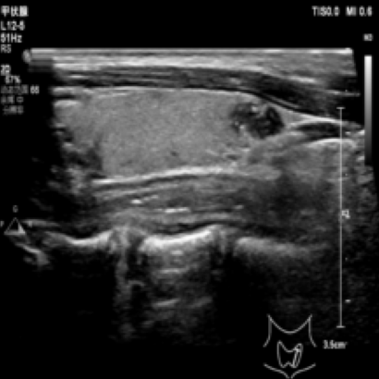
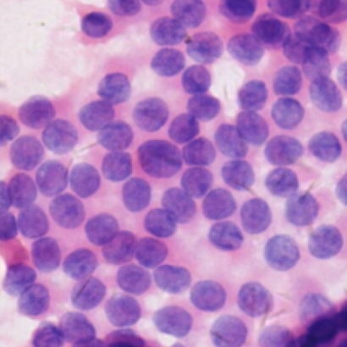
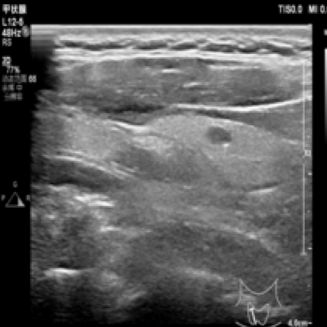
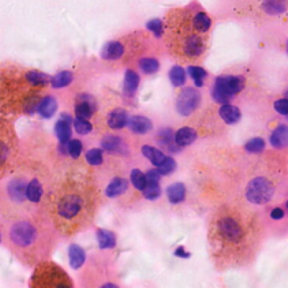
Development and Evaluation of an Interpretable Deep Learning Pipeline for Thyroid Lesion Classification Using Cytological and Ultrasound Images
MIDTERM RESEARCH & SOFTWARE PROJECT PROPOSAL
Team CAI — Cancer Analysis Intelligence
Usmanov Lazizbek (230405) · Team Lead, ML Engineer & Researcher
Supervisor: Dr. Eugene Castro
4-SRC-10-804 Scientific Research and Communication · October 2026
Ultrasound
Cytology (FNA)
One patient → one fused prediction: P(PTC) = 0.912
Notes:
Good morning. I am Lazizbek Usmanov from team CAI, Cancer Analysis Intelligence. My project is the development and evaluation of an interpretable deep learning pipeline that classifies thyroid lesions as benign or papillary thyroid carcinoma by combining two kinds of images from the same patient: an ultrasound image and several cytology patches from fine-needle aspiration. On the right you can see real examples from our dataset. In the next ten minutes I will explain the problem, my research questions, what the literature says, how the system is designed, the first results, and the plan to reach a working MVP by the end of the semester.

Slide 2
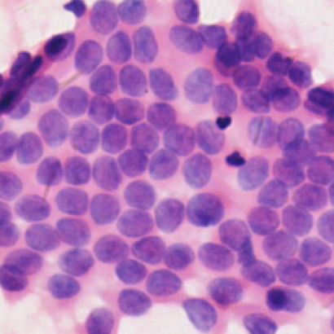


Context: two examinations, two specialists — no shared model
1
2
3
4
Ultrasound imaging
ACR TI-RADS score
FNA cytology
Bethesda category
Radiologist views the nodule
Rule-based risk category
Cells aspirated and stained
Cytopathologist report, 6 tiers
WHERE AI STANDS TODAY
0.91–0.95
0.932
95%
The gap
Models are single-modality, need very large cohorts, and rarely calibrate or explain their output.
AUROC of ultrasound-only CNNs trained on 131k images (Li et al., 2019)
AUROC of an ML model on whole-slide FNA cytology, 908 cases (Elliott Range et al., 2020)
Patient-level accuracy of VGG-16 on cytology — only 40 test patients (Guan et al., 2019)
Notes:
In clinical practice, a thyroid nodule is first examined with ultrasound and scored with ACR TI-RADS. Suspicious nodules are aspirated, and a cytopathologist reports the smear with the Bethesda system. These are two different specialists reading two different modalities, and their findings are not combined in one quantitative model. Deep learning already works on each modality separately: ultrasound CNNs reach AUROC around 0.91 to 0.95, and cytology models around 0.93. But these systems use one modality, depend on very large cohorts, and rarely report calibration or explain their decisions. That is the gap my project addresses.

Slide 3



The core problem: three failures we observed in our own prototype
RP1
RP2
RP3
Overfitting on small data
Fragmented pipeline
Opaque evaluation
~99%
7 scripts
Accuracy only
accuracy in the first epochs with a fully unfrozen ConvNeXt-Tiny on 384 patients
in the first prototype, with duplicated transforms, model and data loaders
no confidence intervals, no calibration, no explanation of predictions
Memorisation instead of learning → poor generalisation to new patients.
Preprocessing, training and evaluation silently diverge → results not reproducible.
Clinicians cannot judge reliability or see why a case is called malignant.
Why it is a Computer Science problem: learning from few samples · fusing one image with a variable-size set of patches · reproducible ML engineering · trustworthy evaluation and explainability
Notes:
These are the three research problems from my approved proposal, and each one comes from evidence in my own work. First, overfitting: when I fine-tuned a fully unfrozen ConvNeXt-Tiny on only 384 patients, accuracy reached about 99 percent within the first epochs, which is memorisation, not learning. Second, the first prototype was split into seven scripts with duplicated definitions, so preprocessing, training and evaluation could silently diverge. Third, evaluation reported only accuracy, with no confidence intervals, no calibration and no explanation. Together, these make it a Computer Science problem: small-data learning, multimodal fusion, reproducible engineering and trustworthy evaluation.

Slide 4
Research questions → objectives → measurable targets
General objective: design, develop, implement and evaluate a unified, interpretable pipeline that improves generalisation, reproducibility and evaluation reliability.
RESEARCH QUESTION
SPECIFIC OBJECTIVE
SMART TARGET · DEADLINE
To what extent can backbone freezing, regularisation and optimised training improve the generalisation of a ConvNeXt-Tiny model on limited data?
Implement and evaluate freezing, dropout, weight decay, label smoothing, LR schedule, clipping and early stopping.
Ablation A0–A3 on 5 folds: AUROC ≥ 0.95, fold SD ≤ 0.03 · Weeks 7–10
RQ1
How can a unified pipeline improve the reproducibility, consistency and efficiency of thyroid classification experiments?
Develop one pipeline: metadata → preprocessing → training → validation → inference → evaluation.
Same-seed re-runs within ±0.005 AUROC; 0 duplicated definitions · Weeks 4–9
RQ2
How can attention-based visualisation and clinical metrics improve the interpretability and reliability assessment of predictions?
Evaluate with AUROC, AUPRC, sens/spec, F1, MCC, Brier and bootstrap CI; implement relevance visualisation.
ECE ≤ 0.05 after scaling; deletion test ≥ 70% of TP cases · Weeks 9–13
RQ3
Notes:
Each problem becomes one research question and one specific objective, exactly as approved in my proposal. RQ1 asks how much backbone freezing, regularisation and an optimised training schedule improve generalisation; the objective is to implement these controls and evaluate them with an ablation study across five folds. RQ2 asks how a unified pipeline improves reproducibility, consistency and efficiency; the objective is one pipeline from metadata to evaluation, with identical-seed re-runs agreeing within 0.005 AUROC. RQ3 asks how visualisation and clinical metrics improve interpretability and reliability; the objective is a full clinical metric panel plus validated patch-level explanations. The right column shows the SMART targets and deadlines I will be judged against.

Slide 5



Literature: each modality works alone — fusion and trust remain open
Study | Modality | Key result | Limitation
Li et al., 2019 | Ultrasound | AUROC 0.908–0.947 (131k images) | US only; huge cohort
Buda et al., 2019 | Ultrasound | Sens. 87% ≈ TI-RADS experts | Biopsy decision; US only
Guan et al., 2019 | Cytology | 95% patient-level accuracy | 40 test patients
Elliott Range et al., 2020 | Cytology WSI | AUROC 0.932 ≈ cytopathologist | Needs slide scanners
Ilse 2018 · Lu 2021 | MIL / pathology | Bag-level learning with attention | Attention ≠ explanation
This project | US + cytology | Fold-0 AUROC 0.979 (preliminary) | Small-data, calibrated, explained
What works
CNNs extract strong signal from both ultrasound and cytology; attention-based MIL turns a bag of image fields into one patient decision.
What fails
Single modality · cohorts of 10⁴–10⁵ images · accuracy-only reporting · attention maps rarely tested for faithfulness.
Our position
Patient-level US + cytology fusion in a 384-patient regime, with ablation, CIs, calibration and validated relevance.
Sources: Li [7], Buda [8], Guan [9], Elliott Range [10], Ilse [21], Lu [12] — numbering as in the written proposal.
Notes:
The literature shows that each modality works on its own. Li and colleagues reached AUROCs between 0.91 and 0.95 on ultrasound, but with more than 130 thousand images. Buda showed a CNN on par with TI-RADS experts for biopsy decisions. On cytology, Guan reported 95 percent patient-level accuracy but on only 40 test patients, and Elliott Range matched a cytopathologist using whole-slide scans. Multiple-instance learning gives us a principled way to handle bags of patches, but attention weights are not automatically valid explanations. So what is missing is patient-level fusion of both modalities in a small-data regime, with honest evaluation and validated explanations. That is my position.

Slide 6
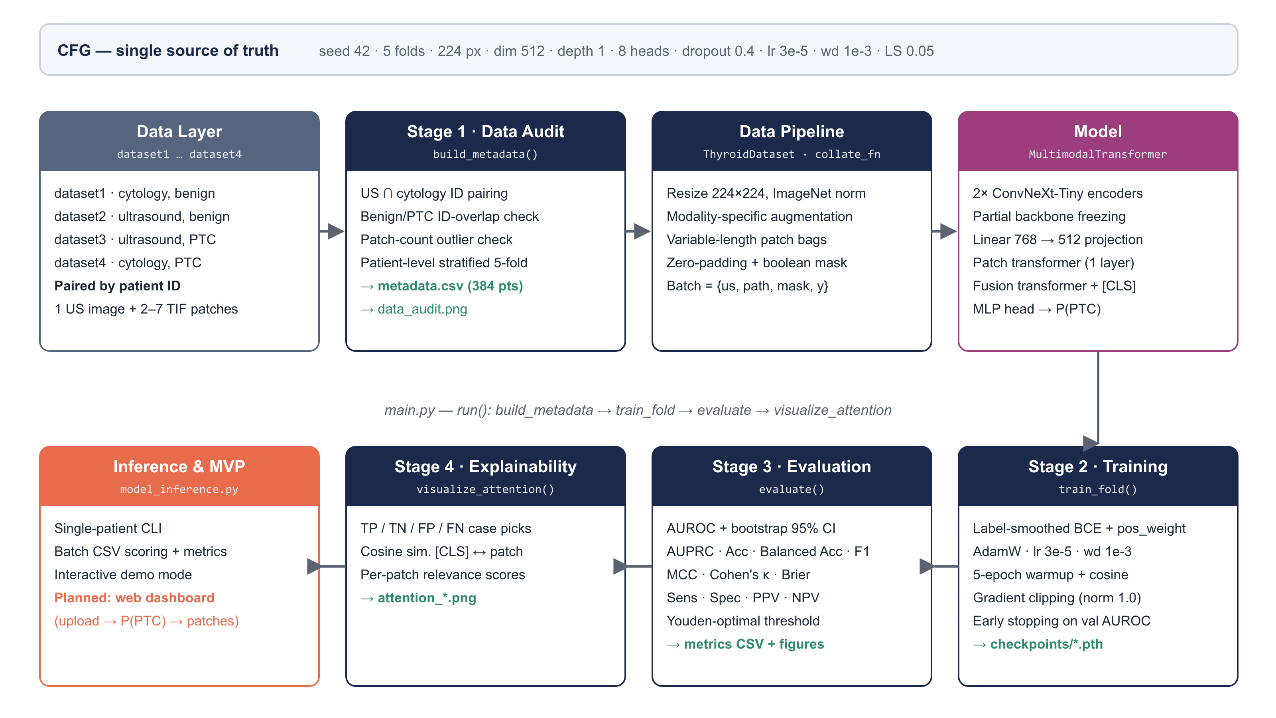


Methodology ① · Architecture: one entry point, four stages
Single source of truth
One CFG dict drives every stage and is saved inside each checkpoint.
No patient leakage
Stratified 5-fold split assigned per patient, never per image.
Agile + Git
2-week sprints, feature branches, pull requests, fixed seeds.
Notes:
This is the system architecture. Everything is driven by one configuration dictionary, which is also stored inside every checkpoint. The single entry point runs four stages: first, a data audit pairs ultrasound and cytology files by patient ID and assigns patient-level stratified folds, so no patient ever appears in both training and validation. Then the data pipeline loads and augments images and pads the variable-length patch bags with a mask. The model is trained with the regularisation recipe, evaluated with the full metric panel, and finally explained with patch-level relevance. The inference tool reuses the checkpoint and will be wrapped by the web demo. I work in two-week sprints with Git feature branches and fixed seeds.

Slide 7
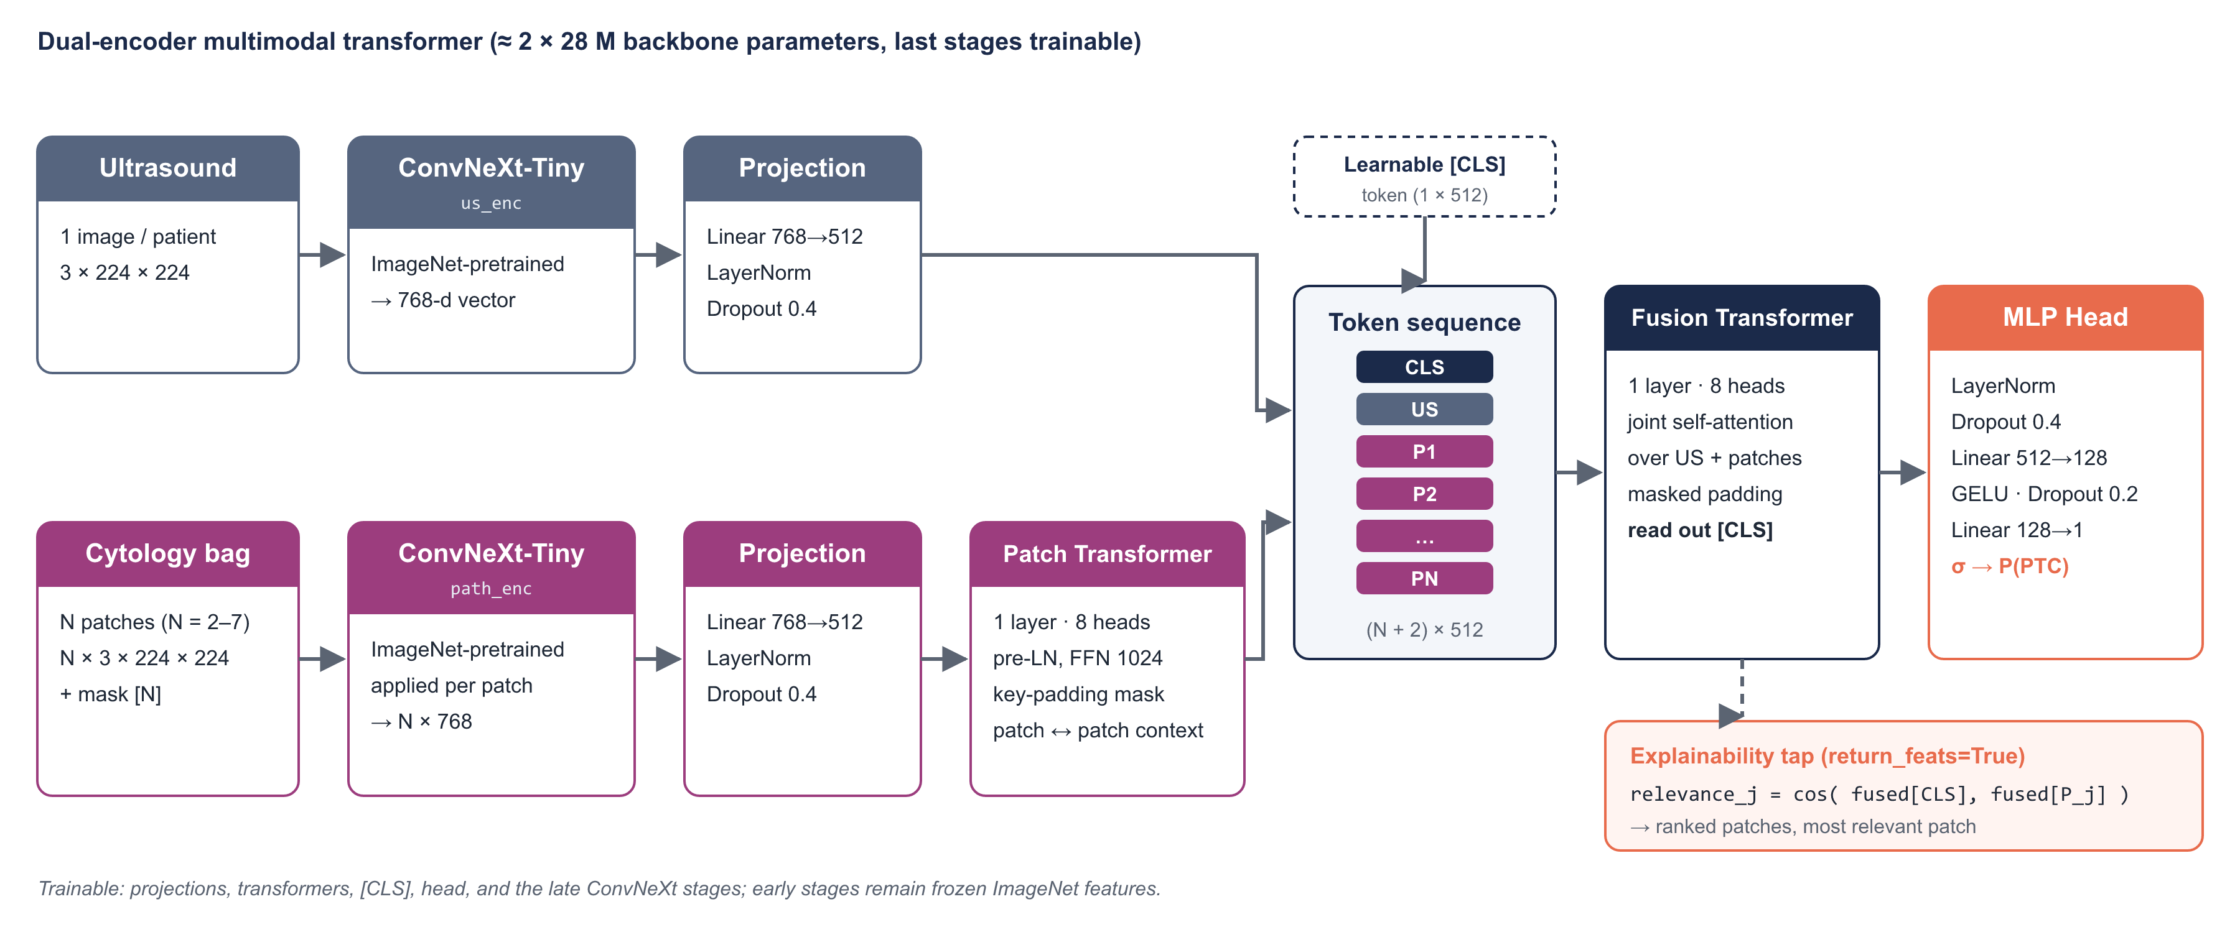
Methodology ② · Model: two encoders fused by a [CLS] transformer
384 paired patients
165 / 219 benign / PTC
1,332 cytology patches (2–7 each)
224 px ImageNet norm + augmentation
Notes:
Here is the model. Each patient has one ultrasound image and two to seven cytology patches. Two separate ImageNet-pretrained ConvNeXt-Tiny encoders turn the ultrasound image and each patch into 768-dimensional vectors, which are projected to 512 dimensions. A small transformer lets the cytology patches exchange context, with a mask so padding is ignored. Then the sequence of a learnable CLS token, the ultrasound token and the patch tokens goes through a fusion transformer, and the CLS output is classified by an MLP head into the probability of PTC. For explainability, I compare the fused CLS token with each patch token. The dataset has 384 paired patients, 165 benign and 219 PTC, and 1,332 cytology patches.

Slide 8
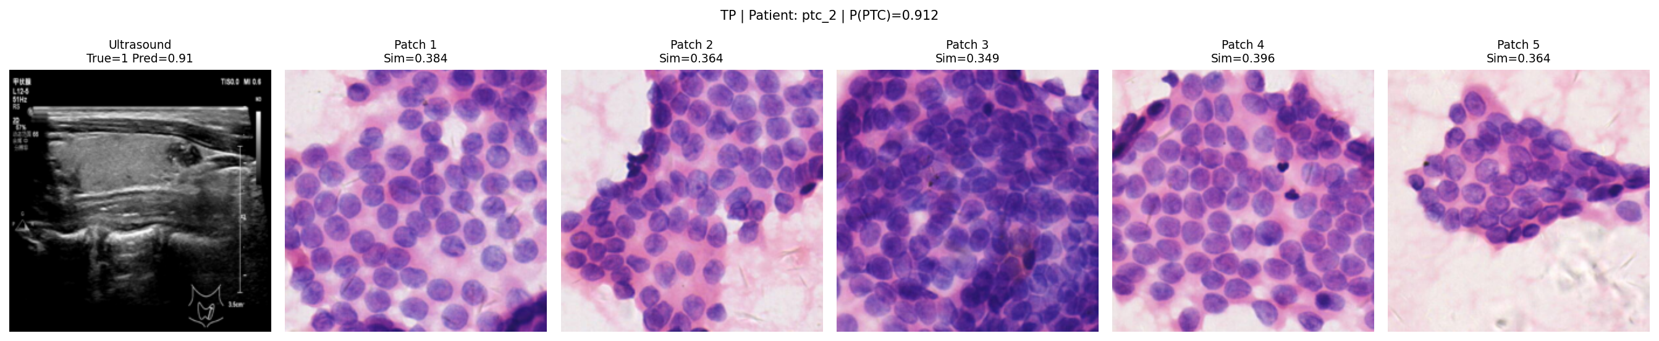
Methodology ③ · Overfitting controls and first results
Component | Baseline | Current
Backbone | Fully unfrozen | Early stages frozen
Dropout | 0.1 | 0.4
Weight decay | 1e-4 | 1e-3
Learning rate | 1e-4 | 3e-5 + warm-up/cosine
Transformer | 2 layers × 768 | 1 layer × 512
Label smoothing | — | 0.05
Gradient clipping | — | L2 norm 1.0
Selection | — | Best val. AUROC
0.979
1.00
0.73 → 0.85
AUROC
Sensitivity
Specificity
95% CI 0.948–0.997
44 / 44 PTC detected
τ = 0.5 → Youden τ* = 0.89
Patch relevance (cosine to fused [CLS]) for a true-positive patient, P(PTC) = 0.912
Preliminary: one fold, checkpoint chosen on that fold → optimistic. 5-fold nested CV and calibration are planned.
Notes:
After the baseline overfitted, I froze the early backbone stages, raised dropout to 0.4 and weight decay to 1e-3, lowered the learning rate to 3e-5 with warm-up and cosine decay, made the transformers smaller, and added label smoothing, gradient clipping and model selection on validation AUROC. On fold 0, the pipeline reaches an AUROC of 0.979 with a 95 percent confidence interval from 0.948 to 0.997, and it misses no PTC case. The weak point is specificity: 0.73 at the default threshold, rising to 0.85 at the Youden threshold. The bottom-left image is the explainability output for a true positive. I want to be honest: this is one fold, selected on itself, so it is optimistic — the full five-fold nested evaluation is next.

Slide 9


Semester roadmap: from working prototype to evaluated MVP
Weeks 1–3
Weeks 4–6
Weeks 7–8
Weeks 9–10
Weeks 11–12
Week 13
Week 14
COMPLETED
COMPLETED
IN PROGRESS
PLANNED
PLANNED
PLANNED
PLANNED
Requirements, literature, data audit, environment
Unified main.py, multimodal model, overfitting fixes, fold-0 run, CLI
Midterm proposal; shared model.py; explicit freezing; ablation setup
5-fold nested CV; ablation A0–A3; re-run checks; MVP tests
Calibration; deletion test, rollout, Grad-CAM; Gradio web demo
Answer RQ1–RQ3 vs. SMART targets; FP/FN error analysis
Final report, README, final presentation and live demo
MVP BY WEEK 14
Data audit + 5-fold metadata
Multimodal model
Inference CLI
5-fold CV + ablation
Calibrated eval + validated XAI
Gradio web demo
Notes:
This is my semester roadmap. Weeks one to six are completed: the data audit, the unified pipeline, the multimodal model, the overfitting fixes, the first fold, and the inference command-line tool. In weeks seven and eight, I am doing this proposal and fixing the issues the audit found, such as a shared model module and explicit stage freezing. Weeks nine and ten run full five-fold nested cross-validation and the ablation study. Weeks eleven and twelve add calibration, the explanation faithfulness tests and the Gradio web demo. Week thirteen answers the research questions against the SMART targets, and week fourteen is documentation and the final demo. The bottom row shows the MVP: three parts already work, three are planned.

Slide 10




Conclusion & expected contribution
An interpretable, reproducible pipeline that fuses ultrasound and cytology to classify thyroid lesions — already working at AUROC 0.979 on fold 0, with a clear plan to evaluate it rigorously.
RQ1
RQ2
RQ3
MVP
Empirical
Engineering
Methodological
Product
Controlled ablation of each overfitting control in a 384-patient, two-modality setting.
Single-entry, config-driven, reproducible pipeline with shared model code.
Clinical evaluation protocol: CIs, calibration, thresholds, faithfulness-tested relevance.
Inference CLI + web demo: images in → P(PTC) + visual explanation out (research use only).
From a promising prototype to an evaluated, explainable, research-grade MVP by the final presentation.
Notes:
To conclude: this project builds an interpretable, reproducible pipeline that fuses ultrasound and cytology to classify thyroid lesions, and it already works, with an AUROC of 0.979 on the first fold. I expect four contributions. Empirically, a controlled ablation showing how much each overfitting control helps. In engineering, a single-entry, reproducible pipeline. Methodologically, a clinical evaluation protocol with confidence intervals, calibration and tested explanations. And as a product, a working MVP that takes a patient’s images and returns a malignancy probability with a visual explanation, clearly marked for research use only. Thank you, I am happy to take your questions.

Slide 11
Questions & discussion
THANK YOU
Team CAI · Usmanov Lazizbek (230405)
Interpretable Deep Learning Pipeline for Thyroid Lesion Classification
Backup slides: MVP conceptual diagram · key references
Notes:
Thank you for your attention. I am ready for questions. If useful, I have two backup slides: the MVP conceptual diagram and the key references.

Slide 12
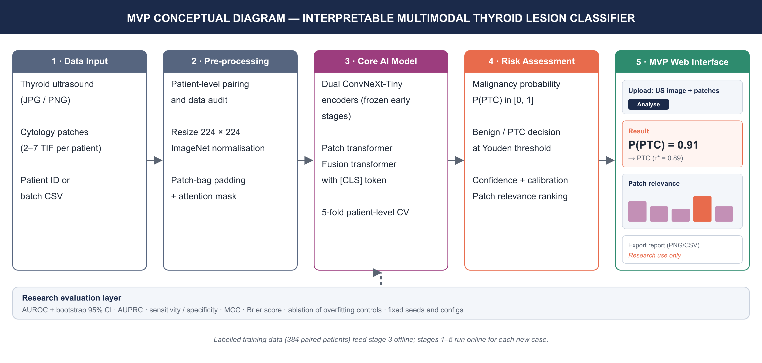
Backup: MVP conceptual diagram
Notes:
Backup slide: the MVP conceptual diagram. Data input, pre-processing, the core model, risk assessment with a calibrated probability and threshold, and the planned web interface showing the probability and patch relevance, all supported by the research evaluation layer.

Slide 13
Backup: key references (IEEE)
[7] X. Li et al., “Diagnosis of thyroid cancer using deep CNN models applied to sonographic images,” Lancet Oncol., vol. 20, no. 2, pp. 193–201, 2019.
[8] M. Buda et al., “Management of thyroid nodules seen on US images: Deep learning may match performance of radiologists,” Radiology, vol. 292, no. 3, pp. 695–701, 2019.
[9] Q. Guan et al., “Deep CNN VGG-16 model for differential diagnosing of papillary thyroid carcinomas in cytological images,” J. Cancer, vol. 10, no. 20, pp. 4876–4882, 2019.
[10] D. Elliott Range et al., “Application of a machine learning algorithm to predict malignancy in thyroid cytopathology,” Cancer Cytopathol., vol. 128, no. 4, pp. 287–295, 2020.
[12] M. Y. Lu et al., “Data-efficient and weakly supervised computational pathology on whole-slide images,” Nat. Biomed. Eng., vol. 5, pp. 555–570, 2021.
[15] J. Mongan, L. Moy, and C. E. Kahn Jr., “Checklist for Artificial Intelligence in Medical Imaging (CLAIM),” Radiol. Artif. Intell., vol. 2, no. 2, e200029, 2020.
[19] Z. Liu et al., “A ConvNet for the 2020s,” in Proc. CVPR, 2022, pp. 11976–11986.
[20] A. Vaswani et al., “Attention is all you need,” in Adv. Neural Inf. Process. Syst., vol. 30, 2017, pp. 5998–6008.
[21] M. Ilse, J. M. Tomczak, and M. Welling, “Attention-based deep multiple instance learning,” in Proc. ICML, 2018, pp. 2127–2136.
[22] S.-C. Huang et al., “Fusion of medical imaging and electronic health records using deep learning,” npj Digit. Med., vol. 3, Art. no. 136, 2020.
[29] C. Guo et al., “On calibration of modern neural networks,” in Proc. ICML, 2017, pp. 1321–1330.
[35] S. Jain and B. C. Wallace, “Attention is not explanation,” in Proc. NAACL-HLT, 2019, pp. 3543–3556.
Notes:
Backup slide with the key references. Numbers match the full list of 38 IEEE references in the written proposal.

