Slide 1
Academic writing skills
Writing, referencing & using electronic resources
“Care in the choice of one’s words is the respect that the mind pays to the instrument of its own being”

Slide 2
Agenda
Writing
  What is academic writing
  Project/Research reports Vs. Essays
Referencing
  Books
  Articles
  Others
Electronic resources

Slide 3
Academic writing
What is it all about?
Project/Research reports vs. essays!

Slide 4
Writing
Academic writing is Formal
  No exaggeration (Not: extremely important)
  Impersonal (no use of “I am”)
  Direct to the meaning
  No final judgment!! Always allow for arguing and accepting other opinions!!

Slide 5


WHAT DOES FORMAL WRITING LOOK LIKE?
Focus on the issue, not the writer Keeping your writing objective and impersonal can make it more convincing.
  It will be argued that the benefits of sales promotion outweigh the disadvantages.
  I will argue in this essay that ...

Slide 6
Choose words with precise meanings
Avoid words with vague meanings
  Compare:
    The writer looks at the issue
  with
    The writer examines the issue.
The second option is more formal.
  Formal choices:
    He states … maintains … argues
  Informal choices:
    He says … talks about …

Slide 7
Make your claims tentative rather than definite
This leaves the door open for further discussion and/or research. After all, it’s unlikely that you’ve reached the only possible conclusion!
1. Television viewing causes reading problems in childhood.
2. Excessive television viewing may be a contributing cause of some cases of reading problems in childhood.

Slide 8
Research reports Vs. Essays
You are requested to read research reports and write essay
Therefore it is important to understand both!!

Slide 9
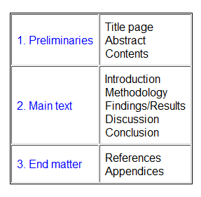
Research reports
Any report should have the following sections

Slide 10
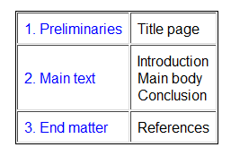
Essays
Your essay should have the following sections:

Slide 11
Preliminaries
The title page should contain information to enable your lecturer to identify exactly what the piece of work is. It should include:
  Your group names and
  Course;
  The title of the assignment

Slide 12
Main text
The main text of the essay has three main parts:
  An introduction
  A main body
  A conclusion

Slide 13
The introduction.
The introduction consists of two parts:
  It should include a few general statements about the subject to provide a background to your project/essay and to attract the reader's attention. It should try to explain why you are writing the essay or what the project is all about. It may include a definition of terms in the context of the project/essay, etc.
  It should also include an indication of how the topic is going to be tackled in order to specifically address the question.
It should introduce the central idea or the main purpose of the writing.

Slide 14
The main body
The main body consists of one or more paragraphs of ideas and arguments, together with illustrations or examples.
The paragraphs are linked in order to connect the ideas.
The purpose of the essay must be made clear and the reader must be able to follow its development.

Slide 15
Flow of information in paragraphs
Paragraphs are usually structured as
  Topic Sentence
    This is the first sentence and it expresses The main idea.
  Supporting Sentences
    details that expand your main idea.
  Concluding Sentence
    a rounding off, possibly by summarizing what has been said or drawing a logical conclusion from it.

Slide 16
Flow of information in paragraphs
Use linking words
  also, as well as, firstly, next, then, finally, so thus, as a result, because, therefore, for example, for instance, in contrast, on the other hand.

Slide 17
The conclusion
The conclusion includes the writer's final points.
  It should recall the issues raised in the introduction and draw together the points made in the main body
  and explain the overall significance of the conclusions. ((What general points can be drawn from the essay as a whole?))
It should clearly signal to the reader that the essay is finished and leave a clear impression that the purpose of the essay has been achieved.

Slide 18
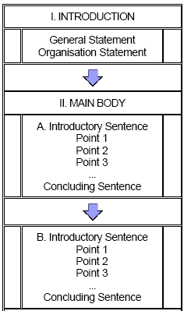
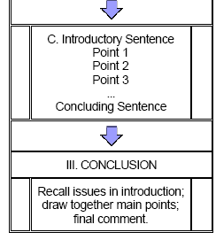

Slide 19
PLAN THE ESSAY AND ORGANIZE IDEAS
There should be a central question the essay is trying to answer!!!
  E.g. What are advertising appeals and how they are effective?
  Investigating the effect of using different color in advertising
  What are the different factors that could affect brand positioning?
  The effect of the self theory on consumption?
  Culture differences and the effect on ads/consumption/consumer preferences…etc.

Slide 20
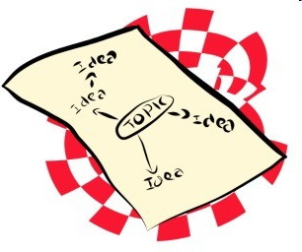
So how do I plan this essay?
What is the answer to your question?
What points do you need to make to support or give evidence to prove your answer?
What is the best order to arrange these points? Are they relevant to the topic? These points become your paragraphs in the body of your essay. Remember you are arguing your point of view, showing you are aware of their views, but maintaining your stance (position).

Slide 21
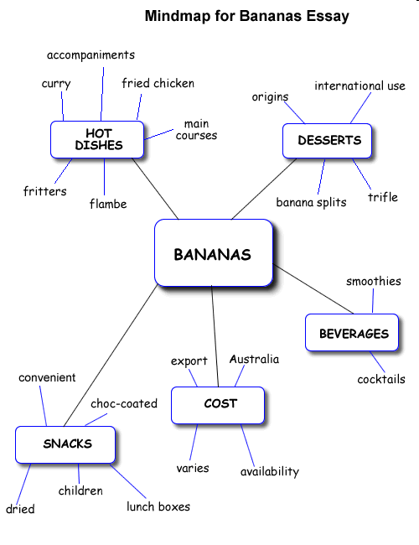

Slide 22
Skeleton outline of an essay
Topic: Analyse the value and adaptability of the banana as an ingredient in a range of menus.
Using note form, write your plan using headings for main points, and sub-headings under them (such as evidence and examples you are using to support each point).
Use heading for main points and subheadings
explanation?
example?
supporting evidence?
concluding sentence idea?
NB Next paragraph should connect to ideas in previous paragraph- it could refer back to it, or move on from an idea in it.
Introduction: wide range of uses -sweet/ savoury, raw/cooked, main/dessert/snack/beverages, low cost
Body Points/Paragraphs
1. desserts-origins, international uses, eg banana split, trifle
2. beverages- smoothies, cocktails
3. children's snack - TV shows promoting, eg banana man, bananas in pyjamas
4. hot dishes - accompaniments- fried chicken, curry, main courses- fritters, flambe
5. cost- available all seasons in Australia, low cost
Conclusion - international use, abundance and versatility well demonstrated, good value very adaptable, worthwhile ingredient

Slide 23
Add some style
Writing is a very logical exercise, adding style to it will enhance clearness and power of convincing…
  Phrases for transition
  Phrases for emphasis
  Phrases for counterpoint

Slide 24
Phrases for transition
Regarding
Admittedly
Consequently
As a result
Ultimately
According to
For this reason

Slide 25
Phrases for emphasis
Moreover
In fact
Additionally
For example
In point of fact
As a matter of fact
Indeed

Slide 26
Phrases for counterpoint
Conversely
On the other hand
However
Nevertheless
Notwithstanding
Nonetheless
Yet
Despite
Although
Instead

Slide 27
Conclude writing
Writing = logic + style
You should always concentrate on the objective
Good writing skills needs a lot of READING and exercise
Writing is important for, university assignments, exams (TOEFL), real life (writing convincing reports!!)

Slide 28
Referencing
What does referencing mean?
Why should I include references in my work?
How do I reference my work?

Slide 29
What does referencing mean?
When writing an academic piece of work you need to acknowledge any ideas, information or quotations which are the work of other people. This is known as referencing or citing.

Slide 30
Why should I include references in my work?
You should include references in order to:
  acknowledge the work of others
  provide evidence of your own research
  illustrate a particular point
  support an argument or theory
  allow others to locate the resources you have used
And most importantly:
  avoid accusations of plagiarism

Slide 31
How do I reference my work?
Your references should be consistent and follow the same format. Various systems have been devised for citing references, but most Schools use the Harvard system

Slide 32
Referencing while writing
References will be cited in your work in two places: -
  1) Where a source is referred to in the text (Citation)
  2) In a list (the Bibliography/List of references) at the end of the assignment.

Slide 33
Citing references in the text
Citing the author in the text
Whenever a reference to a source is made, its author's surname and the year of publication are inserted in the text as in the following examples...

Slide 34
Citing references in the text Cont.
  Dogs were the first animals to be domesticated (Sheldrake, 1999).
If the author's name occurs naturally in the sentence the year is given in brackets .>>
  Sheldrake (1999) asserts that dogs were the first animals to be domesticated.

Slide 35
Using direct quotes
If you quote directly from a source you must insert the author’s name, date of publication and the page number of the quotation.
  ‘The domestication of dogs long predated the domestication of other animals.’ (Sheldrake, 1999, p.5).
The page number should be given at the end of the quote, in separate brackets if necessary, as in the example below.
  Sheldrake (1999) asserts that the ‘domestication of dogs long predated that of other animals.’ (p.15).

Slide 36
Citing works by more than one author
If your source has two authors you should include both names in the text.
  Anderson and Poole (1998) note that a ‘narrow line often separates plagiarism from good scholarship.’ (p.16).

Slide 37
Citing works by three or more authors
If there are three or more authors you should include the first named author and then add ‘et al.’ in italics followed by a full stop. This is an abbreviation of ‘et alia’ which means ‘and others’ in Latin.
  In the United States revenue from computer games now exceeds that of movies (Kline et al., 2003).

Slide 38
Citing works by the same author written in the same year
If you cite two or more works written in the same year by the same author, then you must differentiate between them in both the text and your List of references by listing them as a,b,c etc.
  Natural selection can cause rapid adaptive changes in insect populations (Ayala, 1965a) and various laboratory experiments have been conducted to assess this theory (Ayala, 1965b).

Slide 39
Citing secondary sources
When citing secondary sources (i.e. an author refers to a work you have not read) cite the secondary source, but include the name of the author and date of publication of the original source in the text. Only the secondary source should be listed in your references. You should only cite secondary sources if you are unable to read the original source yourself.
  Sheff (1993) notes that Nintendo invested heavily in advertising (cited in Kline et al.,2003, p.118).

Slide 40
Writing a Bibliography or List of references
The List of references appears at the end of your work and gives the full details of everything that you have cited in the text in alphabetical order by the author’s surname

Slide 41
Printed books
Printed books should be referenced using the following format and punctuation.
  Author/editor’s surname and initials.,
  (Year of publication).
  Title of book: including subtitles. (in italics or underlined)
  Edition. (if applicable)
  Place of publication: (followed by a colon)
  Name of publisher.

Slide 42
Reference to a book with one author
  Sheldrake, R., (1999). Dogs that know when their owners are coming home: and other unexplained powers of animals. London: Arrow Books.
Reference to a book with two authors
  Anderson, J. and Poole, M., (1998). Assignment and thesis writing. 3rd ed. Chichester: John Wiley & Sons.

Slide 43
Print journals and newspapers
Print journals should be referenced using the following format and punctuation.
  Author's surname, initials., (or Newspaper title where there is no author,)
  (Year of publication).
  Title of article.
  Name of journal. (in italics or underlined),
  Date of publication (if applicable e.g. 18 June)
  Volume number (in bold) (if applicable)
  (Part/issue number), (if applicable)
  Page numbers.

Slide 44
Example
Britton, A., (2006). How much and how often should we drink? British Medical Journal. 332 (7552), 1224-1225.
OR
Britton, A., (2006). How much and how often should we drink? British Medical Journal. Vol. 332, No. 7552, pp.1224-1225

Slide 45
E-journal article accessed via website on the open Internet
Britton, A., (2006). How much and how often should we drink? British Medical Journal. 332 (7552), 1224-1225. [online] Available from:http://bmj.bmjjournals.com/cgi/content/full/332/7552/1224 [Accessed 2 June 2006].

Slide 46
Websites, web pages
Websites, web pages and PDF documents downloaded from the Internet should be referenced using the following format and punctuation.
  Author/editor’s surname, initials., or name of owning organization e.g. University of London)
  (Year of publication).
  Title. (in italics or underlined)
  Edition. (if applicable, e.g. update 2 or version 4.1)
  [online]
  Place of publication: (if known)
  Name of publisher. (if known)
  Available from: <URL>
  [Accessed (enter date you viewed the website)].

Slide 47
  Holland, M., (2005). Citing references. [online] Poole: Bournemouth University. Available from: <http://www.bournemouth.ac.uk/academic_services/documents/Library/Citing_References.pdf> [Accessed 2 June 2006].
  University of Westminster, (2007). Harry Potter fans to cast spell over Westminster. [online] London: University of Westminster. Available from: <http://www.wmin.ac.uk/page-14428> [Accessed 24 July 2007].

Slide 48
Conclusion
Writing and referencing are important skills that are critical to academic writing.
Learning it is REALLY important and will ensure you will get a high grade in every written paper (assignments, homework, exams…etc)

Slide 49
Searching electronic resources
EBESCO & Ebrary
How to find an article
How to “efficiently” read an article
Brief example on writing an essay.

