Slide 1
Literature review classification

Slide 2
Introduction
The purpose of this paper is to determine how to automatically classify literature review genres.

Slide 3
Methodology
We use the five step process of knowledge-discovery in database.

Slide 4
Step 01: Data Selection
We start by performing text mining on teh abstract of articles classed as “meta-reviews” by Templier and Paré (2018). Link: https://www.tandfonline.com/doi/abs/10.1080/0960085X.2017.1398880
Accordingly, this paper analyses 142 abstracts of literature reviews.
A polarized wordcloud allows to graphically assess whether there are word associated to one specific genre in the literature.

Slide 5
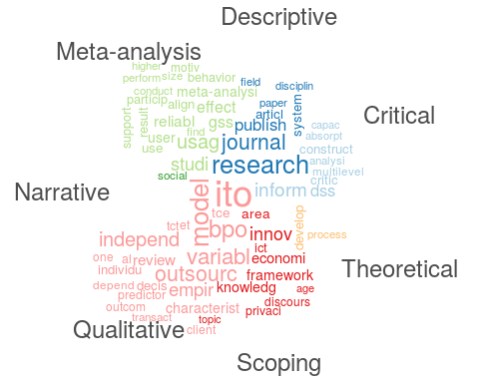

Slide 6
Step 02: Data Pre-processing
We start by associating to each abstract a set of information, and by analysis the frequency of appeareance of each word in the text.
## Reference ## 1 Ahuja, M. K. (2002). Women in the information technology profession: A literature review, synthesis and research agenda. European Journal of Information Systems, 11(1), 20–34. ## 2 Akhlaghpour, S., Wu, J., Lapointe, L., & Pinsonneault, A. (2013). The ongoing quest for the IT artifact: Looking back, moving forward. Journal of Information Technology, 28(2), 150–166. ## 3 Aksulu, A., & Wade, M. (2010). A comprehensive review and synthesis of open source research. Journal of the Association for Information Systems, 11(11/12), 576–656. ## 4 Alaghehband, F. K., Rivard, S., Wu, S., & Goyette, S. (2011). An assessment of the use of transaction cost theory in information technology outsourcing. The Journal of Strategic Information Systems, 20(2), 125–138. ## 5 Alavi, M., & Leidner, D. E. (2001). Review: Knowledge management and knowledge management systems: Conceptual foundations and research issues. MIS Quarterly, 25(1), 107–136. ## paper critic analys natur state ## 1 0 0 0 0 0 ## 2 2 0 0 0 0 ## 3 1 0 0 0 1 ## 4 1 0 0 1 0 ## 5 3 0 0 0 0

Slide 7
Step 03: Data transformation
To perform an automatic classification, we add the type of review as a dependent variable.
## Type paper critic analys natur state ## 1 Critical 0 0 0 0 0 ## 2 Critical 2 0 0 0 0 ## 3 Critical 1 0 0 0 1 ## 4 Critical 1 0 0 1 0 ## 5 Critical 3 0 0 0 0 ## 6 Critical 2 1 1 1 2

Slide 8
Step 04: Data mining
We use the decision tree algorithm to automatically extracts classification rules. Other classification algorithms have been shown to be more effective for natural language processing, but here we are interested in the ability to extract a set of rules, which can be easily understood by humans.

Slide 9
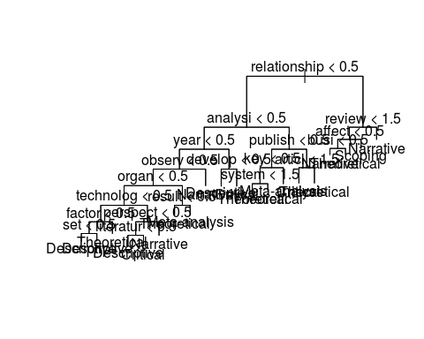

Slide 10
## ## Classification tree: ## tree(formula = Type ~ . - Type, data = classification[, -2]) ## Variables actually used in tree construction: ## [1] "relationship" "analysi" "year" "observ" "organ" ## [6] "technolog" "factor" "set" "perspect" "literatur" ## [11] "result" "develop" "publish" "key" "system" ## [16] "articl" "review" "affect" "busi" ## Number of terminal nodes: 20 ## Residual mean deviance: 1.787 = 218 / 122 ## Misclassification error rate: 0.3944 = 56 / 142
The misclassification rate is 39%.
As a complement, we run the random forest algorithm, which tests mutliple decision trees.
## ## Call: ## randomForest(formula = Type ~ ., data = classification[, -2], ntree = 500, mtry = 500, importance = TRUE) ## Type of random forest: classification ## Number of trees: 500 ## No. of variables tried at each split: 500 ## ## OOB estimate of error rate: 65.49% ## Confusion matrix: ## Critical Descriptive Meta-analysis Narrative Qualitative Scoping ## Critical 0 0 0 0 1 0 ## Descriptive 0 0 0 0 0 0 ## Meta-analysis 0 0 0 1 0 0 ## Narrative 0 0 0 2 0 0 ## Qualitative 1 1 0 0 0 0 ## Scoping 0 0 0 0 0 0 ## Theoretical 0 1 0 4 0 0 ## Theoretical class.error ## Critical 15 1.00000000 ## Descriptive 22 1.00000000 ## Meta-analysis 11 1.00000000 ## Narrative 23 0.92000000 ## Qualitative 4 1.00000000 ## Scoping 9 1.00000000 ## Theoretical 47 0.09615385
## Critical Descriptive Meta-analysis Narrative Qualitative Scoping ## critic 0.08671165 -0.5976026 -0.1857017 -1.418188 0.000000 0.000000 ## analys -1.00100150 1.0010015 0.0000000 0.000000 0.000000 0.000000 ## natur 0.71712654 1.6077069 1.0010015 0.000000 -1.001002 0.000000 ## state 1.00100150 0.0000000 0.0000000 -1.001002 0.000000 0.000000 ## decis 0.21567558 -1.7078070 -1.0010015 1.621140 0.000000 0.000000 ## support -1.00100150 -1.0505017 0.0000000 -1.470308 0.000000 1.001002 ## Theoretical MeanDecreaseAccuracy MeanDecreaseGini ## critic -2.50870720 -3.59386448 0.19271544 ## analys 0.06726758 0.04067873 0.10129193 ## natur -0.59396229 1.84269316 0.30136417 ## state 1.40275209 0.86382325 0.06749535 ## decis 0.36835101 0.49271074 0.33055145 ## support -0.53009355 -1.61608814 0.28057529

Slide 11
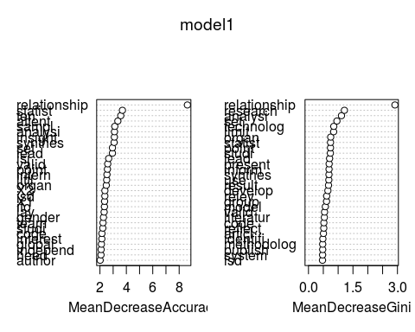

Slide 12
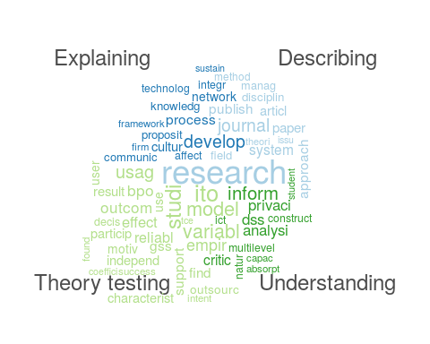
Model 2: The classification done with 4 Types set by Rowe (2014) does not improve the results

Slide 13
## ## Classification tree: ## tree(formula = Type ~ . - Type, data = classification[, -2]) ## Variables actually used in tree construction: ## [1] "relationship" "analysi" "year" "observ" "organ" ## [6] "technolog" "factor" "set" "perspect" "literatur" ## [11] "result" "develop" "publish" "key" "system" ## [16] "articl" "review" "affect" "busi" ## Number of terminal nodes: 20 ## Residual mean deviance: 1.787 = 218 / 122 ## Misclassification error rate: 0.3944 = 56 / 142
## ## Call: ## randomForest(formula = Type ~ ., data = classification_Rowe[, -2], ntree = 500, mtry = 500, importance = TRUE) ## Type of random forest: classification ## Number of trees: 500 ## No. of variables tried at each split: 500 ## ## OOB estimate of error rate: 69.01% ## Confusion matrix: ## Describing Explaining Theory testing Understanding class.error ## Describing 19 28 0 0 0.5957447 ## Explaining 26 25 0 1 0.5192308 ## Theory testing 9 8 0 1 1.0000000 ## Understanding 8 16 1 0 1.0000000

Slide 14
Step 05: interpretation
Appendix:
A more detailed analysis show differences between the words networks of * Meta-Reviews * Critical * Descriptive * Qualitative * Theoretical * Narrative

