Slide 1
Compilation
0368-3133 2014/15a Lecture 13
Assembler, Linker and Loader
Noam Rinetzky

Slide 2
What is a compiler?
“A compiler is a computer program that transforms source code written in a programming language (source language) into another language (target language).
The most common reason for wanting to transform source code is to create an executable program.” --Wikipedia

Slide 3
Stages of compilation
Source code
(program)
Lexical Analysis
Syntax Analysis
Parsing
Context Analysis
Portable/Retargetable code generation
Code Generation
Target code
(executable)
Text
AST + Sym. Tab.
Assembly
Token stream
AST
IR

Slide 4
Compilation ➔ Execution
Source code
(program)
Lexical Analysis
Syntax Analysis
Parsing
Context Analysis
Executing program
Portable/Retargetable code generation
Code Generation
Target code
(executable)
Text
AST + Sym. Tab.
Token stream
AST
IR
Assembler
Loader
Runtime System
Linker
Symbolic Addr
Object File
Executable File
image

Slide 5
Program Runtime State
Registers
0x11000
Code
foo, extern_foo
printf
0x22000
Static Data
G, extern_G
0x33000
Stack
x
0x88000
Heap
0x99000

Slide 6
Challenges
goto L2 ➔ JMP 0x110FF
G:=3 ➔ MOV 0x2200F, 0..011
foo() ➔ CALL 0x130FF
extern_G := 1 ➔ MOV 0x2400F, 0..01
extern_foo() ➔ CALL 0x140FF
printf() ➔ CALL 0x150FF
x:=2 ➔ MOV FP+32, 0…010
goto L2 ➔ JMP [PC +] 0x000FF
0x11000
Code
foo, extern_foo
printf
0x22000
Static Data
G, extern_G
0x33000
Stack
x
0x88000
Heap
0x99000

Slide 7
Assembly ➔ Image
Source program
Compiler
Assembly lang. program (.s)
Assembler
Machine lang. Module (.o): program (+library) modules
Linker
“compilation” time
Executable (“.exe”):
“execution” time
Loader
Libraries (.o)
(dynamic loading)
Image (in memory):

Slide 8
Outline
Assembly
Linker / Link editor
Loader
Static linking
Dynamic linking

Slide 9
Assembly ➔ Image
Source file (e.g., utils)
Source file (e.g., main)
library
Compiler
Compiler
Compiler
Assembly (.s)
Assembly (.s)
Assembly (.s)
Assembler
Assembler
Assembler
Object (.o)
Object (.o)
Object (.o)
Linker
Executable (“.elf”)
Loader
Image (in memory):

Slide 10
Assembler
Converts (symbolic) assembler to binary (object) code
Object files contain a combination of machine instructions, data, and information needed to place instructions properly in memory
Yet another(simple) compiler
One-to one translation
Converts constants to machine repr. (3➔0…011)
Resolve internal references
Records info for code & data relocation

Slide 11
Object File Format
Header
Text Segment
Data
Segment
Relocation Information
Symbol Table
Debugging Information
Header: Admin info + “file map”
Text seg.: machine instruction
Data seg.: (Initialized) data in machine format
Relocation info: instructions and data that depend on absolute addresses
Symbol table: “exported” references + unresolved references

Slide 12
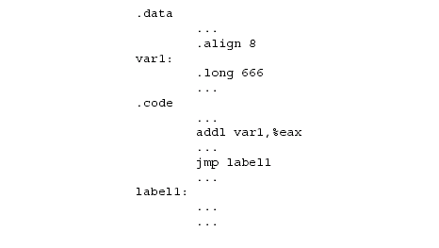
Handling Internal Addresses

Slide 13
Resolving Internal Addresses
Two scans of the code
Construct a table label → address
Replace labels with values
One scan of the code (Backpatching)
Simultaneously construct the table and resolve symbolic addresses
Maintains list of unresolved labels
Useful beyond assemblers

Slide 14
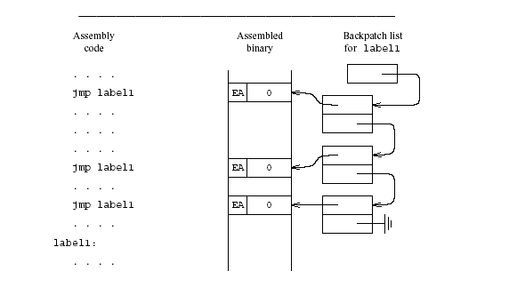
Backpatching

Slide 15
Handling External Addresses
Record symbol table in “external” table
Exported (defined) symbols
G, foo()
Imported (required) symbols
Extern_G, extern_bar(), printf()
Relocation bits
Mark instructions that depend on absolute (fixed) addresses
Instructions using globals,

Slide 16
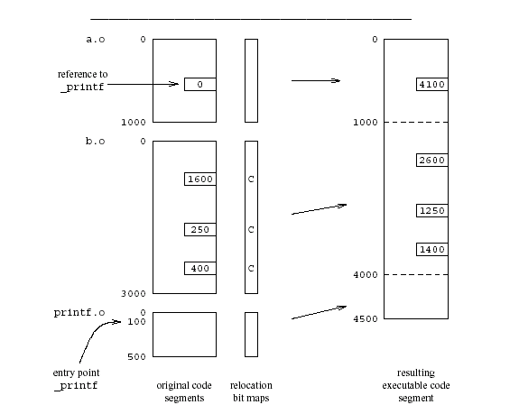
Example
External references resolved by the Linker using the relocation info.

Slide 17
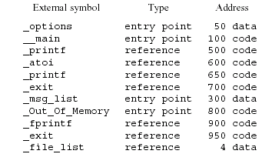
Example of External Symbol Table

Slide 18
Assembler Summary
Converts symbolic machine code to binary
addl %edx, %ecx ⇒ 000 0001 11 010 001 = 01 D1 (Hex)
Format conversions
3 ➔ 0x0..011 or 0x000000110…0
Resolves internal addresses
Some assemblers support overloading
Different opcodes based on types

Slide 19
Linker
Merges object files to an executable
Enables separate compilation
Combine memory layouts of object modules
Links program calls to library routines
printf(), malloc()
Relocates instructions by adjusting absolute references
Resolves references among files

Slide 20
Linker
0
foo
0
foo
Code Segment 1
ext_bar()
Code Segment 1
100
100
Data
Segment 1
Code Segment 2
ext_bar
250
120
zoo
280
200
400
Data
Segment 1
420
0
150
Code Segment 2
ext_bar
zoo
180
500
Data
Segment 2
300
Data
Segment 2
650
580
450
380

Slide 21
Relocation information
Information needed to change addresses
Positions in the code which contains addresses
Data
Code
Two implementations
Bitmap
Linked-lists

Slide 22
External References
The code may include references to external names (identifiers)
Library calls
External data
Stored in external symbol table

Slide 23
Example of External Symbol Table

Slide 24
Example

Slide 25
Linker (Summary)
Merge several executables
Resolve external references
Relocate addresses
User mode
Provided by the operating system
But can be specific for the compiler
More secure code
Better error diagnosis

Slide 26
Linker Design Issues
Merges
Code segments
Data segments
Relocation bit maps
External symbol tables
Retain information about static length
Real life complications
Aggregate initializations
Object file formats
Large library
Efficient search procedures

Slide 27
Loader
Brings an executable file from disk into memory and starts it running
Read executable file’s header to determine the size of text and data segments
Create a new address space for the program
Copies instructions and data into memory
Copies arguments passed to the program on the stack
Initializes the machine registers including the stack ptr
Jumps to a startup routine that copies the program’s arguments from the stack to registers and calls the program’s main routine

Slide 28
Program Loading
0
Code Segment 1
foo
Registers
Code Segment
100
Code Segment 2
ext_bar
250
Static Data
zoo
280
400
Data
Segment 1
420
Stack
500
Data
Segment 2
Heap
650
580
Loader Image
Program Executable

Slide 29
Loader (Summary)
Initializes the runtime state
Part of the operating system
Privileged mode
Does not depend on the programming language
“Invisible activation record”

Slide 30
Static Linking (Recap)
Assembler generates binary code
Unresolved addresses
Relocatable addresses
Linker generates executable code
Loader generates runtime states (images)

Slide 31
Dynamic Linking
Why dynamic linking?
Shared libraries
Save space
Consistency
Dynamic loading
Load on demand

Slide 32
What’s the challenge?
Source program
Compiler
Assembly lang. program (.s)
Assembler
Machine lang. Module (.o): program (+library) modules
Linker
“compilation” time
Executable (“.exe”):
“execution” time
Loader
Libraries (.o)
(dynamic linking)
Image (in memory):

Slide 33
Position-Independent Code (PIC)
Code which does not need to be changed regardless of the address in which it is loaded
Enable loading the same object file at different addresses
Thus, shared libraries and dynamic loading
“Good” instructions for PIC: use relative addresses
relative jumps
reference to activation records
“Bad” instructions for : use fixed addresses
Accessing global and static data
Procedure calls
Where are the library procedures located?

Slide 34
How?
“All problems in computer science can be solved by another level of indirection"
Butler Lampson

Slide 35
PIC: The Main Idea
Keep the global data in a table
Refer to all data relative to the designated register

Slide 36
Per-Routine Pointer Table
Record for every routine in a table
foo
&foo
&D.S. 1
&D.S. 2
PT ext_bar
&ext_bar
&D.S. 2
&zoo
&D.S. 2
PT ext_bar

Slide 37
Per-Routine Pointer Table
Record for every routine in a table
foo
&foo
&D.S. 1
foo
Code Segment 1
ext_g
&D.S. 2
PT ext_bar
Code Segment 2
ext_bar
&ext_bar
zoo
&D.S. 2
Data
Segment 1
&zoo
Data
Segment 2
&D.S. 2
PT ext_bar
580

Slide 38
Per-Routine Pointer Table
Record for every routine in a table
Record used as a address to procedure
Caller:
Load Pointer table address into RP
Load Code address from 0(RP) into RC
Call via RC
Callee:
RP points to pointer table
Table has addresses of pointer table for subprocedures
RP
.func
Other data

Slide 39
PIC: The Main Idea
Keep the global data in a table
Refer to all data relative to the designated register
Efficiency: use a register to point to the beginning of the table
Troublesome in CISC machines

Slide 40
ELF-Position Independent Code
Executable and Linkable code Format
Introduced in Unix System V
Observation
Executable consists of code followed by data
The offset of the data from the beginning of the code is known at compile-time
Code
Segment
XX0000
call L2
L2:
popl %ebx
addl $_GOT[.-..L2], %ebx
GOT
(Global Offset Table)
Data
Segment

Slide 41
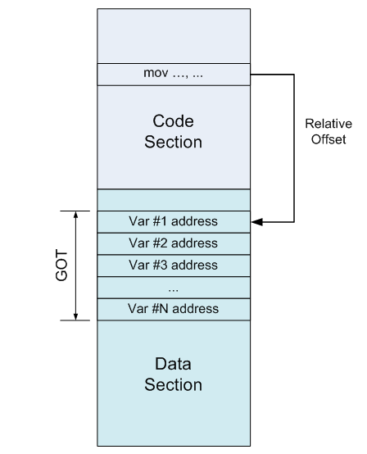
ELF: Accessing global data

Slide 42
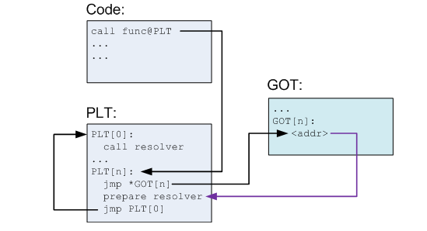
ELF: Calling Procedures (before 1st call)

Slide 43
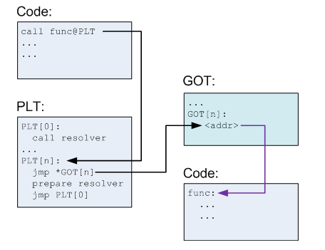
ELF: Calling Procedures (after 1st call)

Slide 44
PIC benefits and costs
Enable loading w/o relocation
Share memory locations among processes
Data segment may need to be reloaded
GOT can be large
More runtime overhead
More space overhead

Slide 45
Shared Libraries
Heavily used libraries
Significant code space
5-10 Mega for print
Significant disk space
Significant memory space
Can be saved by sharing the same code
Enforce consistency
But introduces some overhead
Can be implemented either with static or dynamic loading

Slide 46
Content of ELF file
Program
Libraries
Text
Call
Routine
Text
PLT
PLT
Data
Data
GOT
GOT

Slide 47
Consistency
How to guarantee that the code/library used the “right” library version

Slide 48
Loading Dynamically Linked Programs
Start the dynamic linker
Find the libraries
Initialization
Resolve symbols
GOT
Typically small
Library specific initialization
Lazy procedure linkage

Slide 49
Microsoft Dynamic Libraries (DLL)
Similar to ELF
Somewhat simpler
Require compiler support to address dynamic libraries
Programs and DLL are Portable Executable (PE)
Each application has it own address
Supports lazy bindings

Slide 50
Dynamic Linking Approaches
Unix/ELF uses a single name space space and MS/PE uses several name spaces
ELF executable lists the names of symbols and libraries it needs
PE file lists the libraries to import from other libraries
ELF is more flexible
PE is more efficient

Slide 51
Costs of dynamic loading
Load time relocation of libraries
Load time resolution of libraries and executable
Overhead from PIC prolog
Overhead from indirect addressing
Reserved registers

Slide 52
Summary
Code generation yields code which is still far from executable
Delegate to existing assembler
Assembler translates symbolic instructions into binary and creates relocation bits
Linker creates executable from several files produced by the assembly
Loader creates an image from executable

