Slide 1
Indy: Technical test Steel Plate Defect Prediction: A simple & pragmatical approach of ML 18/03/2024 Nicolas Legrand

Slide 2

Introduction
Kaggle competition :
Duration: 1 month.
Teams: More than 1.3k involved.
Goal : Predict the probability of various defects on steel plates.
Motivation:
May concern Indy's problematics: categorizing banking transactions
Taking part in a competition is a great way to challenge and learn.
Can a simple and pragmatic approach to ML concepts perform well in a highly competitive environment?

Slide 3
Summary
Data Overview
Methodology
Results
Final Thoughts
Appendices

Slide 4
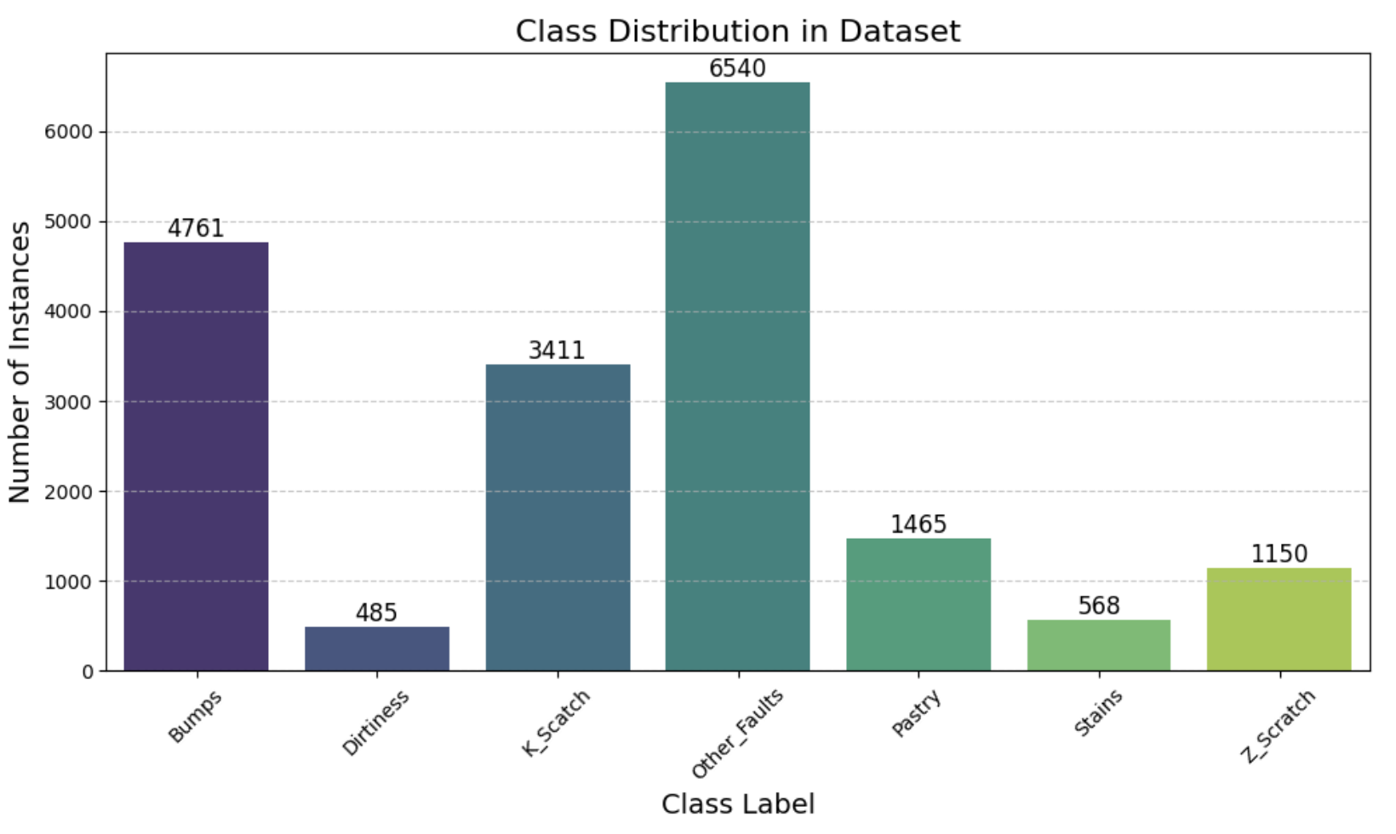
Data Overview: Targets
Exploratory Data Analysis (EDA):
7 defect categories:
Imbalanced classes
Hypothesis:
Remove multilabel rows (<0.1%)
Multiclass classification problem:
Multilabel -> Single-label

Slide 5
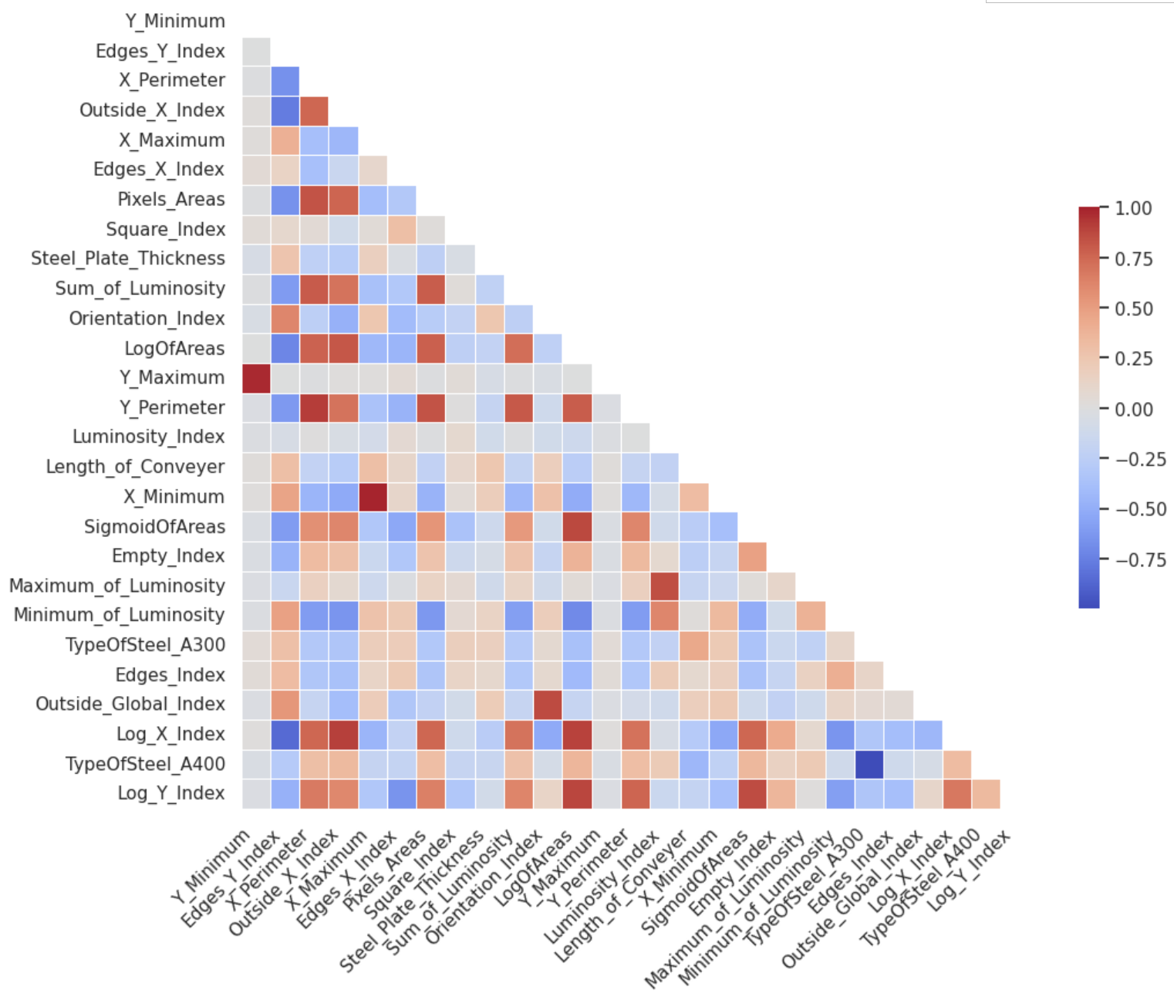
Data Overview: Features
Exploratory Data Analysis (EDA):
18.380k rows
27 features:
25 numerical
2 Categorical (binary)
No missing values
Independent but correlated features
Additional Feature Engineering:
2 features added thanks to Symbolic Regression

Slide 6
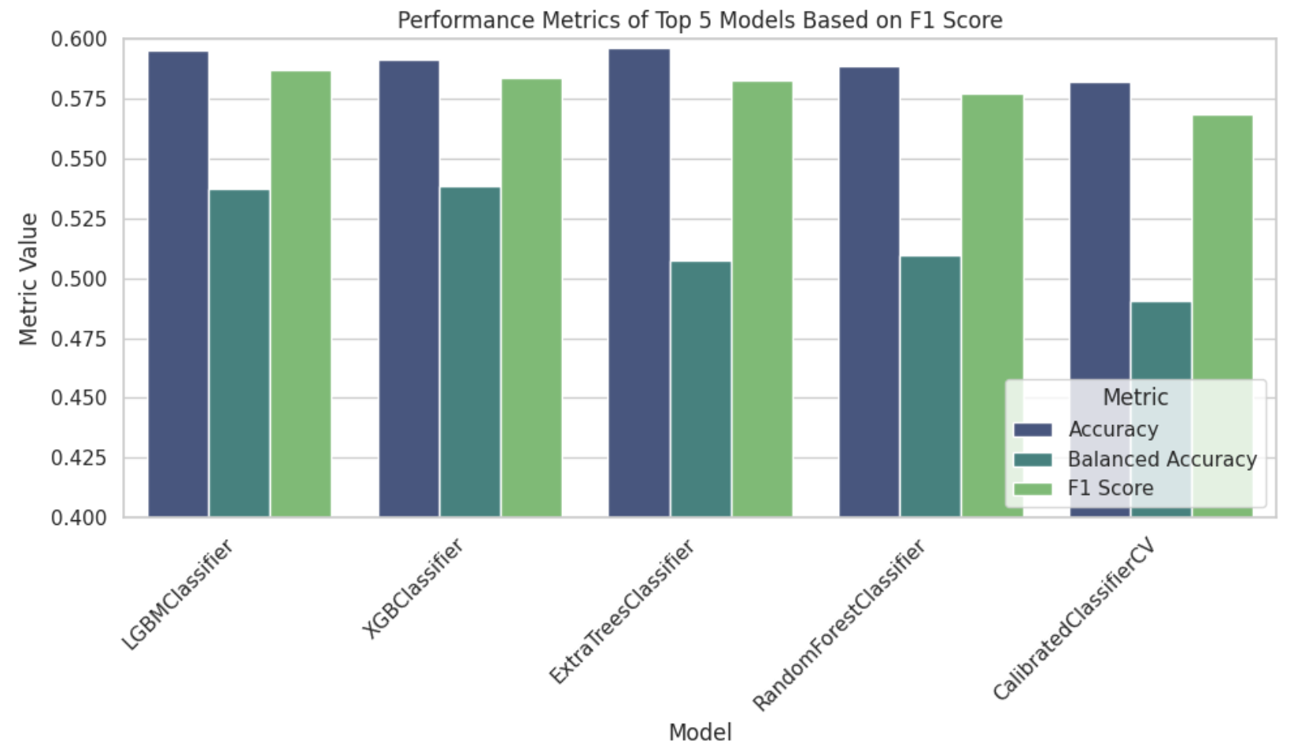
Methodology
Model selection with LazyPredict:
26 models tested
Rank by F1 score as it balances precision and recall
The choice of LightGBM:
Perform well
Handle overfitting due to correlated features with regularization
Enable to deal with unbalanced classes
Notes:
F1 Score can sometimes serve as a good proxy because it balances the precision and recall of the classifier, which might correlate with good AUC performance in imbalanced classification tasks.

Slide 7

Methodology
Trainset
90%
10%
Train/Test ShuffleSplit:
Test size = 10%
Cross validation:
5 folds
Stratification & Shuffling
HPs Optimization with Optuna:
8 classical HPs & 100 iterations
Exception for “n_estimators”:
Early stopping 1/10
CV Trainset
Testset
Optuna + CV
HPs
Hps*
Final train
n_estimators
LightGBM
HPs*
n_estimators*

Slide 8
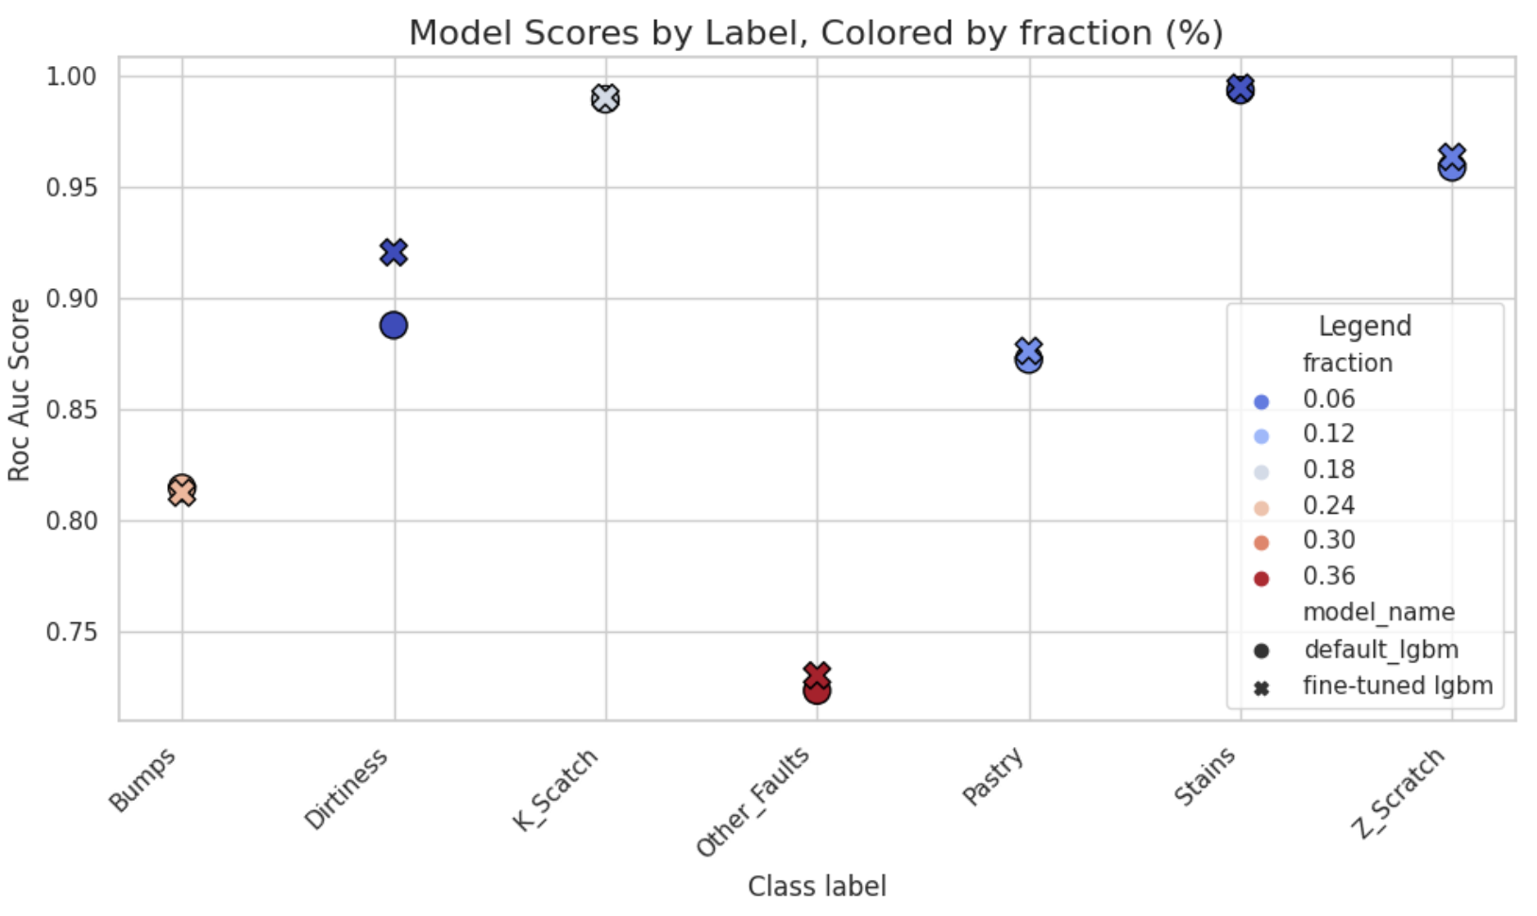
Results on Testset
Custom evaluation metric:
Average of AUC scores for all classes: “my_auc_avg”
Use of LightGBM Python API
Interpretations:
Performance gain over benchmark: +8% with score of 0.898
Least well-predicted classes are those with the most data..!

Slide 9
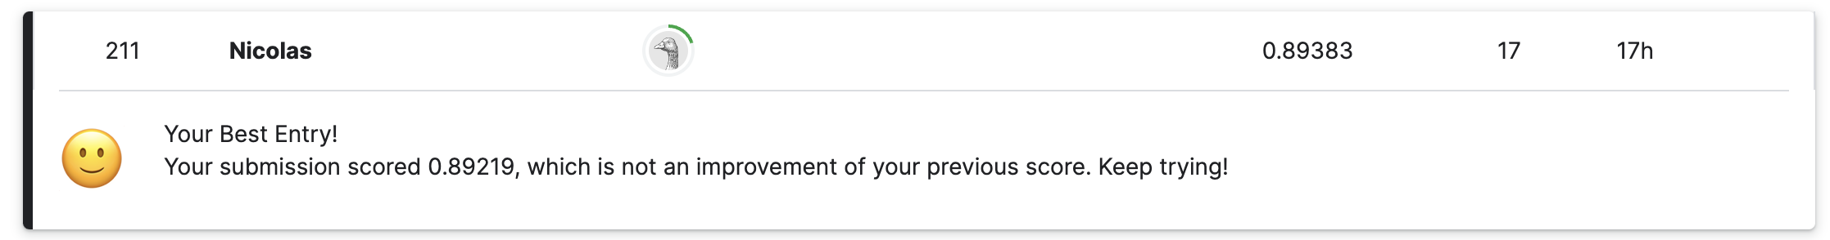
Results on Kaggle
Kaggle ranking:
Mean auc score of 0.89383 on the hidden test set
Ranked 220 over 1300 teams i.e. in the first 17%
Next steps:
Integrate the original dataset – adding 2k of data - as suggested by Kaggle
Invest much more time on feature engineering & modeling:
PCA, Outliers, Umap & Clustering, Ensemble model, Class weights etc…

Slide 10
Final Thoughts
First encouraging performance only thanks to rigorous application of ML principles :
Top 17% ranking in a multi- classification Kaggle competition
In general, simple & pragmatic approach enables:
Rapid iterations with feedback for software/product development
Respect KISS (Keep It Simple, Stupid) & YAGNI (You Ain't Gonna Need It) principles
Beyond Modeling: The ML Lifecycle
Transitioning from notebook experiments to production-ready code: See code on Github
MLOps (Deploying, Serving & Monitoring) is an important part of the job!

Slide 11
Thank you!
Questions? ☺

Slide 12
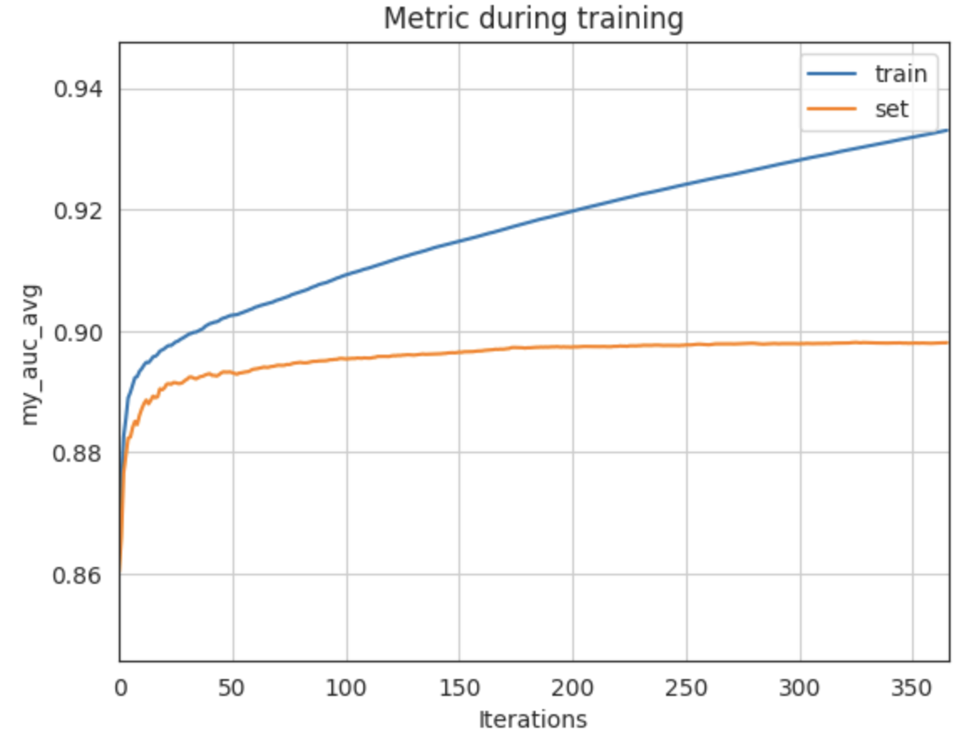
Appendices:

Slide 13
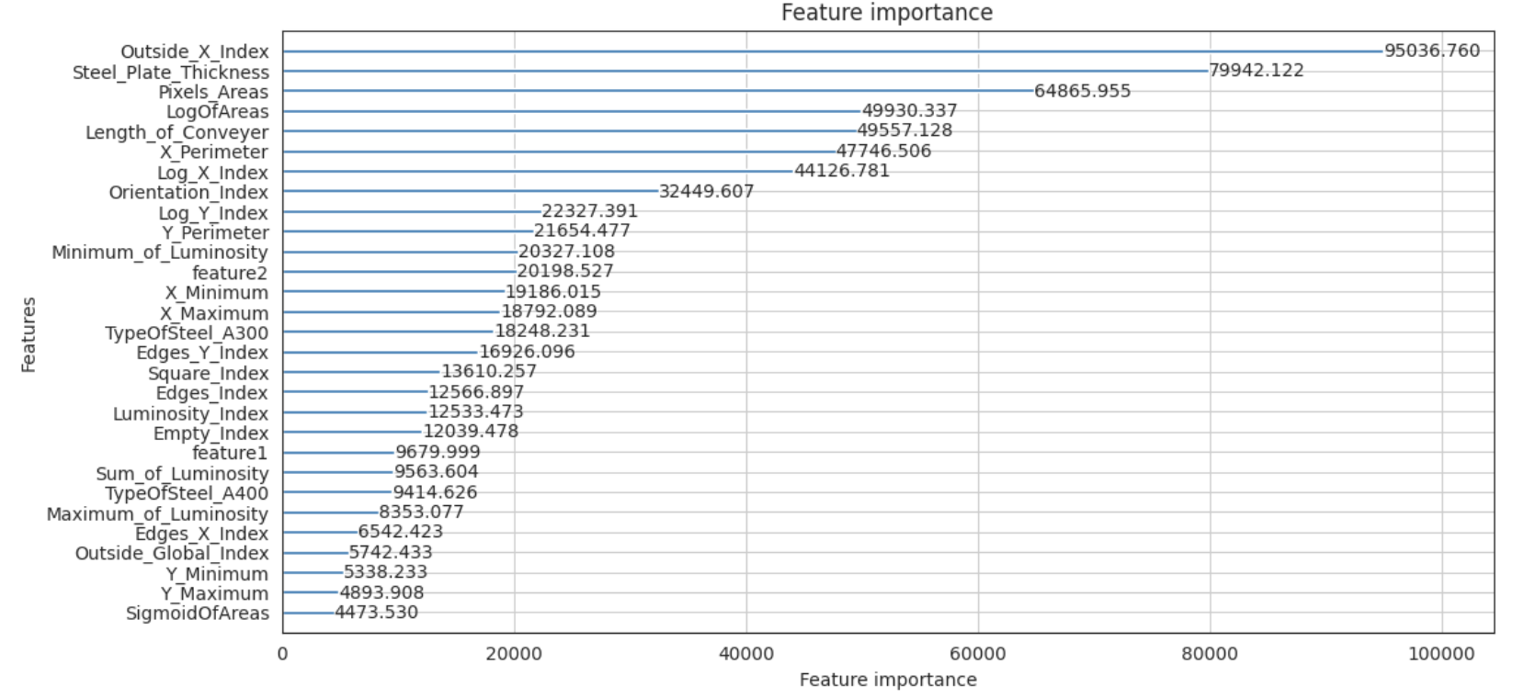
Appendices:

Slide 14
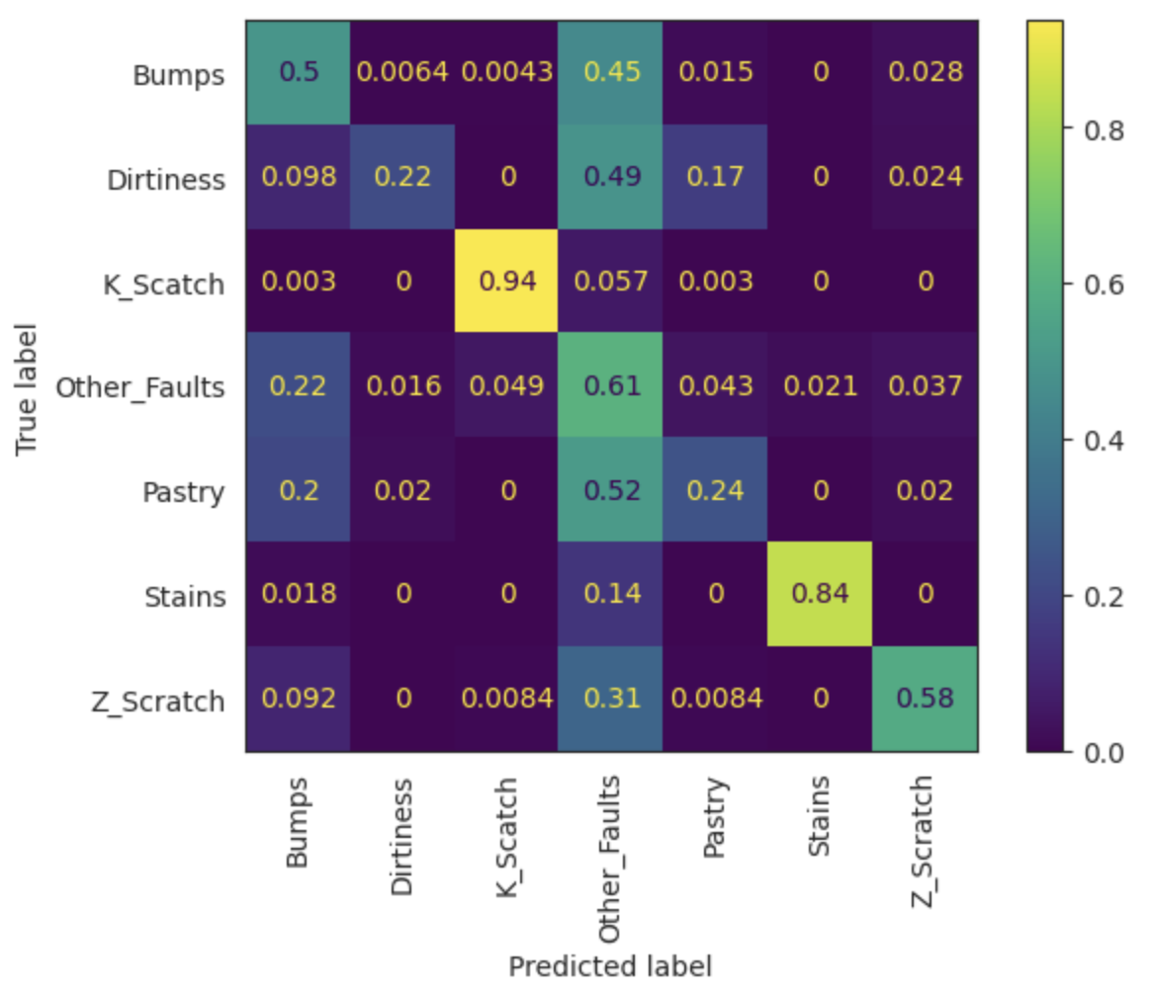
Appendices:

