Slide 1
EDES 301 PCB Project
Alejandro Andrade
Due 05/05/2025 @ 11:59pm

Slide 2
Background Information
RF Transponder with GPS position and RF functionality
Hardware:
12-pin JST Connector
CC1200 (Transmitter)
CC1190 (RF Front End)
NEO-M9N (GPS Module)
ANN-MB5 (Active Patch Antenna)
Whip Antenna
2x 915 MHz Coupler
1.5 GHz Coupler

Slide 3
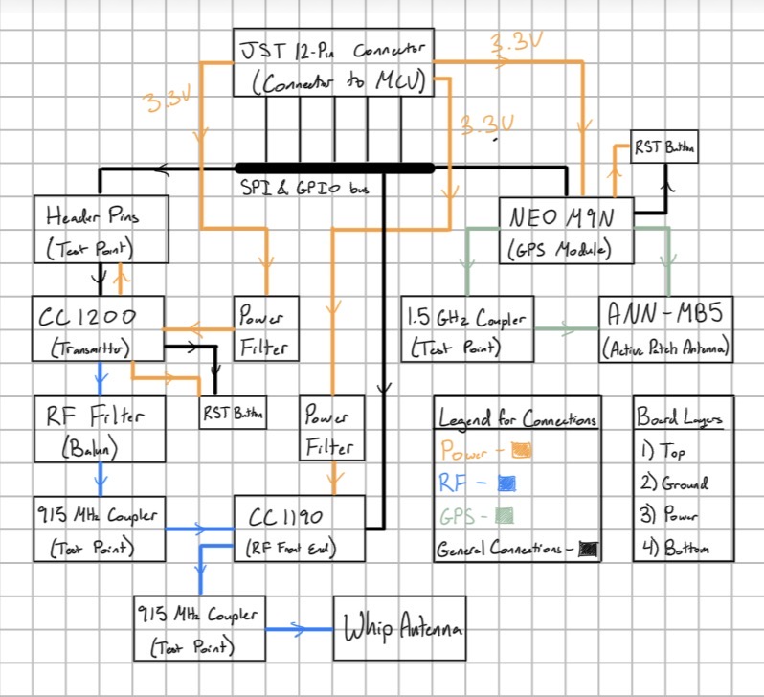
System Block Diagram

Slide 4
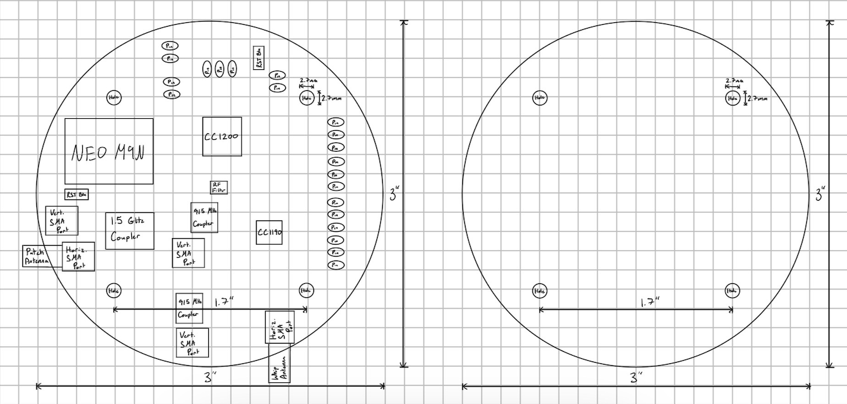
Mechanical Drawing
FRONT
BACK

