Slide 1
EDES 301 Portable Drum Machine Proposal
02/22/2026
Alejandro Andrade

Slide 2
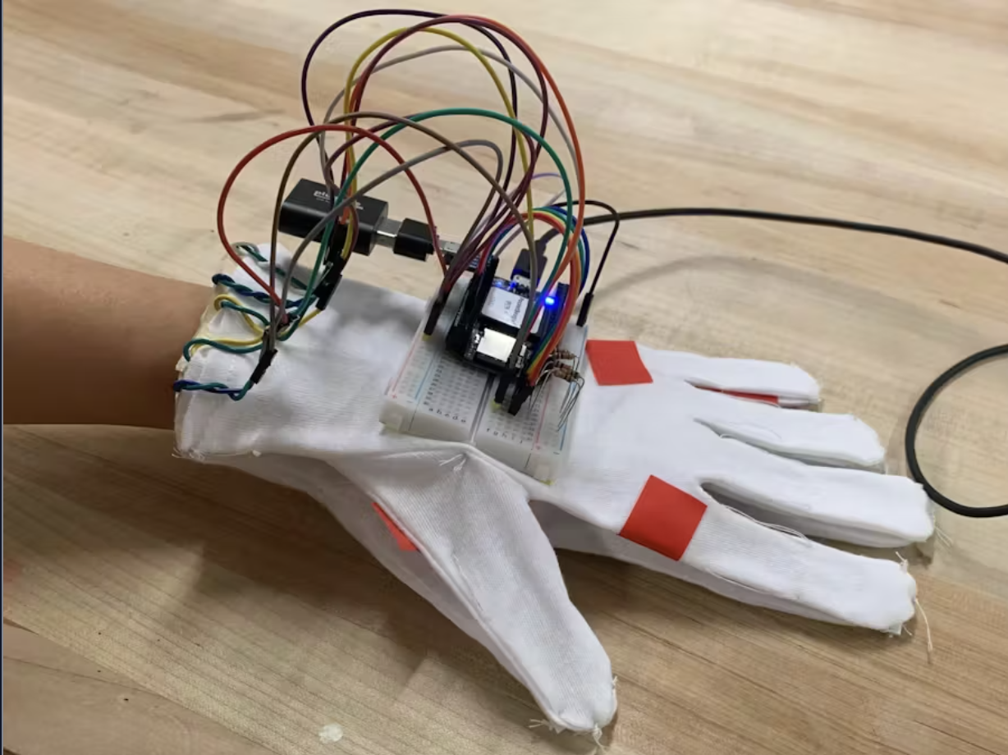
Background Information
What is being proposed?
A portable drum machine with an audio jack for headphones and a metronome, activated by touch sensors. Another important factor is that I want memory storage so that you can save and call back drum patterns and play them so you can use them later. The purpose of this mini drum machine is that you can take it with you anywhere and then come back home with pattern ideas, and use your real drum machine to produce music.
Pictures
Links to existing projects / libraries
https://www.hackster.io/jas21/pocketbeagle-synthesizer-10f638
https://www.hackster.io/eric-voigt/instrument-glove-4537b7
What improvements / additions over existing project
Metronome
Memory
Perhaps several instruments?
Volume Control
Scrolling

Slide 3
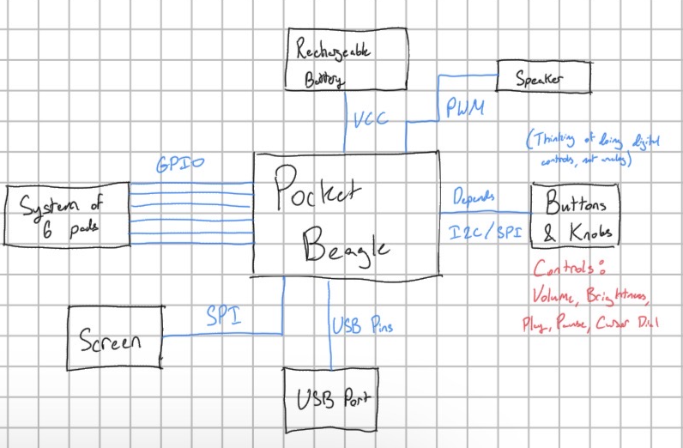
System Block Diagram
Create a System Block Diagram
Label interfaces (I2C, SPI, GPIO, etc.; You do not need to know all of the connections)
Components (part numbers if possible)

Slide 4
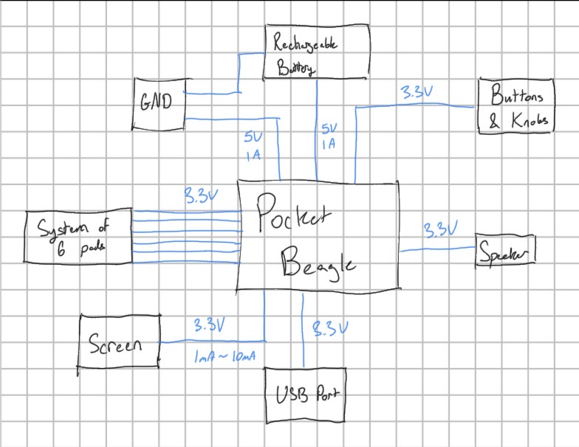
Power Block Diagram
Create a Power Block Diagram
Label voltages / currents of components

Slide 5
Components / Budget
Component | EDES301 to Buy? | Cost
Screen | Yes | 11.48
USB to Audio Jack | Yes | 0.92
Capacitive Touch Pads | Yes | 8.39
USB Port | Yes | 6.99
Dials | No | -
Buttons | No | -
Speakers | Yes | 7.95
Rechargeable Battery | Yes | 7.78
See Next Slide for Instructions

Slide 6
Component Selection (Remove slide for submission)
All components must be from either: Amazon, Adafruit, Sparkfun, Digi-Key, or Mouser
Select no more than two (2) components that are not on approved component spreadsheet
See Canvas 🡪 Files 🡪 assignments 🡪 EDES301_project_01_parts_list.xlsx
If there is a cheaper part that you would like to use, we can discuss in the project meeting
All components needed for the project should be listed on Slide 5
All components should have links to the website where they can be purchased
Please trim URLs for links to Amazon
EDES301 will supplement $25 to $35 dollars for components
Please indicate what components need to be purchased by EDES301
If you have a special request, we can discuss in the project meeting

