Slide 1
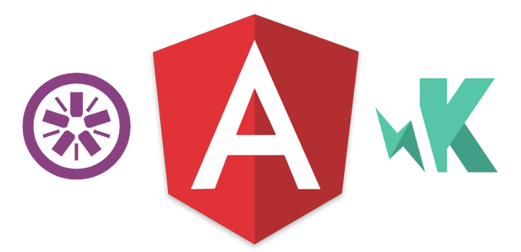
Unit Testing in AngularJS
with Karma & Jasmine
by Alyona Pysarenko

Slide 2
Unit Testing: What and Why?
Proof of correctness
Lack of compiler
Catch errors early
Prevent regressions

Slide 3
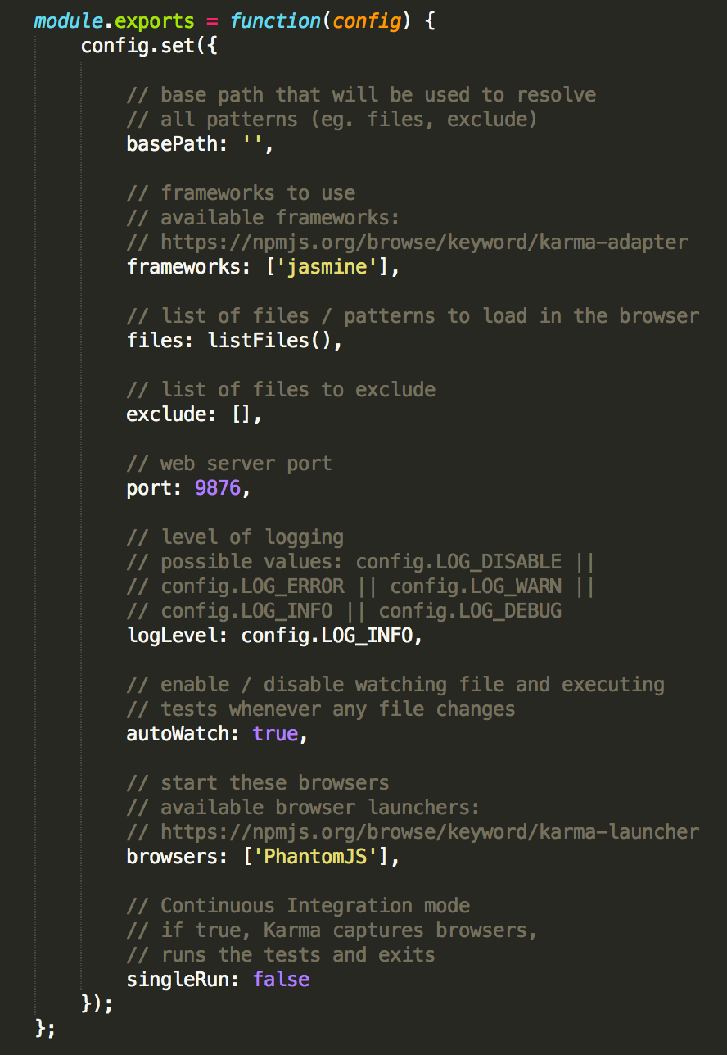
Introduction to Karma
Karma is the test runner that makes running tests painless and amazingly fast.
Explaining the Karma Config:
basePath
frameworks
files
exclude
port
logLevel
autoWatch
browsers
singleRun

Slide 4
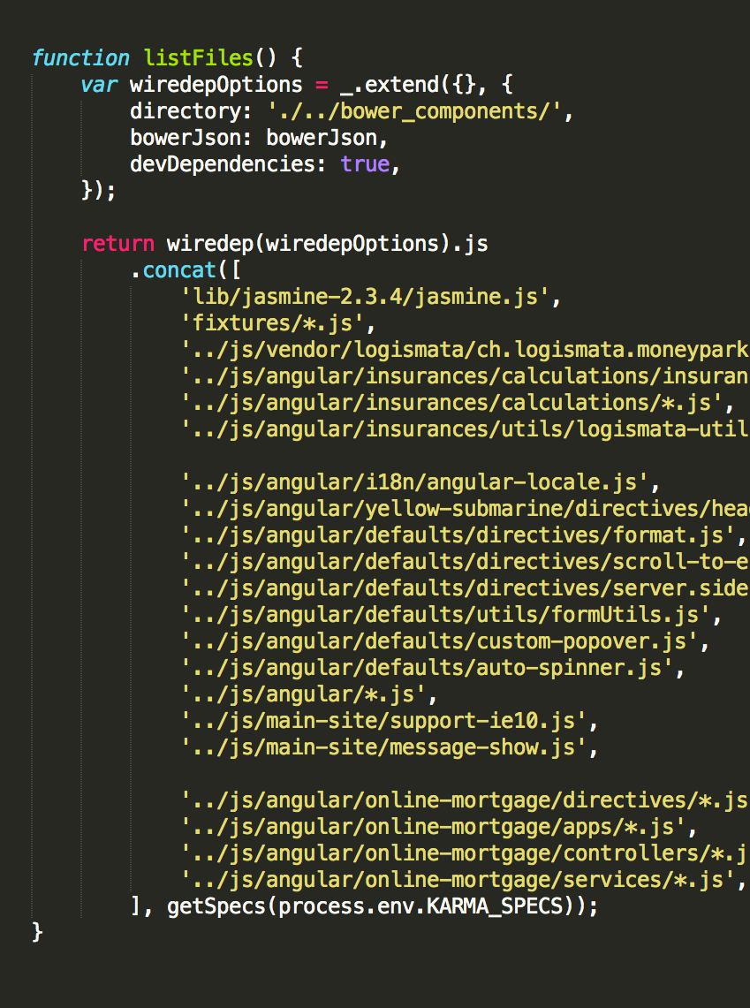
“Files” Option in Karma
The list of files paths to load

Slide 5
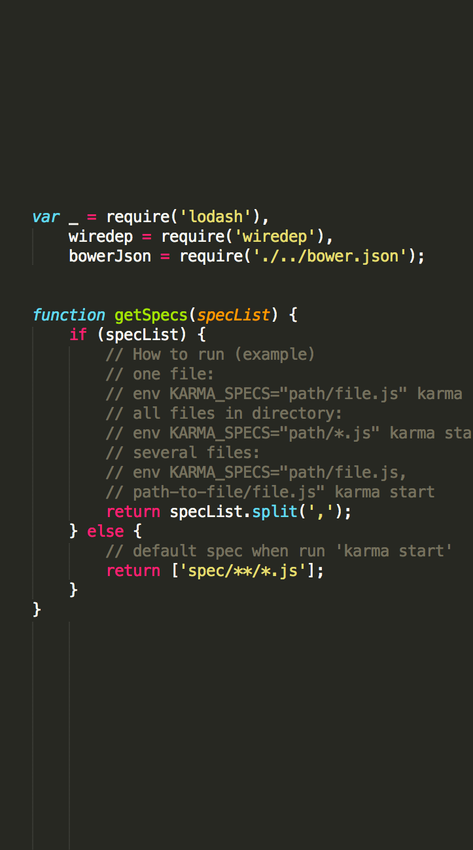
Possibility to run specific file
getSpecs() function

Slide 6
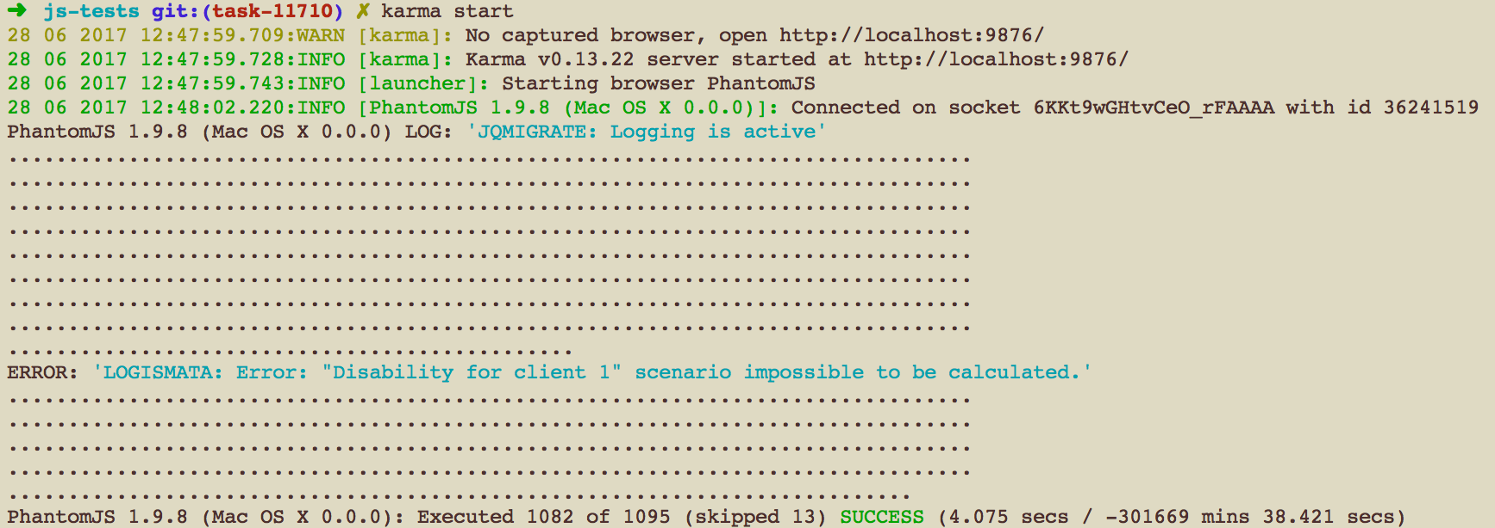
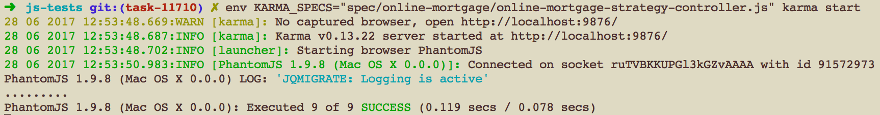
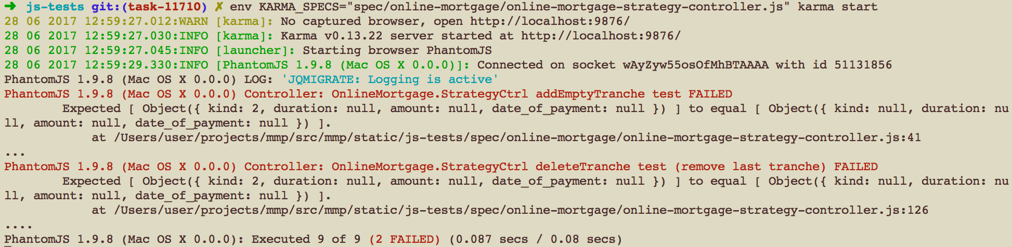
How to run and verify results?
karma start
env KARMA_SPECS=“spec/online-mortgage/online-mortgage-strategy-controller.js” karma start
Success
Failed

Slide 7
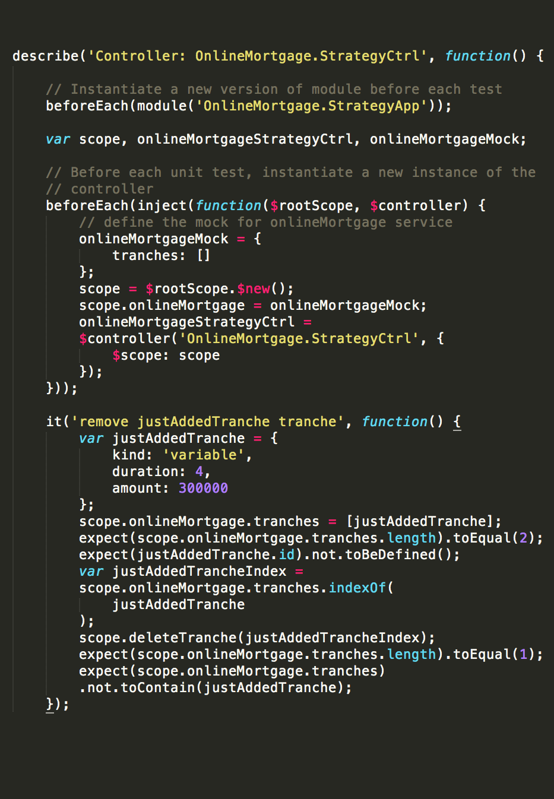
Jasmine: Spec Style of Testing
Jasmine Syntax
describe
beforeEach
it
afterEach
expect
Useful Jasmine Matchers
toEqual
toBe
toBeTruthy
toBeFalsy
toBeDefined
toBeUndefined
toBeNull
toContain
toMatch

Slide 8
Mocking Out Services
Inline mock
The first way is to override the service during the unit test, as an inline mock
Global mock
The second option to override services would be at a global level instead of a unit test level.

Slide 9
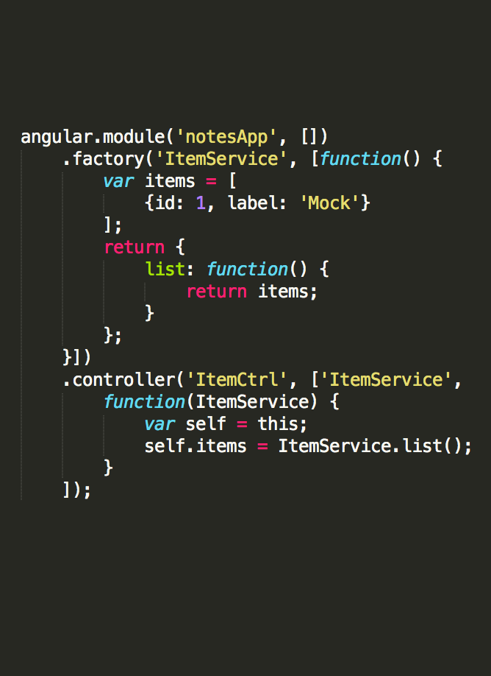
a Simple AngularJS Service
to mock out

Slide 10
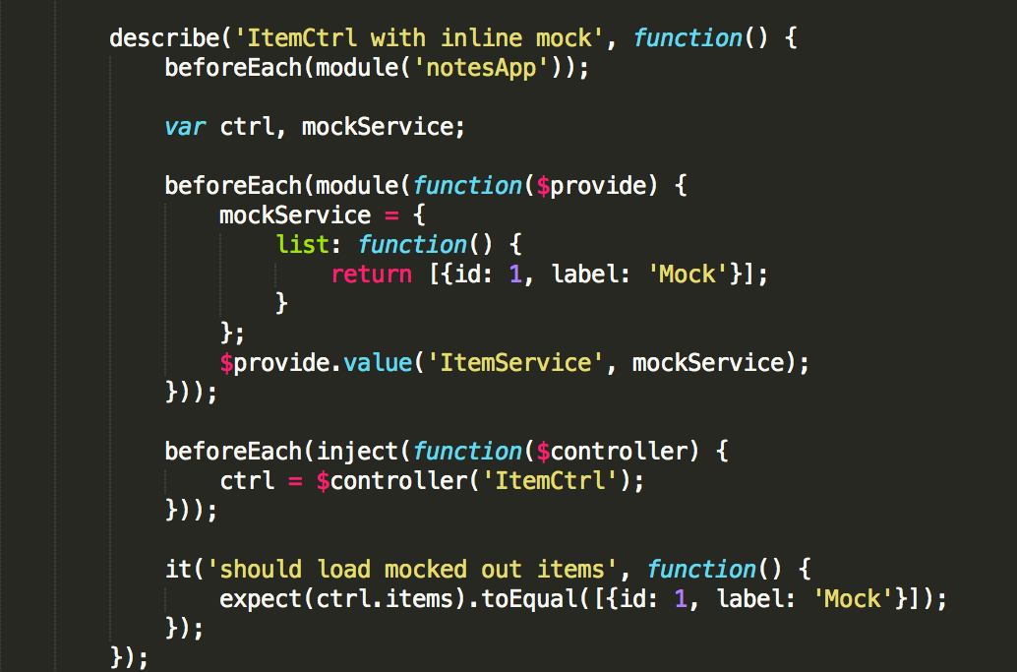
inline service mock

Slide 11
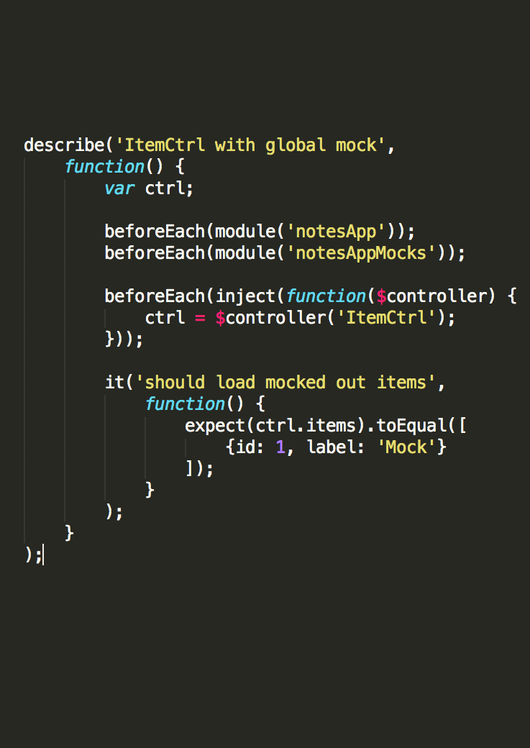
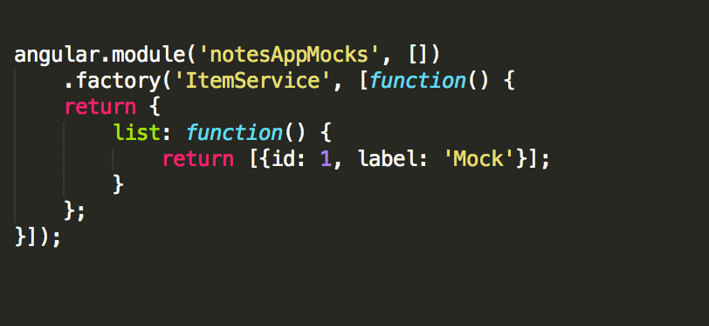
Global Service mock
File: notesApp-mocks.js

Slide 12
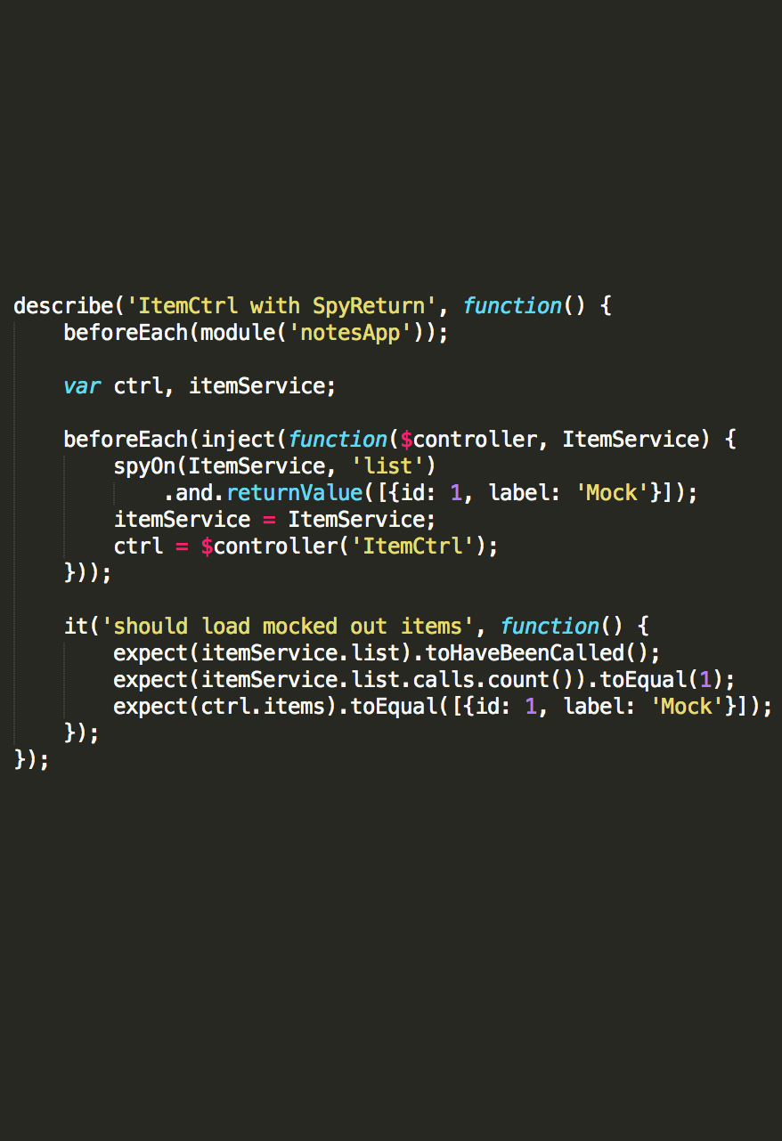
Spies
In Jasmine, mocks are referred to as spies.
Spies allow us to hook into certain
functions, and check whether they:
were called
how many times they were called
what arguments they were called with
define value that has to be retuned

Slide 13
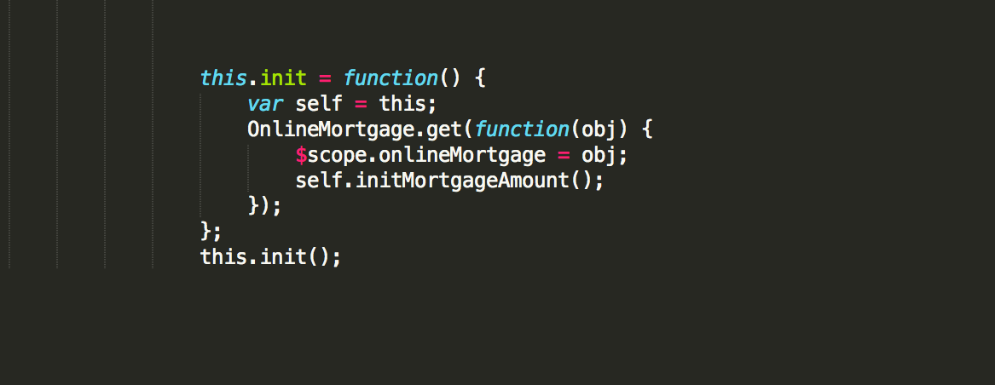
Unit Testing Server Calls
init() function in controller

Slide 14
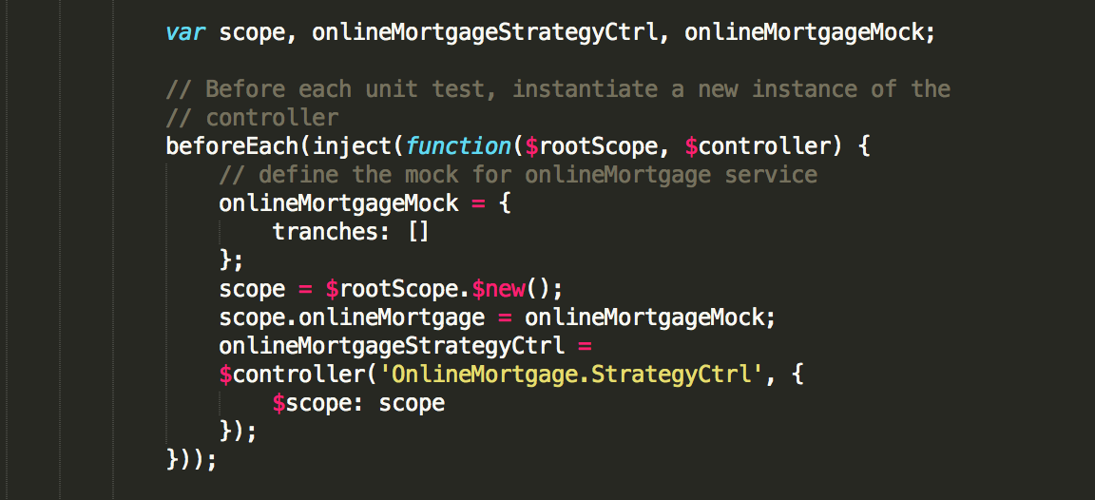
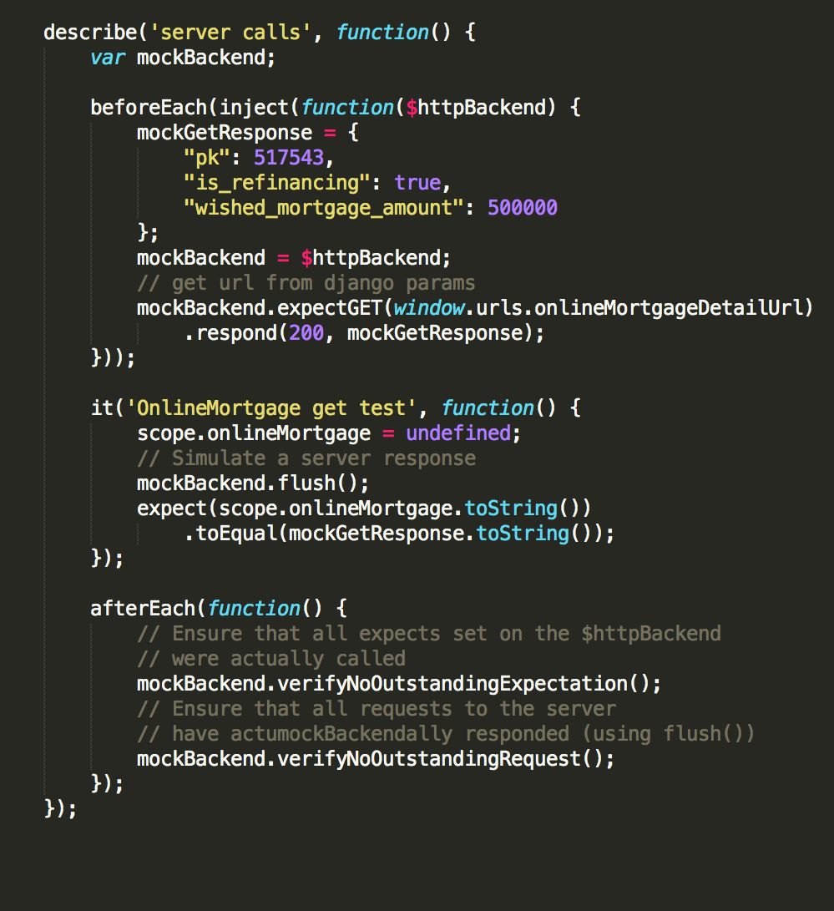
Unit Testing Server Calls
The $http service internally uses the $httpBackend to make the actual XHR requests.
The angular-mocks.js file provides a mock $httpBackend service that
prevents server calls
gives us hooks to set expectations mockBackend.expectGET(‘/api/note’).respond(200, mockGetResponse)
allow to trigger responses flush()

Slide 15
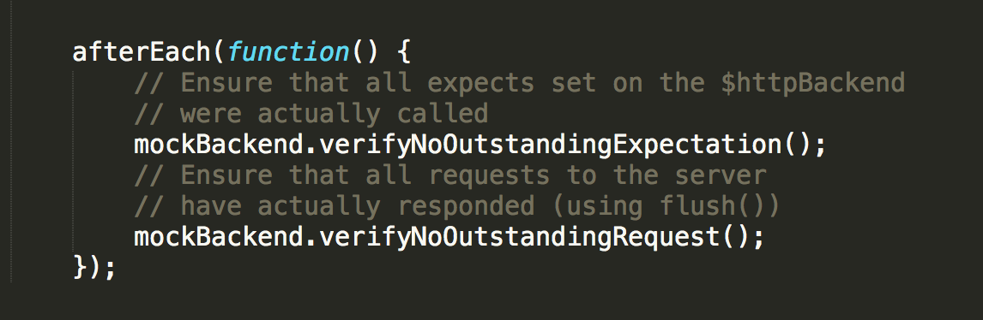
afterEach FUNCTIONS
verifyNoOutstandingExpectations()
Ensure that all expects set on the $httpBackend were actually called
verifyNoOutstandingRequests()
Ensure that all requests to the server have actually responded (using flush())

Slide 16
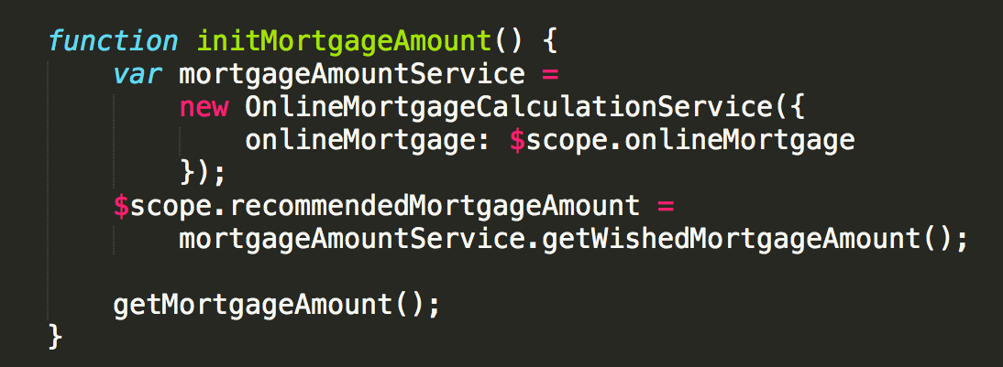
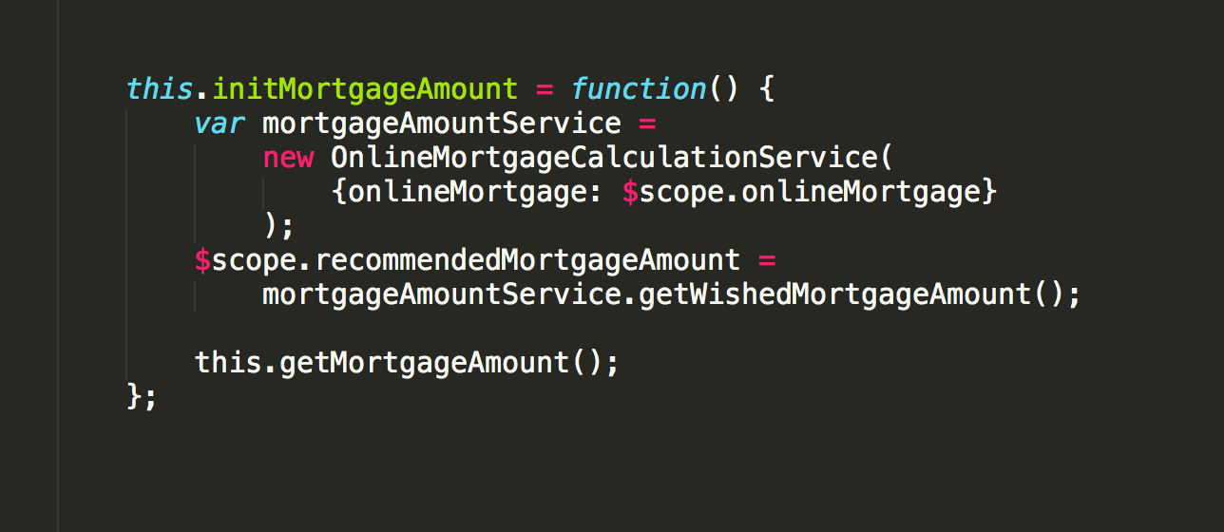
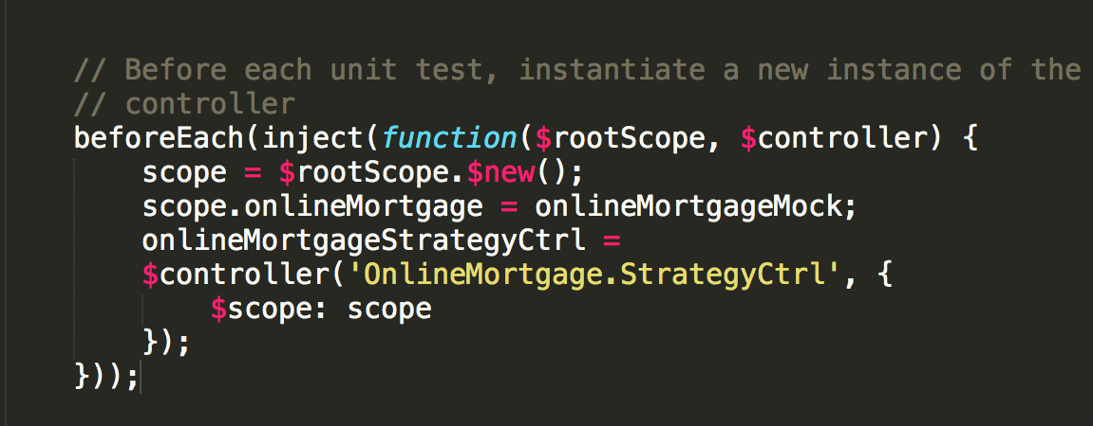
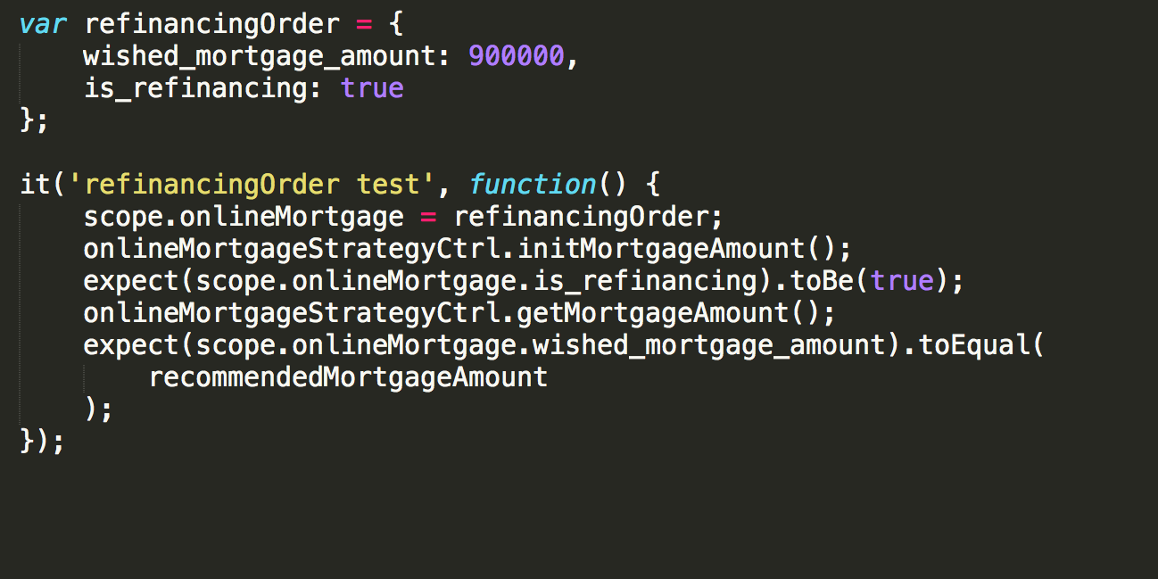
Issues we met
Syntax of private functions in controller
before test
after test
Call private function in test

Slide 17
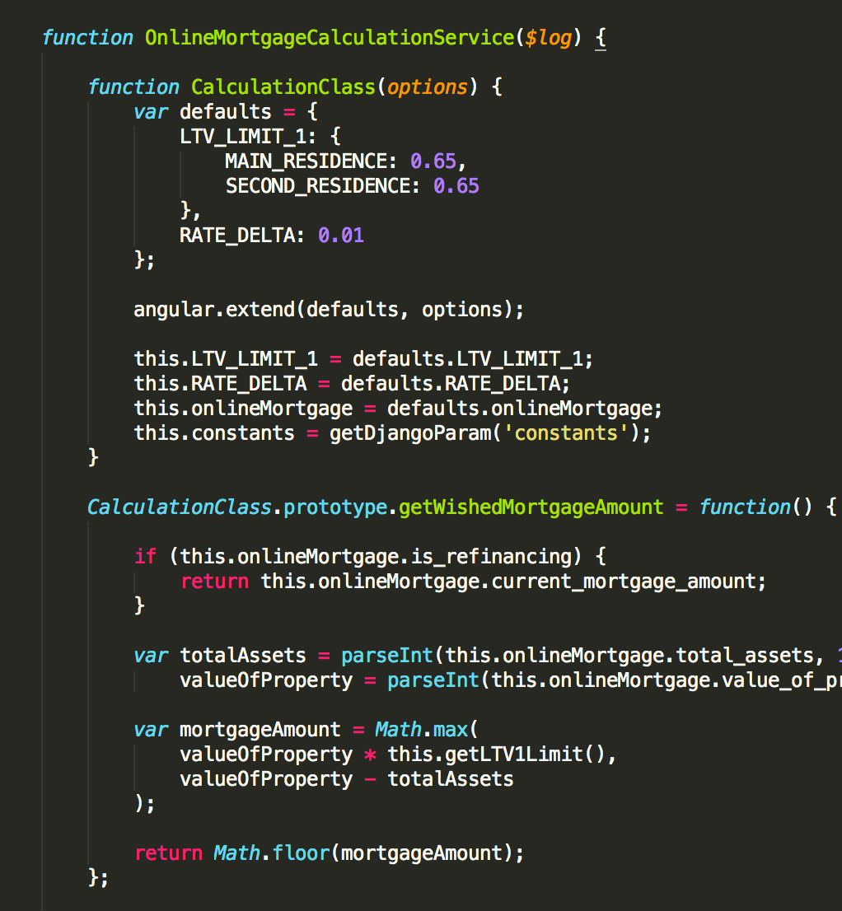
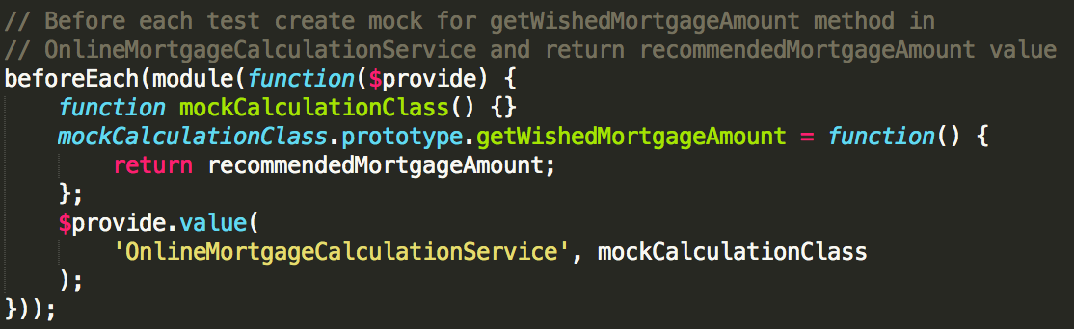
Issues we met
2. Mocking service that returns class with extended prototype

Slide 18
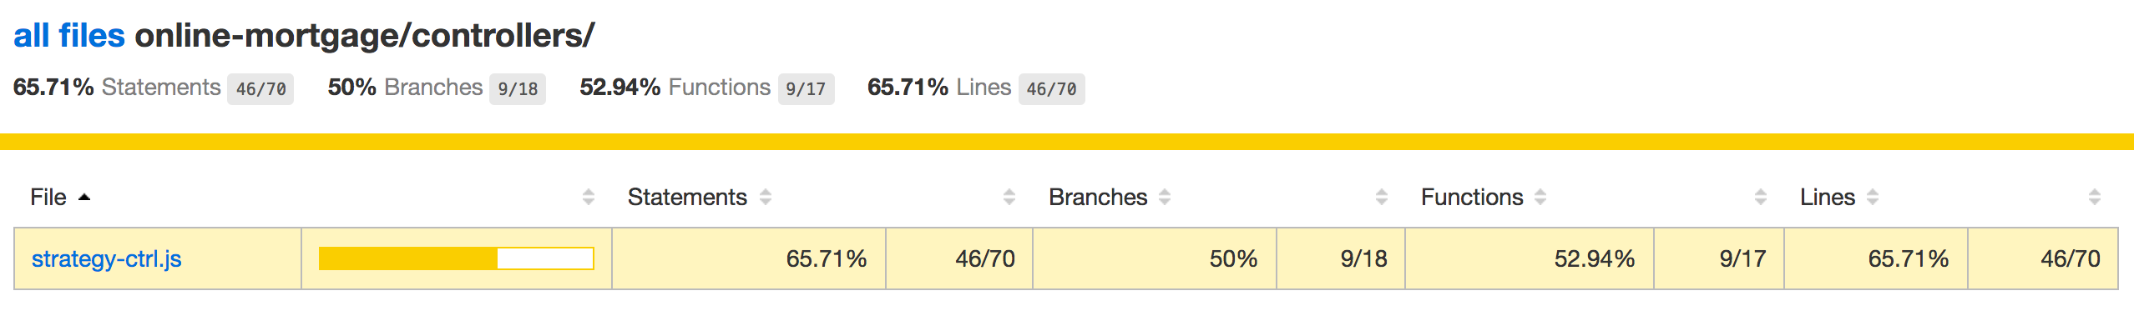
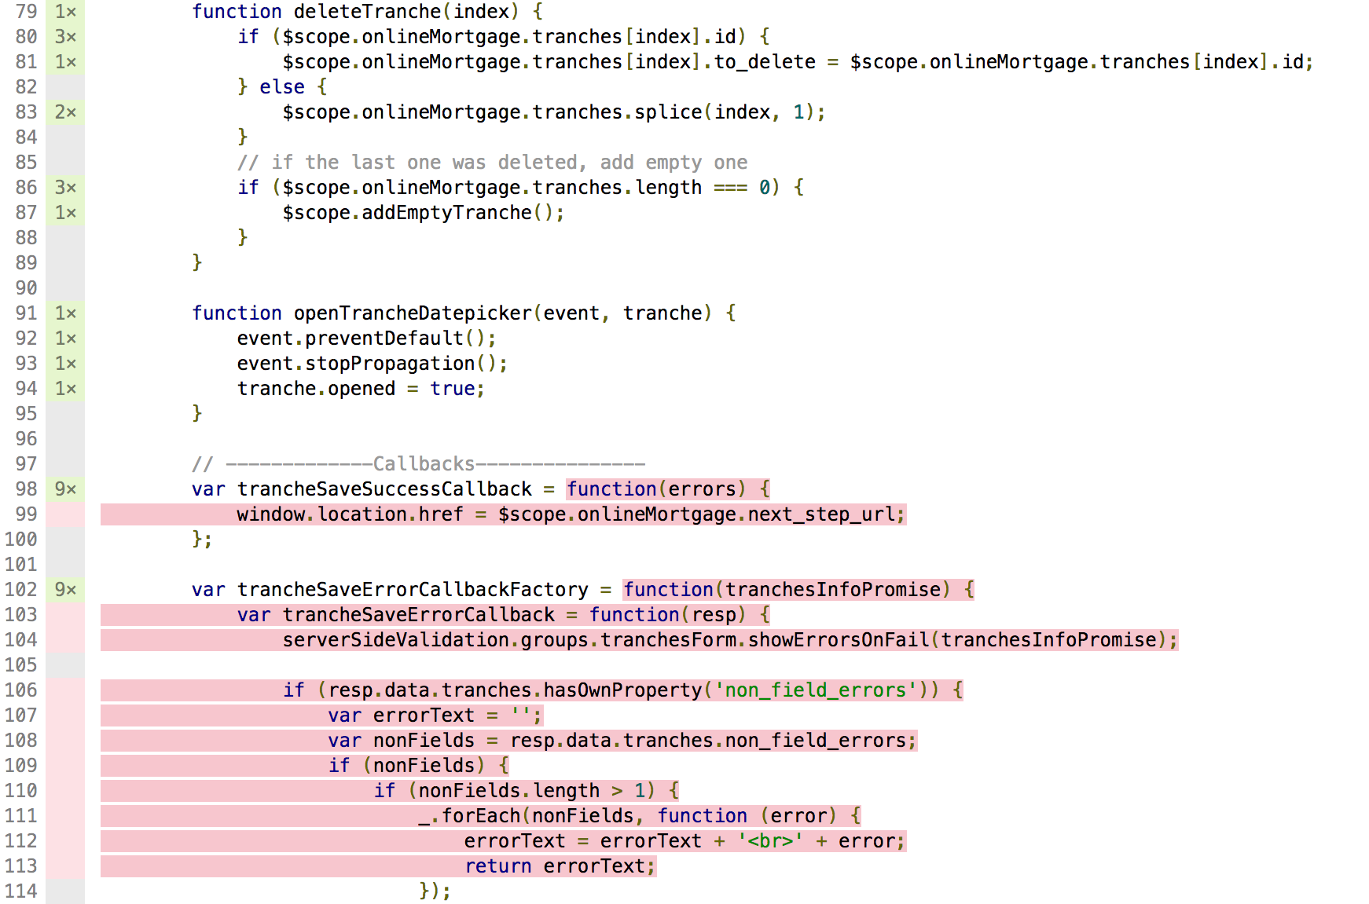
Test COVERAGE

Slide 19
Thank you
for your attention!

