Slide 1


RNCP35288 CDSD Bloc 2
Analyse exploratoire, descriptive et inférentielle des données
Analysing airline growth
using Snowflake
Ned CHAMBERS
25/02/2025
Group #dafs-ft-09, groupe en distanciel

Slide 2

Summary
Dataset
Data preparation
Insights
Conclusion
Notes:
Image source: Home · NYC311 (screenshot)
Exemples des choses que 311 vous permet de faire :
faire réparer un nid-de-poule dans votre quartier,
faire remettre le chauffage dans votre appartement,
obtenir un remboursement pour une amende de stationnement payée en trop,
… ou bien encore!
DAVID

Slide 3
1. Dataset

Slide 4
AIRCRAFT_DATA database
Contains five tables:
Table | Contents | Nb. of rows
AIRCRAFT | Aircrafts and their attributes | 5
AIRLINES | Data about 3 different airlines | 3
AIRPORTS | Data about 3 airports | 3
FLIGHT_SUMMARY_DATA | Aggregated flight performance metrics | 1.6K
INDIVIDUAL_FLIGHTS | Flight records | 2.3K
Notes:
IRYNA

Slide 5
2. Data preparation

Slide 6



Data preparation
Created tables in Snowflake and inserted data via DDL commands in a SQL worksheet
Connected Snowflake to Deepnote
Ran queries in a Deepnote notebook to view results
Exported final report as an app & PDF
Notes:
IRYNA

Slide 7
3. Insights

Slide 8
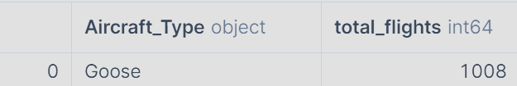
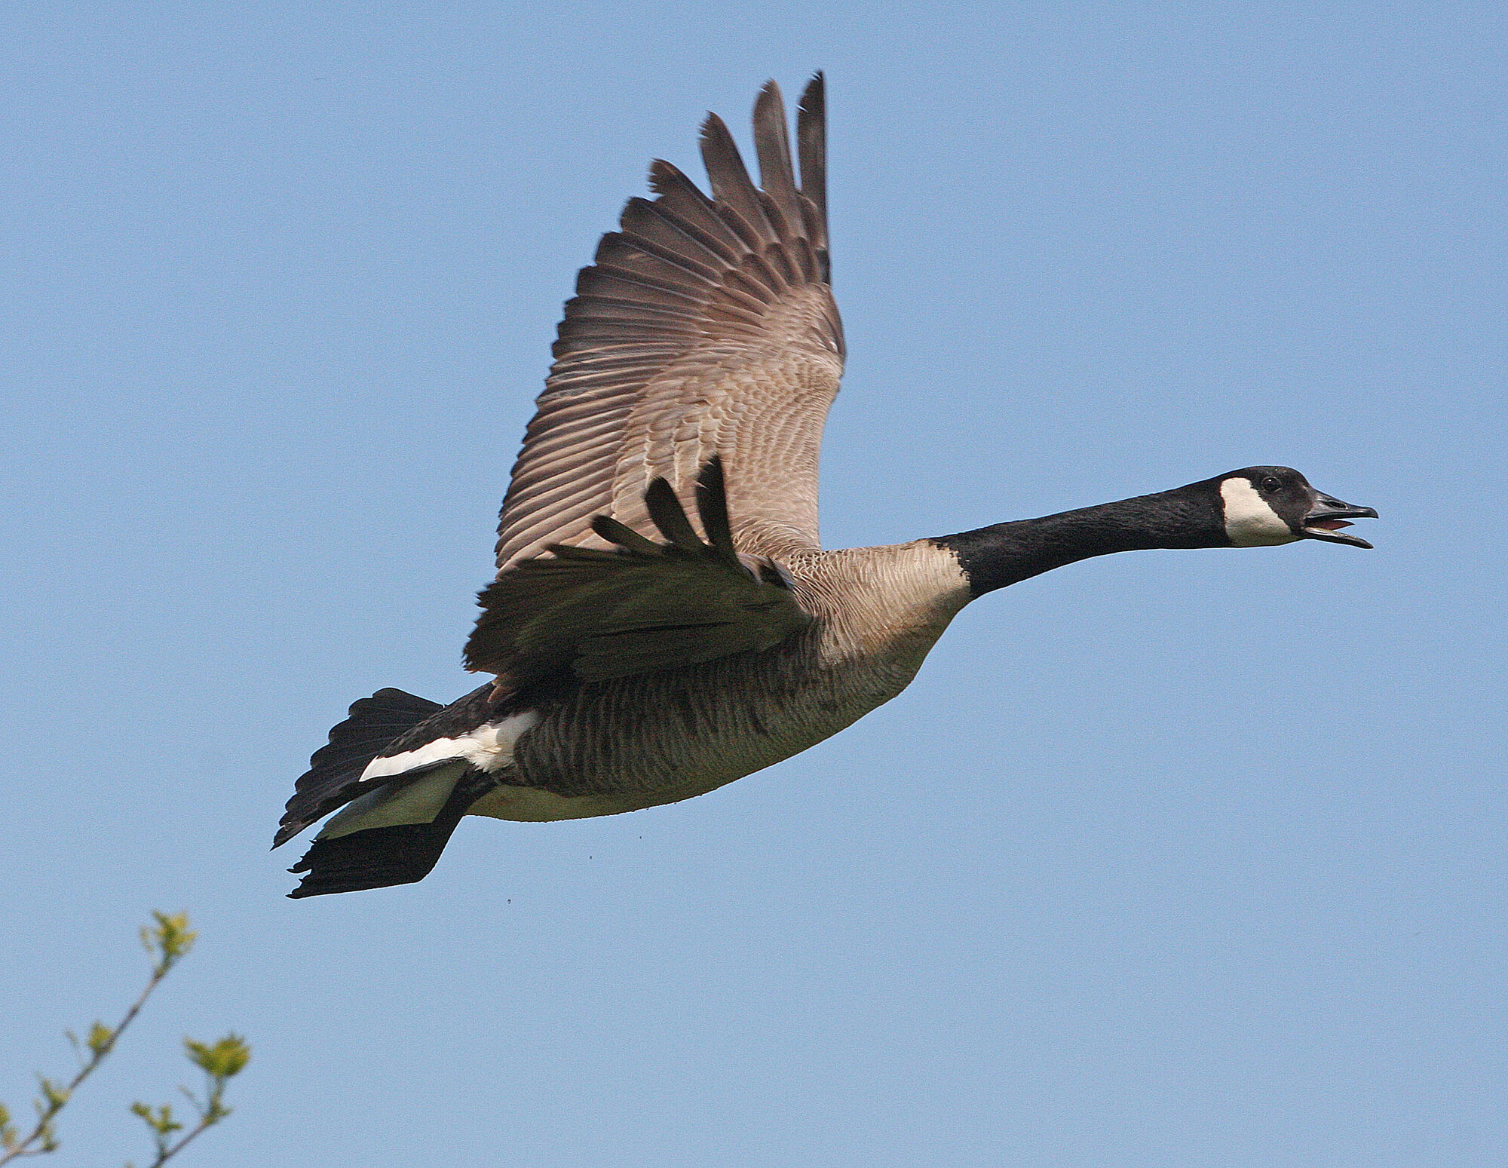
1. Which aircraft has flown the most?
The aircraft with the most flights is the Goose, with 1008 flights in total.
Image source: Wikimedia commons
Notes:
Image source: Wikimedia commons

Slide 9
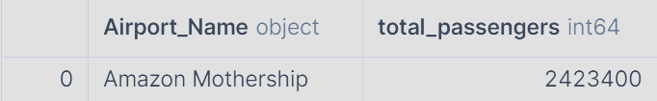
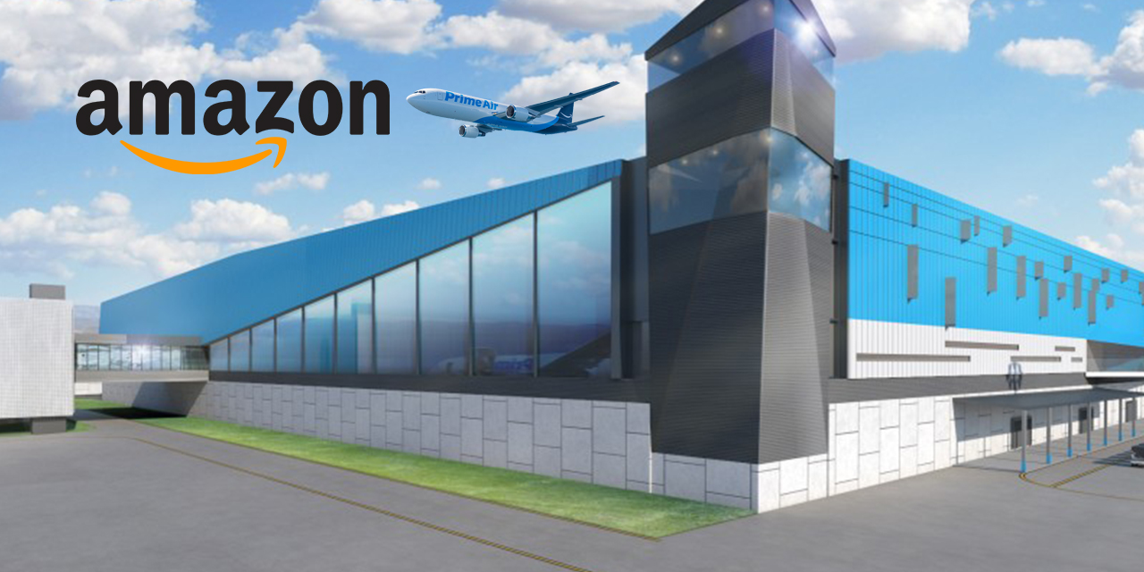
2. Which airport has transported the most passengers through it?
The Amazon Mothership has welcomed a total of 2,423,400 passengers.
Image source: Amazon.co.uk
Notes:
Image source: Wikimedia commons

Slide 10
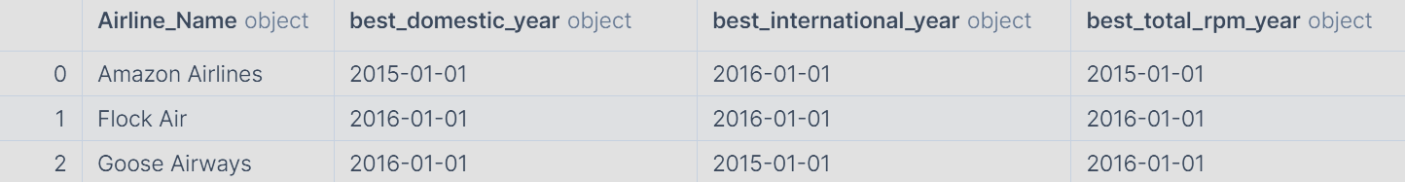
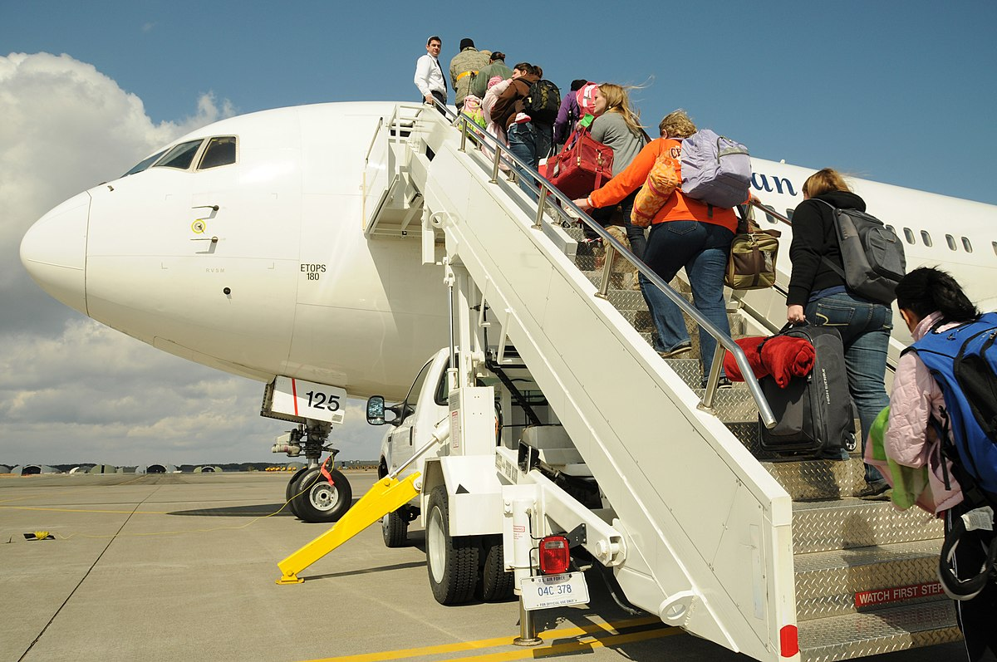
3.
What was the best year for Revenue Passenger-Miles
(RPM) for each airline?
Overall, the best years for RPM were 2015 (for Amazon Airlines) and 2016 (for Flock Air and Goose Airways).
Image source: Wikimedia commons
Notes:
Image source: Wikimedia commons

Slide 11
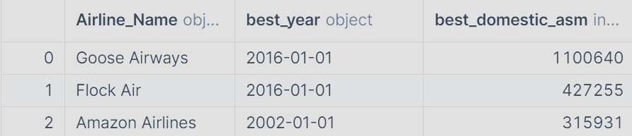
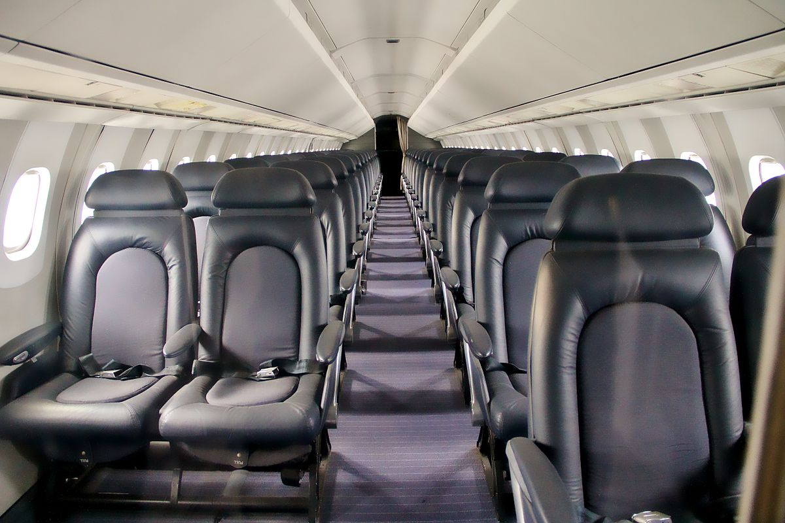
4. What was the best year for growth for each airline, as measured by domestic Available Seat Miles (ASM)?
For Goose Airways and Flock Air, the best year for growth was 2016.
Amazon Airlines reached peak growth much earlier, in 2002.
Image source: Wikimedia commons
Notes:
Image source: Wikimedia commons

Slide 12
4. Conclusions

Slide 13
Summary of insights
Amazon Airlines are the most established company, having reached their peak growth in 2002 and transported 2,423,400 passengers through their flagship Amazon Mothership airport.
Flock Air and Goose Airways are up-and-coming competitors whose growth peaked more recently in 2016. The latter company’s Goose aircraft holds the title for aircraft with the most flights.
The best years for business yet (in terms of RPM) were 2015 for the more established Amazon Airlines and 2016 for their competition.
Notes:
IRYNA

Slide 14
Recommendations for Amazon Airlines
Modernise fleet and expand routes to match rising competition.
Invest in customer loyalty programmes and marketing promotions to retain passengers and attract new customers.
Leverage Amazon Mothership airport by optimising operations and partnerships to maximise passenger flow and revenue.
Notes:
IRYNA

Slide 15
Thank you
for your attention!

