Slide 1


RNCP35288 CDSD Bloc 2
Analyse exploratoire, descriptive et inférentielle des données
Uncovering hidden bias in dating apps
An Exploratory Data Analysis (EDA) project inspired by Tinder
Ned CHAMBERS
25/02/2025
Group #dafs-ft-09, groupe en distanciel

Slide 2

Summary
Disclaimer
Problem & Objectives
Dataset
Data preparation
Insights
Recommendations
6. Next steps
7. Conclusion
Notes:
Image source: Home · NYC311 (screenshot)
Exemples des choses que 311 vous permet de faire :
faire réparer un nid-de-poule dans votre quartier,
faire remettre le chauffage dans votre appartement,
obtenir un remboursement pour une amende de stationnement payée en trop,
… ou bien encore!
DAVID

Slide 3
Disclaimer
1. US and UK legal and ethical context
2. Fictional business case
Notes:
Image source: Home · NYC311 (screenshot)
Exemples des choses que 311 vous permet de faire :
faire réparer un nid-de-poule dans votre quartier,
faire remettre le chauffage dans votre appartement,
obtenir un remboursement pour une amende de stationnement payée en trop,
… ou bien encore!
DAVID

Slide 4
1. Problem & objectives

Slide 5
Problem & Objectives
Problem:
Global decline in Tinder match rates → hurting user satisfaction and retention.
Suspected cause:
Hidden social biases (race, ethnicity, demographics)
Goal:
Understand how biases affect match rates to improve fairness, inclusivity, and user satisfaction.
Notes:
Image source: Home · NYC311 (screenshot)
Exemples des choses que 311 vous permet de faire :
faire réparer un nid-de-poule dans votre quartier,
faire remettre le chauffage dans votre appartement,
obtenir un remboursement pour une amende de stationnement payée en trop,
… ou bien encore!
DAVID

Slide 6
2. Dataset

Slide 7
Speed Dating Data
Contains data on 8,378 real-world speed dating interactions (Columbia Business School, Ray Fisman & Sheena Iyengar).
Key attributes:
Demographics (age, race, income)
Ratings (attractiveness, fun, shared interests)
Match outcomes (decisions to go on a second date)
Methods used:
EDA & data cleaning (Python: Pandas, NumPy), statistical hypothesis testing (SciPy), visualisation using Python libraries (Seaborn, Matplotlib, Plotly)
Notes:
IRYNA

Slide 8
3. Data preparation

Slide 9
Data preparation
Loaded dataset from CSV
Explored data to understand structure
Removed columns with excessive missing values
Selected key features (demographics, personality traits, match outcomes)
Imputed missing values in critical columns
Validated data types and ranges
Formatted categorical variables for analysis
Notes:
IRYNA

Slide 10
4. Insights

Slide 11
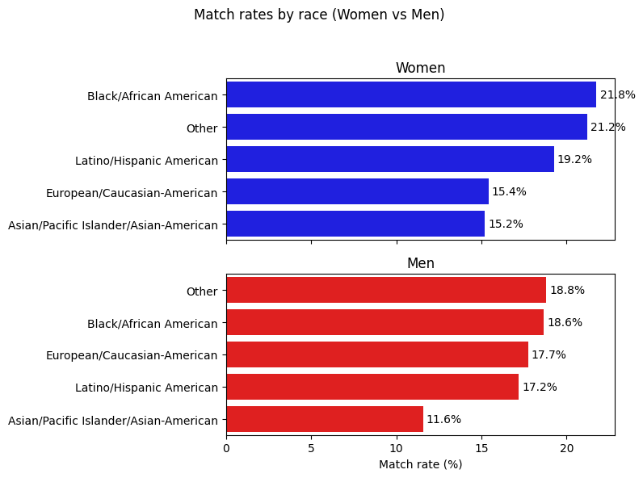
Hidden biases shape dating outcomes
Significant disparities in match rates exist
(Kruskal-Wallis:
p<0.0001)
Notes:
Image source: Wikimedia commons

Slide 12
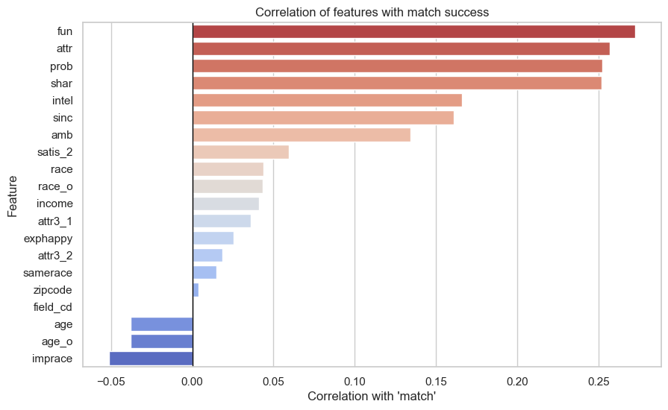
Personality and compatibility drive meaningful connections
Being perceived as fun, attractive, and sharing interests strongly predicts match success.
Notes:
Image source: Wikimedia commons

Slide 13
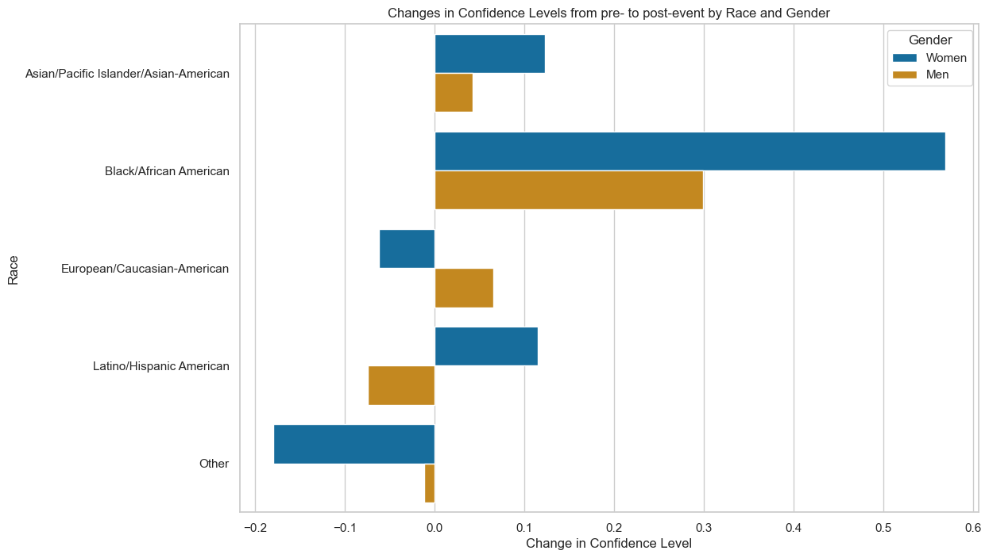
Successful matches positively reinforce confidence
Kruskal-Wallis:
p<0.0000
Test statistic:
Women: 80.77
Men: 25.55
Notes:
Image source: Wikimedia commons

Slide 14
5. Recommendations

Slide 15
Recommendations for Tinder
Reduce bias: Minimise sensitive demographic data collection.
Focus on compatibility: Encourage personality-based matching (UX nudges).
Anti-discrimination policy: Enforce strict guidelines for user profiles.
Transparency: Increase explainability & user control over matching algorithms.
Continuous monitoring: Regularly audit and address hidden biases.
Notes:
IRYNA

Slide 16
Next steps
Extend analysis with qualitative user feedback.
Collect representative data beyond academic settings (LGBTQIA+, diverse backgrounds).
Test UX interventions for improving user satisfaction and reducing biases.
Track long-term relationship outcomes beyond initial matches.
Notes:
IRYNA

Slide 17
Conclusion
Dating apps hold up a mirror to societal biases.
Proactive, data-informed strategies can create a fairer, more engaging and more satisfying user experience – driving stronger long-term retention and sustained brand success.
Notes:
IRYNA

Slide 18
Thank you
for your attention!

