Slide 1
Global Suicide Trends and Analysis
BY: Neda Noorbakhsh
SID: 500 85 80 60

Slide 2
Introduction
According to the WHO Suicides organization, there are close to 800,000 people who die due to suicide every year, which is one person in every 40 seconds. Many more attempt suicide during their life and it is the second leading cause of death among 15-29 year old globally. It is a global phenomenon.
I will use R to analyze the global trend of suicides, analyze the rate of suicide based on gender, age, continent and investigate any possible correlation between number of suicides and other attributes of the dataset.

Slide 3
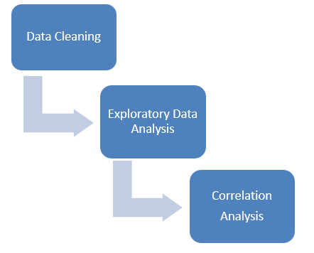
Approach

Slide 4
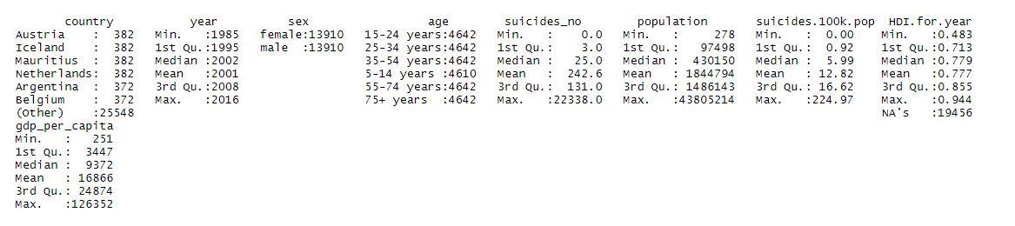
Summary of dataset

Slide 5
Data Cleaning
“HDI for year” column is removed because more than 2/3 of the values are missing
Data for 2016 was removed because only a few countries had data for that year
Continent data is added to the dataset by using the “countrycode” package

Slide 6
Exploratory Data Analysis

Slide 7
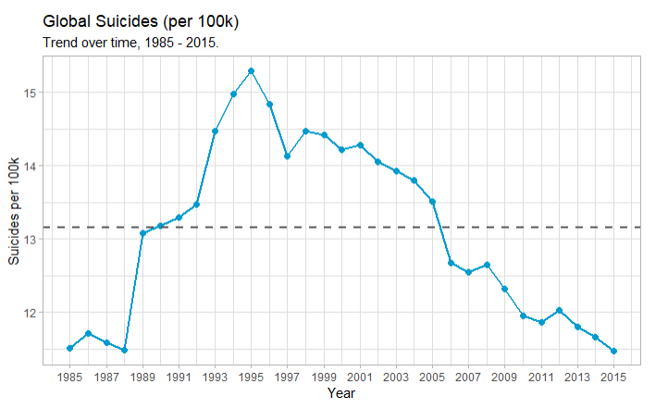
Global Trend

Slide 8
Global Trend
The suicide rate is decreasing globally.
Peak suicide rate was about 15 deaths per 100K in 1995 but since then it decreased steadily to 11.5 deaths per 100K in 2015.

Slide 9
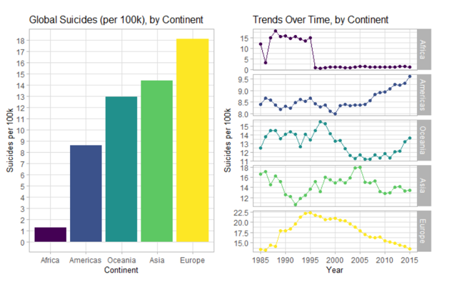
Trend by continent

Slide 10
Trend by continent
European countries have the highest suicide rate in overall, but it has steadily decreased since 1995 and its rate in 2015 is almost similar to Asia and Oceania.
Among all continents, the trends for Oceania and Americas are more concerning because they are increasing.
The trend line for Africa is due to poor quality of data as only 3 countries have provided data.

Slide 11
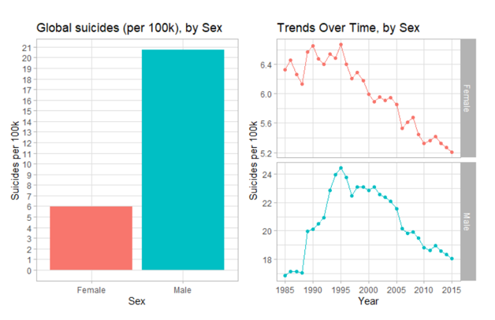
Trend by gender

Slide 12
Trend by gender
Globally, the suicide rate in men has been about 3.5 times higher than women.
The peak amount for both men and women was in 1995 and it has been declined for both genders since then.

Slide 13
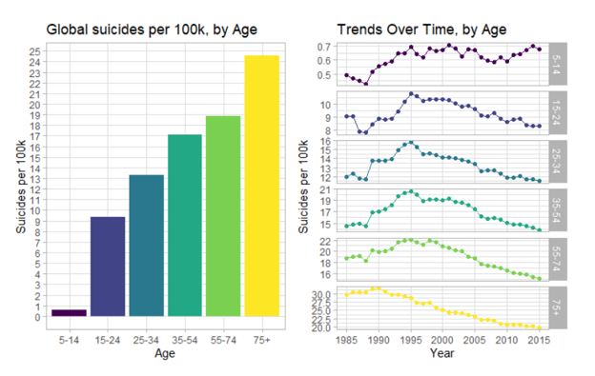
Trend by age

Slide 14
Trend by age
As we can see in previous charts, the number of suicides increases with age globally.
Since 1995, suicide rate for those of 15 years old and up, has been linearly decreasing but it remained almost steady and small for 5-14 years old category as about 1 person per 100K per year.

Slide 15
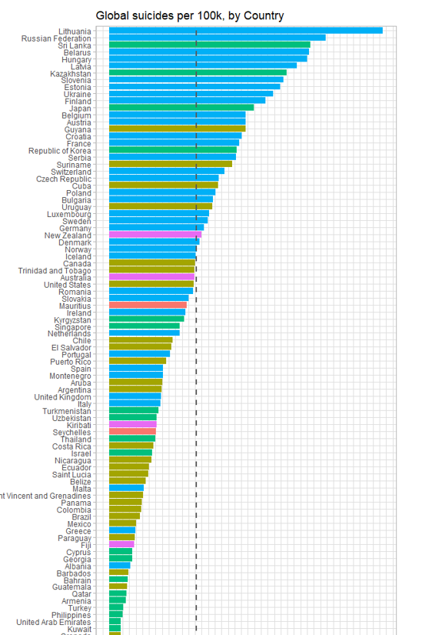

Trend by country

Slide 16
Trend by country
Lithuania has the highest suicide rate among all other countries of our dataset.
There are lots of European countries with high suicide rates and a few with low rates among all countries.

Slide 17
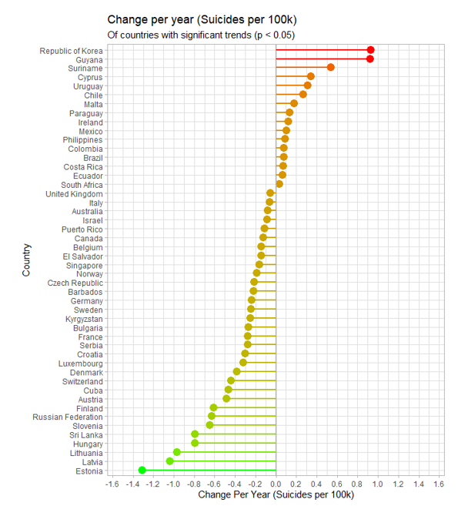
Trends within each country over years

Slide 18
Trends within each country over years
As we can see in the diagram, suicide rate in 48 countries is changing linearly as time passes.
It’s decreasing in 32 countries out of 48 countries over time.

Slide 19
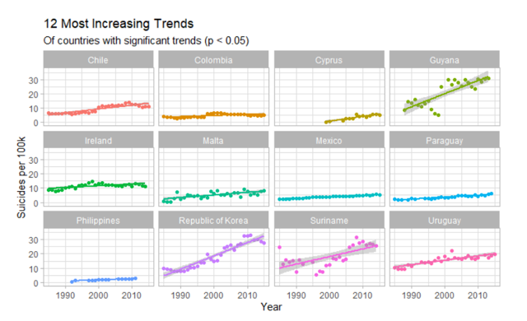
12 Most Increasing Trends
South Korea and Guyana have the steepest increase among other countries

Slide 20
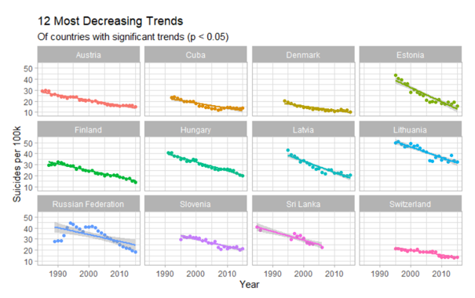
12 Most Decreasing Trends
Estonia has steepest decrease in suicide rate.
For Russia, it only began to decrease in 2002. Since then it has decreased about 50%

Slide 21
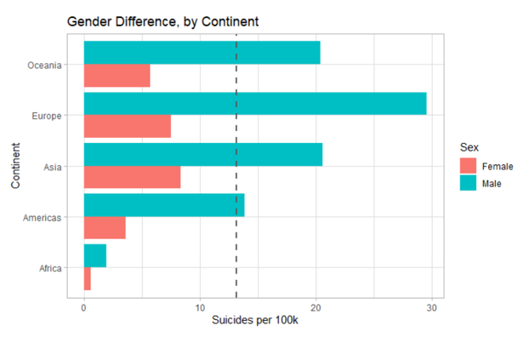
Gender difference by Continent
European men had the highest suicide rate between 1985 – 2015, with about 30 suicides per 100K, per year and it was about 4 times more than women.

Slide 22
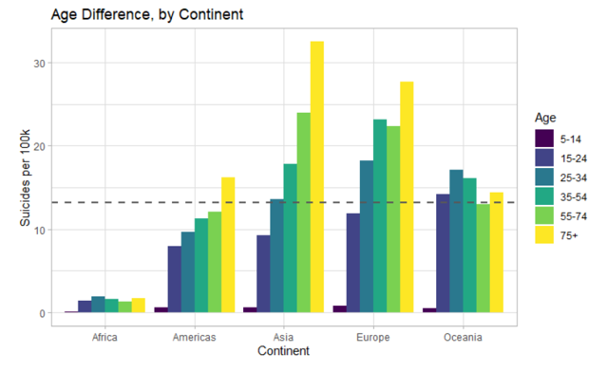
Age difference by Continent
In America, Asia and Europe, suicide rate increases with age but in Oceania and Africa, the highest rate is among 25-34 years old people

Slide 23
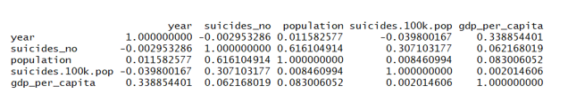
correlation between all numerical attributes of the dataset
It shows that there is a positive correlation between “suicides.100k.pop” with “population” and “gdp_per_capita” and a negative correlation with “year”. But the values are so small and close to zero.

Slide 24
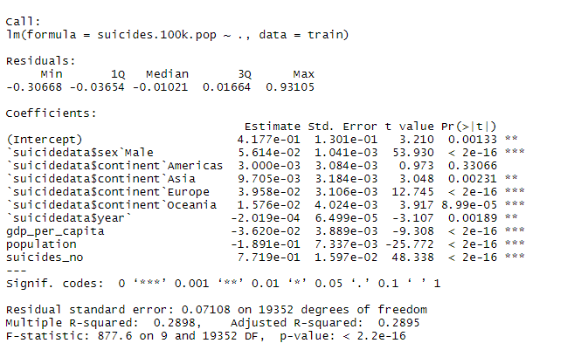
Multiple linear regression
gdp_per_capita,population,suicides_no,suicides.100k.pop are normalized.
The **p-value** of the model is < 2.2e-16.This means that, at least, one of the predictor variables is significantly related to the outcome variable.
Except for America, the p-value for other attributes of the model is < 0.05 which means we can reject H0 that there are no association between those attributes and the number of suicide.

Slide 25
conclusions
I did an Exploratory Data Analysis on a suicide dataset originated from WHO Suicides organization.
It required some data cleaning such as removing attributes which had lots of missing values. Also I added Continent attribute to the dataset in order to be able to do some analysis by the continent value.
Based on my analysis, the peak suicide rate was in 1995 but it has been decreasing steadily since then globally. However, the analysis shows that the suicide rate for Oceania and Americas is increasing in 21st century.
Also the suicide rate for men has been almost 3.5 times higher than for women globally.
The analysis of suicide and age showed that on average, suicide rate increases with age.

