Slide 1
Machine Vision
Somayyeh Aghababaei(P50092)
Mr Mohd Zamri Murah
SEMESTER 1 :2009_2010

Slide 2
Introduction to machine vision
What is machine vision
The history of machine vision

Slide 3



What is required for machine vision:
Knowledge about the objects (regions) in a scene and projection geometry is required.
The information which is recovered differs depending on the application
– Satellite, medical images etc.
Processing takes place in stages:
– Enhancement, segmentation, image analysis and matching (pattern recognition).

Slide 4
Components of a machine vision system:
one or more digital or analog camera
Camera interface for digitizing images
A processor
Input/Output hardware
Lenses
Suitable, often very specialized, light sources
A program
A synchronizing sensor
Some form of actuators

Slide 5
Processing methods
Commercial and open source machine vision software packages typically include a number of different image processing techniques such as the following:
Pixel counting
Thresholding
Segmentation
Barcode reading
optical character recognition
Gauging
Edge detection
Template matching

Slide 6
Machine Vision Applications
•Biometrics
Large-scale industrial manufacture
Short-run unique object manufacture
Safety systems in industrial environments
Inspection of pre-manufactured objects (e.g. quality control, failure investigation)
Visual stock control and management systems (counting, barcode reading, store interfaces for digital systems)
Control of Automated Guided Vehicles (AGVs)
Automated monitoring of sites for security and safety
Monitoring of agricultural production
Quality control and refinement of food products
Retail automation
Consumer equipment control
Medical imaging processes (e.g. interventioal radiology)
Medical remote examination and procedures
Vision for Humanoid or Robot also called Robot Vision
Provide Artificial Visual Sensing for the blind (e.g. Super Vision System, Artificial Eye System)

Slide 7
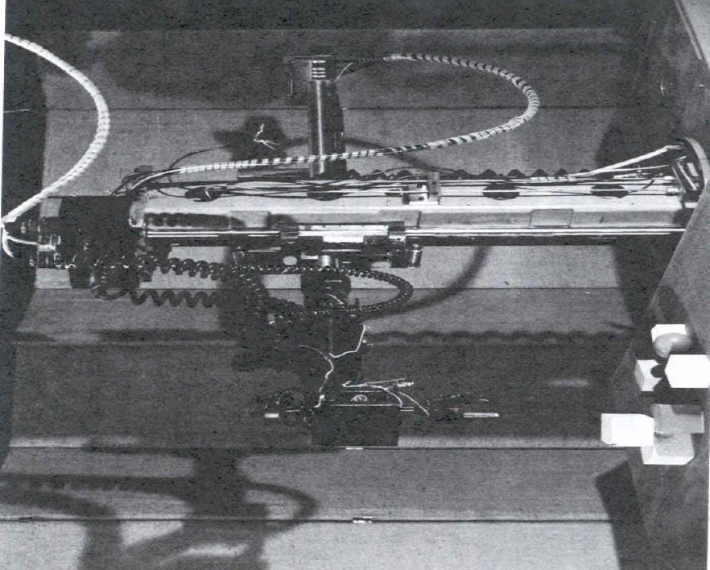
Robot Vision

Slide 8
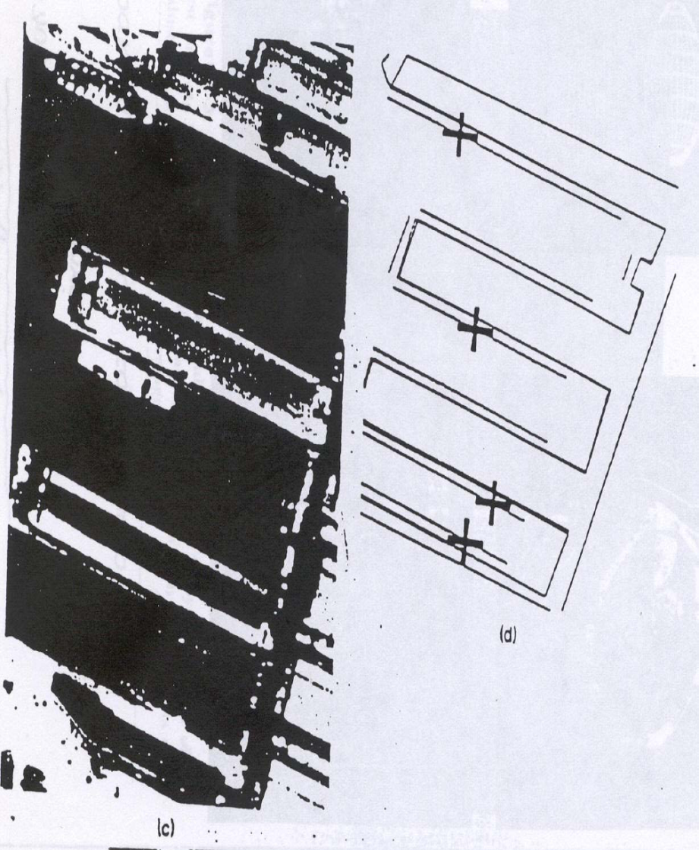
Remote Sensing

Slide 9
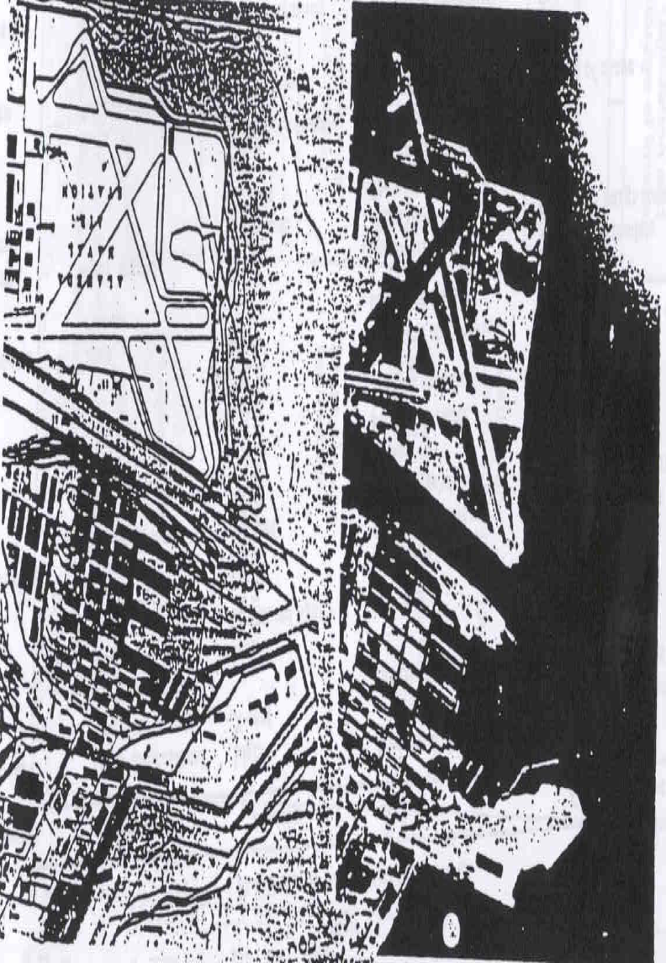
Remote Sensing

Slide 10
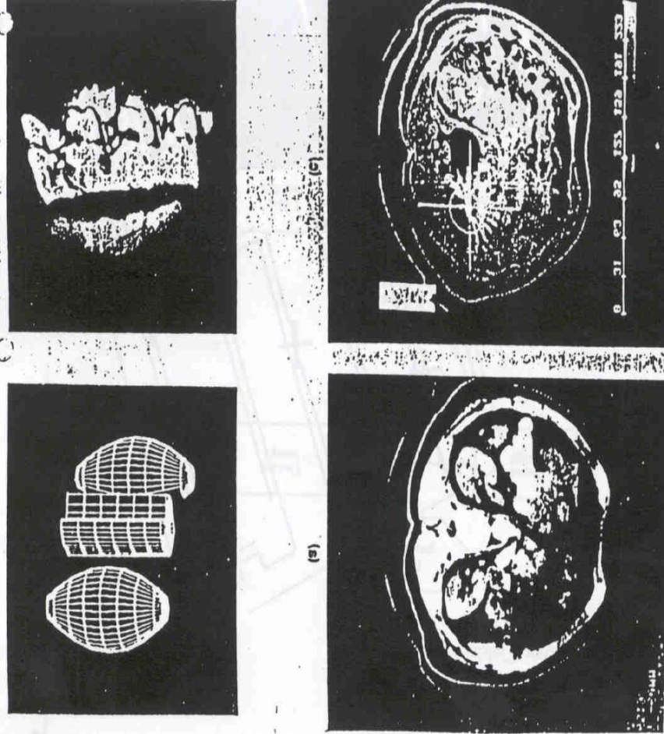
Medical Applications

Slide 11
Machine Vision Stages
Image Acuquisition(by cameras,scanners etc)
Image processing
Image enhancement
Image restoration
Image segmentation
Image analysis
(binary image processing)
Model matching
Pattern recognition

Slide 12
Image Processing
Image processing
Input image
Output image

Slide 13
Image segmentation
Image segmentaion
Input image
Ragions /objects

Slide 14
Image analysis
Image analysis
Input image
Segmented image
Regions/objects
Measurements

Slide 15
Pattern Recognition
Model Matching
Pattern Recognition
Image/regions 􀃆
•Measurements, or
•Structural
Class identifier

Slide 16
Relationships to other fields
•Image Processing (IP)
•Pattern Recognition (PR)
•Computer Graphics (CG)
•Artificial Intelligence (AI)
•Neural Networks (NN)
•Psychophysics

Slide 17
Thank you for attention

