Slide 1

Project for Casimir Programming Course
By
Neda .Hesam Mahmoudi Nezhad
8/11/2019
TUDelft- Applied Physics
Imaging Physics
Charged Particle Optics

Slide 2
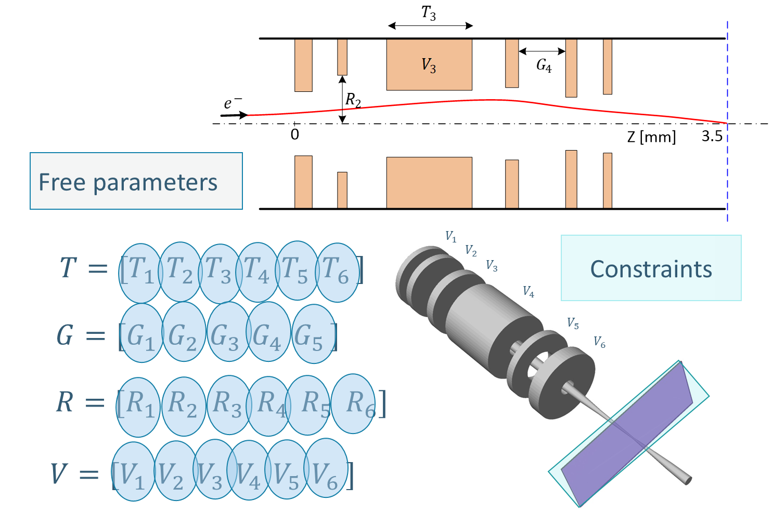
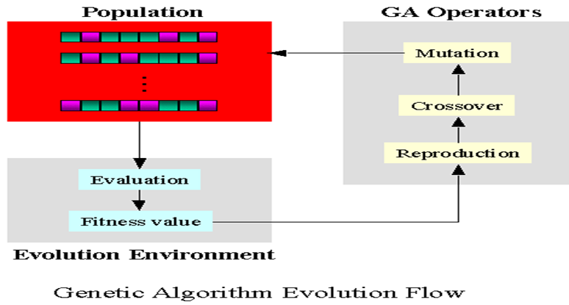
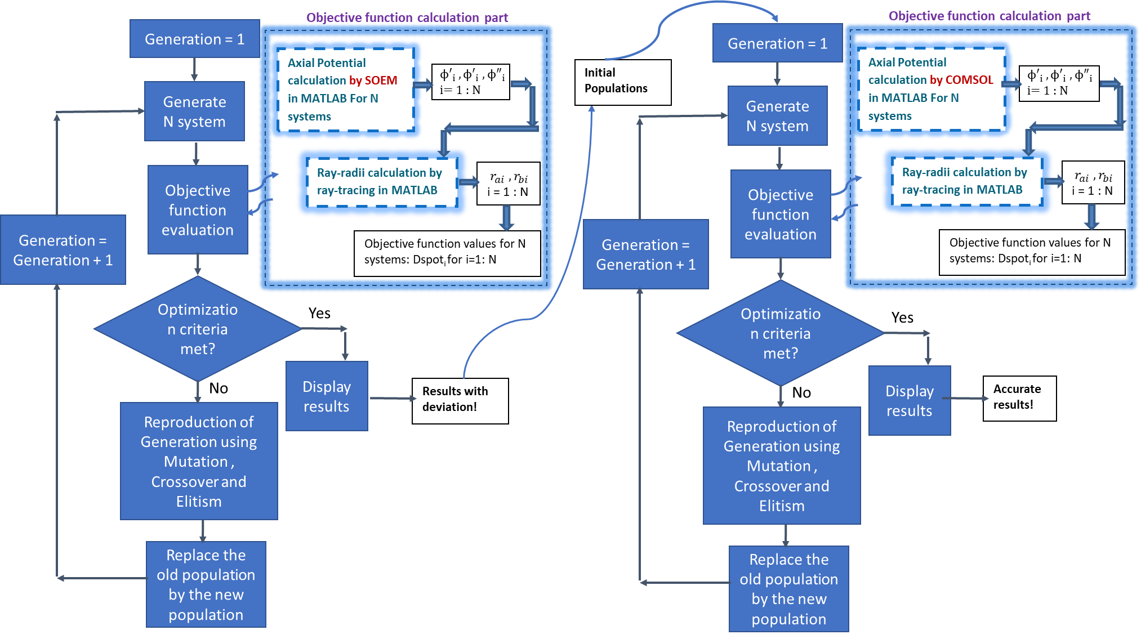
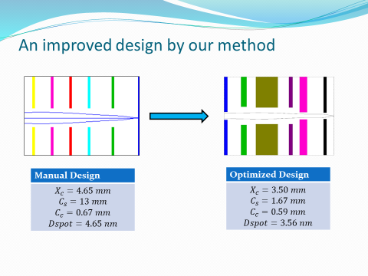

Electrostatic Lens Optimization Using Genetic Algorithms

Slide 3

Optimization using Genetic Algorithms By Python!?
Search in Google →
Continuous Genetic Algorithm From Scratch With Python! ☺
https://towardsdatascience.com/continuous-genetic-algorithm-from-scratch-with-python-ff29deedd099

Slide 4
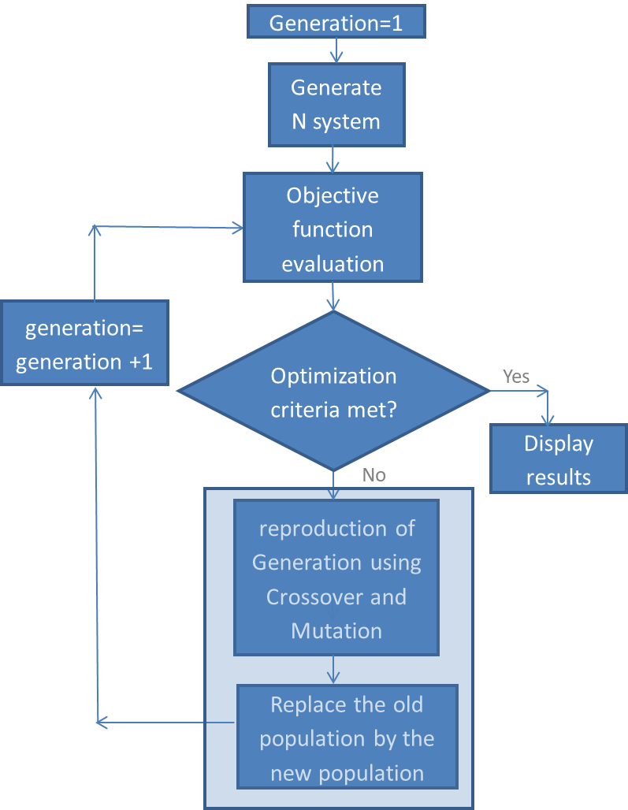
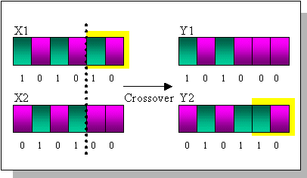
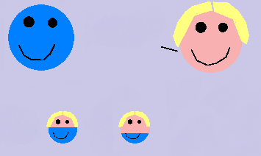


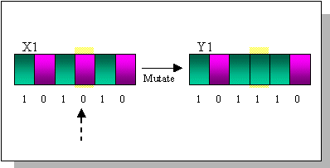
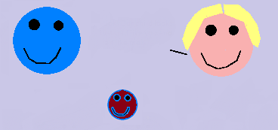

Crossover
Look! Our Children look just like us!
Mutation
What Happened?!
He doesn`t look like any of us!

Slide 5
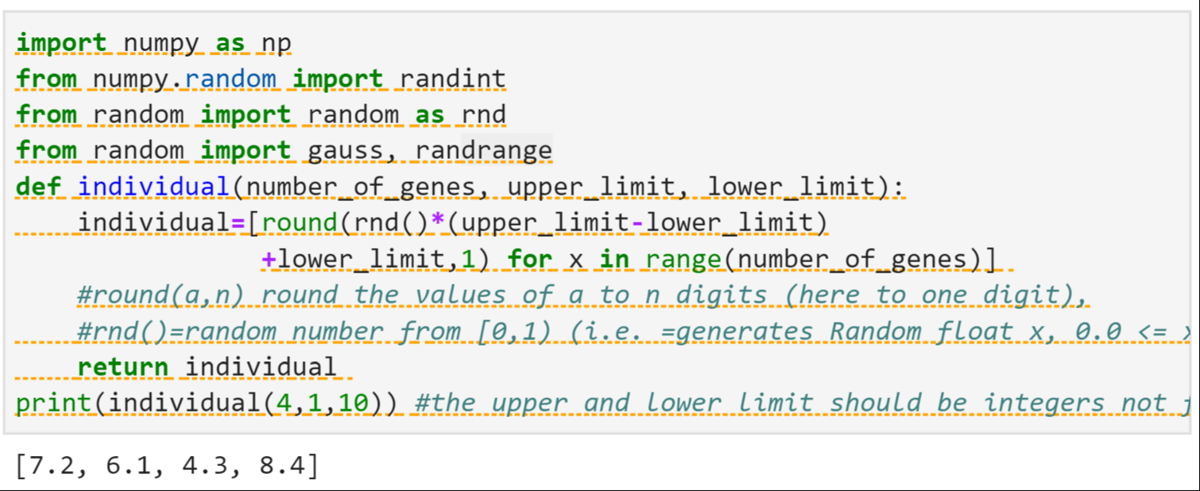
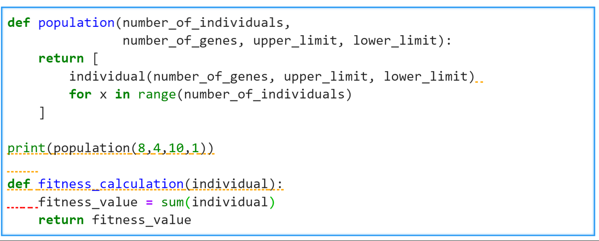
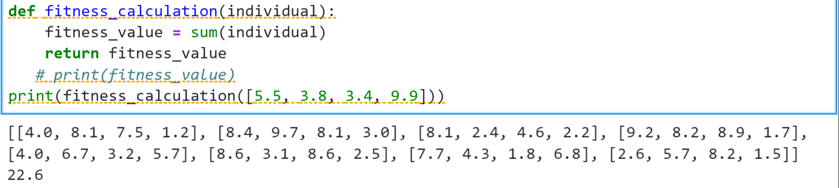
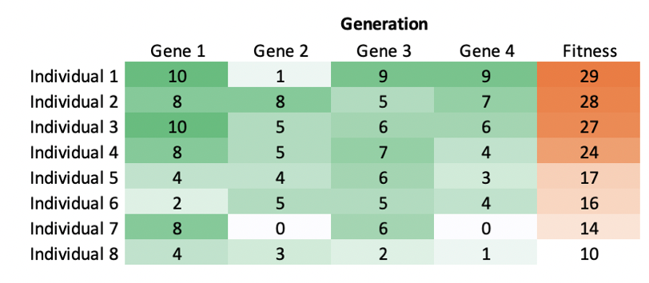
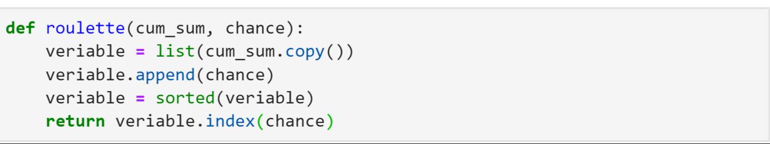
-Calling functions from python library, such as numpy, randint, gauss
-Define function “individual” to create Individuals
Input: “number of Genes”, “upper limit”, “lower limit”
Output: an “Individual”
-Define function “Population” to create many Individuals
Input: “number of individuals”, “number of Genes”, “upper limit”, “lower limit”
Output: N “Individual”s
-Define function “Fitness Calculation” to calculate fitness
Input: “individual”
Output: fitness value of the individual

Slide 6
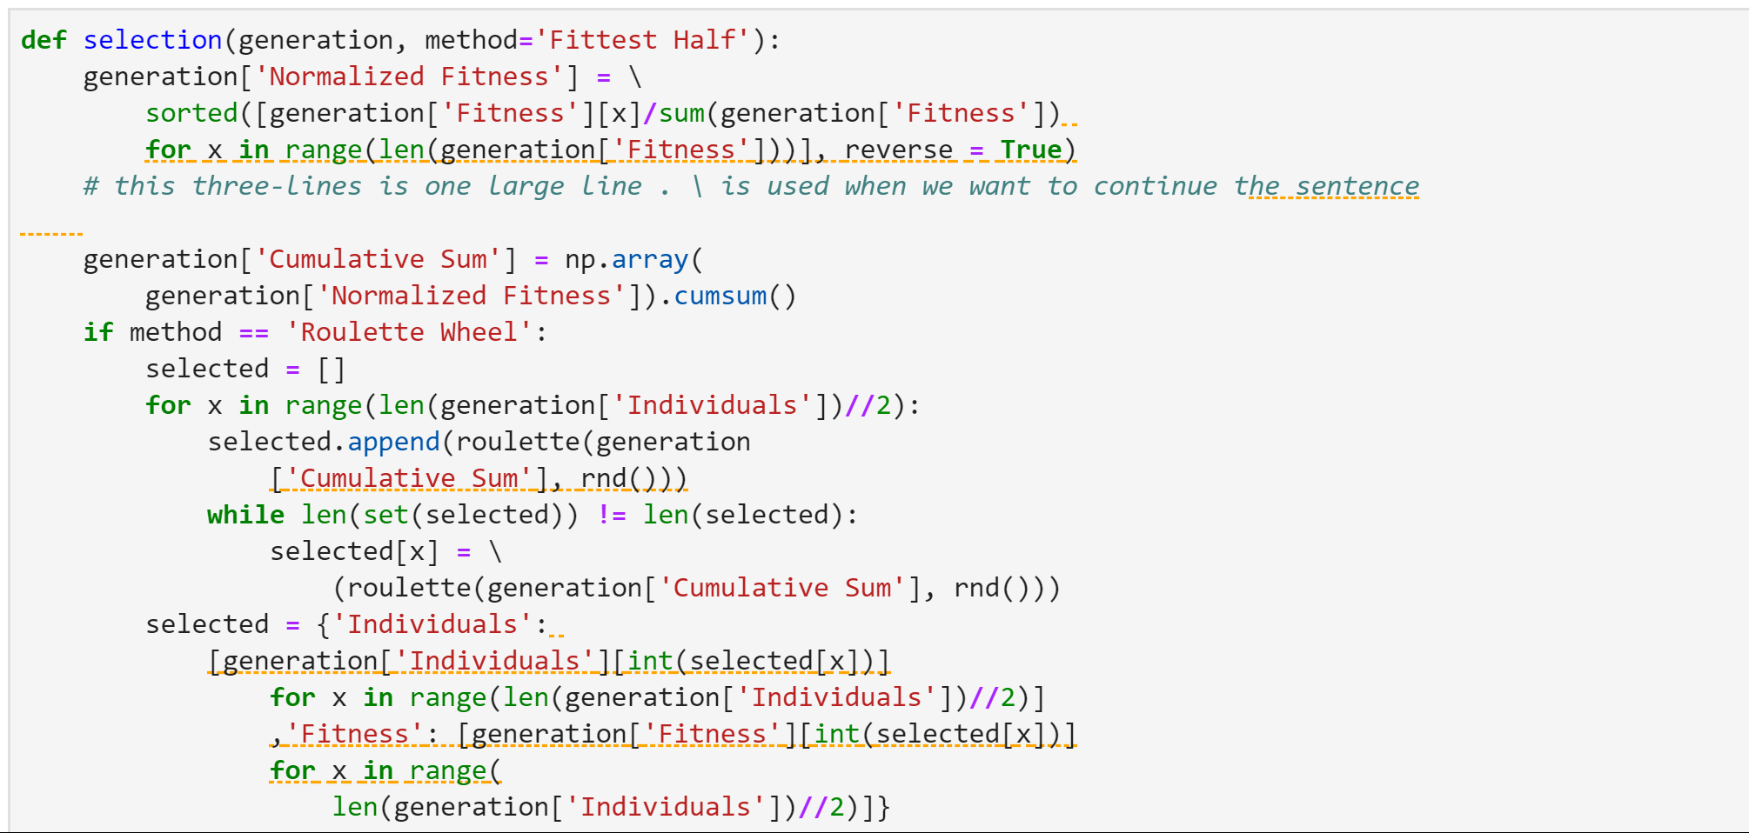
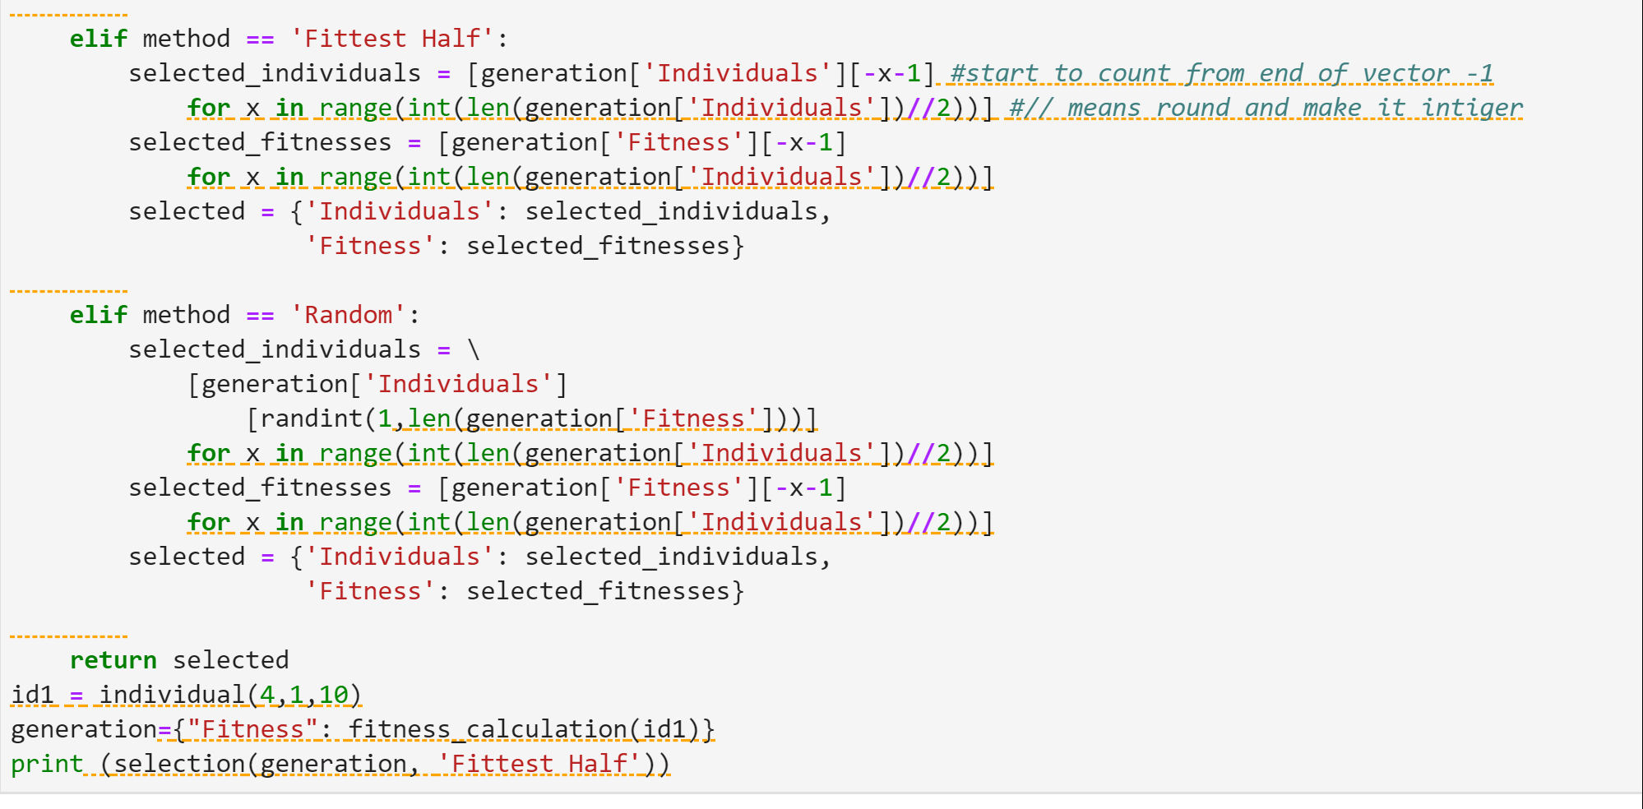
-Define function “Selection ” to select best Individuals to bring into next generation
Input: “individuals”, “generation”, “method of selection”
Output: N best selected “Individual”s

Slide 7
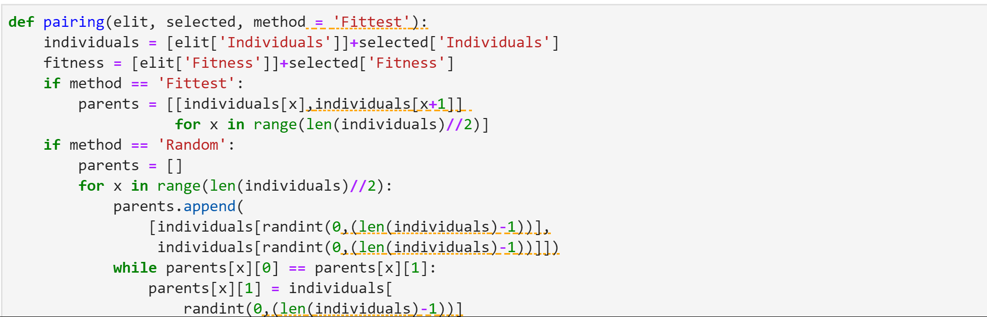
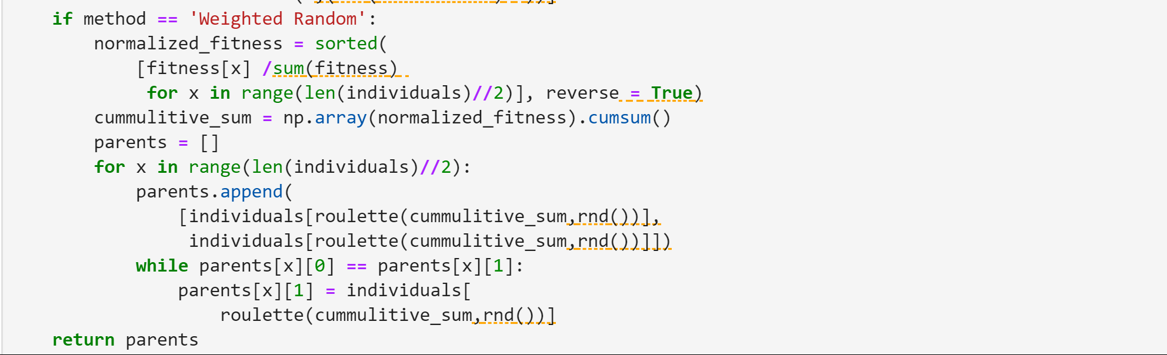
-Define function “pairing ” to choose how many of the best Individuals we want to keep and bring into next generation
Input: selected N “individuals”, “elit”, “method of pairing”
Output: N new “Individual”s ,called “parents”

Slide 8
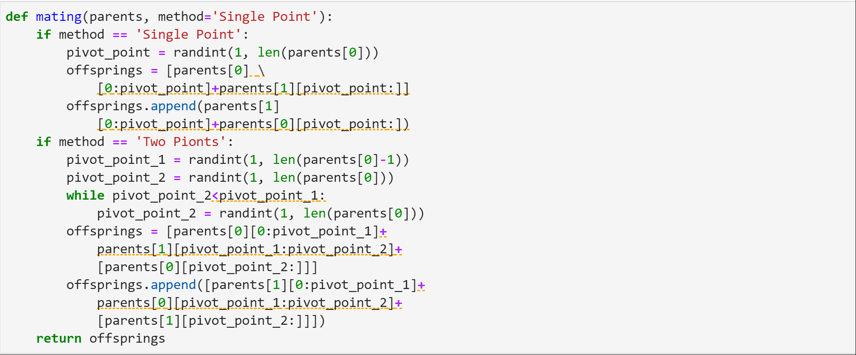
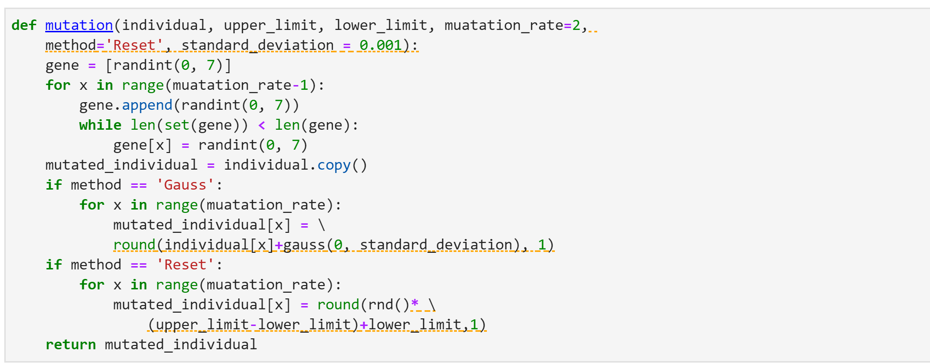
-Define function “mating ” to combine (crossover), the individuals to create new individuals
Input: N selected “individuals” (=parents ), “method of mating”
Output: N new “individulas” (children) , called “offsprings”
-Define function “mutation” to insert some mutated individuals among others
Input: N selected “individuals”, “method of mutation”
Output: N “mutated individuals”

Slide 9
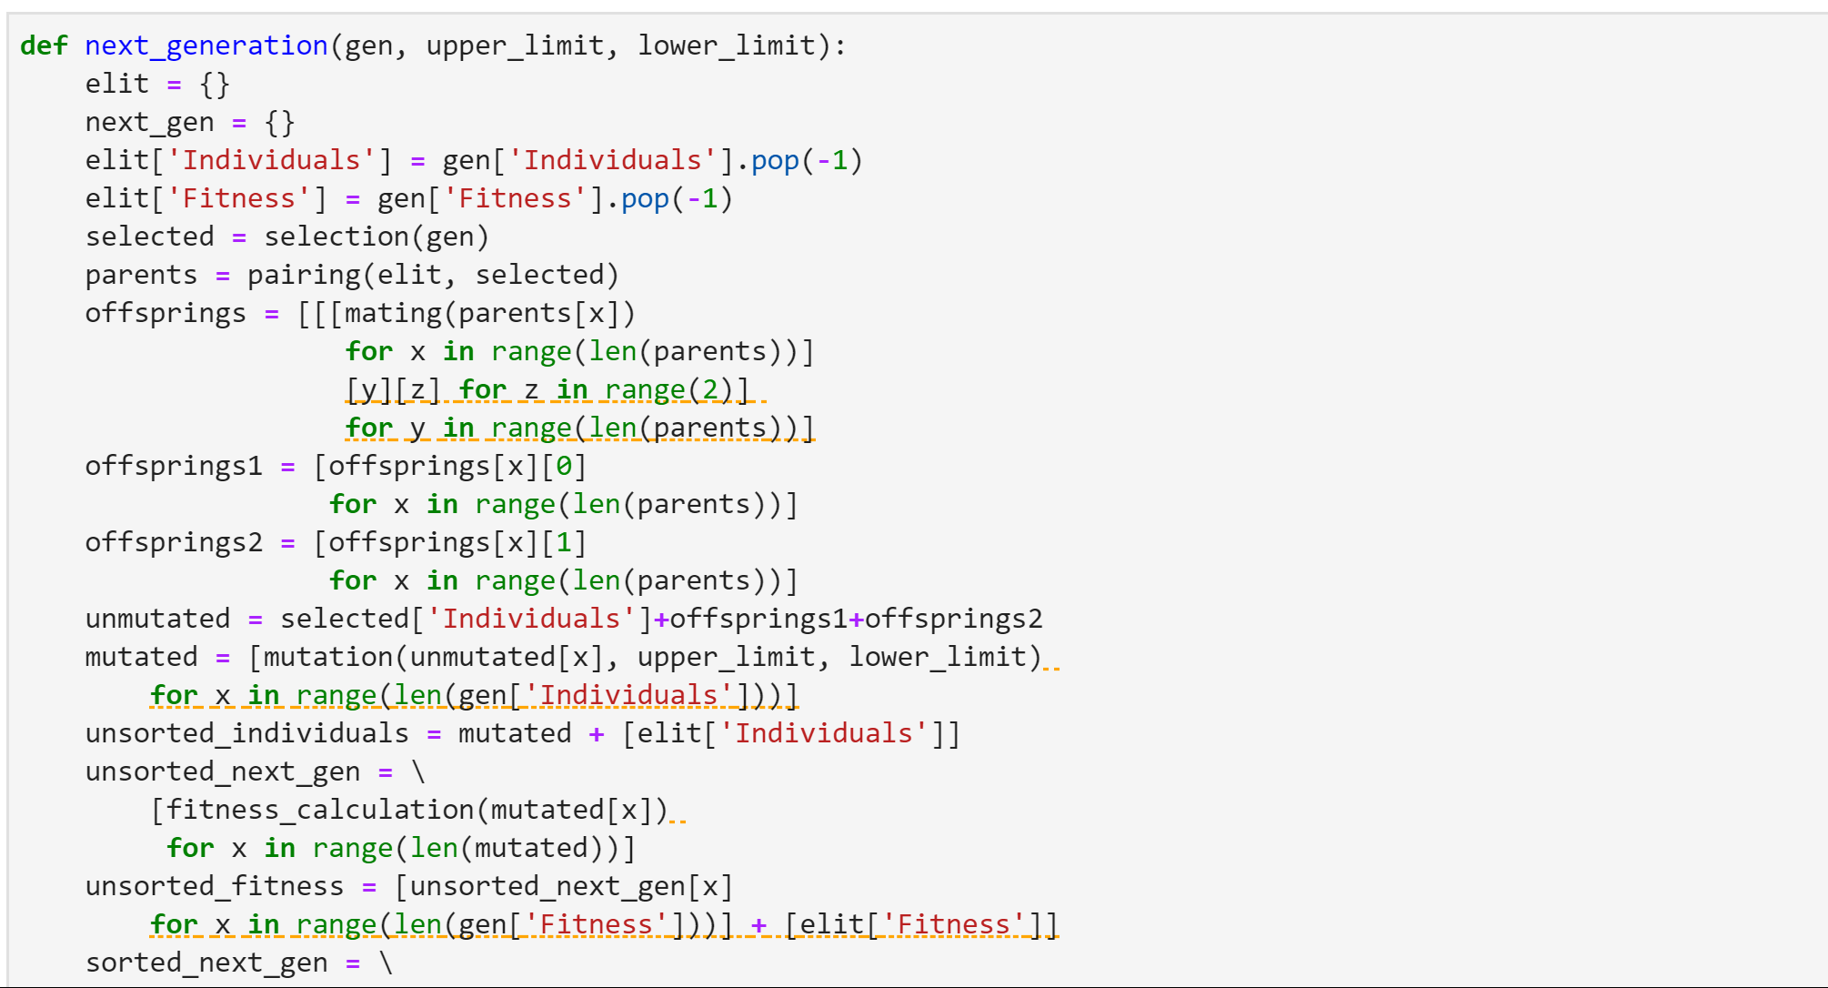
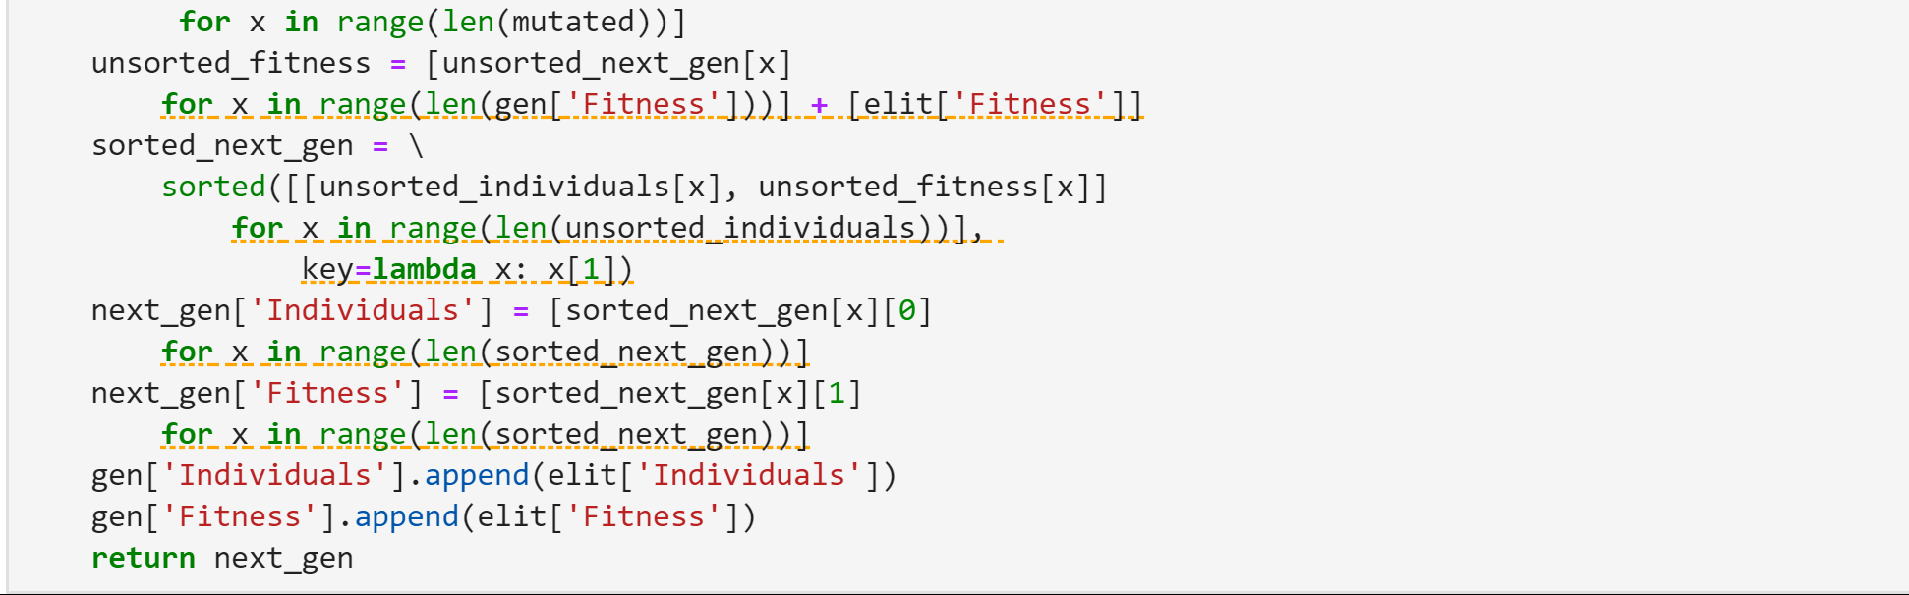
-Define function “next generation”
Input: generation, upper-limit, lower-limit
Output: next generation of individuals

Slide 10
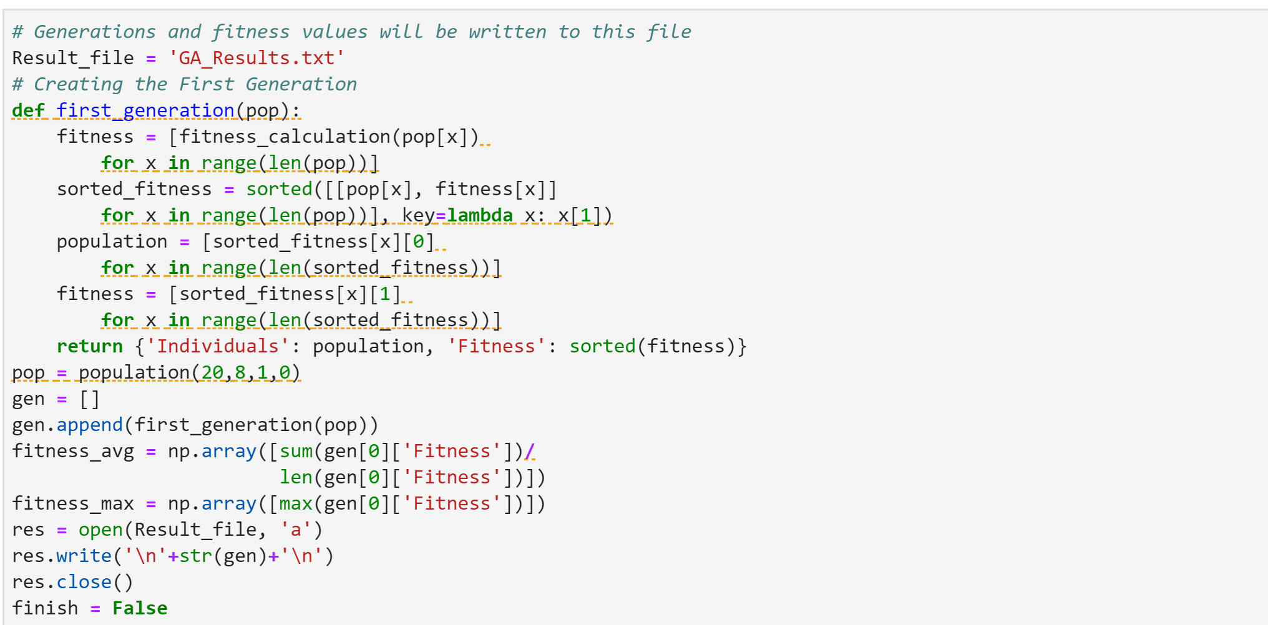
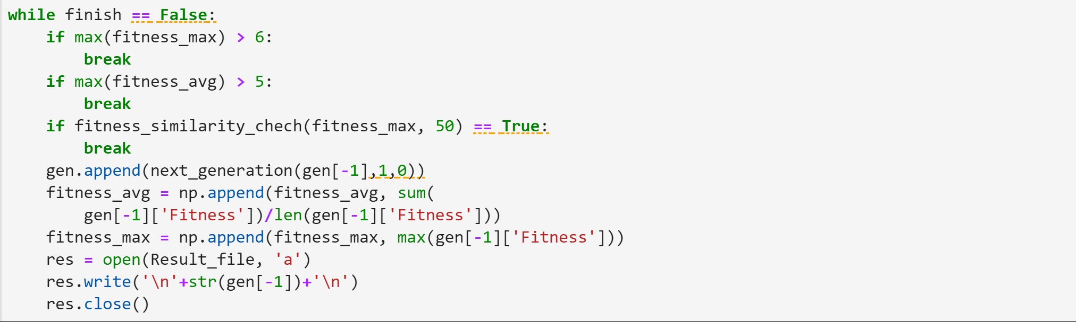

Slide 11
To be Continued….

