Slide 1
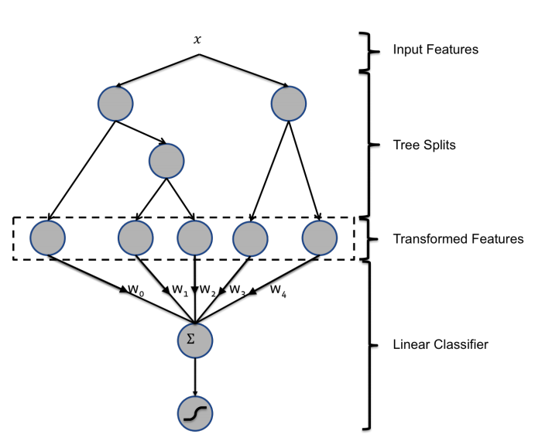
Feature transformation using ensemble trees
Example Use Case: Facebook – Predicting Clicks on Ads¹
Approach:
X is the original feature matrix
First step is to build a series of ‘shallow’ trees (e.g. use random forest or gradient boosted trees).
Each leaf of each tree becomes a categorical input variable in a new feature matrix (i.e. one-one hot encoding to create dummy variables).
The transformed feature set is now sparse.
The new features are then used to train a sparse linear classifier (e.g. logistic regression with lasso [L1] regularization).
Can output probabilities.
Notes:
1: Xinran, He et al., Practical Lessons from Predicting Clicks on Ads at Facebook, Internal Workshop on Data Mining for Online Advertising, 2014

