Slide 1

Analytics Engineer Assessment Presentation
Provided by Neda Rostami
Summer 2024

Slide 2
Introduction
Data engineering for Q1 and Q2
Data Analysis Q3

Slide 3

Daily Ingestion of Personal Data
Unified Customer Data Object
Automate the ingestion
Q1

Slide 4
How to ingest these files in a systematic and automated way?
Q1
Selecting Data from Source Tables
Creating the Unified Customers Table
Inserting Data from Each Source Table
Deduplicating the Unified Customers Table
Automating the Ingestion Process

Slide 5
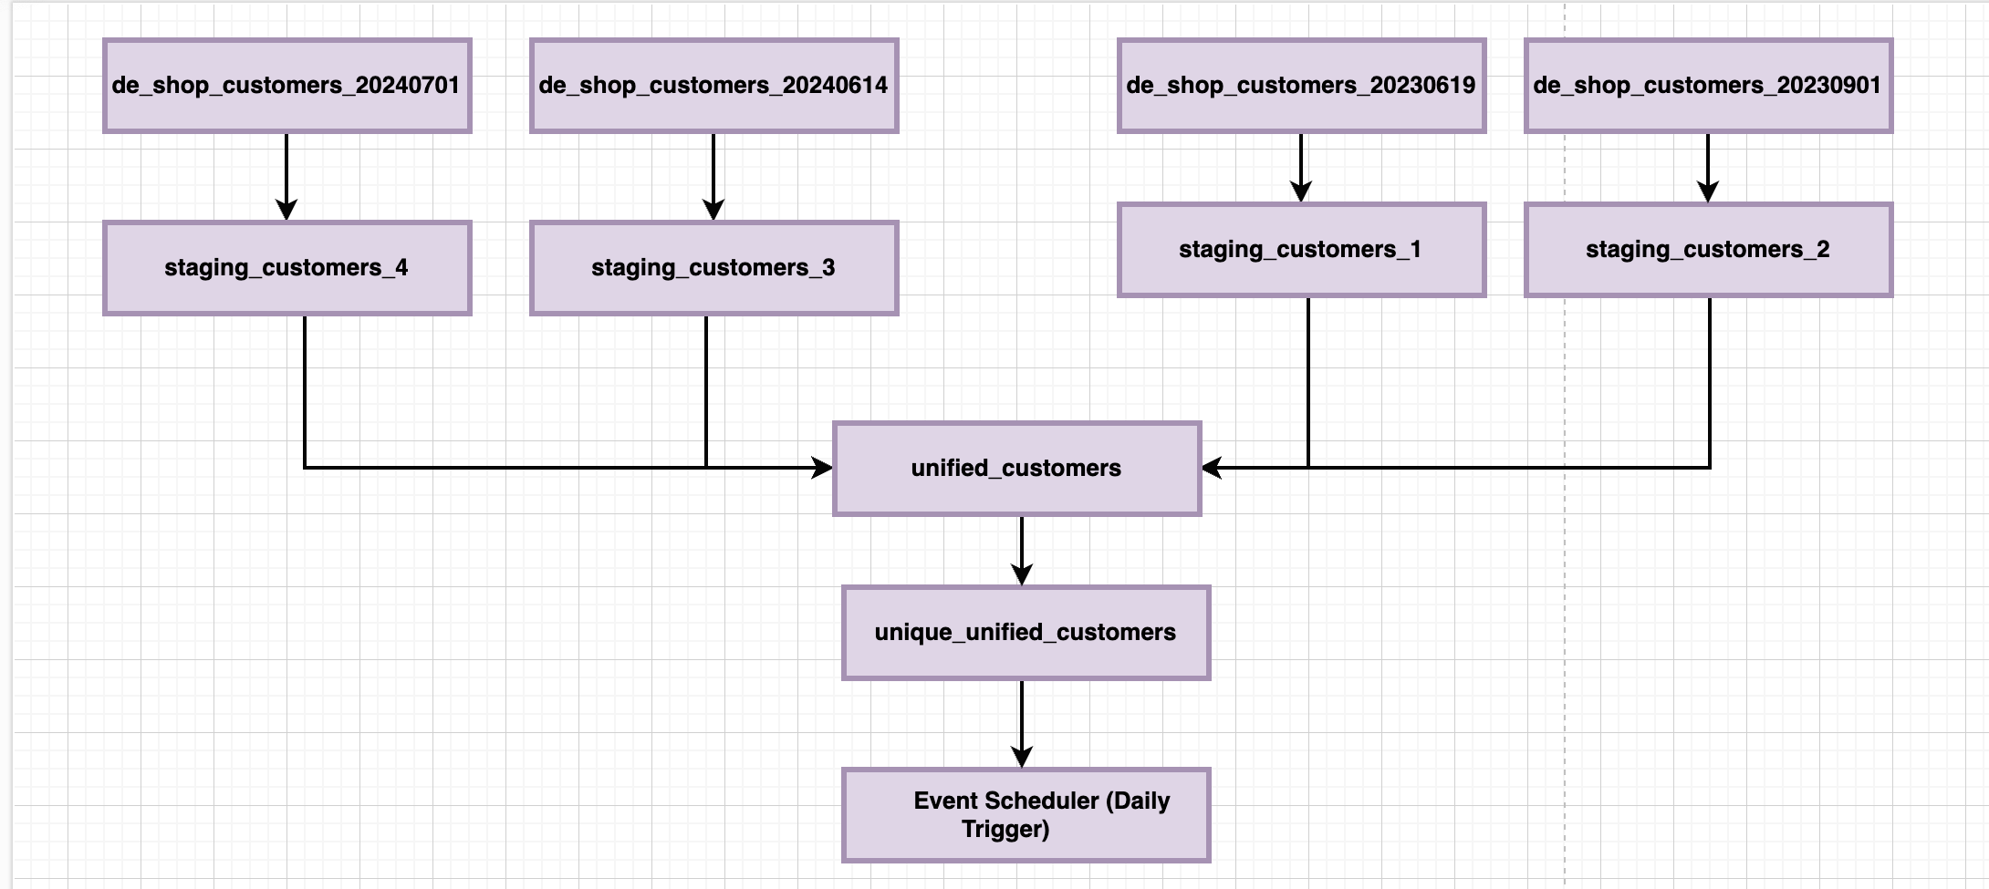

Ingestion Process Diagram
Q1

Slide 6
ERD
Q1
unified_customers
| first_name : VARCHAR(255) |
| last_name : VARCHAR(255) |
| company_name : VARCHAR(255) |
| address : VARCHAR(255) |
| city : VARCHAR(255) |
| county : VARCHAR(255) |
| state : VARCHAR(255) |
| postal_code : VARCHAR(20) |
| phone1 : VARCHAR(20) |
| phone2 : VARCHAR(20) |
| email : VARCHAR(255) |
| web : VARCHAR(255) |
| source_file : VARCHAR(50)
unique_unified_customers
| first_name : VARCHAR(255) |
| last_name : VARCHAR(255) |
| company_name : VARCHAR(255)
| address : VARCHAR(255) |
| city : VARCHAR(255) |
| county : VARCHAR(255) |
| state : VARCHAR(255) |
| postal_code : VARCHAR(20) |
| phone1 : VARCHAR(20) |
| phone2 : VARCHAR(20) |
| email : VARCHAR(255) |
| web : VARCHAR(255) |
| source_file : VARCHAR(50)
de_shop_customers
| first_name : VARCHAR(255) |
| last_name : VARCHAR(255) |
| company_name : VARCHAR(255) |
| address : VARCHAR(255) |
| city : VARCHAR(255) |
| county : VARCHAR(255) |
| postal_code : VARCHAR(20) |
| phone1 : VARCHAR(20) |
| phone2 : VARCHAR(20) |
| email : VARCHAR(255) |
| web : VARCHAR(255) |

Slide 7
Q1
Data Security and Confidentiality :
Data Encryption
Access Control
Audit and Monitoring
Data Backup and Recovery
Employee Training and Awareness

Slide 8
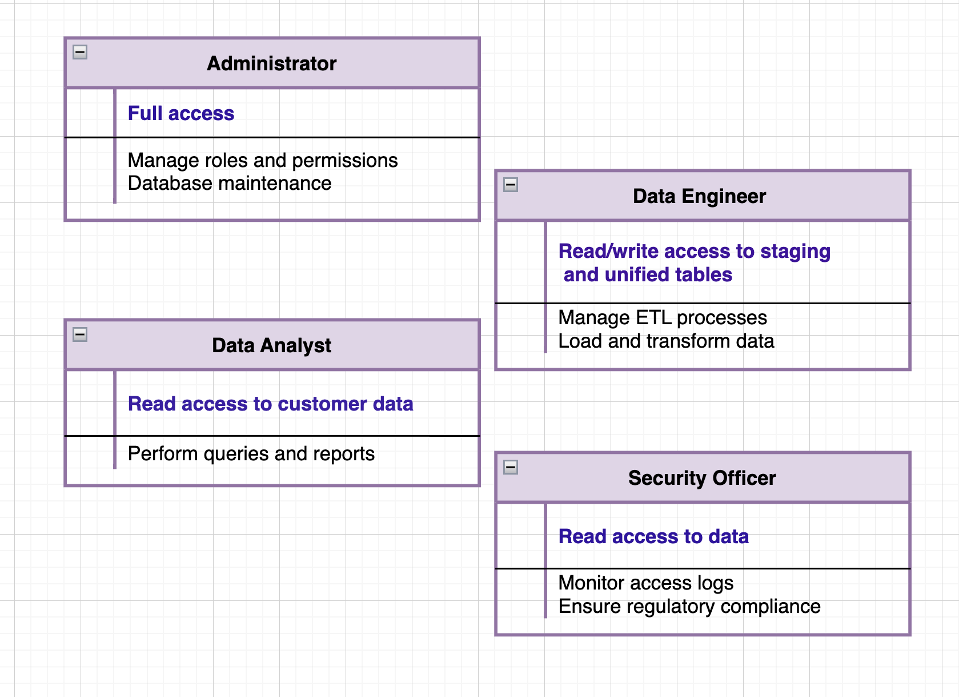
Q1
Roles and Access Levels Diagram

Slide 9

Q2
Defining Dimensions for BI Reporting from Wholesaler Data
Total Sales Amount
Total Refunds Amount
Total Items Sold
Unit Price of Items
Top 10 Customers & Contact Details

Slide 10
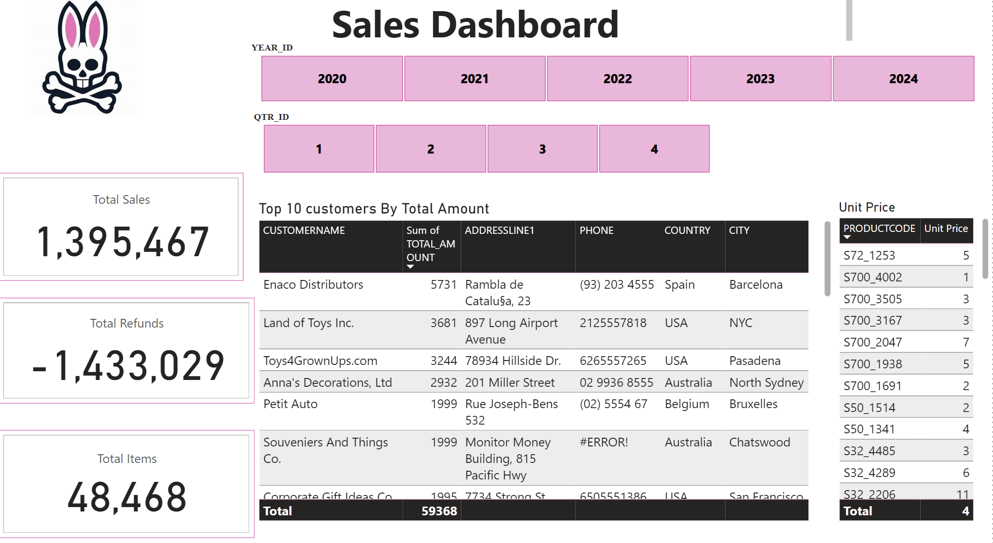
$4,498,300

Slide 11

Sales Patterns for Future Collections
Q3
Analysis for 2022 and 2023.
Sales Prediction for 2024.
Recommendations for Upcoming Collections

Slide 12
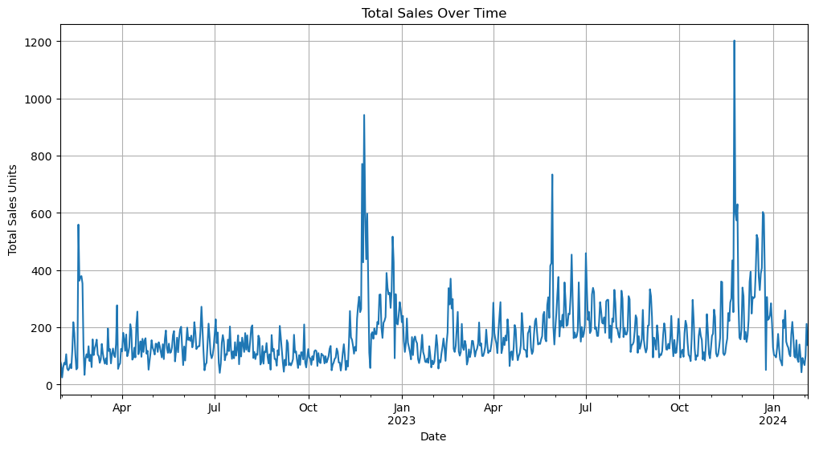
Q3
Total Sales Over Time

Slide 13
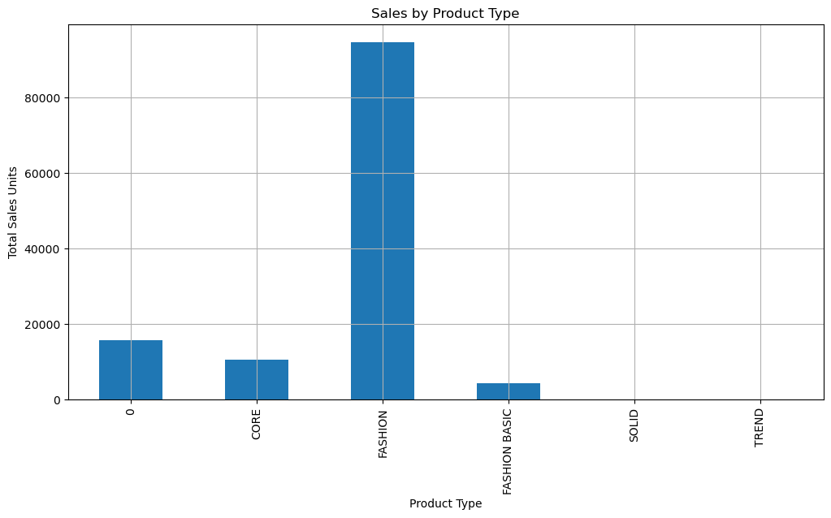
Q3
Sales by Product Type

Slide 14
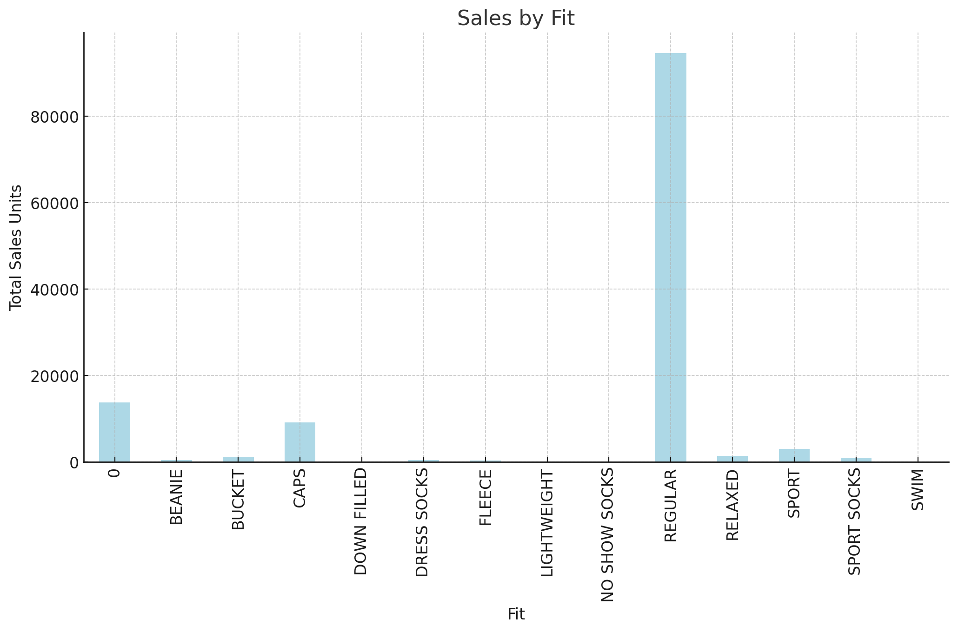
Q3
Sales by Fit

Slide 15
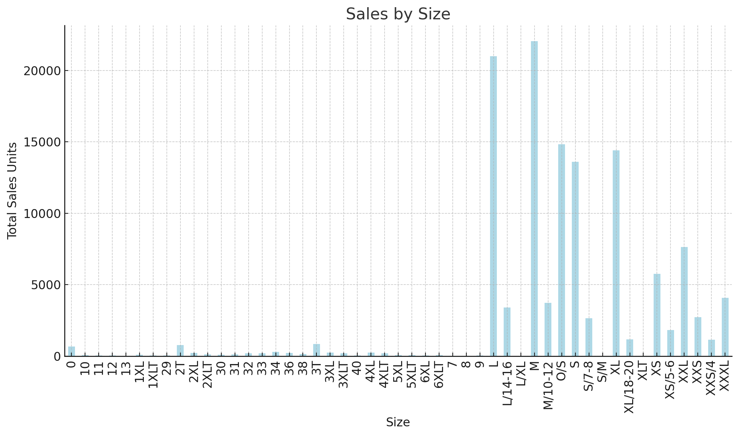
Q3
Sales By Size

Slide 16
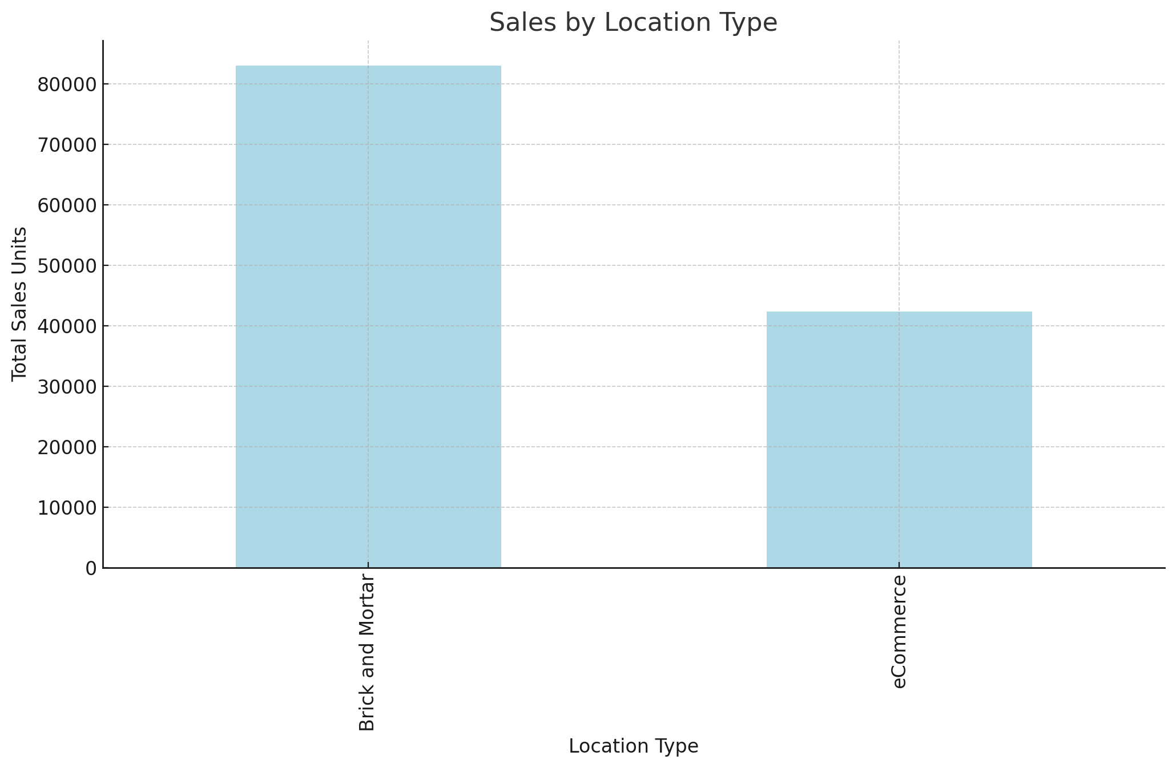
Q3
Sales by Location Type

Slide 17
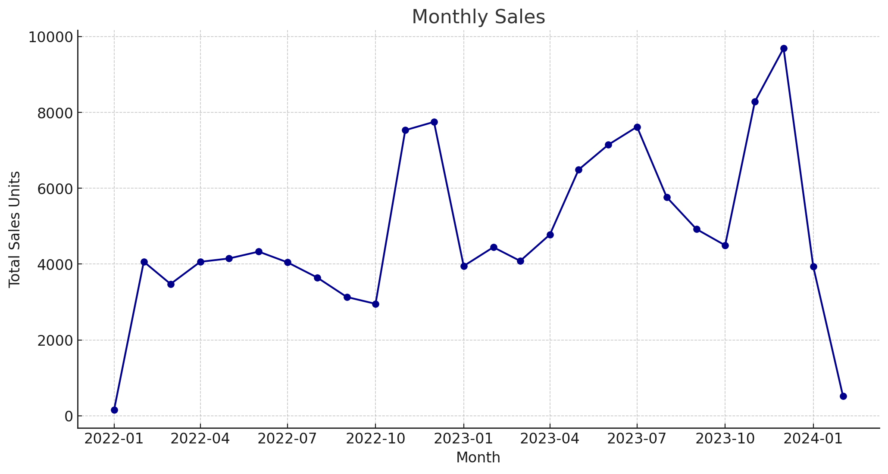
Q3
Monthly Sales

Slide 18
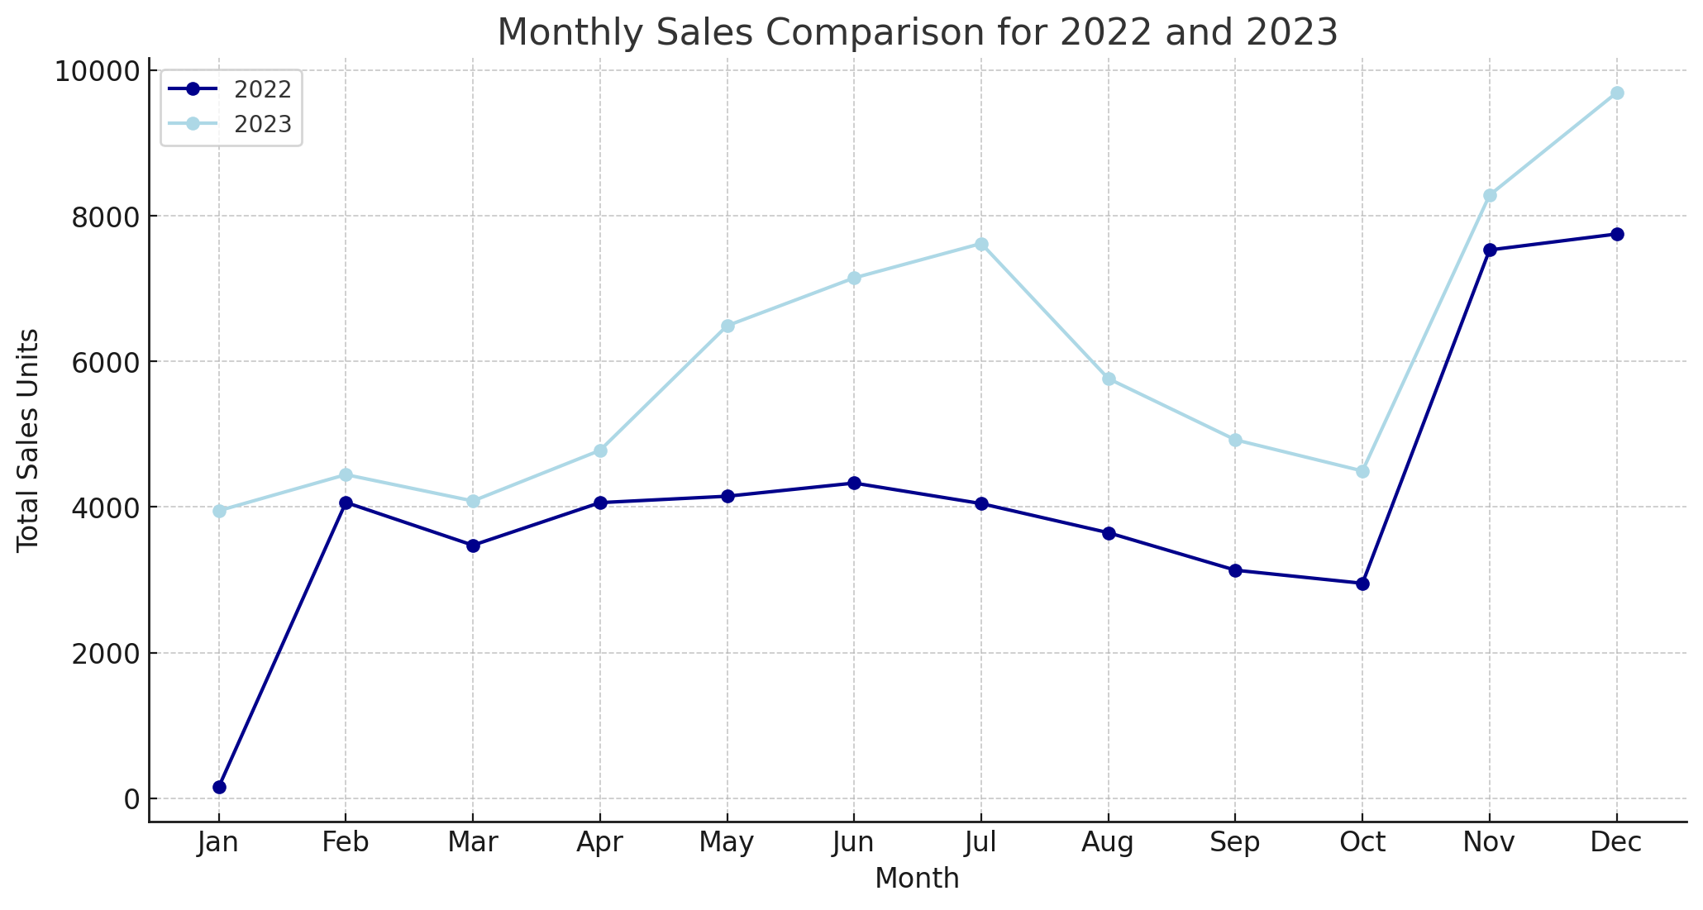
Q3
Monthly Sales

Slide 19
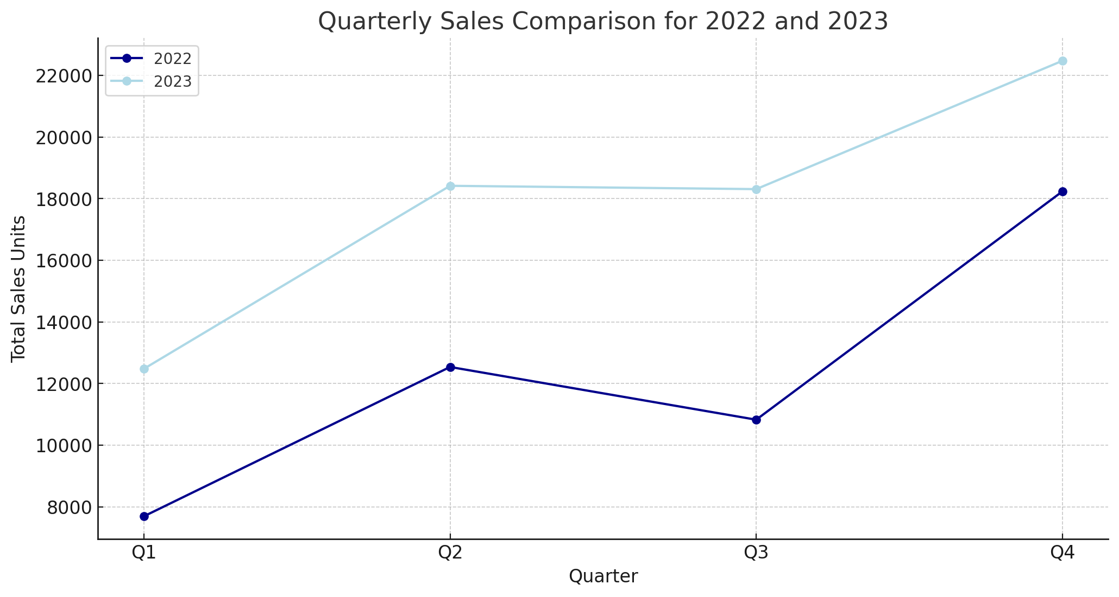
Q3
Quarterly Sales

Slide 20
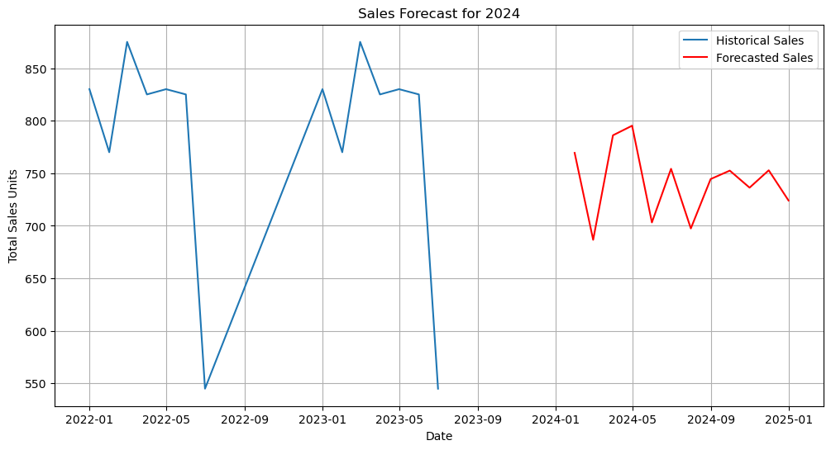
Q3
Sales Forecast 2024

Slide 21
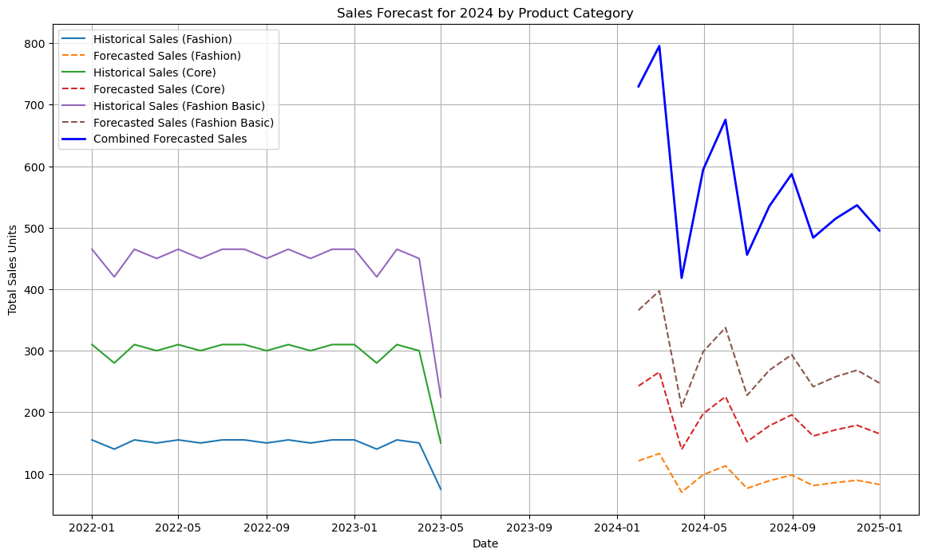
Q3
Sales Forecast for 2024 By Product category

Slide 22
Conclusion
Q3
Analysis
Sales Trends
Category Performance
Recommendations
Inventory Management
promotions and Marketing
Product Development

Slide 23
Conclusion
Q3
Action Items
Stock Planning
Promotional Strategies
Category Review
Market Research
Stakeholders
Product Design Team
Buying Team

Slide 24
Thank You!

