Slide 1

Campus Resource Hub: Streamlining Discovery, Booking, and Management
User Access
Role-based register/login
Discovery & Creation
Search and explore resources
Create and publish resource listings
Booking Flow
Book with real-time availability
Join waitlists for full resources
Governance & Communication
Admin approval for restricted bookings
In-app messaging
Smart Enhancements
AI Concierge for resource bookings
iCal export for calendar integration
Team 15

Slide 2
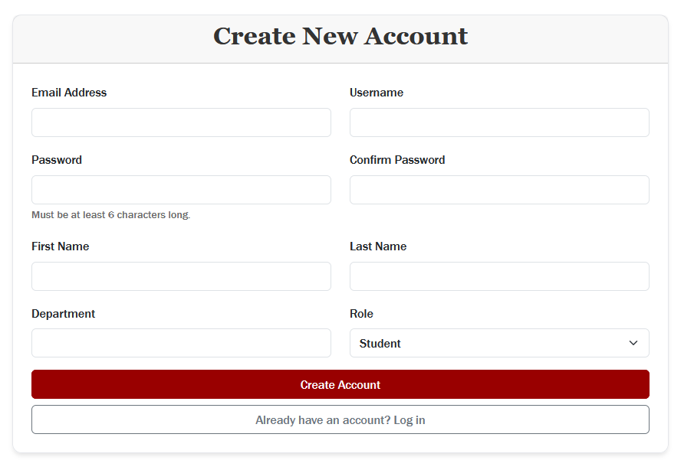
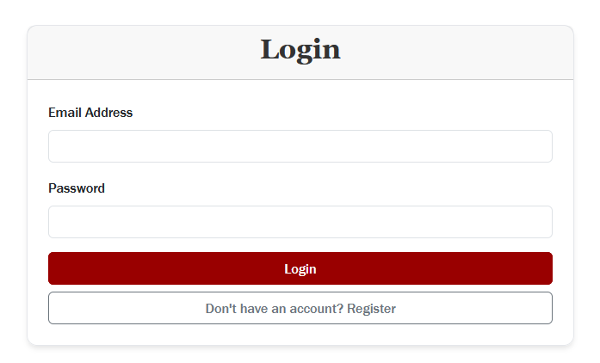
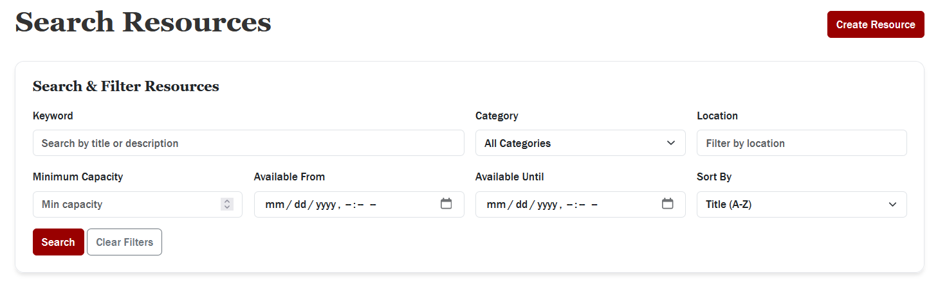
Campus Resource Hub enables students, staff, and administrators to manage campus bookings efficiently
Register a new account
Log in with credentials
Browse or search for resources
Open resource details & view availability

Slide 3
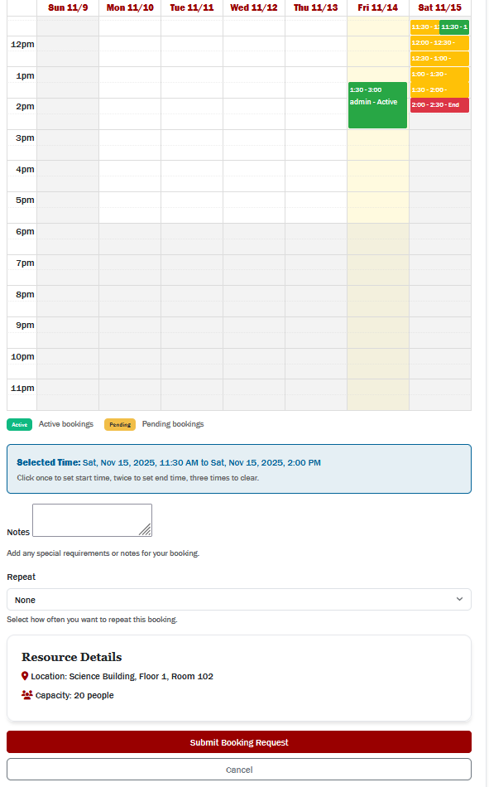
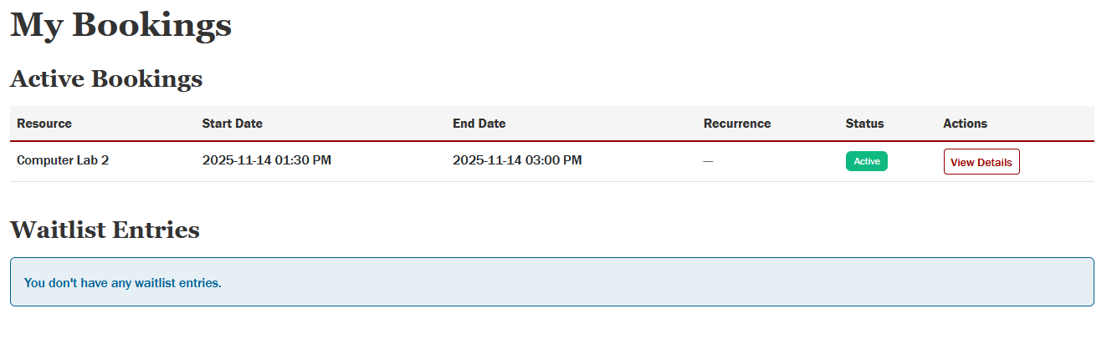
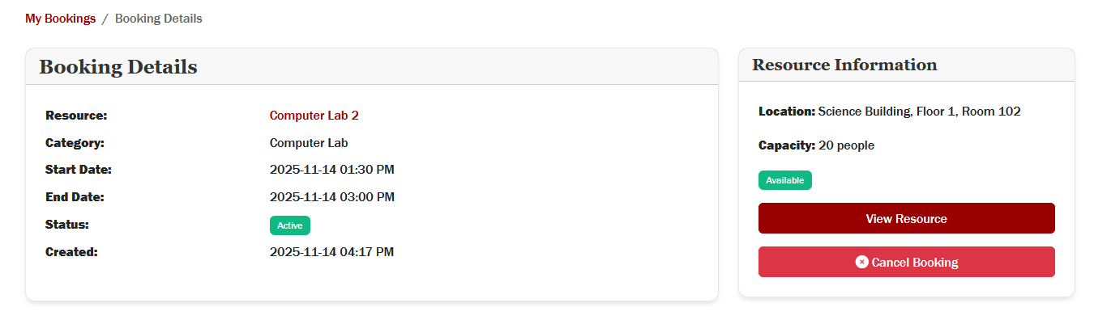
Students can easily search for resources, submit booking requests, and manage their reservations in one place
Choose a resource & select a time slot
Submit a booking request
Booking status updates
(Pending → Approved/Active)
If full → Join waitlist
Receive notifications for approvals or openings
View or cancel bookings in dashboard

Slide 4
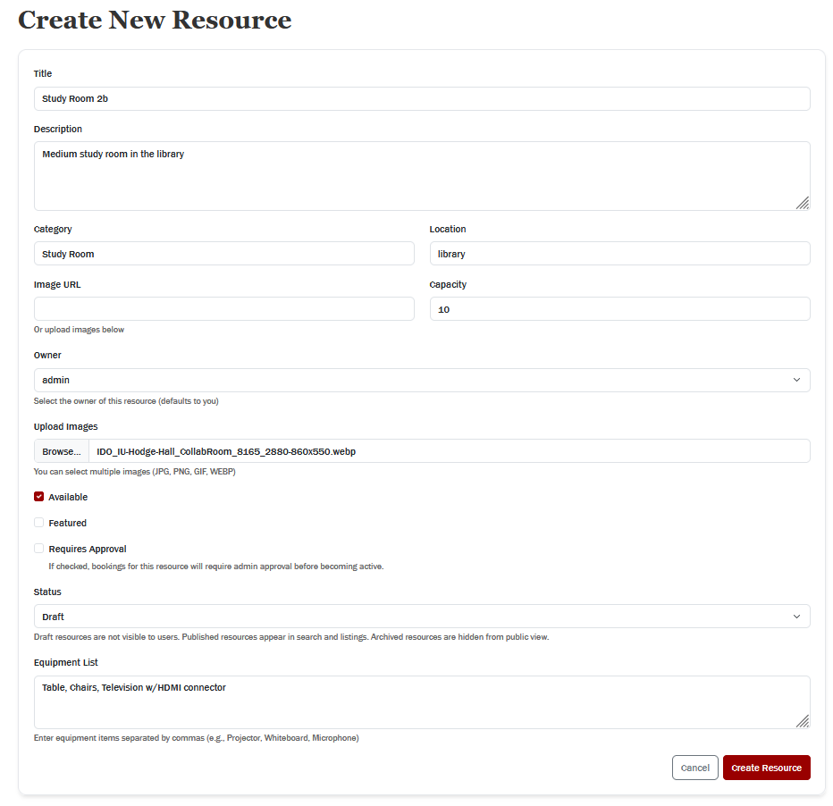
Staff can efficiently create and publish new resources for students to book
Log in as staff
Open “Manage Resources”
Enter title, description, location, capacity
Add images & set availability
(Optional) Require admin approval
Publish → Resource appears to students

Slide 5
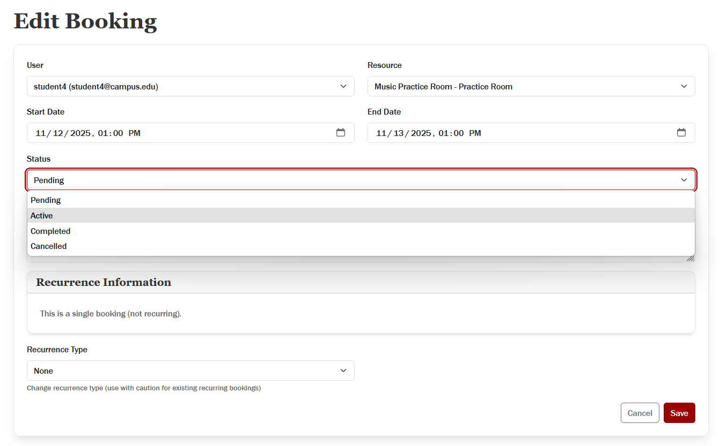
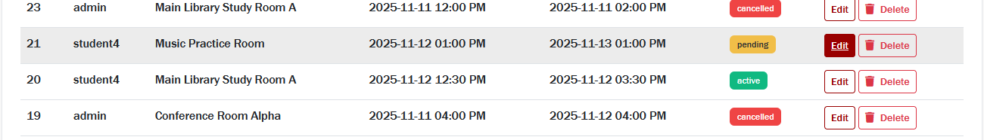
Admins can review booking requests, update statuses, and trigger real-time notifications to students
Log in as admin
Open “Manage Bookings”
Review pending requests
Approve/ reject/ update booking
Booking Status updated in system
Student receives real-time notification

Slide 6
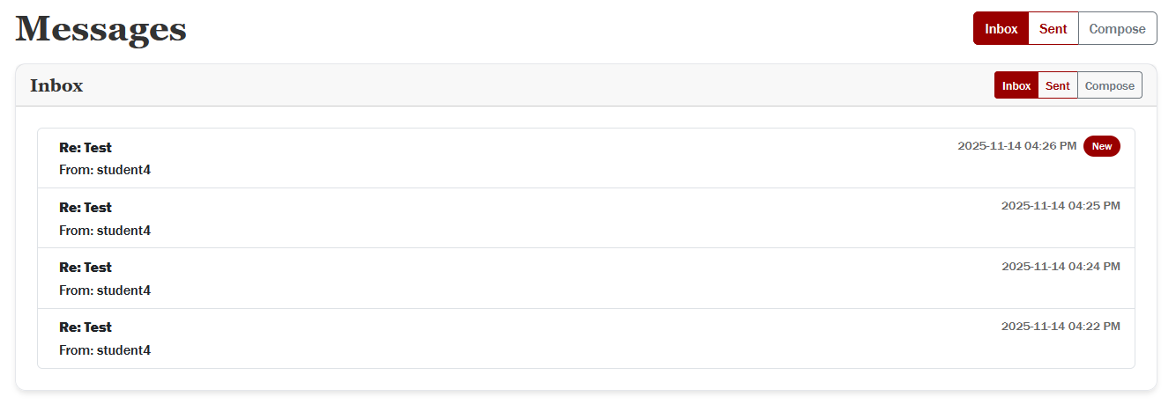
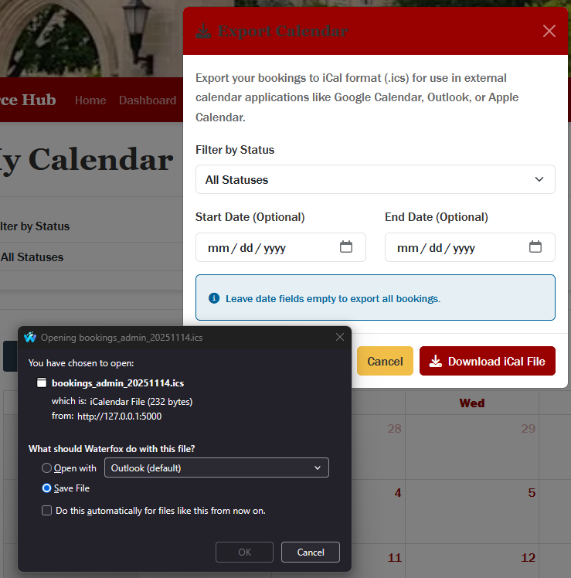
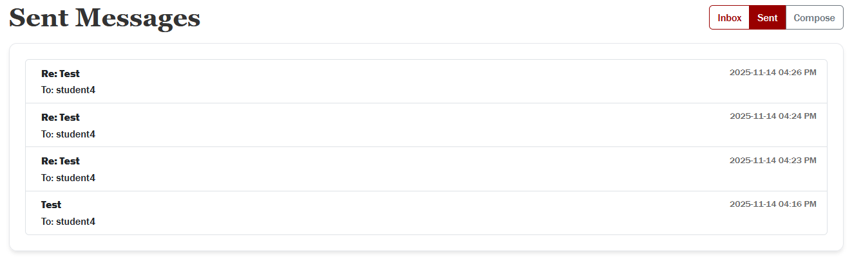
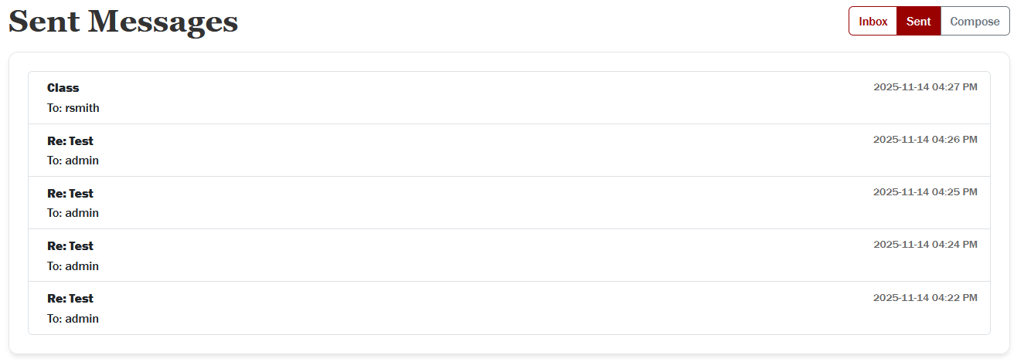
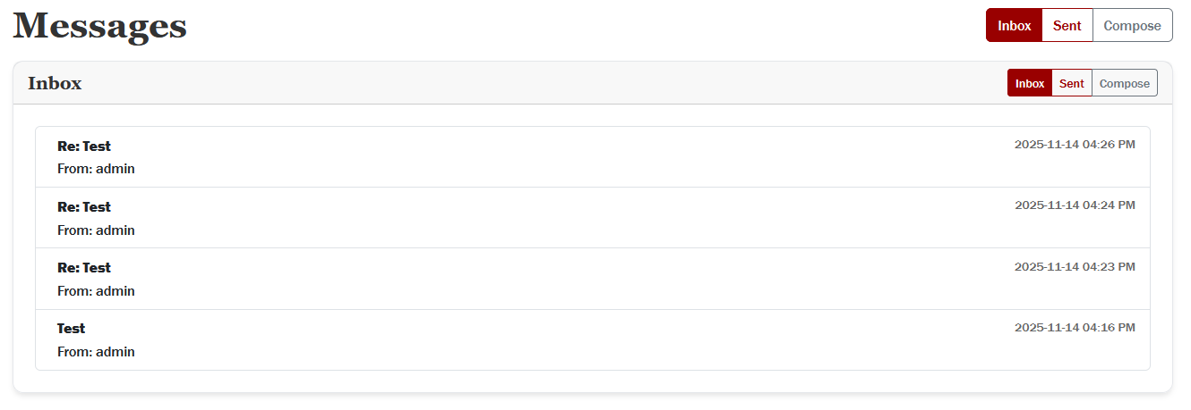
Students and staff can communicate on bookings and export confirmed reservations directly to their personal calendars
Student sends message on resource/booking
Open a confirmed booking
Owner/ Admin receives the message
Click “Export to iCal”
Owner/ Admin replies
File downloads
Conversation thread updates for both users
Add to personal calendar

Slide 7
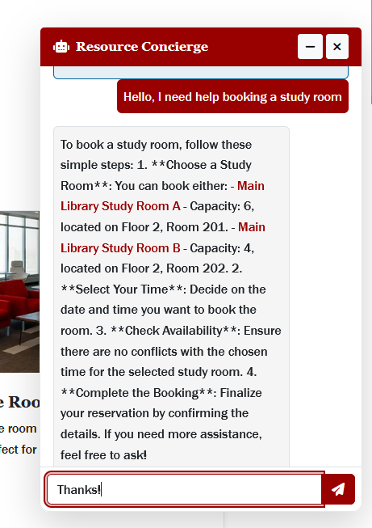
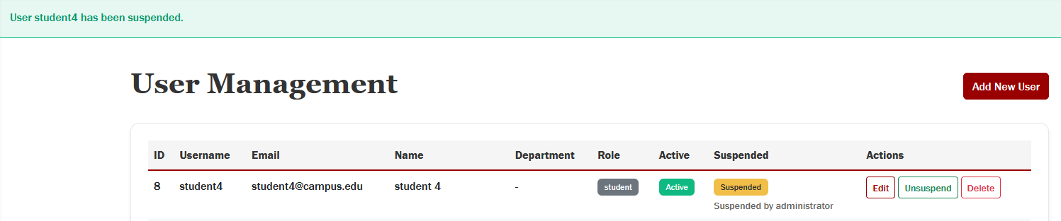
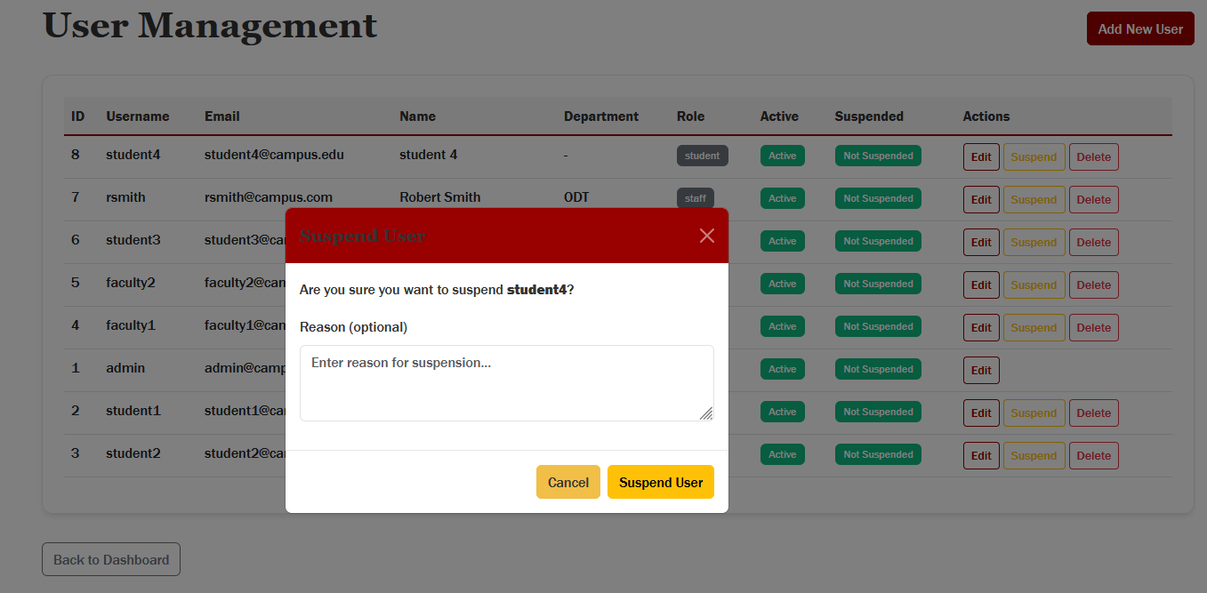
The AI concierge guides users through the platform while admins maintain control with robust user management tools
Admin opens “Manage Users”
Open AI Concierge
Search/select a user
Ask any question about using the platform
Suspend or reactivate account
Concierge provides step-by-step guidance
Add suspension reason
User follows instructions
Action logged in audit trail

