Slide 1
SMART TRAFFIC PREDICTION
AND INTELLIGENT TRAFFIC MANAGEMENT SYSTEM
Integrated Machine Learning, Deep Learning & Generative AI
Project
Core modules
Data Science with Python
March 2026 – August 2026
ML prediction • LSTM forecasting • RAG assistant
Final Project Presentation Nedha Saleem

Slide 2
1. Project Overview
From historical traffic data to prediction, forecasting and natural-language assistance
Why this problem matters
What the project combines
Final prototype
Urban traffic is affected by time, weather, holidays, road capacity and changing travel patterns. A useful system should predict traffic and also make the results understandable.
• Supervised ML for traffic-volume prediction
• LSTM for sequential forecasting
• RAG + Llama 3.2 for traffic information and assistance
FastAPI exposes the prediction/assistant endpoints and Streamlit provides the interactive user interface.
Historical traffic analysis
Model comparison and selection
24-hour sequence forecasting
Knowledge-base question answering
Integrated web dashboard
Smart Traffic Prediction & Intelligent Traffic Management System
2

Slide 3
2. Problem Statement & Objectives
Problem statement
Preprocess historical traffic data
Identify temporal and environmental patterns
Develop and compare ML models
Develop an LSTM time-series model
Build a RAG-based Intelligent Traffic Assistant
Expose the system through an interactive dashboard
Existing traffic systems may provide numerical predictions but can be difficult for users to interpret. They may also miss complex temporal dependencies. The project therefore targets accurate prediction, temporal forecasting, understandable information and an interactive interface.
Smart Traffic Prediction & Intelligent Traffic Management System
3

Slide 4
3. Dataset & Data Understanding
Metro Interstate Traffic Volume — hourly observations from westbound I-94
Original rows
Original columns
Clean rows
Final ML features
Target
48,187
9
40,575
12
traffic_volume
Input variables
Data quality findings
Temperature, rain, snow, cloud coverage, holiday, weather category, hour, day, day of week, month, year and weekend indicator.
No missing values after cleaning. Exact duplicate rows removed. 13,042 rows belonged to duplicated timestamp groups; each timestamp had only one unique traffic value, so repeated timestamps were reduced to 40,575 unique observations.
Target
Traffic volume in vehicles/hour
Smart Traffic Prediction & Intelligent Traffic Management System
4

Slide 5
4. Data Preprocessing & Feature Engineering
Clean
Time features
Categorical encoding
Chronological split
Model-ready data
Remove exact duplicates and repeated timestamps
Extract hour, day, weekday, month, year, weekend
One-hot encode holiday and weather_main
80% train / 20% test without future leakage
33 transformed features for ML
Training set
Test set
32,460 observations • 2012-10-02 → 2017-10-26
8,115 observations • 2017-10-26 → 2018-09-30
Smart Traffic Prediction & Intelligent Traffic Management System
5

Slide 6
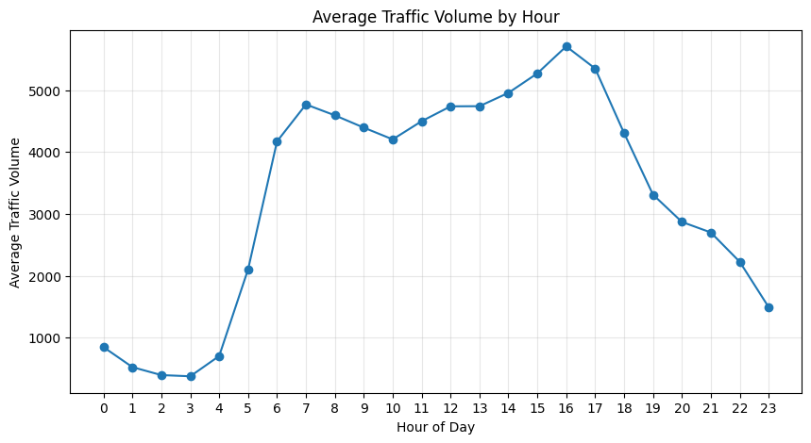
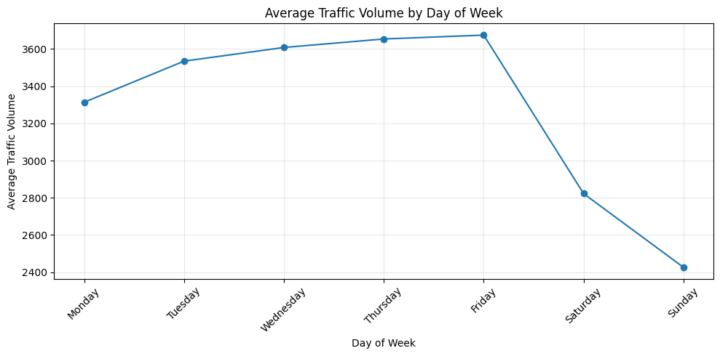
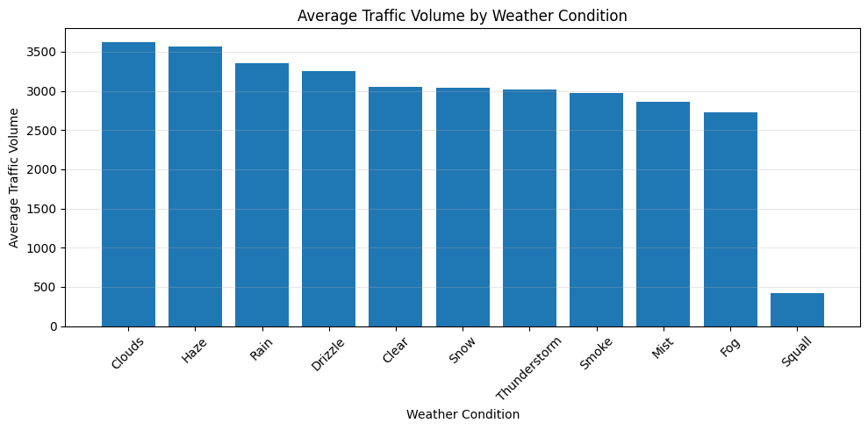
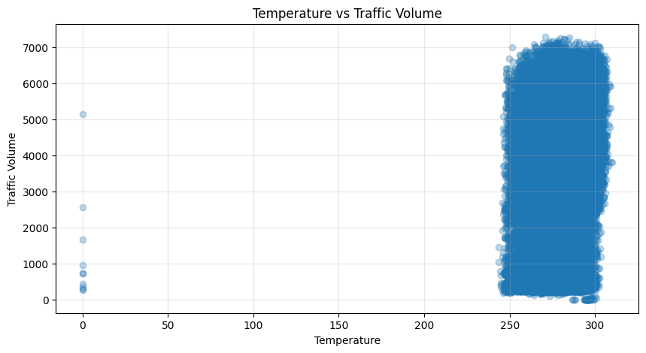
5. Exploratory Data Analysis
The project examined hourly, weekly, monthly and weather-related traffic patterns
Smart Traffic Prediction & Intelligent Traffic Management System
6

Slide 7
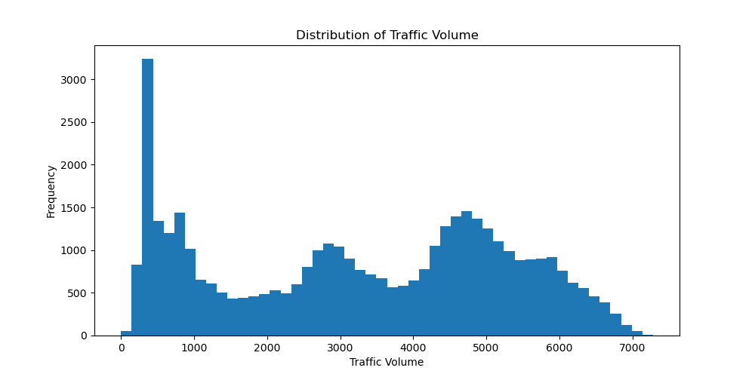
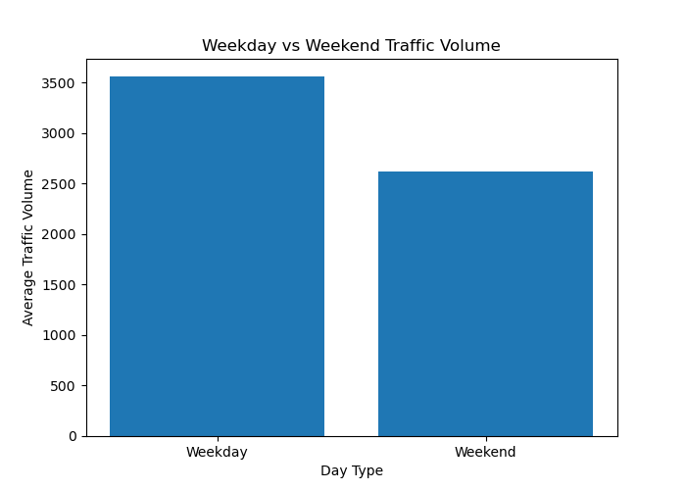

Slide 8
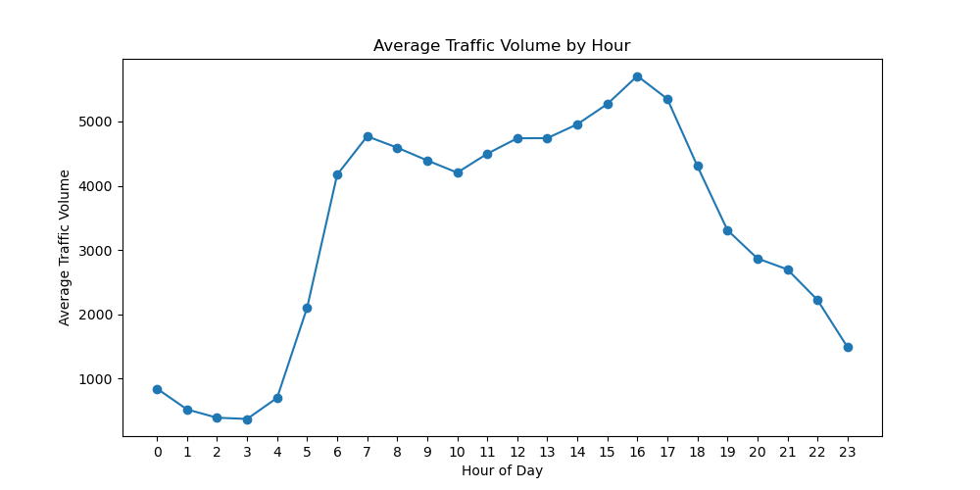
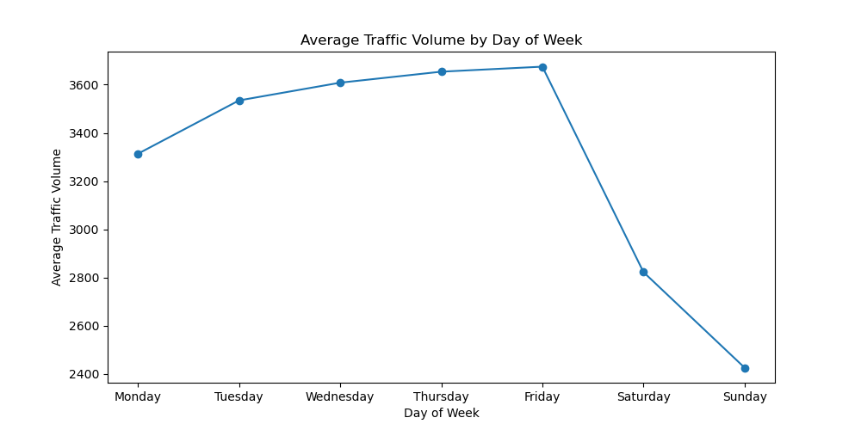
6. Key EDA Insights
Patterns observed in the actual analysis
Hourly pattern
Day-of-week pattern
Weather & temperature
Traffic rises sharply after early morning hours and reaches its strongest level around the afternoon/evening commute period.
Weekdays show substantially higher average traffic than weekends, with Friday among the highest weekday averages.
Weather categories and temperature were examined to understand associations with traffic volume; relationships should not be interpreted as direct causation.
Smart Traffic Prediction & Intelligent Traffic Management System
7

Slide 9
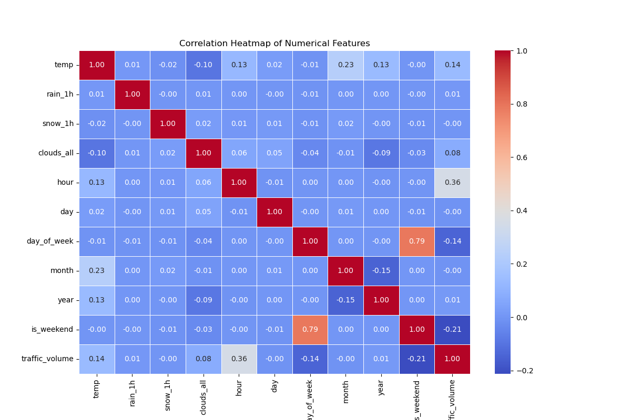

Slide 10
7. Machine Learning Methodology
Regression models trained on engineered temporal, weather and holiday features
Linear Regression
Random Forest
XGBoost
Baseline linear model
Ensemble of decision trees
Gradient-boosted trees
LightGBM
CatBoost
Efficient gradient boosting
Boosting with categorical handling
Evaluation metrics
MAE • MSE • RMSE • R² — lower error is better; higher R² is better
Smart Traffic Prediction & Intelligent Traffic Management System
8

Slide 11
8. ML Model Comparison
Exact test-set results from the final ML notebook
Model | MAE | RMSE | R²
Linear Regression | 1551.45 | 1766.93 | 0.1956
Random Forest | 254.53 | 433.64 | 0.9516
XGBoost | 246.70 | 408.00 | 0.9571
LightGBM | 249.81 | 413.16 | 0.9560
CatBoost | 247.70 | 419.96 | 0.9546
Best model: XGBoost
Lowest MAE, MSE and RMSE, with the highest R² = 0.9571.
0.952
0.957
0.956
0.955
Interpretation
Approximately 95.7% of the variance in test traffic volume is explained by the model.
0.196
Linear
RF
XGB
LGBM
CatBoost
Smart Traffic Prediction & Intelligent Traffic Management System
9

Slide 12
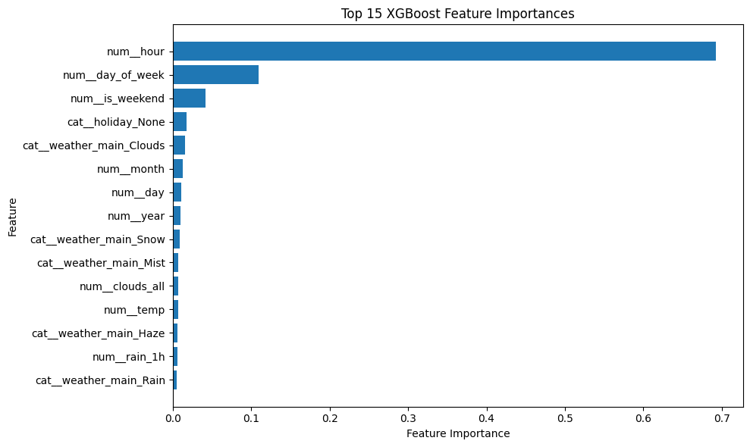
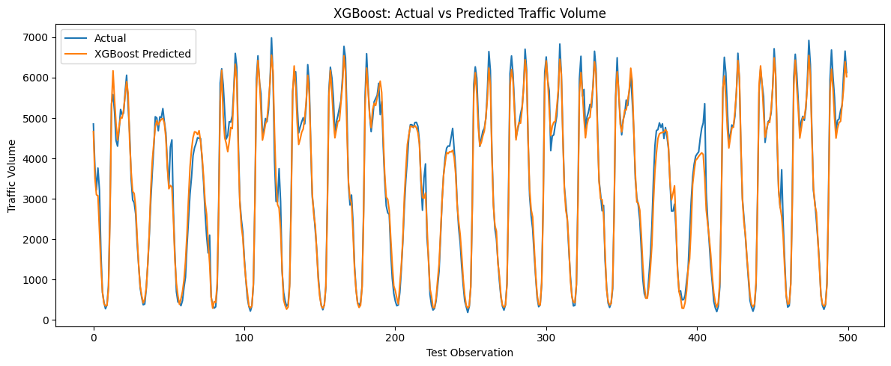
9. XGBoost Results & Feature Importance
The selected ML model for the prediction API
MAE
RMSE
R²
246.70 vehicles/hour
408.00 vehicles/hour
0.9571
Smart Traffic Prediction & Intelligent Traffic Management System
10

Slide 13
10. ARIMA Baseline
Classical univariate time-series baseline for traffic-volume forecasting
Model
Selection
Train
Test
ARIMA(2,1,2)
Best AIC
40,340
6,105
ARIMA setup
• Regular hourly traffic-volume series was prepared for ARIMA.
• Candidate orders were compared using AIC/BIC; ARIMA(2,1,2) had the lowest AIC.
• ARIMA uses the historical traffic-volume series itself and does not use the 22-feature LSTM input sequence.
Smart Traffic Prediction & Intelligent Traffic Management System
14

Slide 14
11. ARIMA Performance
Final test-set performance from the ARIMA forecasting baseline
MAE
MSE
RMSE
R²
2,388.49
8,924,468.90
2,987.38
-1.2751
Interpretation
• MAE = 2,388.49 and RMSE = 2,987.38 indicate large prediction errors.
• R² = -1.2751 means the ARIMA predictions performed worse than a simple mean-based benchmark on the test set.
• The result suggests that basic ARIMA does not capture the complex temporal and contextual traffic patterns as effectively as the project's ANN/LSTM models.
Smart Traffic Prediction & Intelligent Traffic Management System
15

Slide 15
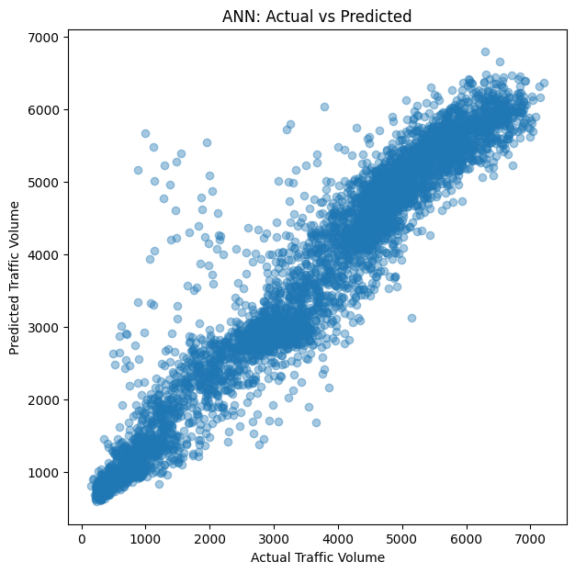
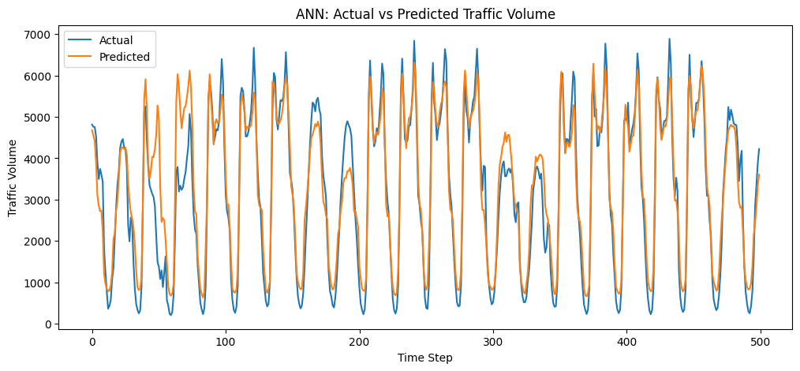
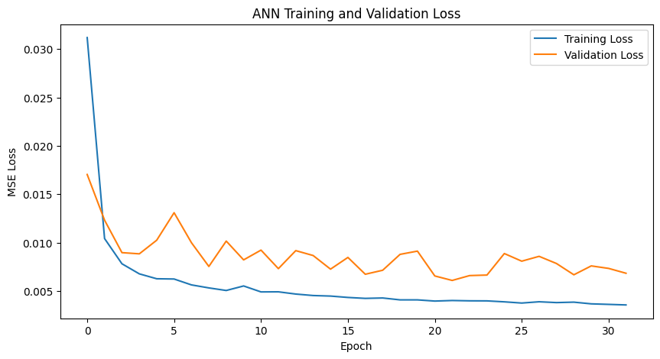
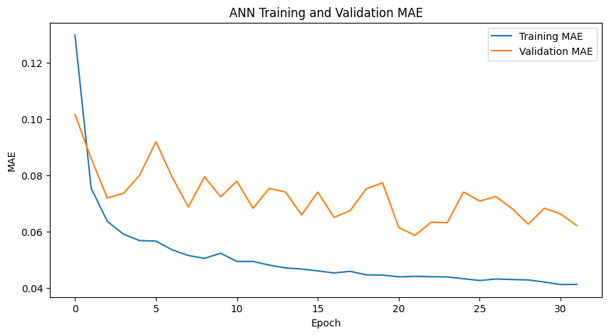
12. Deep Learning: ANN Baseline
A feed-forward neural network was also evaluated before the sequential LSTM model
ANN structure
Dense(128) → Dropout → Dense(64) → Dropout → Dense(32) → Dense(1)
ANN performance
MAE: 375.71
RMSE: 511.04
R²: 0.9334
Smart Traffic Prediction & Intelligent Traffic Management System
11

Slide 16
13. LSTM Time-Series Forecasting
24-hour sequences were used to predict the next traffic-volume time step
Hour 1
Hour 2
Hour 3
Hour 4
LSTM output
Feature vector
Feature vector
Feature vector
Feature vector
Next-hour volume
Input
Architecture
Sequence datasets
Sequence length: 24
Features per time step: 22
Chronological continuous segments used to avoid crossing missing-time gaps.
LSTM(64)
Dropout(0.2)
Dense(32, ReLU)
Dense(1)
Optimizer: Adam • Loss: MSE
Train: 17,251 sequences
Validation: 5,771
Test: 5,801
Smart Traffic Prediction & Intelligent Traffic Management System
12

Slide 17
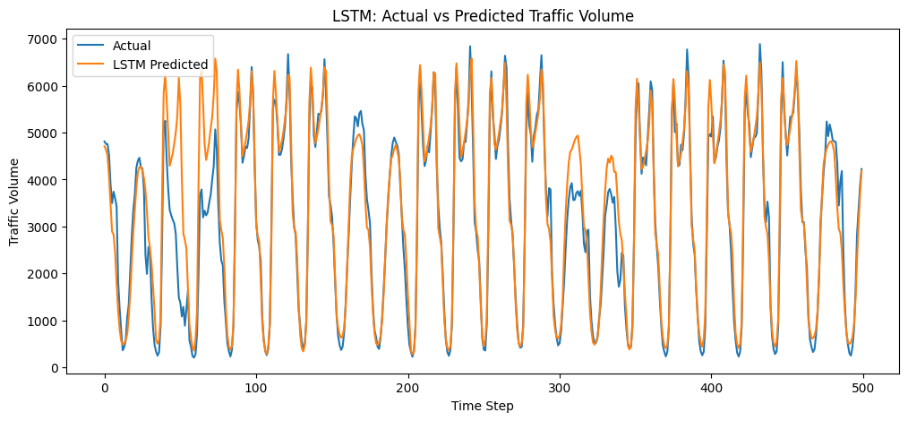
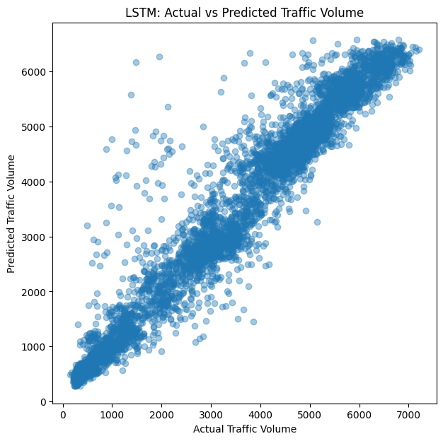
14. LSTM Performance
Final test-set performance from the Deep Learning notebook
MAE
MSE
RMSE
R²
300.44
212,013.74
460.45
0.9460
Result
LSTM captured temporal dependencies effectively and substantially improved over the ANN baseline.
Smart Traffic Prediction & Intelligent Traffic Management System
13

Slide 18
15. ML vs DL: What Each Model Contributes
XGBoost — tabular prediction
LSTM — sequential forecasting
• Uses engineered contextual features
• Strong performance on the cleaned ML dataset
• Best test R² among the evaluated ML regressors: 0.9571
• Selected for the direct ML prediction endpoint
• Uses 24 consecutive observations
• Learns temporal dependencies
• Test R²: 0.9460
• Selected as the deep-learning forecasting component
Design decision
Use both: XGBoost for feature-based prediction and LSTM for sequence-based forecasting.
ARIMA serves as a classical baseline; its test R² was -1.2751, weaker than the ANN and LSTM.
Smart Traffic Prediction & Intelligent Traffic Management System
16

Slide 19
16. Generative AI Module — RAG Pipeline
Final implemented prototype: knowledge-base retrieval + Llama 3.2
Knowledge base
Chunking
TF-IDF
Retrieval
Prompt
LLM
24,247 characters
291 paragraphs
20 chunks
1500 chars / 200 overlap
20 × 628 sparse vectors
Cosine similarity
Top-3 chunks
Retrieved context + question
Safety / grounding rules
Ollama
Llama 3.2
Grounding principle
The assistant is instructed not to invent routes, traffic conditions or prediction results, and to distinguish historical/model predictions from real-time conditions.
Smart Traffic Prediction & Intelligent Traffic Management System
17

Slide 20
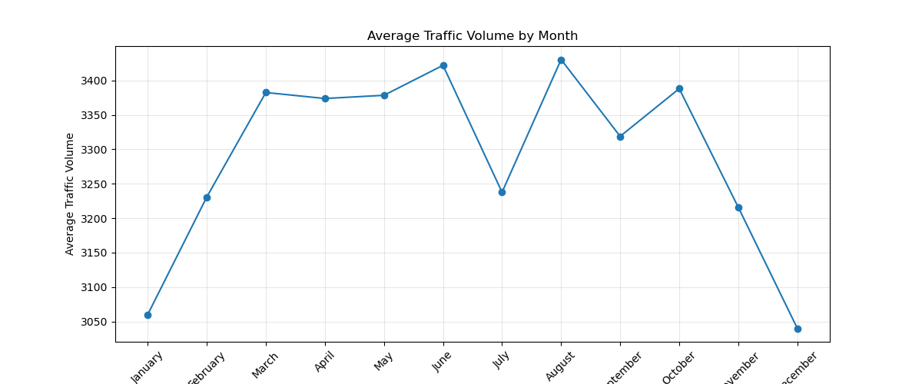
17. Knowledge Base & Retrieval
Actual GenAI notebook outputs
Documents
Characters
Paragraphs
Chunks
1
24,247
291
20
Retrieval example
For “What is traffic congestion?”, the top retrieved chunk had cosine similarity ≈ 0.4433.
Smart Traffic Prediction & Intelligent Traffic Management System
18

Slide 21
18. Llama 3.2 Response Generation
The retrieved context is injected into a controlled prompt before generation
Prompt design
Test question
1. Use retrieved knowledge as the primary source.
2. Do not invent unsupported traffic facts.
3. State when information is unavailable.
4. Give clear, helpful answers.
5. Add safety guidance where relevant.
6. Do not confuse model predictions with live conditions.
“What is traffic congestion?”
Generated answer
“Traffic congestion occurs when the number of vehicles using a road approaches or exceeds the road’s available capacity, resulting in slower speeds, longer travel times, increased fuel consumption, and increased driver frustration.”
Why RAG?
It grounds the language model in project-specific traffic knowledge before generating the response.
Smart Traffic Prediction & Intelligent Traffic Management System
19

Slide 22
19. FastAPI REST API Integration
The trained artifacts and RAG assistant were exposed through a common backend
GET /
POST /predict/dl
API running message
Requires exactly 24 time steps for LSTM forecasting
GET /health
POST /ask
Health check → status: healthy
Traffic question → RAG → Llama 3.2 answer
POST /predict/ml
Artifacts loaded
XGBoost prediction using the saved preprocessor + model
XGBoost JSON + preprocessor + LSTM .keras + feature/target scalers
Smart Traffic Prediction & Intelligent Traffic Management System
20

Slide 23
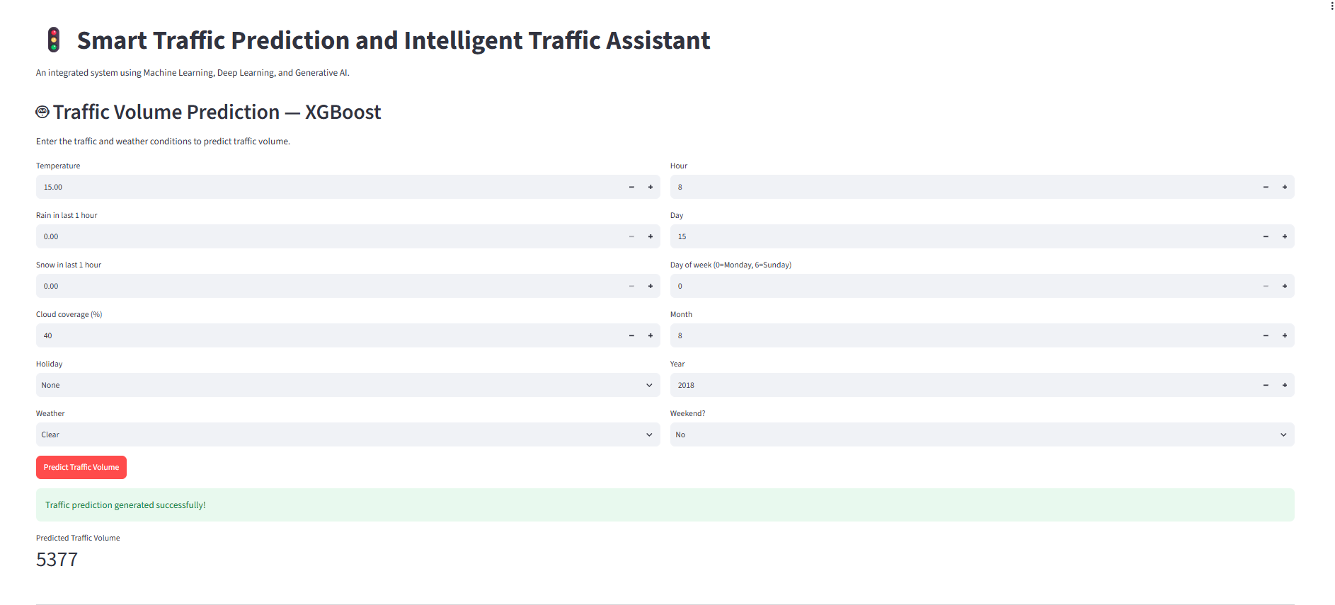
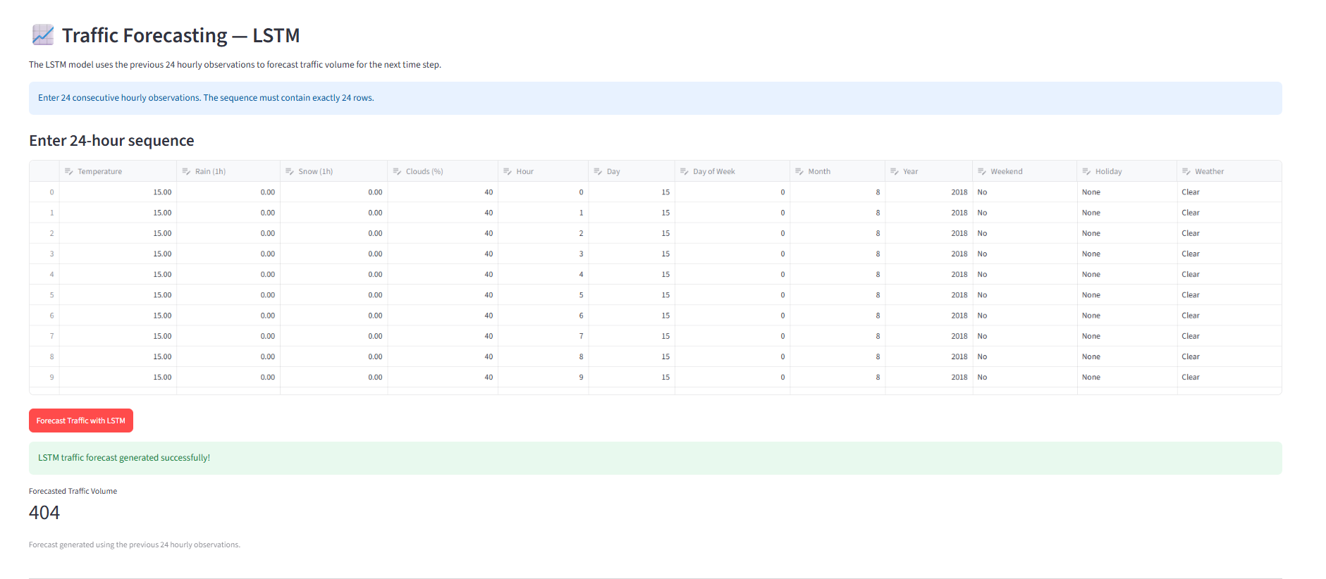
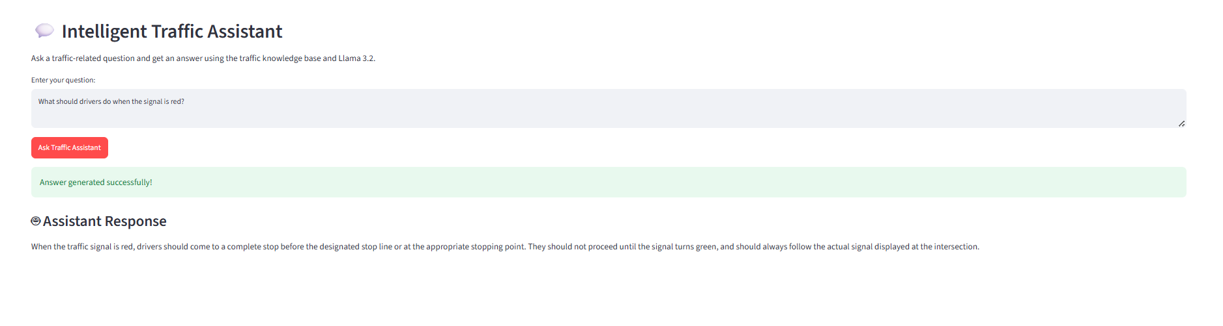
20. Streamlit Dashboard
Single user interface for ML prediction, LSTM forecasting and the Intelligent Traffic Assistant
User-facing capabilities
• ML traffic-volume prediction
• 24-hour LSTM forecasting
• Traffic-related natural-language questions
• Success/error feedback from FastAPI
Smart Traffic Prediction & Intelligent Traffic Management System
21

Slide 24
21. End-to-End System Flow
Implemented prototype flow
Historical data
Cleaning & features
XGBoost / LSTM
Prediction / forecast
FastAPI
Streamlit
Question
Retrieve
Llama 3.2
Answer
Smart Traffic Prediction & Intelligent Traffic Management System
22

Slide 25
22. Overall Results
Best ML R²
LSTM R²
KB size
RAG chunks
0.9571
0.9460
24,247 chars
20
Prediction & forecasting
GenAI & deployment
XGBoost provided the strongest tabular ML result. LSTM achieved strong sequential forecasting using 24-hour windows.
ARIMA was included as a classical baseline and achieved test R² = -1.2751, indicating weaker performance on this dataset.
A local Llama 3.2 assistant was connected to retrieved traffic knowledge. FastAPI unified the backend and Streamlit provided the user interface.
System outcome
A working integrated prototype spanning data processing → AI models → RAG assistant → REST API → dashboard.
Smart Traffic Prediction & Intelligent Traffic Management System
24

Slide 26
23. Future Scope
Real-time traffic APIs and live weather data
CCTV/video-based vehicle detection using YOLO
Transformer-based time-series forecasting
Real-time congestion alerts
Verified route optimization
Smart-city infrastructure integration
Mobile application
Cloud deployment and scalable vector database
Smart Traffic Prediction & Intelligent Traffic Management System
26

Slide 27
24. Technology Stack
Layer | Implemented / used
Language | Python
Data processing | Pandas, NumPy
Analysis & ML | Scikit-learn, XGBoost, LightGBM, CatBoost
Deep learning | TensorFlow / Keras, LSTM
GenAI | Ollama, Llama 3.2
Retrieval | TF-IDF + cosine similarity
API | FastAPI, Uvicorn
UI | Streamlit
Development | Jupyter / Google Colab
Version control | Git / GitHub
Smart Traffic Prediction & Intelligent Traffic Management System
27

Slide 28
25. Conclusion
The project developed an integrated AI prototype for historical traffic prediction and intelligent traffic assistance.
XGBoost achieved the best ML performance with R² = 0.9571.
LSTM provided strong sequential forecasting with R² = 0.9460.
RAG retrieval connected a project-specific knowledge base to Llama 3.2 for grounded traffic assistance.
FastAPI and Streamlit turned the separate components into an interactive application.
Basic ARIMA was included as a classical baseline; its test R² of -1.2751 was weaker than the ANN and LSTM results.
Key takeaway
Prediction + forecasting + explainable natural-language assistance in one prototype.
Smart Traffic Prediction & Intelligent Traffic Management System
28

Slide 29
26. References & Project Files
Metro Interstate Traffic Volume Dataset (UCI Machine Learning Repository)
Scikit-learn documentation — preprocessing and regression metrics
XGBoost documentation — gradient boosting regression
TensorFlow / Keras documentation — LSTM networks
Ollama documentation — local LLM runtime
Llama 3.2 model used through Ollama
Project knowledge base: traffic_knowledge_base.txt
Project notebooks: ML, Deep Learning, GenAI and FastAPI
Smart Traffic Prediction & Intelligent Traffic Management System
29

Slide 30
THANK YOU
Smart Traffic Prediction and Intelligent Traffic Management System
Nedha Saleem

