Slide 1

Description of a
Thinking Machine
Ph.D. Dissertation Defense
“A Cognitive Computing Architecture”
Department of Electrical and Computer Engineering
J.E. (Ned) Lecky
March 31, 1999

Slide 2
Definitions
Cognition: Using knowledge to solve problems
Thinking: The spontaneous generation of new information from old
Claiming that any machine does either is a stretch
But… the brain is a machine

Slide 3
Traditional Computer Programming
Distill old information into an “algorithm”
Algorithm: sequential, unambiguous procedure or recipe for solving a problem
No “recipe” for spontaneous generation of new information!
Traditional programming can’t think

Slide 4
Neural Computing
Modeling after the brain
  really, just after the neuron
Hodgekin and Huxley, 1939
w1
Sum
> T?
w2
w3
Woefully oversimplified but has merit

Slide 5
Traditional Neural Network
Back propagation: force outputs to desired value for each training pattern
Iterate until (hopefully) every input gives the correct output; makes feedback paths challenging
No thinking here

Slide 6
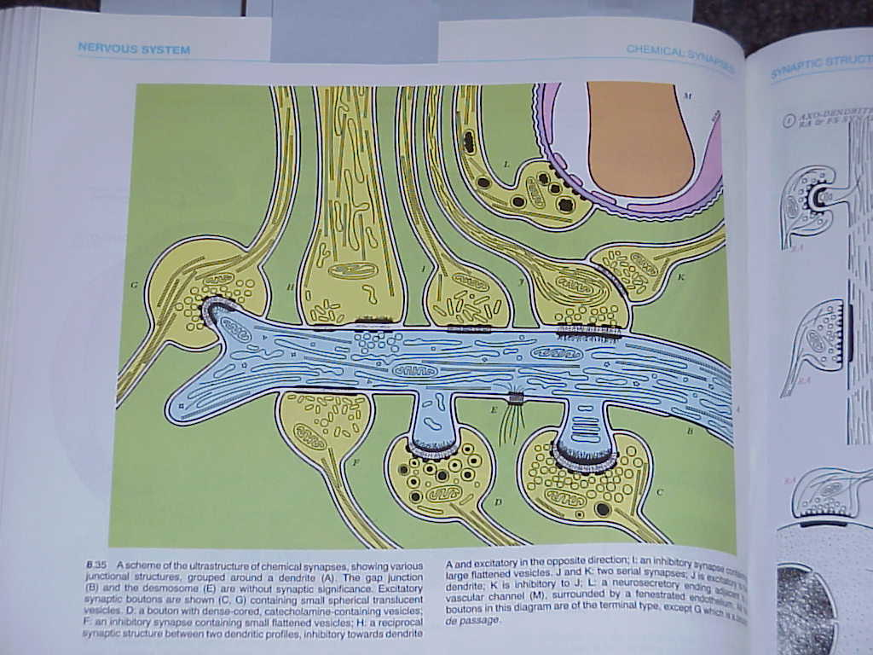
Better Neurophysiology
“Weights” are too much of a simplification
1000s of neuron types
100s of neurotransmitters
100s of ionic channels

Slide 7
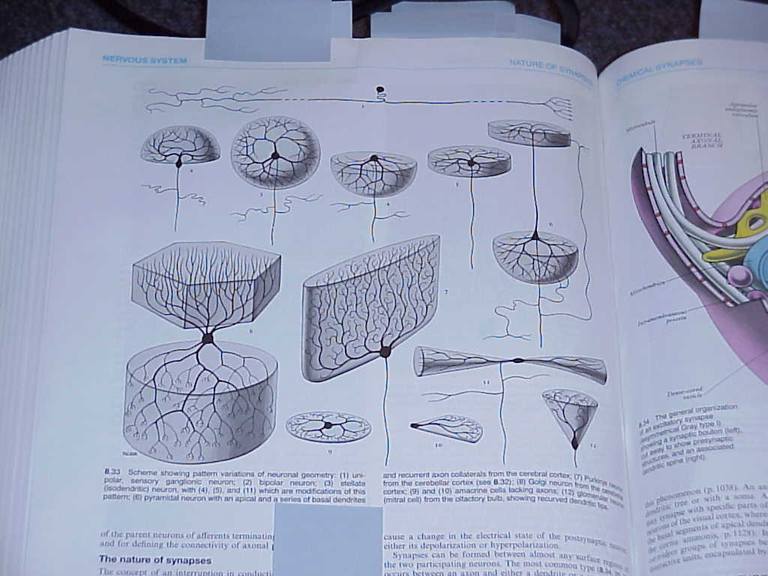
Neurons as Feathers
The neuron is a very flexible digital or analog circuit element
It is probably NOT critical to brain operation, like the feather is not critical to flight

Slide 8
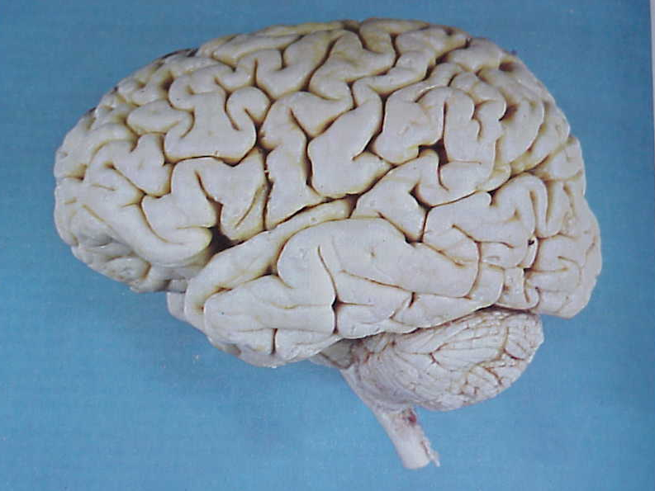
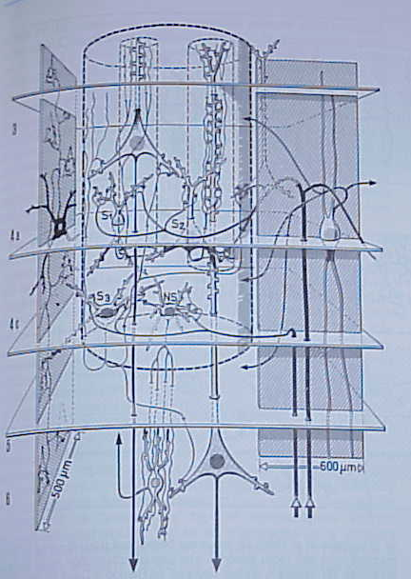
A Look From The Top
The neocortex…
2000 - 10,000 neurons per “macrocolumn”
Quasi-homogeneous

Slide 9
Size of the Machine
“We only use 10% of our brain…”
But a chimp has 25% of our neocortex; why isn’t it as smart?
1,000,000 macrocolumns vs. 250,000?

Slide 10
Three Thinking Problems
8-puzzle
  simple solution
Stream Crossing
  more insight required
Pendulum Inversion
  need for maximal cleverness

Slide 11
The 8-puzzle
1
8
3
1
2
3
Start:
4
2
Goal:
8
4
5
7
6
7
6
5
One blank position to work with
Slide adjacent tiles into the blank
Solution: RULULD….

Slide 12
Stream Crossing
Finish
Start
Get from one side to the other
Legs only so long
Minimize number of steps and water on shoes

Slide 13
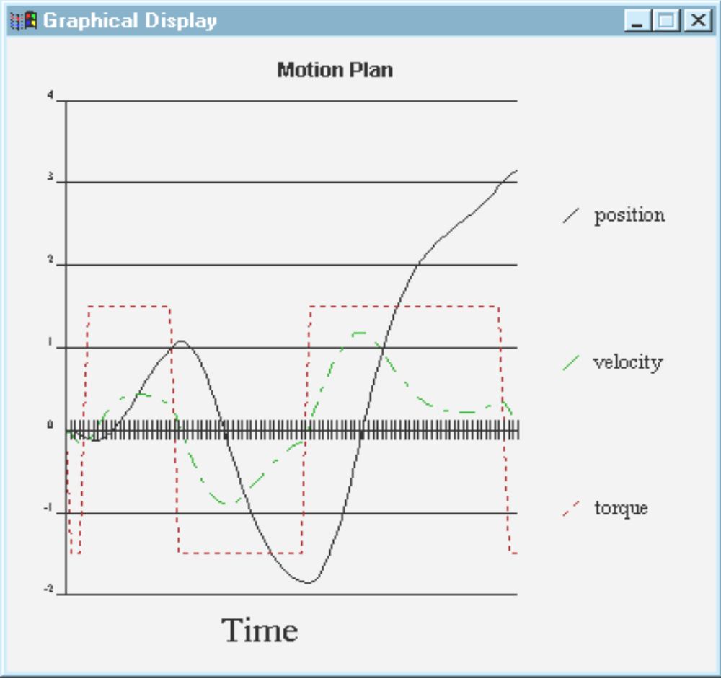
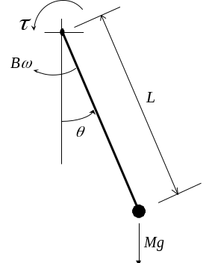
Pendulum Control
Nonlinear system
Clever solutions

Slide 14
The Scouting Concept
Try random sequences of actions
Did I reach the goal?
Elimination of overhead yields:
  simple forward simulation of any problem
  implementation in hardware
  small circuits ➔ parallel implementation
  near infinite scalability

Slide 15
Scout Anatomy
PA: Pick Action, randomly
NS: Determine New Situation
GC: Goal Check
Tricky Part is PA
  should look at last n moves to avoid unmoving

Slide 16
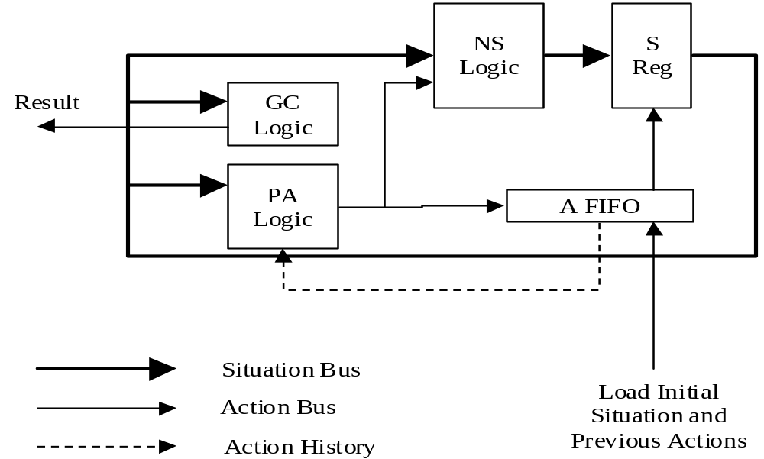
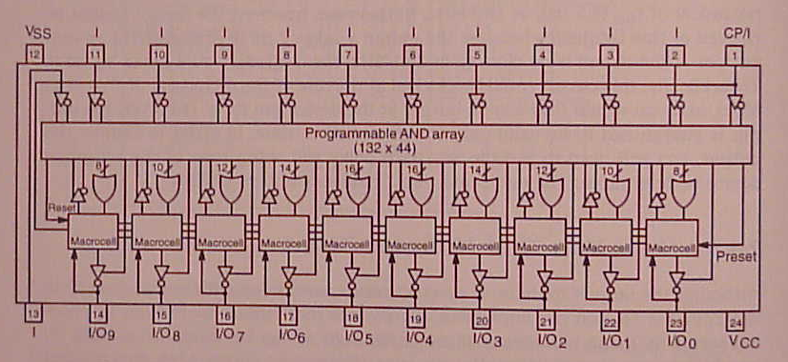
Scout Block Diagram

Slide 17
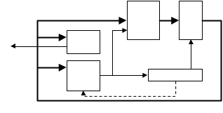
The Scout Cluster
Situation
Rules
Solution
Goal

Slide 18
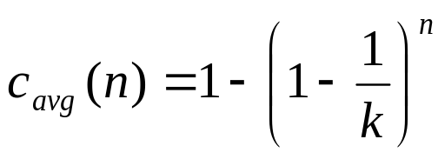
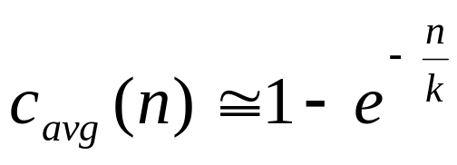
Drawback?
Many scouts could explore the same sequence of actions
Theoretical analysis shows things aren’t too bad

Slide 19
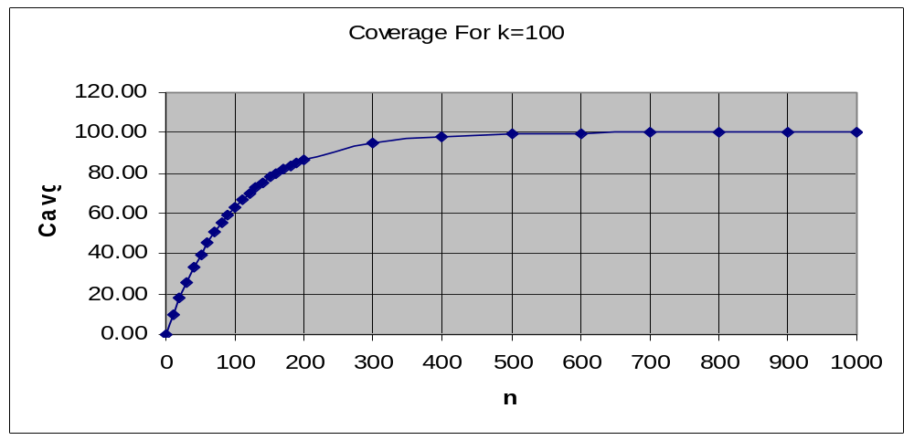
Coverage Interpretation
For 100 paths, run 500 scout cycles
Not so bad if the cycles are 1000X faster than sequential algorithms

Slide 20
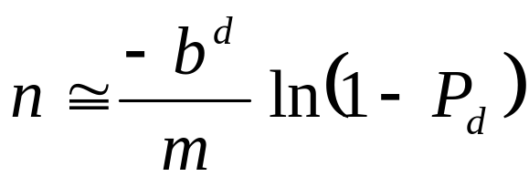
Solution Quality Estimation
Coverage gives expression for likelihood of finding a solution
Can solve for inverse to get number of scout cycles which must run to achieve a solution with a certain probability

Slide 21
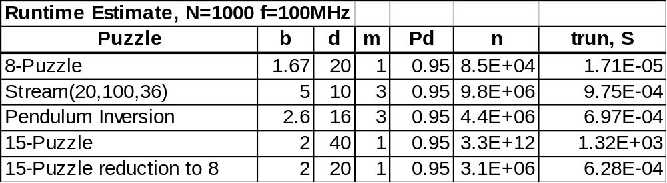
Runtime Estimation
Blisteringly fast
Stepped goals on 15-puzzle

Slide 22
Conclusions, I
Scouting generates spontaneous solutions, and “simulates” thinking
Only a knowledge of the behavior of the problem is required
  no knowledge of the nature of the SOLUTION is required
The inefficiency of random search gives tremendous runtime benefit

Slide 23
Conclusions, II
Hardware block format is amenable to massively parallel physical implementation (PLDs, CPLDs, etc.)
Both digital and analog (motion control) problems can be handled with digital or analog blocks

