Slide 1
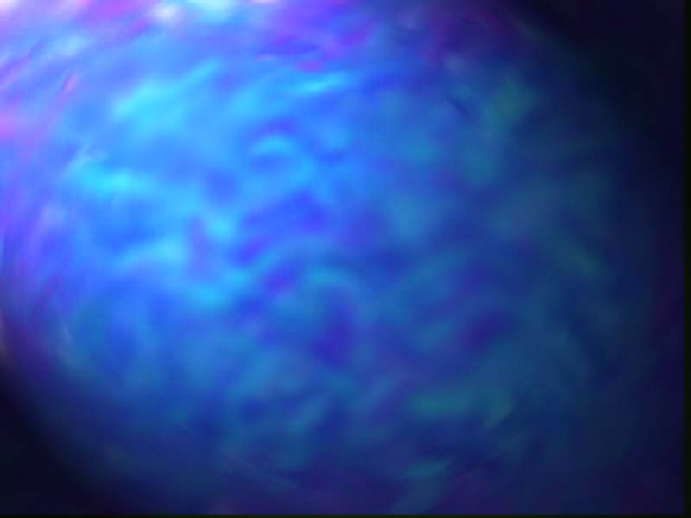
Asynchronous Solvers
Dissertation Research
J.E. (Ned) Lecky

Slide 2
The Vortex Processor
Move 1
Move 2
Move 3
Initial State
Previous Move
Next State
Possible Move
Goal Check
All Moves

Slide 3
Vortex
Goal Check (One for every column)
Move 3
Move 2
Move 1
Initial State

Slide 4
The Spin Processor
Next Move
Goal Check (with complex state memory)

Slide 5
Spin Processor II
Next Move
Delay
Goal Check (with complex state memory)

