Slide 1
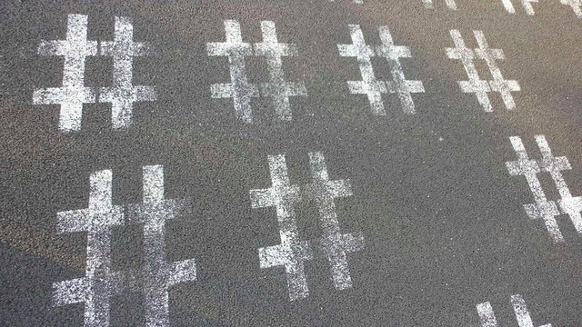
# hashtag analyzer
Omar Abu Nabah
Mahsa Abbasian
Mohamad Ali
Neda Amiri
Simeon Petrov
Sally Masry

Slide 2
Overview
Based on visualizing information collected
from multiple social medias: Instagram and Twitter
Filtrate user search by different search options:
number of likes/favorite count
number of shares/ retweet
geographic locations
hashtag(#) search base on search options.
Allow users to choose between these two medias.

