Slide 1
ONS OpenAPI Training Slides
July 2015

Slide 2
Contents
Introduction
Web Services Basics
ONS OpenAPI Overview
Discovery
Delivery
Error Codes
Client Applications
Examples

Slide 3
1. Introduction
What is the ONS OpenAPI?
NeSS and NOMIS
Release Timetable
Resources

Slide 4
ONS OpenAPI Overview
The ONS OpenAPI allows you to interact with ONS data programmatically from your own application.
Using the API you can:
Request complete datasets to be downloaded into your own system
Request specific sets of data items
Request data to use in real-time, or to store for later
Discover the data available and geographical areas that are available
Create something new and exciting!

Slide 5
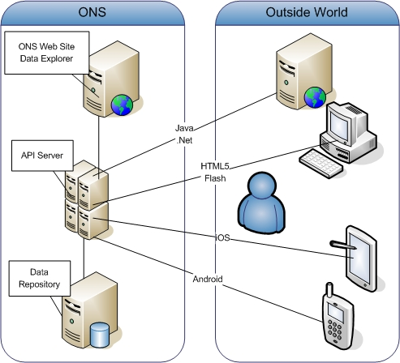
What is the ONS OpenAPI?
The ONS OpenAPI is an Application Programming Interface which makes our data available on demand to client applications both internal and external.
It is implemented as a RESTful web service.

Slide 6
NeSS and NOMIS
NeSS and NOMIS both have live data web services. Whilst the ONS OpenAPI is intended to be the long-term solution, for the time being we have three complementary services.
NeSS Data Exchange – older service (established in 2008) giving access to monovariate NeSS data via SOAP or REST. For details go to its landing page
NOMIS API - modern RESTful service serving data from NOMIS. For details see the instructions page

Slide 7
Release Timetable for the ONS API
Initial Beta release October 2013
Enhanced Beta release July 2014
Further improvements released on October 2014.
Latest version July 2015
Mostly Census 2011 data but more is being continually added over time (e.g. Population Projections, Annual Survey of Hours and Earnings)

Slide 8
Resources
API Service Pages
Manual
Example clients
How To guides
Sample output
Developers’ Forum on Stack Overflow (tag ons-api)
Data questions on StatsUserNet

Slide 9
2. Web Services Basics
What is a Web Service?
SOAP
REST
Security

Slide 10

What is a Web Service?
The W3C defines a web service as "a software system designed to support interoperable machine-to-machine interaction over a network".
Most services work using either the SOAP or REST protocols.

Slide 11

SOAP
SOAP stands for “Simple Object Access Protocol”.
It uses XML messages transmitted via HTTP or SMTP.
A SOAP service’s methods are defined in a document called a WSDL (Web Service Definition Language) – pronounced “wizdel”.
Example method from NeSS Data Exchange: getAreaChildren(‘24UE’). The response is a list of areas in XML.
SOAP services are traditionally tightly coupled with client applications (via stub generation).

Slide 12

REST
REpresentational State Transfer (REST) is a style of software architecture for distributed systems such as the World Wide Web. REST has emerged as a predominant web service design model.
Everything is a resource with a unique URI addressable via an HTTP request.
REST services are loosely coupled with their client applications.
The ONS OpenAPI uses REST.

Slide 13

Security
Some APIs have no security at all – requests are completely anonymous.
Others require an API Key to identify the user.
A few have real authentication requiring a username and password to be sent with each request.
Some APIs encrypt the response using SSL but this slows the service down.
The ONS OpenAPI (Beta) requires a registration key – mainly for usage monitoring but also useful for debugging.

Slide 14
3. ONS OpenAPI Overview
Design Principles
URIs
Elements of URI
Concepts and References
Representations (output formats)
XML
JSON
API Key
Context
Geography
Filter Terms
Paging Parameters
Discovery and Delivery

Slide 15

Design Principles
The API specification follows recommendations made in the document Designing URI Sets for the Public Sector which aims to provide a unified approach for all public data services.
A new set of guidelines has just been issued by the Cabinet Office, too late for our initial design, but may be useful for later versions. From an initial review the ONS API generally follows these guidelines.
The ONS API implements REST using a framework called Jax-RS.
Linked data (RDF) output is not directly supported but the design is sympathetic to future use.

Slide 16
URIs
ONS OpenAPI requests all consist of a Uniform Resource Identifier (URI) submitted via an HTTP GET. The URI includes
Path
Representation
Query String
-> API Key
-> Context
-> Geography
-> Slicing
-> Paging

Slide 17
Elements of URI
Domain: http://data.ons.gov.uk/ons/api
Context: /data/
Path To Resource: Points to thing to be retrieved
Representation: xml, json, csv etc.
Query: Data Context
Query: Geographic Hierarchy
Query: Slice Parameters
Query: Paging Parameters

Slide 18
Path to Resource
Usually a concept and a reference in a pair.
A concept is a category of thing, e.g. dataset.
A reference is an incidence of a thing, e.g. QS01EW.
So the path to the resource is dataset/QS01EW.
The URI Sets paper recommends that omitting the reference is an inferred request for a list. The ONS API uses collection entities instead e.g. datasets

Slide 19

Representation
For the Beta ONS OpenAPI, XML, HTML and JSON are supported for direct responses, with CSV and XLS also available for zipped downloads.
The XML format used for data and dataset structure is SDMX Generic.
The JSON format can be the SDMX auto-converted or alternatively the more lightweight JSON-STAT.

Slide 20
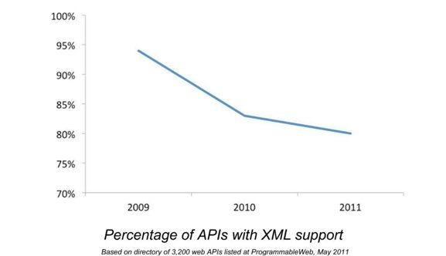
XML
XML losing popularity but still a “must”

Slide 21
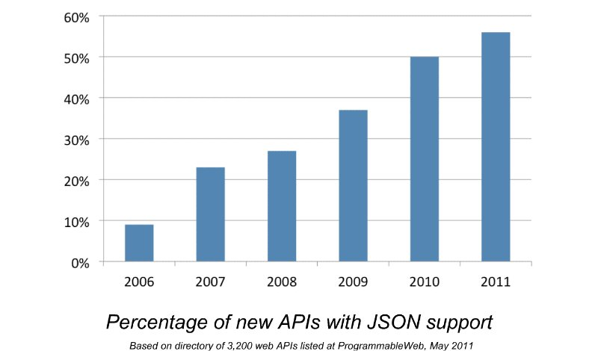
JSON
JSON on the rise – also a “must”

Slide 22
Data Context
The datastore underneath the API is divided into four sections, each one of these is selectable via the query string ?context=<section name>
The four contexts are Census, Socio-Economic, Economic and Social.
It is possible for items with the same name to exist in more than one context.
In the Enhanced Beta version of the API, initially most data was under the context of Census, but there is now quite a bit under Economic and Social too.

Slide 23
Filter Terms
For datasets, you can specify a slice using dimension item values. ?dm/area=E06000047,E05008002 &dm/sex=M (only give me data for males in Durham and Sedgefield).
For geographic hierarchies, you can slice them using level numbers and / or parent codes. For example ?geog=2011WARDH&parent=E12000004&level=3

Slide 24
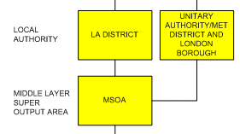
Geographic Hierarchies
The ONS OpenAPI uses an entity called a collection.
Each dataset in the system belongs to a collection.
Each dataset in a collection differs only by the geographic hierarchy the data is for.
You can discover which hierarchies are available for a collection
Then specify the required hierarchy using ?geog=<hierarchy name>

Slide 25
Paging Parameters
Most applications, such as data explorers will want the data served to them in chunks – they will not want to parse huge responses.
The API allows you to specify the number of observations in each chunk e.g. ?noobs=1000.
You can then page from chunk to chunk by changing the start observation number e.g. ?startobs=1001

Slide 26


Discovery and Delivery
All resources within the API can be discovered. There are two types of discovery:
Lists – e.g. give me a list of dimensions within this dataset;
Nodes – e.g. describe this node (entity), including the URIs of related nodes (such as parents and children).
Deliveries are usable things such as data cells, classifications, metadata, binaries etc.

Slide 27
4. Discovery
Self-discovery (HATEOAS)
Entities
Lists
Geographic Queries
Exercise

Slide 28
HATEOAS
HATEOAS, is an abbreviation for Hypermedia As The Engine Of Application State. The principle is that the client program dynamically discovers the URIs for all possible state transitions (where do I go next?)
This is sometimes called self-discovery or programmatic discovery.
Developer discovery (read the manual) is the most common approach but being able to discover related nodes programmatically is still a useful feature.
HATEOAS is partially implemented in the Beta API. Many discovery responses contain linkedNodes which allow navigation of the API’s entity model (see next slide).

Slide 29
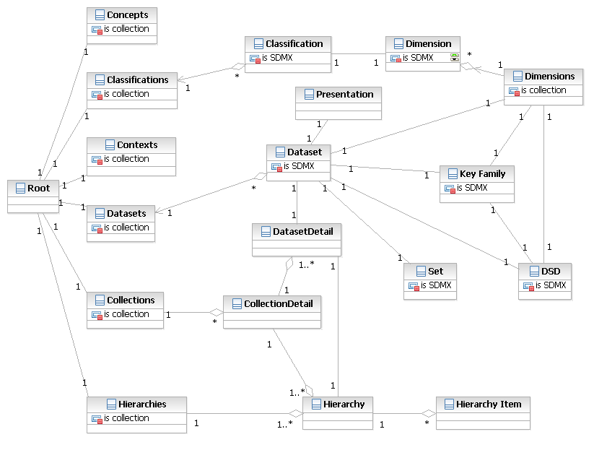
Entities
Diagram showing the entities in the ONS OpenAPI

Slide 30
Lists
Some of the entities in the diagram are collection nodes (ending in s).
For example the url classifications gives you a list of classifications
There is also a collection of collections called collections
The ONS discovery XSD describes the structure of all the possible list items

Slide 31
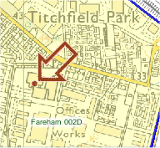
Geographic Queries
Many client user journeys involve clicking on maps and selecting areas. The Beta API does not have advanced geographic querying functions, but sometimes other services can be used (e.g. NeSS Data Exchange does postcode to OA lookups, and ONS has recently launched its Open Geography Service).

Slide 32
Discovery Exercise
In a web browser, view the API’s root node
Use the response to discover how to get a list of contexts.
Now get a list of collections for context=Census
For one of these collections, view the details
Using these details, pick a geography for which a dataset exists
View the details of one of the datasets
Get a list of dimensions for this dataset

Slide 33
Discovery Exercise - Answers
Just the base domain url, plus your key, e.g. data/?apikey=12345
contexts.xml
collections.xml?context=Census
collectiondetails/QS105EW.xml?context=Census
2011WARDH is valid
datasetdetails/QS105EW.xml?context=Census&geog=2011WARDH
dataset/QS105EW/dimensions.xml?context=Census&geog=2011WARDH

Slide 34
5. Delivery
Metadata
Details
Reference
Structural
Data
Slicing
Paging
Downloads
Exercise

Slide 35
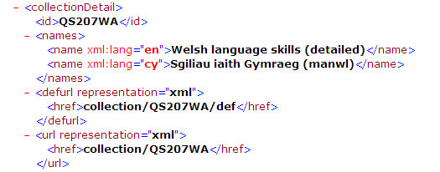
Metadata - Details
Details can be requested for collections, datasets and other entities.
General information about the item, for example number of cells in a dataset.

Slide 36
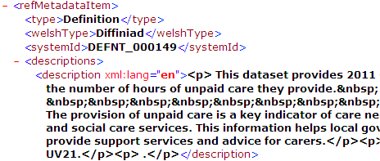
Metadata – Reference
Reference metadata is held for collections, datasets classifications, dimensions and other entities.
The URL is the same as the one which delivers the entity, with the path to resource prefixed by /metadata

Slide 37
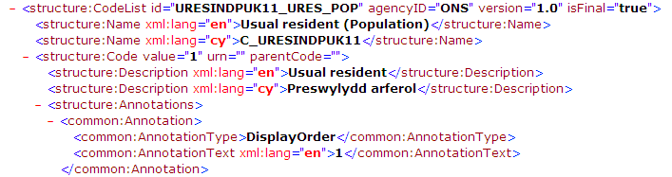
Metadata – Structural
This is the structure of a datasets, known in SDMX terms as the DSD (data structure definition)
The entire DSD can be returned in a single response or parts of it e.g. the “Key Family” can be returned individually.

Slide 38
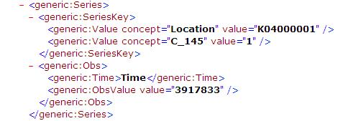
Data - Slicing
Each dataset has a number of dimensions, and each of these has dimension items.
To subset the data, name some or all of the dimensions and the items to include e.g. ?dm/sex=M&dm/shoesize=8,9
Unlisted dimensions are either returned in full if ?totals=false, or just the total item if ?totals=true

Slide 39
Data - Paging
The API has a maximum number of cells internal setting (20000 for XML and 100000 for JSON-Stat) for immediate responses.
The parameter ?noobs can be used to limit the number of observations and ?startobs to move from one “page” to another.

Slide 40
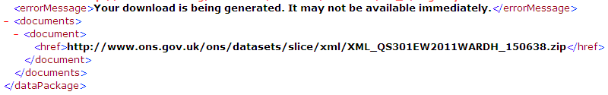
Data - Downloads
Full datasets are available as pre-canned downloads from the Data Explorer
Large slices can be requested as zip file using the /dwn representation. In this case the URI of the dynamically generated zip will be returned.
The download cell limit is higher than the direct one, but if exceeded the full dataset will be offered.

Slide 41

Data - Other
The API is bilingual, most textual content is available in English and Welsh
Some datasets are segmented, each segment containing a different combination of cross-tabulated variables. E.g. Segment 1 = Area x Age x Sex and Segment 2 = Area x Age x Religion
Presentation information (axis and display order) is held for each dimension in a dataset, but is only a “serving suggestion”.

Slide 42

New In July 2015 Release
JSON-Stat URLs can now be auto-generated from the Data Explorer
Higher cell limits for most queries
Geographic queries can no longer inadvertently request huge numbers of items.
AJAX Helper application

Slide 43
Delivery Exercise
Display the details of the dataset you discovered earlier
Display the dataset itself (remove the word details)
Display the reference metadata for that dataset (add the word metadata between data and dataset)
Display the structural metadata (add the word dsd)
Display the cells only (replace dsd with set)
Choose a subset of items for one of the dimensions and apply this to the cells using the ?dm parameter
Limit the number of observations using ?noobs
Get a download url for the slice using the .xml/dwn representation

Slide 44
Delivery Exercise - Answers
datasetdetails/QS105EW.xml?context=Census&geog=2011WARDH
dataset/QS105EW.xml?context=Census&geog=2011WARDH
metadata/dataset/QS105EW.xml?context=Census&geog=2011WARDH
dataset/dsd/QS105EW.xml?context=Census&geog=2011WARDH
dataset/QS105EW/set.xml?context=Census&geog=2011WARDH
dataset/QS105EW.set.xml?context=Census&geog=2011WARDH&dm/2011WARDH=E05008002
dataset/QS105EW/set.xml?context=Census&geog=2011WARDH&noobs=100
dataset/QS105EW/dwn.xml?context=Census&geog=2011WARDH&dm/2011WARDH=E05008002

Slide 45
6. Response Codes
500 - internal server error (unexpected)
407 - proxy authentication required
406 - not acceptable (usually an incorrect accept header)
404 - not found (could be misspelling or dataset id not found on database)
400 – Bad Request (usually a syntax error)
202 – Accepted, not complete (download being generated)
200 - OK (only returned for successful requests, never used for any type of error condition as this can cause ambiguity for the client application)

Slide 46
7. Client Applications
Types of Application
Hunters and Gatherers
Programming Languages
Examples
Demo Clients
AJAX
Android
Excel
Flash
Java
Using The API Indirectly
Data Explorer
Profile Generator

Slide 47
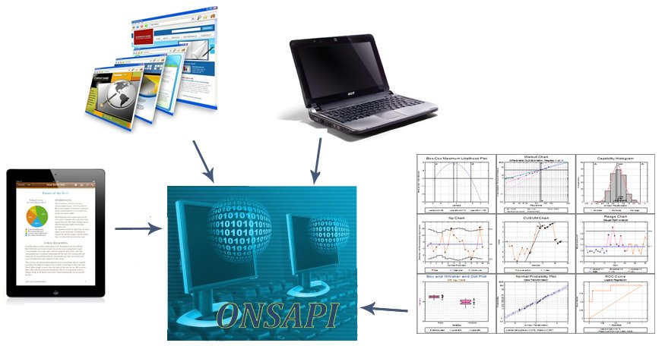
Types of Application
Many types of client applications are possible

Slide 48


Hunters and Gatherers
A Hunter application slays its data and immediately consumes it.
A Gatherer application squirrels away the data for later use (possible transformation, and/or input to other data stores).

Slide 49
Programming Languages
The languages above are Programmable web’s most popular development platforms.
There are many others, including statistical tools such as SAS and R.
JSON-Stat has helper libraries for Python, Java, R and Javascript and can be used with the API output.

Slide 50
Examples
The How To Guides page on the API Service portal takes you through common tasks such as navigating a geographic hierarchy.
The portal also contains some fully functional example applications.
Each demo comes with a one-page description page and contains extensive comments in the code.
They are designed to be simple and concentrate on showing how to use the API with different development tools and platforms.

Slide 51
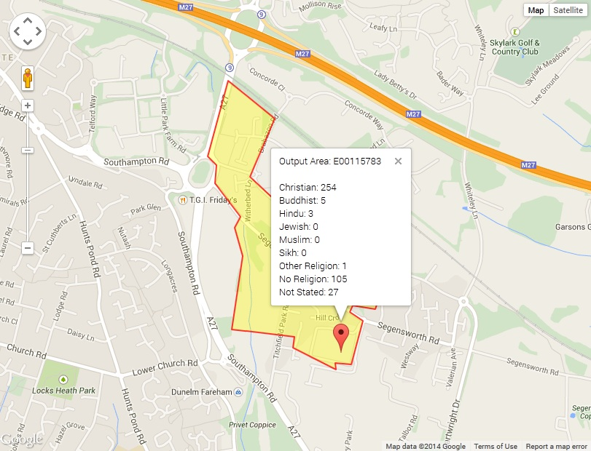
Demo Clients: AJAX - Google Maps

Slide 52
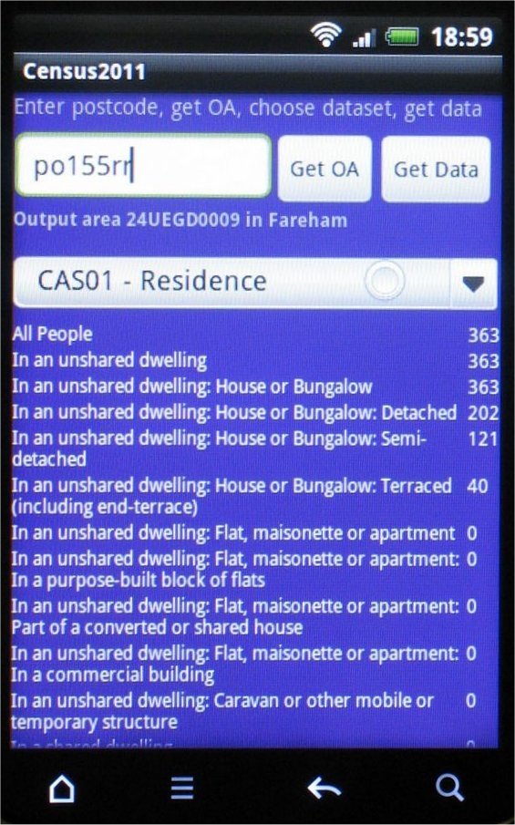
Demo Clients: Android

Slide 53
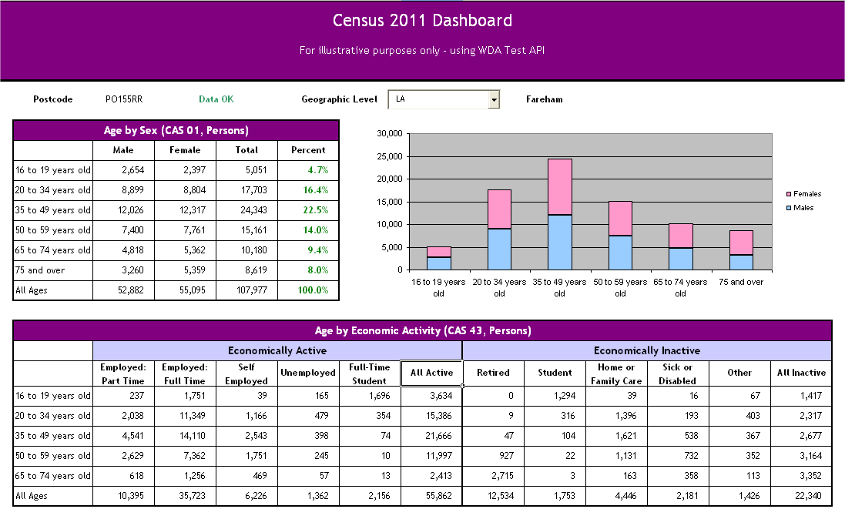
Demo Clients: Excel

Slide 54
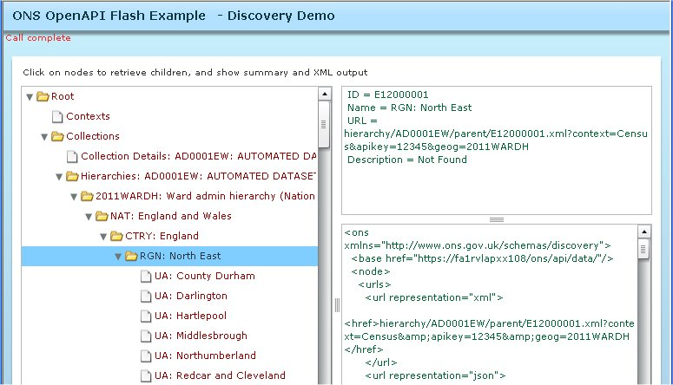
Demo Clients: Flash

Slide 55
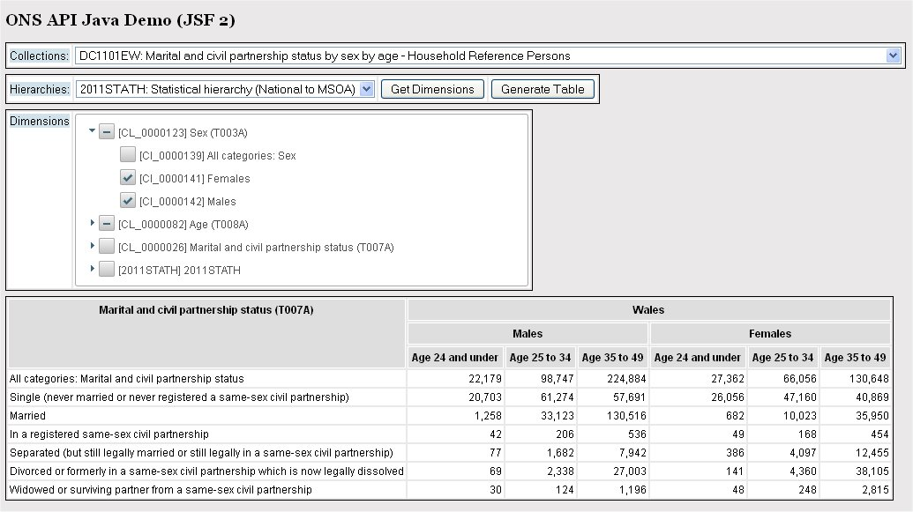
Demo Clients: Java

Slide 56
Using the API Indirectly
Don’t like programming?
Use a tool or service that does the API calls for you!
External Examples: SASPAC, Instant Atlas, LG Inform.
Internal Example: ONS Data Explorer.
Internal Example: Profile Generator – a wizard that “writes” a web page for a dynamic area profile.

Slide 57
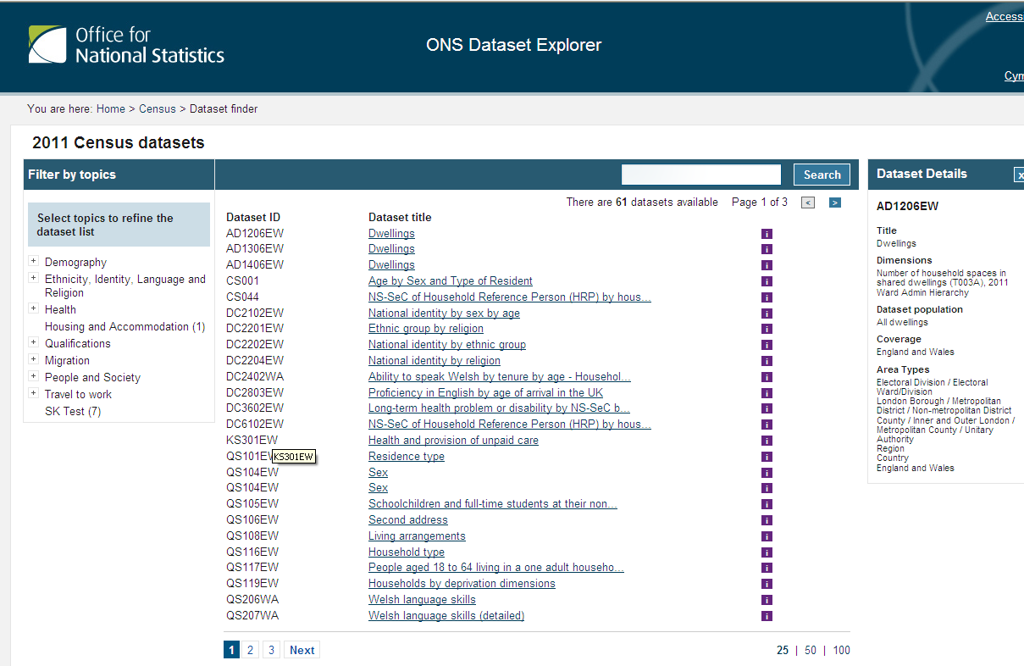
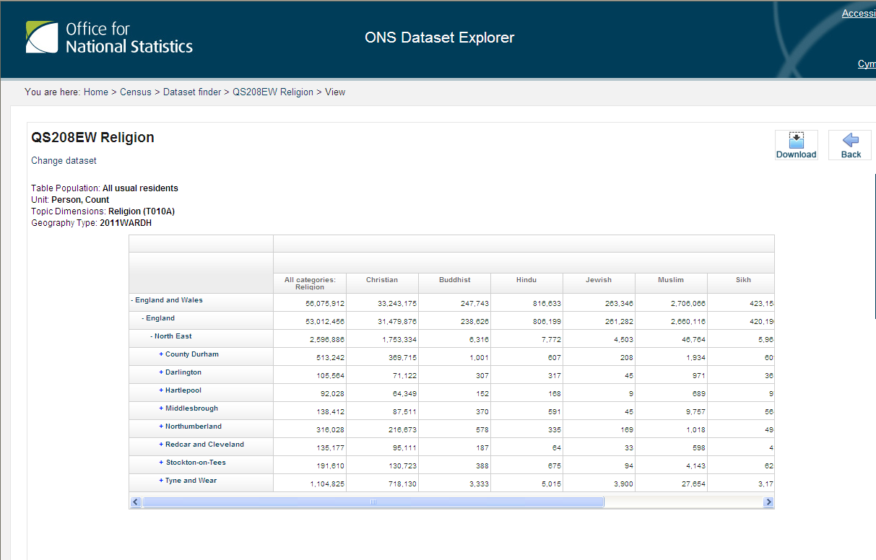
Data Explorer
Uses the API to allow end users to select, view, visualise and download data

Slide 58
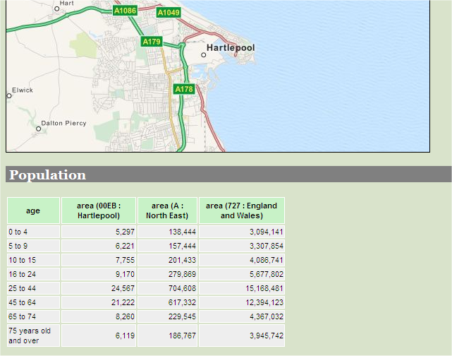
Profile Generator
Allows LAs and others to create their own profile HTML page to take away. [not yet released]

