Slide 1


Comparative Analysis of Transfer Learning Hyperparameters for Image Classification
Neelesh Karthikeyan , M Rajmohan & R Baskaran
Department of Industrial Engineering, College of Engineering Guindy,
Anna University, Chennai-25
ICAIEA 2022

Slide 2
Introduction
2 billion tonnes of waste is generated annually and is expected to be 3.4 billion by 2050.^{[1]}
Over 90% of waste is openly dumped or burned in low-income countries.^{[2]}
Plastic wastes take up to 450 years to decompose in a landﬁll.
Glass takes 4000 years and metal takes 50 - 500 years to decompose.
The objective is to classify biodegradable and non-biodegradable wastes using AI
Transfer learning is the improvement of learning in a new task through the transfer of knowledge from a related task that has already been learned.^{[3]}
The significance of learning rate and batch size on a model’s accuracy is studied using a two-factor analysis of variance.

Slide 3
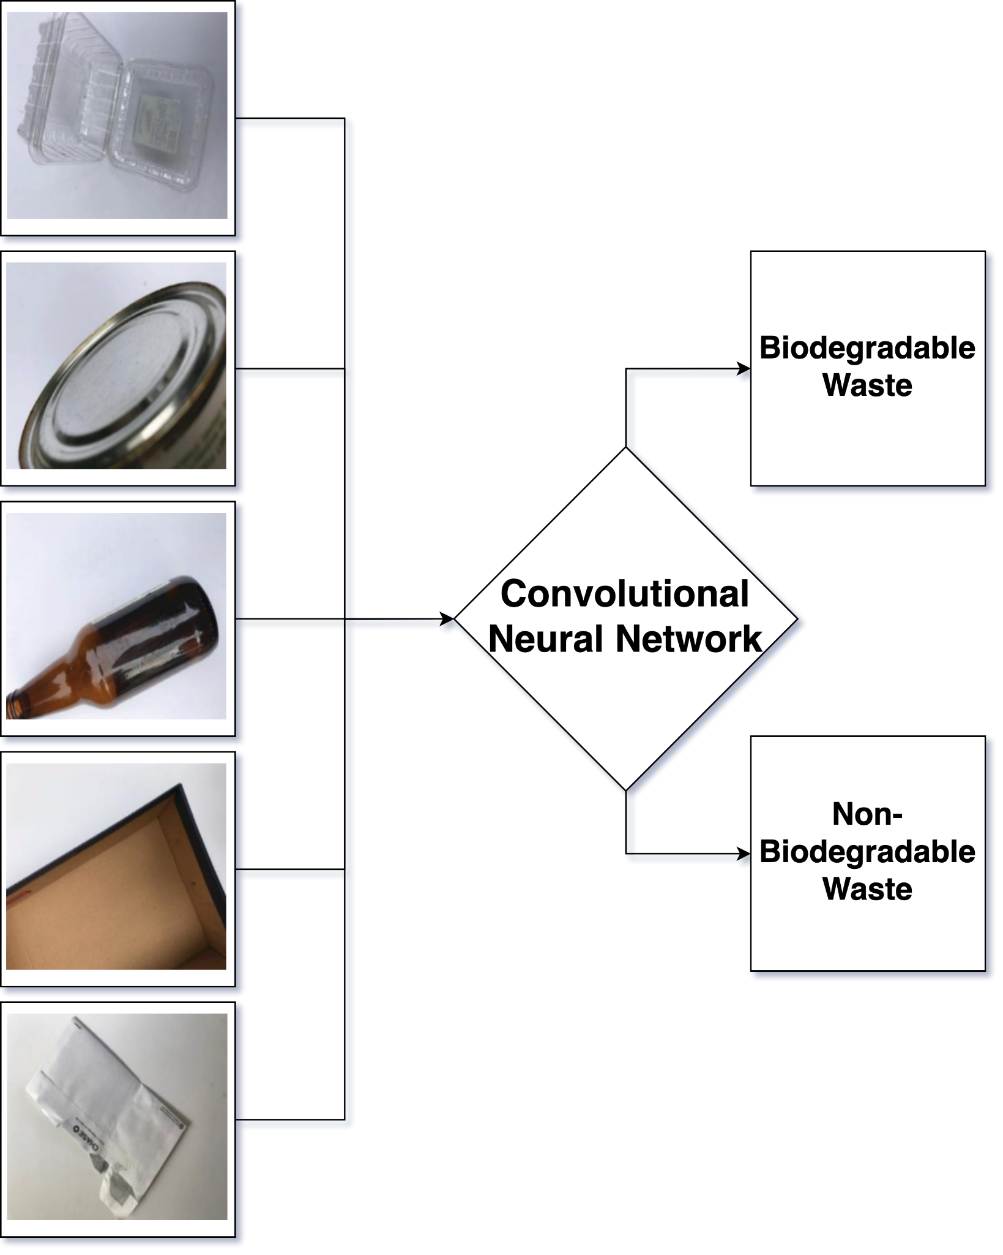
Overview
Convolutional Neural Networks
Related Works
Data Augmentation and splitting
Training Performance
Testing Performance
Deep Learning Hyper-paramter tuning
Two-factor Analysis of Variance
Conclusion and Future Work
Reference
(Cardboard)
(Paper)
(Plastic)
(Metal)
(Glass)

Slide 4

Convolutional Neural Networks
Working of a Convolutional Neural Network^{[4]}

Slide 5
Related Works
S. No | Model | Year Published | Parameters
1 | LeNet-5 | 1998 | 60,850
2 | AlexNet | 2012 | 62,378,344
3 | VGG16 | 2014 | 138,357,544
4 | VGG19 | 2014 | 143,667,240
5 | ResNet50 | 2015 | 25,636,712
6 | ResNet101 | 2015 | 44,707,176
7 | ResNet152 | 2015 | 60,419,944
8 | Xception | 2016 | 22,910,480
9 | ResNet50V2 | 2016 | 25,613,800
10 | ResNet101V2 | 2016 | 44,675,560
11 | ResNet152V2 | 2016 | 60,380,648
12 | InceptionV3 | 2016 | 23,851,784
13 | DenseNet121 | 2017 | 8,062,504
14 | DenseNet169 | 2017 | 14,307,880
15 | DenseNet201 | 2017 | 20,242,984
16 | InceptionResNetV2 | 2017 | 55,873,736
17 | MobileNet | 2018 | 4,253,864
18 | MobileNetV2 | 2018 | 3,538,984
19 | NASNetMobile | 2018 | 5,326,716
20 | NASNetLarge | 2018 | 88,949,818
Transfer learning aid in solving the problem of insufficient training data.
Bircanoglu et al. (2018) developed RecycleNet with 80% accuracy.
Kennedy et al. (2018) used VGG-19 to classify and achieved 88% accuracy.
Transfer Learning Models were trained on ImageNet (1.4M images and 1000+ classes)

Slide 6
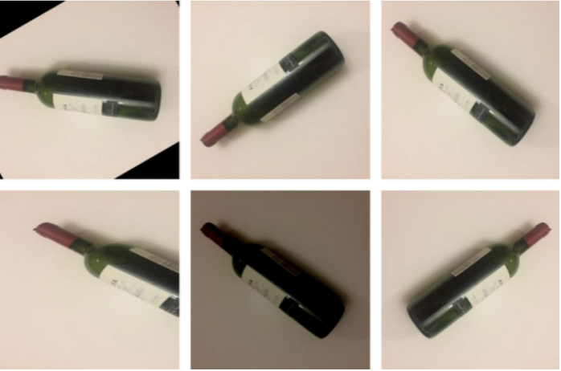
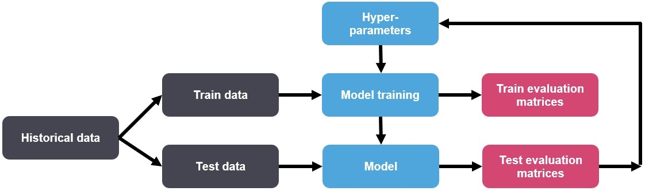
Data Augmentation and Train-Test Split
Sample image
from glass class
80% Train (15,600 images)
10% Validation (1,950 images)
Train set is used to fit the model while training.
Validation set is used during training to check how well the model is generalizing.
Test set is used to test the model's final ability to generalize before deploying to production.^{[5]}
19,500 images
10% Test (1,950 images)
Train - Test Split ^{[6]}

Slide 7
Training Performance
Model | Validation Loss | Training Loss | Validation Accuracy | Training Accuracy
NASNetMobile | 0.202 | 0.078 | 0.924 | 0.971
NASNetLarge | 0.623 | 0.175 | 0.913 | 0.963
DenseNet201 | 0.212 | 0.135 | 0.911 | 0.947
DenseNet121 | 0.259 | 0.154 | 0.896 | 0.938
DenseNet169 | 0.256 | 0.171 | 0.893 | 0.929
ResNet50V2 | 0.305 | 0.135 | 0.886 | 0.948
ResNet101V2 | 0.279 | 0.142 | 0.885 | 0.944
MobileNet | 0.283 | 0.174 | 0.884 | 0.931
ResNet152V2 | 0.312 | 0.153 | 0.883 | 0.938
Xception | 0.283 | 0.131 | 0.882 | 0.950
MobileNetV2 | 0.324 | 0.176 | 0.868 | 0.929
InceptionResNet -V2 | 0.348 | 0.231 | 0.855 | 0.900
InceptionV3 | 0.345 | 0.272 | 0.855 | 0.882
LeNet-5 | 0.434 | 0.296 | 0.817 | 0.871
VGG19 | 0.428 | 0.298 | 0.814 | 0.868
VGG16 | 0.409 | 0.306 | 0.811 | 0.863
AlexNet | 0.573 | 0.413 | 0.735 | 0.806
ResNet50 | 0.617 | 0.593 | 0.662 | 0.691
ResNet101 | 0.661 | 0.614 | 0.592 | 0.662
ResNet152 | 0.674 | 0.620 | 0.590 | 0.661
Training loss is a metric used to assess how a deep learning model fits the training data.
Validation loss is a metric used to assess the performance of a deep learning model on the validation set.^{[7]}
Training accuracy quantifies how the model is able to classify the two images during training on the training dataset.
Validation accuracy is the accuracy on the validation set.

Slide 8
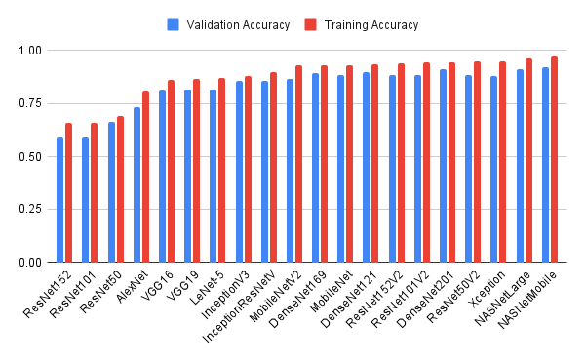
Training Performance
Accuracy of models on train data

Slide 9
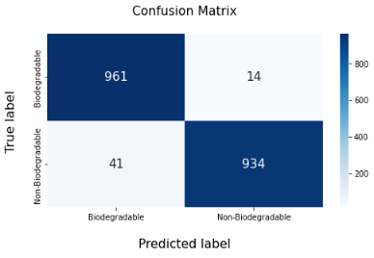
Testing Performance
Model | Test Accuracy | Precision | Recall | F1-score
NASNetMobile | 0.972 | 0.959 | 0.986 | 0.972
NASNetLarge | 0.962 | 0.944 | 0.982 | 0.962
DenseNet201 | 0.953 | 0.945 | 0.963 | 0.954
DenseNet169 | 0.953 | 0.944 | 0.964 | 0.954
Xception | 0.932 | 0.924 | 0.941 | 0.932
DenseNet121 | 0.931 | 0.917 | 0.949 | 0.932
ResNet101V2 | 0.929 | 0.907 | 0.957 | 0.931
MobileNet | 0.927 | 0.919 | 0.937 | 0.928
ResNet50V2 | 0.925 | 0.887 | 0.973 | 0.928
ResNet152V2 | 0.913 | 0.885 | 0.951 | 0.916
MobileNetV2 | 0.913 | 0.893 | 0.937 | 0.915
InceptionV3 | 0.896 | 0.897 | 0.895 | 0.896
InceptionResNetV2 | 0.896 | 0.859 | 0.948 | 0.901
VGG16 | 0.879 | 0.893 | 0.863 | 0.877
VGG19 | 0.872 | 0.892 | 0.846 | 0.868
LeNet-5 | 0.829 | 0.798 | 0.881 | 0.863
ResNet50 | 0.723 | 0.729 | 0.708 | 0.806
AlexNet | 0.708 | 0.647 | 0.915 | 0.691
ResNet152 | 0.652 | 0.651 | 0.655 | 0.662
ResNet101 | 0.637 | 0.588 | 0.913 | 0.661
- Test data accuracy = (TP + TN) / (TP+ FP + FN + TN)
- Precision = (TP) / (TP + FN)
- Recall = (TP) / (TP + FP)
- F1-score = (2 * Precision * Recall) / (Precision + Recall)
TP
FP
FN
TN

Slide 10
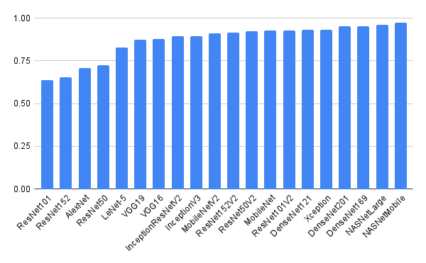
Testing Performance
Accuracy of models on test data

Slide 11
Deep Learning Hyper-parameter tuning
Activation Function | Validation | Training | Test
ELU | 0.965 | 0.960 | 0.950
ReLU | 0.962 | 0.956 | 0.950
LeakyReLU | 0.962 | 0.952 | 0.947
Optimizer | Validation | Training | Test
Adam | 0.97 | 0.9585 | 0.943
RMSprop | 0.965 | 0.9435 | 0.9389
SGD | 0.96 | 0.9557 | 0.9451
Learning Rate | Validation | Training | Test
0.001 | 0.9625 | 0. 9578 | 0.9475
0.0001 | 0.945 | 0. 9650 | 0.9375
0.01 | 0.94 | 0. 9528 | 0.9175
Batch Size | Validation | Training | Test
32 | 0.9725 | 0.9635 | 0.9375
64 | 0.9675 | 0.9635 | 0.955
128 | 0.9625 | 0.9621 | 0.955
Activation Function decides whether a neuron should be activated or not.
Optimizer is a function or an algorithm that modifies the attributes of the neural network, such as weights and learning rate.
Learning rate controls how quickly the model is adapted to the problem.
Batch size is the number of samples that will be passed through to the network at one time.

Slide 12
Analysis of Variance
Accuracy (%) |  | Batch size
 |  | 32 | 64 | 128
Learning Rate | 0.0001 | 96.4103 | 95.3333 | 95.6923
 |  | 94.7179 | 95.8974 | 95.4872
 | 0.001 | 95.8974 | 95.4872 | 95.4359
 |  | 95.4359 | 95.3846 | 95.641
 | 0.01 | 93.6923 | 94.9744 | 95.0769
 |  | 90.9744 | 94.7179 | 93.8462
F_{0.05,2,9} = 4.26 and F_{0.05,4,9} = 3.63 ^{[8]}
Learning Rate has got significant effect on the accuracy of a neural network.
However, Batch Size and the interaction effect shows no significance.
Source of Variation | Sum of Squares | Degrees of Freedom | Mean Squares | F₀
Batch Size | 2.14 | 2 | 1.07 | 1.55
Learning Rate | 11.4 | 2 | 5.7 | 8.26
Learning Rate x Batch Size | 5.24 | 4 | 1.31 | 1.9
Error | 6.23 | 9 | 0.69
Total | 25.01 | 17

Slide 13
Conclusion and Future Work
A CNN model based on NasNetMobile that classifies trash with 97% accuracy.
A new image classification dataset of about 19500 images belonging to 5 classes.
For trash classification, NASNet models performs better than ResNet models.
Learning rate has a greater influence on a model’s accuracy than the batch size.
Exponential Linear Unit (ELU) performed better than other activation functions.
The model with Adam optimizer gave higher accuracy than with other optimizers.
A learning rate of 0.001 can be chosen while training the neural network.
A batch size of 32 is recommended to take advantage of the GPU's processing power.
Object detection needs to be performed before waste classification as all images in the dataset has a white background.
False negatives (predicting non-biodegradable waste as degradable) needs to be reduced.
New models like EfficientNet can be used to train and compared with the existing models.

Slide 14
References
[1] https://openknowledge.worldbank.org/bitstream/handle/10986/30317/211329ov.pdf
[2]https://www.worldbank.org/en/news/immersive-story/2018/09/20/what-a-waste-an-updated-look-into-the-future-of-solid-waste-management
[3] Handbook Of Research On Machine Learning Applications and Trends: Algorithms, Methods and Techniques
[4] https://towardsdatascience.com/a-comprehensive-guide-to-convolutional-neural-networks-the-eli5-way-3bd2b1164a53
[5]https://deeplizard.com/learn/video/Zi-0rlM4RDs
[6] https://www.analyticsvidhya.com/blog/2021/04/evaluating-machine-learning-models-hyperparameter-tuning/
[7] https://machinelearningmastery.com/how-to-choose-loss-functions-when-training-deep-learning-neural-networks/
[8] K. Krishaiah, P. Shahabudeen, “Applied Design of Experiments and Taguchi Methods”, PHI Learning Private Limited, New Delhi, 2012

Slide 15
THANK YOU…….

