Slide 1
CAUSAL-ESUS · R01 WORKING PACKAGE
Preliminary Evidence for Aim 1:
Modular Causal Endotyping in ESUS
Technical update for Dr. Bukhari and Dr. Khan · 3 August 2026
Neeam Hayder — technical lead
All results below are synthetic, reproducible, and traced to a saved output file.
Notes:
Frame: everything shown traces to a CSV. One finding changes what the next month should be — flag it early.

Slide 2
AGENDA
What you asked me to bring
1
Current experimental results
Three locked experiments, 500 paired repeats each
2
Figures for Aim 1 preliminary evidence
Seven code-generated figures; one critical gap
3
Additional diagrams for the proposal
Three proposed — none exist yet
4
Methodology improvements and gaps
One finding that changes the plan
Headline: the evidence base is solid. The counterfactual claim is not — and I found out why.

Slide 3
1
Current experimental results
Three experiments · 500 paired replicates each · seed 20260728 · all validation checks pass

Slide 4
THE SETUP
What the experiments actually test
Every simulated patient has one true mechanism. The model never sees it. We ask: can it recover the mechanism when a biomarker has more than one cause?
Atrial mechanism
Competing mechanism
Renal dysfunction
Drives the NT-proBNP-like marker and the atrial electrical marker
Drives only the competing-specific marker
Raises the NT-proBNP-like marker — but does NOT change the mechanism
The clinical problem in one line
A competing-mechanism patient with kidney disease can look exactly like an atrial patient — high NT-proBNP, wrong reason. A model that only asks “what does this resemble” will call it atrial.
Nuisance strength is dialled up in four steps — None → Weak → Moderate → Strong (0 to 1.5 SD direct renal effect on the NT-proBNP-like marker).
800 training / 1,000 test patients · renal prevalence 30% · 500 paired repeats per level
Notes:
For Khan: NT-proBNP has more than one owner. Atrial stretch, heart failure, kidneys.

Slide 5
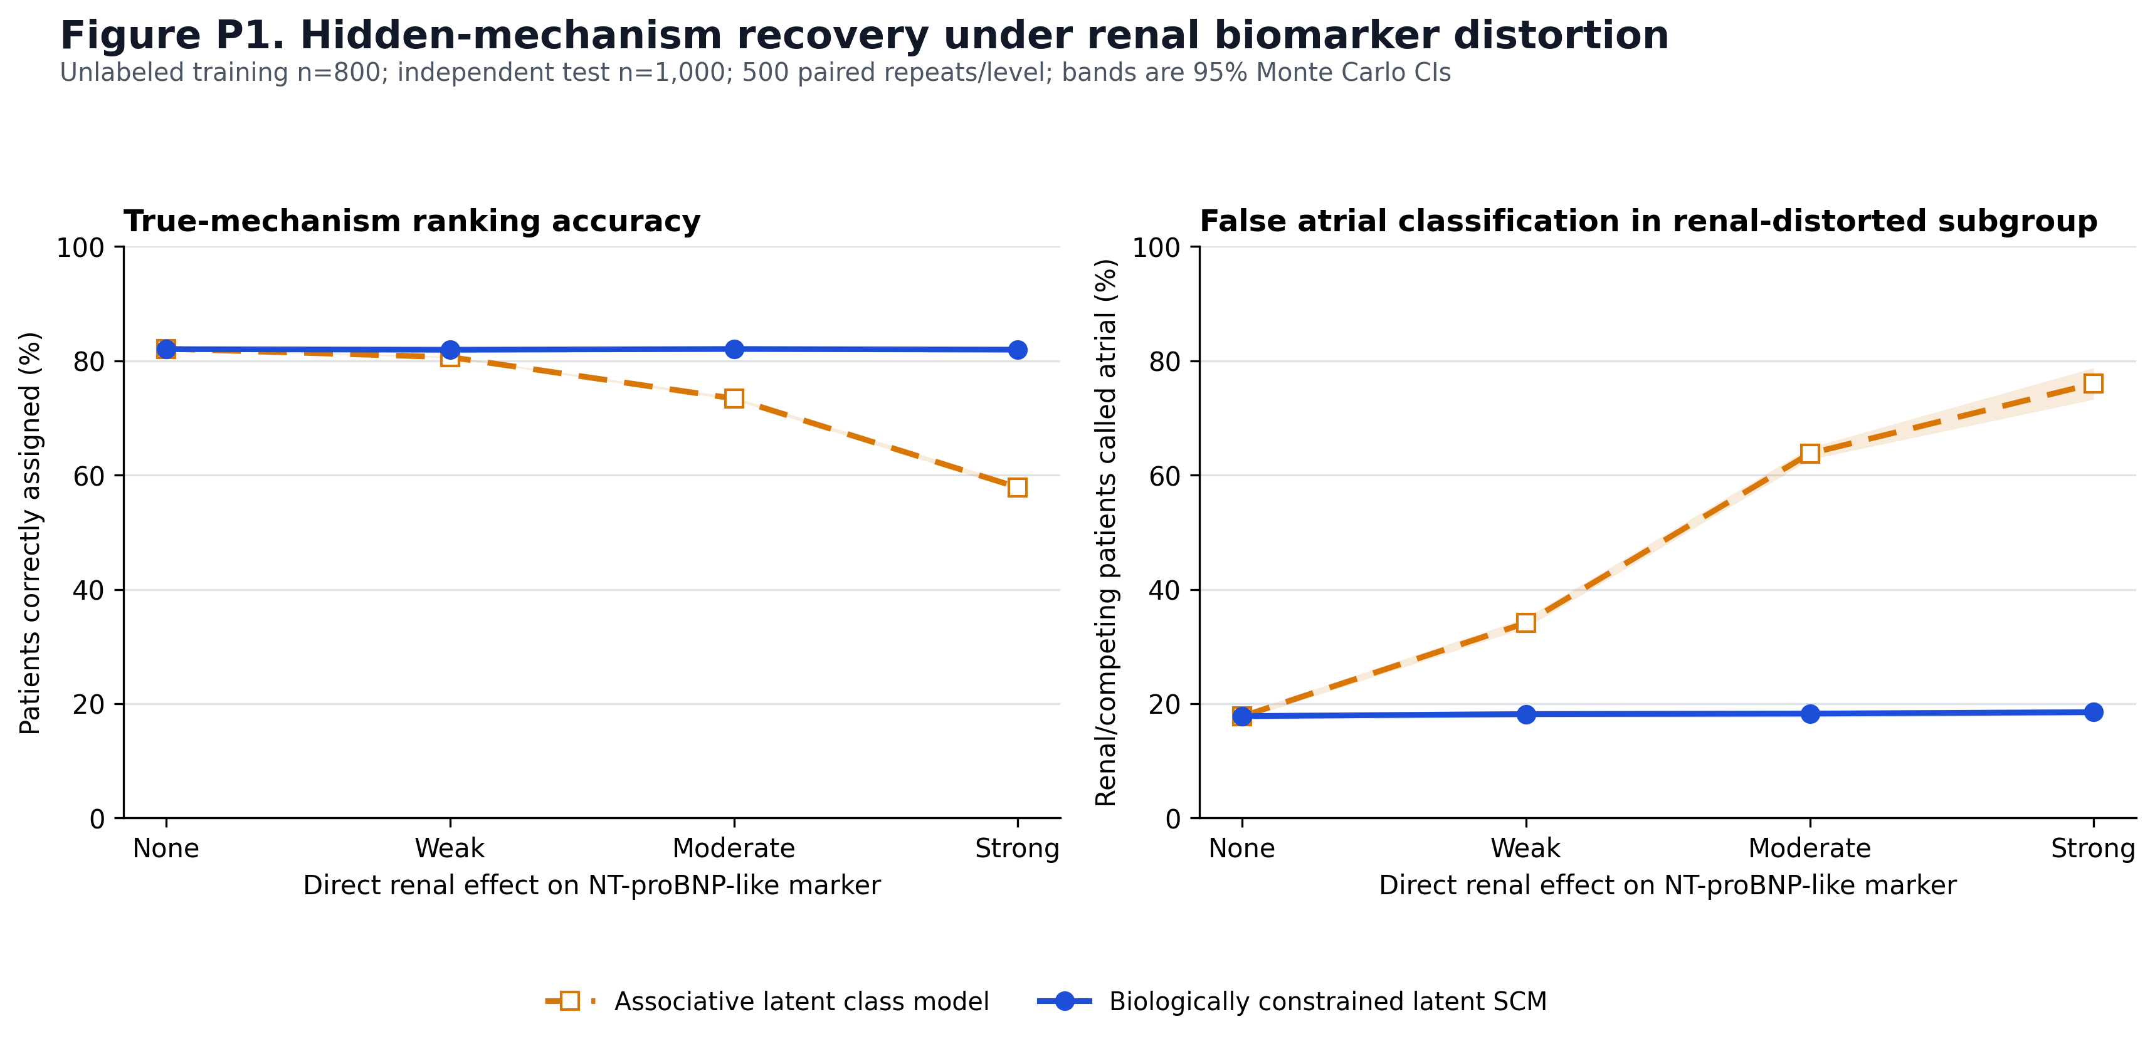
EXPERIMENT 1 · RENAL BIOMARKER DISTORTION
Result 1 — Explicit nuisance modelling prevents false atrial calls
Model at strong distortion | Accuracy | False atrial
Pooled associative | 57.9% | 76.0%
Renal-adjusted associative | 81.6% | 19.7%
Biology-constrained SCM | 81.9% | 18.5%
Oracle (ceiling) | 82.7% | 17.3%
Causal − pooled = +24.08 pp [23.55, 24.62]
Causal − renal-adjusted = +0.30 pp [0.22, 0.37]
outputs_latent_endotyping/figure_P1_latent_recovery
“False atrial” = renal-impaired patients whose true mechanism is
competing, called atrial by the model.
The honest reading — say this before anyone asks
Against the pooled model we gain 24 points. Against a correctly renal-adjusted model we gain 0.30. This experiment supports explicit nuisance-path modelling — it does not establish counterfactual superiority.
Notes:
Lead with the caveat. It is the credibility move.

Slide 6
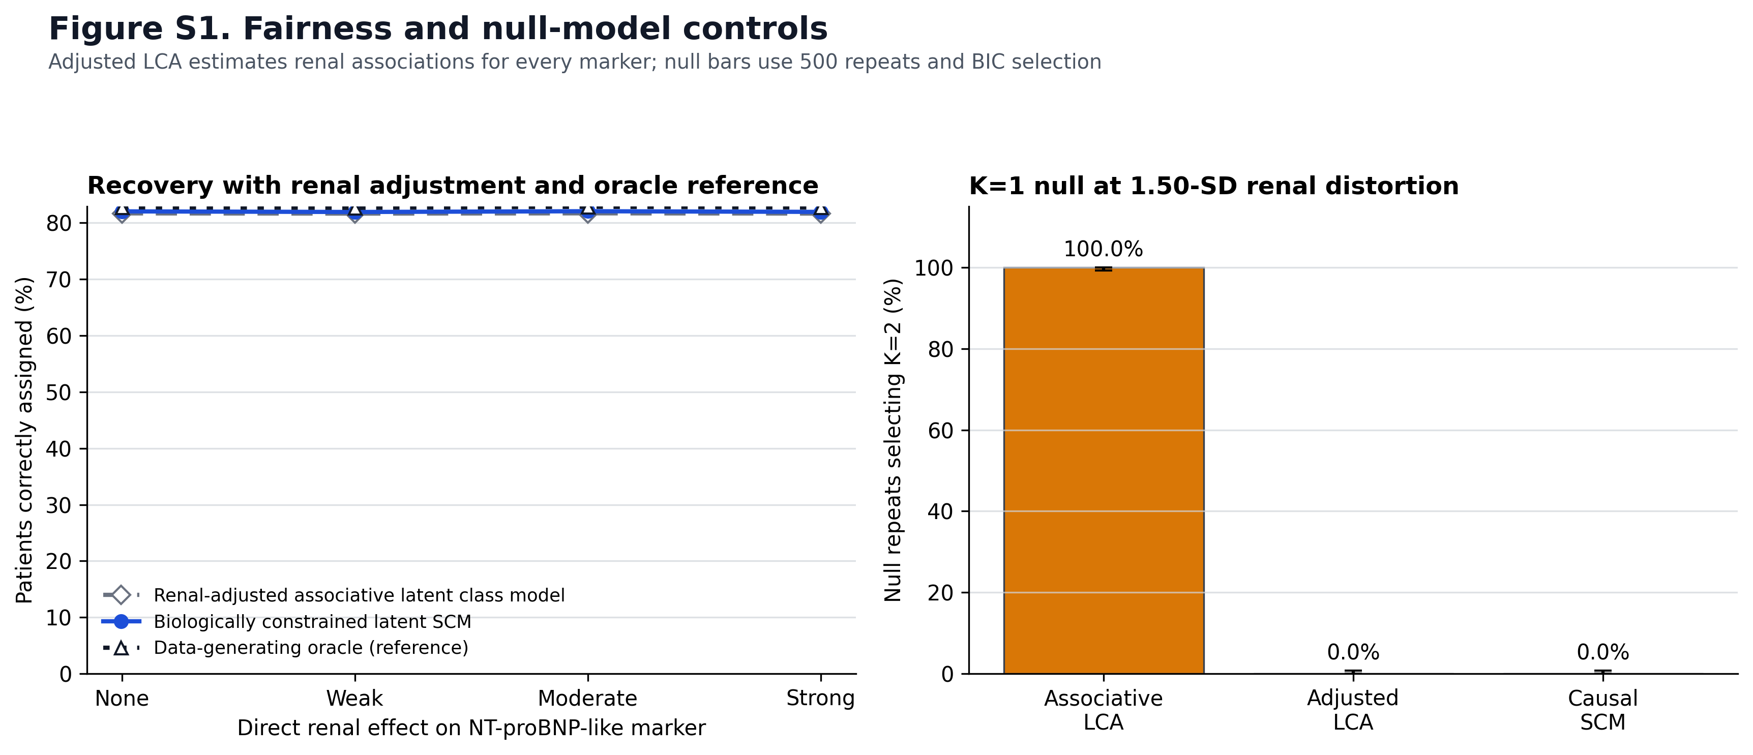
EXPERIMENT 1b · K = 1 NULL TEST ← STRONGEST RESULT IN THE PACKAGE
Result 2 — The standard method invents endotypes
We hand every model a cohort with NO subtypes — one homogeneous group. Does it invent some anyway?
500 / 500
0 / 500
0 / 500
Pooled associative model
falsely selected K = 2
Renal-adjusted associative
Biology-constrained SCM
Why this is the strongest result
It is a false-discovery argument, not an accuracy argument — much harder to argue with.
Median ΔBIC (K2−K1) = −277.8 for the associative model. Not marginal — confident.
Causal SCM ΔBIC = +27.3, i.e. it correctly prefers one regime.
Aim 1 sets a K = 1 false-discovery target of ≤ 5%. We are at 0%.
outputs_latent_endotyping/figure_S1_controls
Notes:
For Khan: hand it a group with no real subtypes. The standard method made some up, 500 times out of 500.

Slide 7
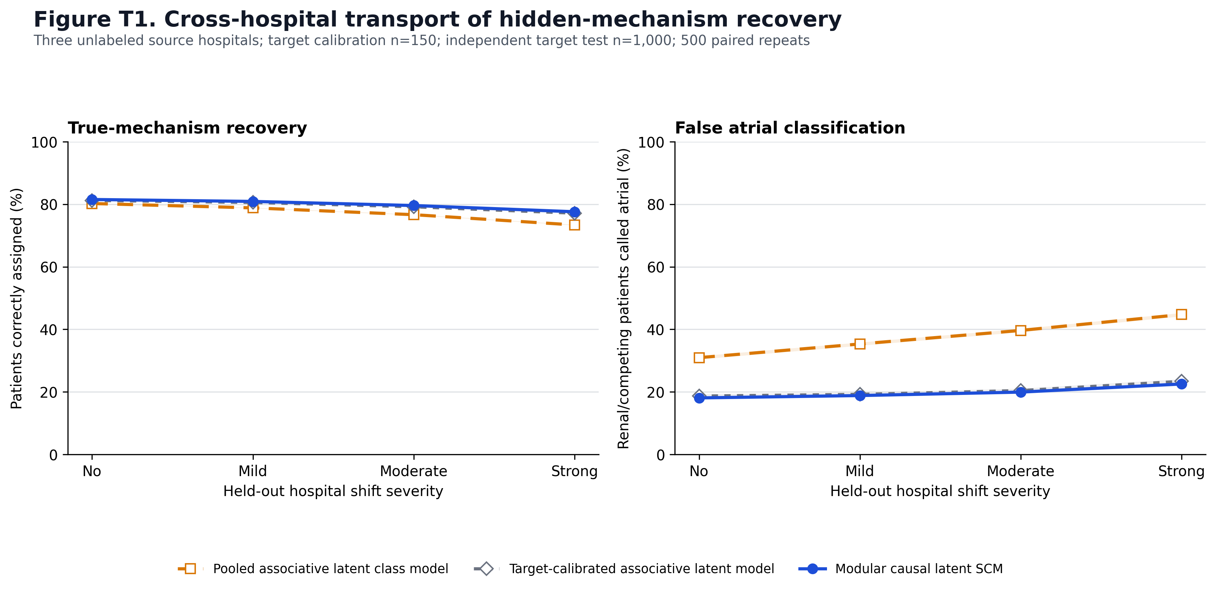
EXPERIMENT 2 · CROSS-HOSPITAL SHIFT
Result 3 — Causal structure alone does not transport
Model under strong shift | Accuracy | False atrial | ECE
Pooled associative | 73.4% | 44.7% | 0.071
Frozen causal SCM | 76.2% | 36.6% | 0.066
Target-calibrated associative | 77.1% | 23.4% | 0.049
Modular causal SCM | 77.6% | 22.5% | 0.042
Target oracle (ceiling) | 78.1% | 22.2% | 0.029
The finding
A frozen causal model still made 36.6% false atrial calls. Only when the nuisance and measurement modules recalibrate on 150 unlabeled target patients does it reach 22.5% — against an oracle floor of 22.2%.
outputs_transportability/figure_T1_transportability
Accuracy lost, no-shift → strong shift
−6.86 pp
−5.42 pp
−4.08 pp
−3.92 pp
−3.83 pp
Modular causal lands on the oracle's degradation floor. Negative control passes: with no shift it is statistically equivalent to target-calibrated association (+0.30 pp, inside the ±1 pp margin).
Pooled
Frozen causal
Target-calib.
Modular causal
Oracle
3 source hospitals × 600 patients · 150 unlabeled target calibration · 1,000 target test · 500 repeats

Slide 8
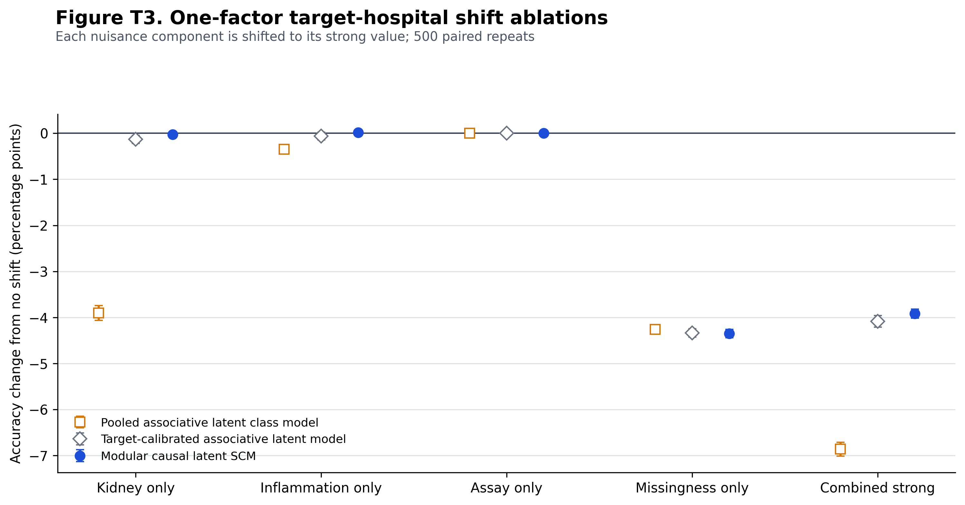
EXPERIMENT 2b · SHIFT-COMPONENT ABLATION
Result 3b — Which part of the shift does modularization actually fix?
Shift component | Pooled | Modular causal
Kidney only | −3.90 pp | −0.03 pp
Inflammation only | −0.35 pp | +0.01 pp
Assay only | 0.00 | 0.00
Missingness only | −4.26 pp | −4.35 pp
Combined strong | −6.86 pp | −3.92 pp
The clean win
Under a kidney-only shift the modular causal model is effectively immune — it loses 0.03 pp where pooled association loses 3.90. Sharpest single-component evidence we have.
outputs_transportability/ablations/figure_T3_shift_ablations
Two caveats I want on the record
Assay-only is exactly 0.00 for every method by construction — calibration metadata is handed to all of them. The panel is vacuous. Re-run with unknown calibration or drop it.
Missingness hurts everyone equally, including the oracle. That is irreducible information loss, not a modelling failure — frame it that way.

Slide 9
SUPPORTING · ARCADIA FEASIBILITY SIMULATION
Result 4 — ARCADIA can support mechanism work, not a confirmatory subgroup claim
2,000 replications per K. We rebuilt an ARCADIA-sized trial thousands of times and asked: if a responder subgroup were real, would we see it?
1,015
~80
~71
6.4–9.3%
randomized (507 / 508)
recurrent strokes total
(40 per arm)
events by the 2-year
analysis horizon
power to detect a real
treatment × endotype effect
The test is calibrated — so this is an information limit
How to read this — and how not to
Type-I error 5.0 / 5.3 / 4.4 / 4.8% for K = 2–5
95% CI coverage 95.1 / 94.7 / 95.6 / 95.2%
Best sensitivity corner tested (K=2, HR 0.50, strong separation): 18.0% — still far below the 80% gate
Optimistic by construction: the posterior uses the correct simulated biomarker model. 9.3% is a ceiling, not an estimate.
It audits only the held-out RCT rung. It does not learn the DAG or recover endotypes — do not cite it as validation of the method.
This is why Aim 2 is outcome-blind. We simulated the confirmatory question, found the trial cannot answer it, and redesigned the aim around what the data can support.
Notes:
Not bad news. This is the design justification and reviewers reward it.

Slide 10
2
Figures available as Aim 1 preliminary evidence
Seven code-generated figures · every one regenerates from a saved result file

Slide 11
ASK 2 · PRELIMINARY EVIDENCE
Figure inventory — what exists today
Figure | File | What it shows | Proposal slot
Framework overview | figure1_causal_esus_academic | Hand-built, BioRender-style. Not AI-generated. | R01 Fig 1
Renal distortion recovery | figure_P1_latent_recovery | Accuracy + false atrial vs distortion strength | R01 Fig 2A
Controls & K=1 null | figure_S1_controls | Adjusted comparator, oracle, false-discovery test | Supplement
Example patient | figure_P2_example_patient | Per-patient posterior with uncertainty | Supplement
Cross-hospital transport | figure_T1_transportability | Four methods × four shift levels | R01 Fig 2B
Transport controls | figure_T2_transport_controls | Negative control and calibration | Supplement
Shift-component ablation | figure_T3_shift_ablations | Kidney / inflammation / assay / missingness | Aim 1 support
The gap that matters
The M0–M5 source-of-gain ablation figure does not exist — and that experiment IS Aim 1's core contribution. The transport ablation covers part of the ladder, but not the full M0→M5 sequence on identical cohorts and paired seeds.

Slide 12
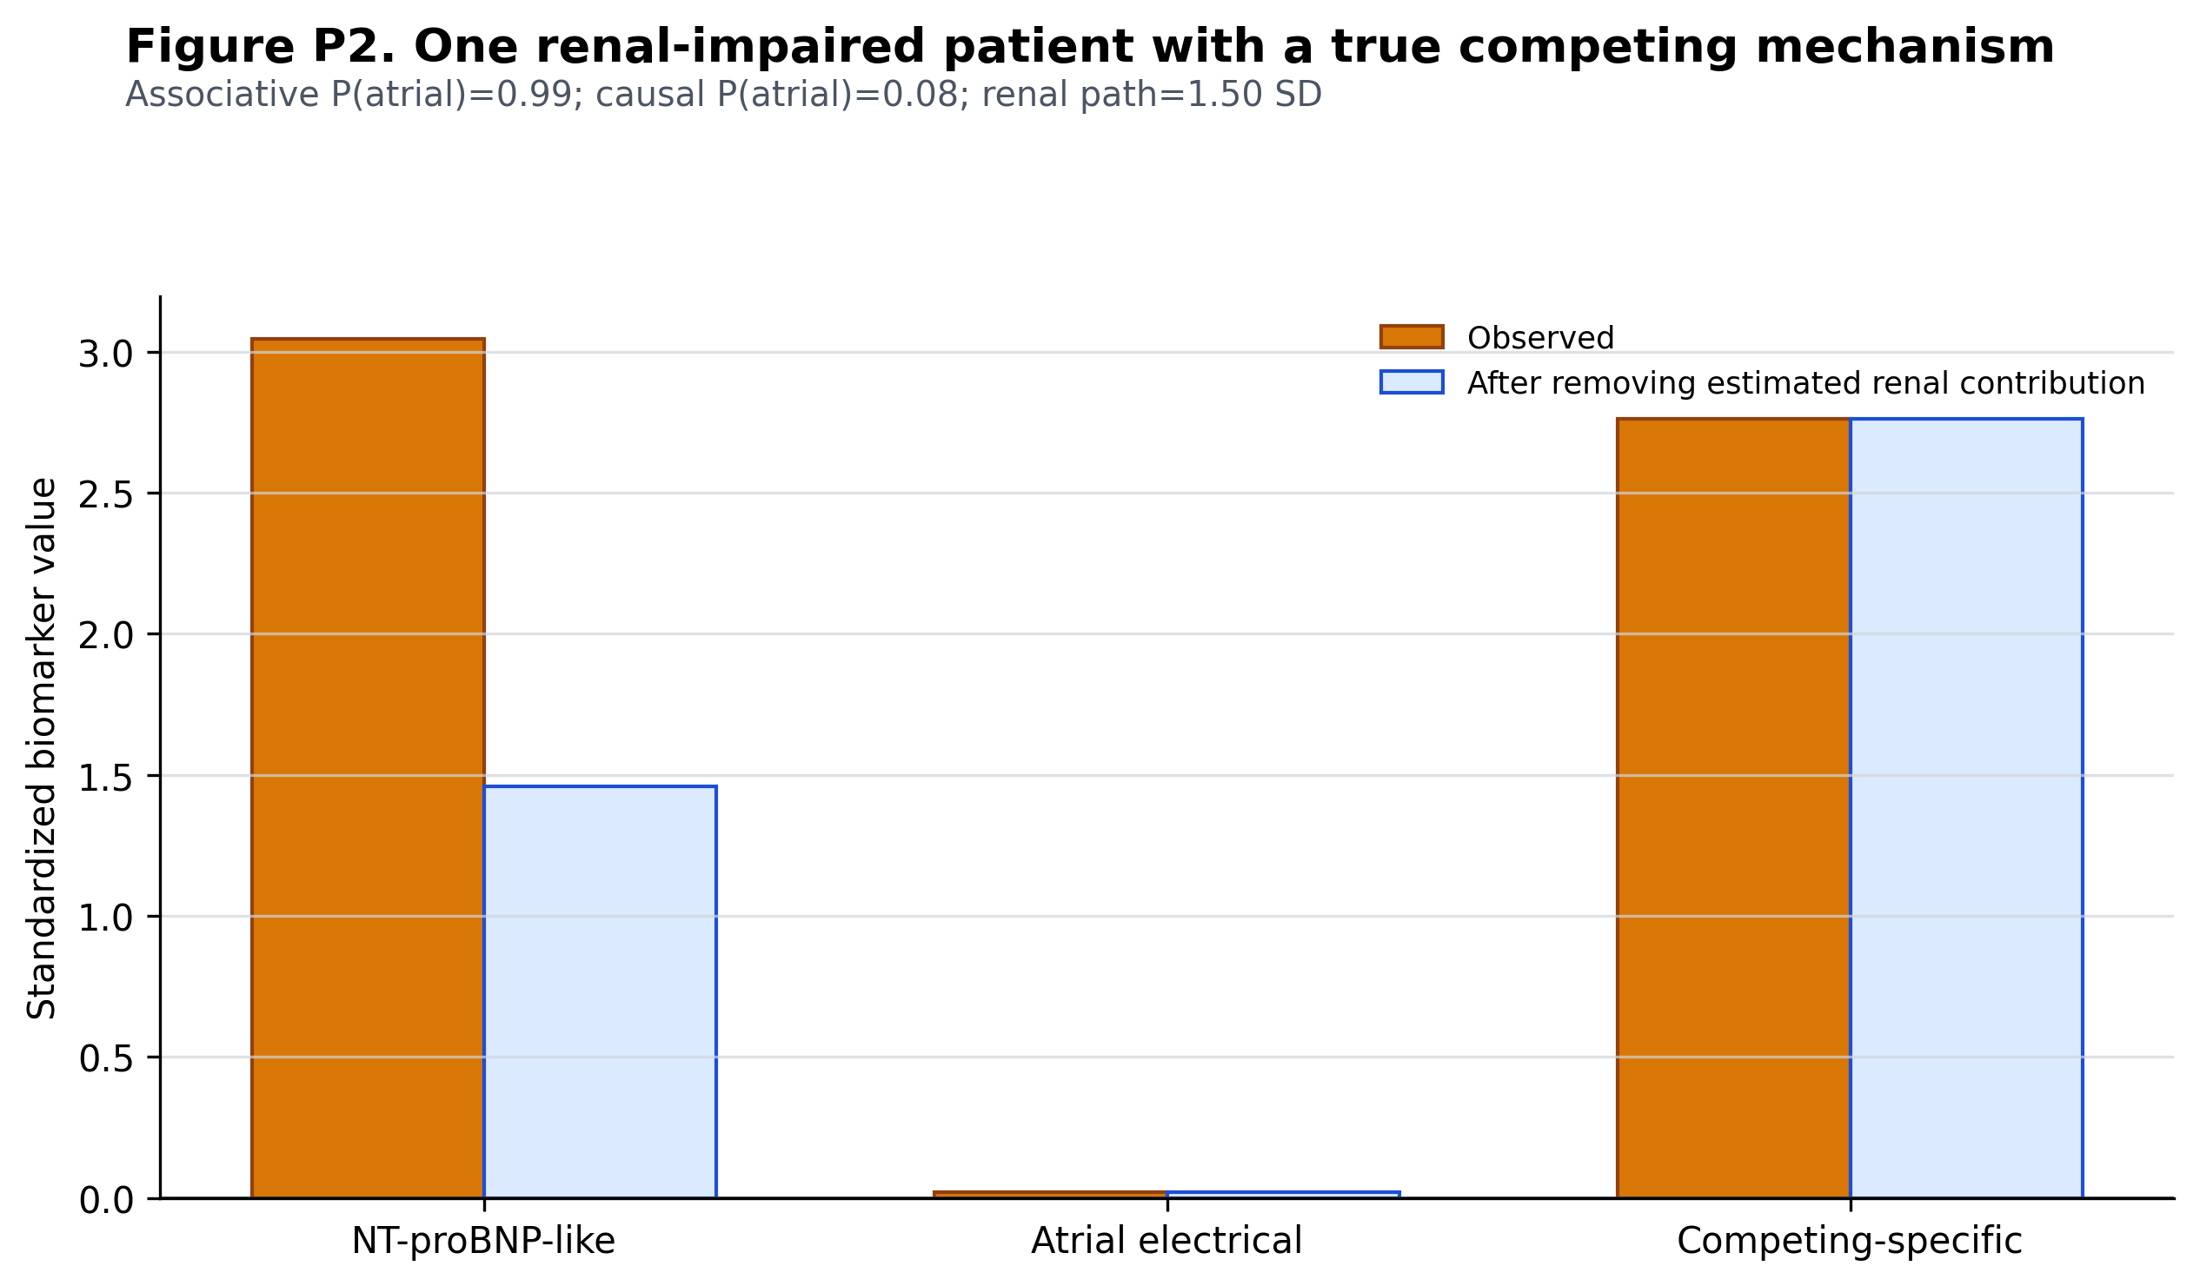
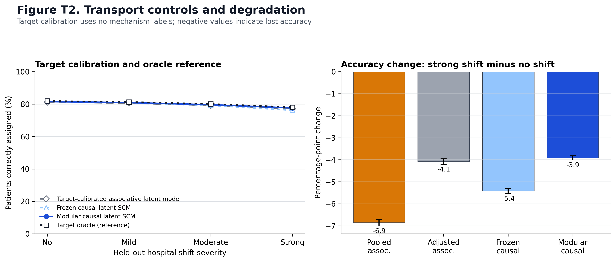
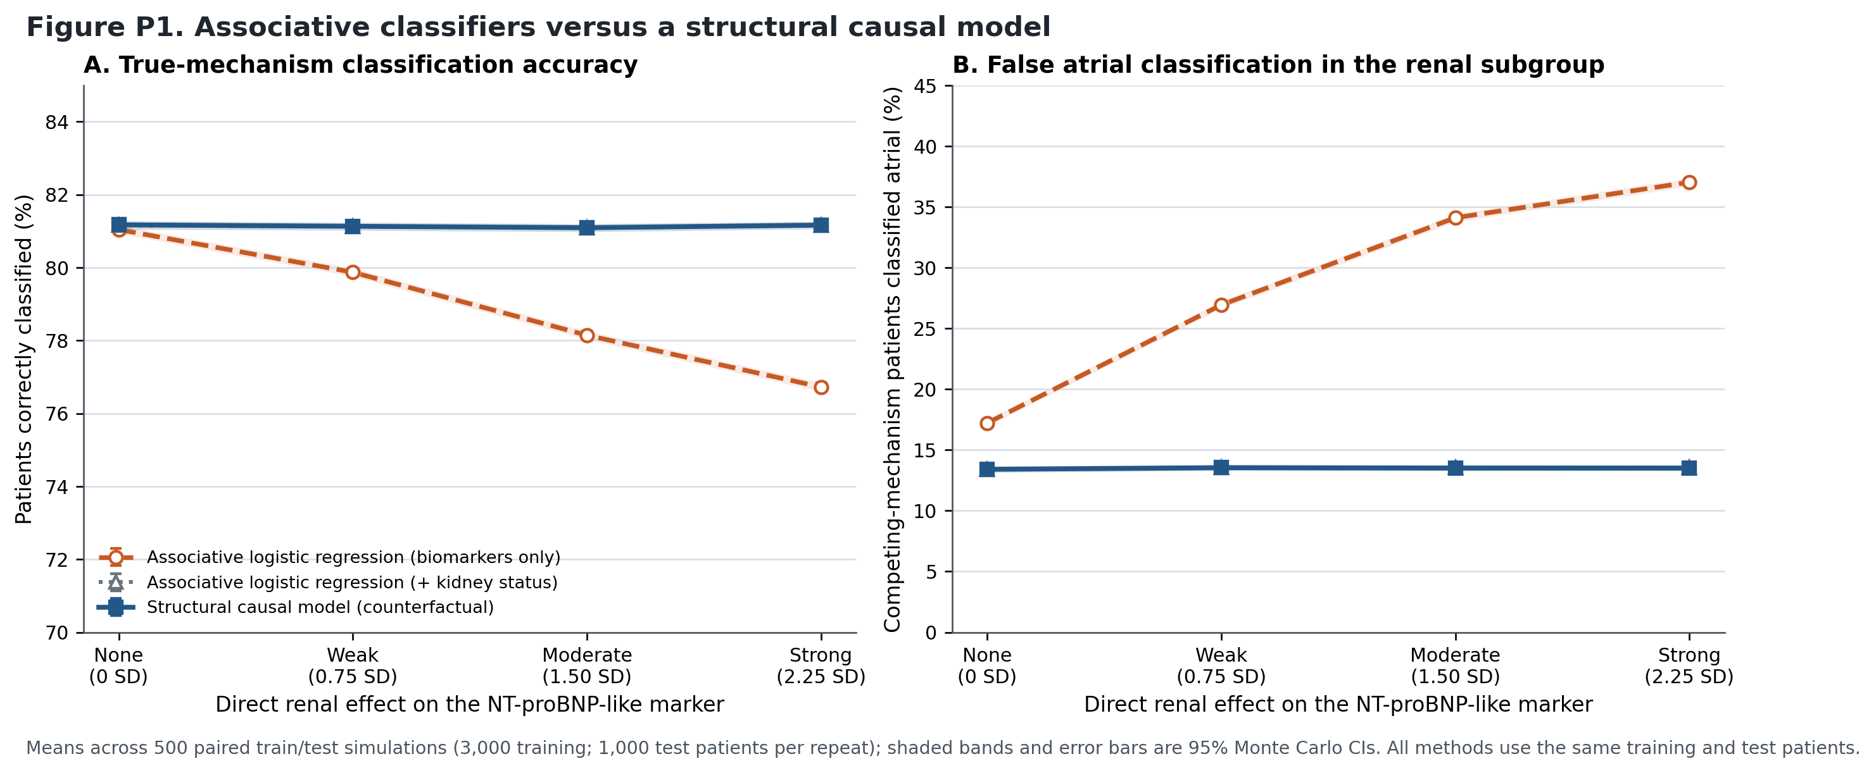
ASK 2 · SUPPLEMENT MATERIAL
Supporting panels
figure_P1_associative_vs_scm — supervised comparison (labels used in training; NOT endotype discovery)
figure_T2_transport_controls — negative control and calibration
figure_P2_example_patient — per-patient posterior with uncertainty
Reproducibility status
Every figure regenerates from a saved CSV — no manually transcribed values anywhere.
Machine-readable validation_checks.json passes for both experiments: convergence 100%, truth never reaches a fit function, class labels oriented without simulated truth.
Still missing: a clean-environment rerun, a lockfile, and a single-command entry point. That is this week.

Slide 13
3
Additional diagrams to strengthen the proposal
Three proposed · none exist yet · all buildable this week

Slide 14
ASK 3 · PROPOSED — NOT YET BUILT
Three diagrams I propose building next
PLACEHOLDER
M1 / M2 / M3 milestone map
milestones → Aims 1–3
with hard decision gates
PLACEHOLDER
Stable vs adaptable modules
shared DAG with mechanism gates
separated from nuisance / assay /
missingness / prevalence
PLACEHOLDER
M0–M5 source-of-gain ladder
each rung adds exactly one
component — Aim 1's core figure
1
M1/M2/M3 milestone map
You framed the project this way. No diagram exists. It maps directly onto the three aims and shows reviewers the decision gates.
2
Stable vs adaptable modules
The single clearest way to show what “modular” means — and why a frozen causal graph is not automatically invariant.
3
M0–M5 ablation ladder
This is Aim 1's core experiment. Without it, Aim 1 has no headline figure.
Also still placeholder in the Research Strategy: Figure 3 ARCADIA composite (marker-overlap UpSet + missingness heat map) and Figure 4 five-year work plan.

Slide 15
4
Methodology: one finding, and the gap register
This is the part that changes what the next month should look like

Slide 16
ASK 4 · KEY METHODOLOGICAL FINDING
The counterfactual result collapsed — and it is algebra, not a null
Sufficiency and disablement returned rankings identical to the posterior at every confounding level — not approximately, exactly.
Renal effect | Counterfactual | Posterior | Identical?
0.00 SD | 0.811388 | 0.811388 | yes
0.75 SD | 0.811440 | 0.811440 | yes
1.50 SD | 0.812222 | 0.812222 | yes
2.25 SD | 0.812198 | 0.812198 | yes
From our own code's docstring:
“In this deliberately symmetric K = 2 toy model, normalized sufficiency and disablement are monotone transformations of the correctly specified posterior.”
r21_preliminary_experiment.py, lines 232–238
outputs/main_simulation_summary.csv — top-1 accuracy, same fitted SCM
Monotone transforms preserve ordering. So identical top-1 accuracy is guaranteed by construction — it is not a measurement. Running this design again answers nothing.
The deeper problem
What the framework is meant to detect is redundancy — high sufficiency with low disablement. That needs an alternative path that survives disabling the mechanism. With mutually exclusive mechanisms there is none. The generator structurally cannot produce the phenomenon we are claiming.
Notes:
Say it plainly. This is not a failed experiment — it is a result we can state as a proposition.

Slide 17
ASK 4 · METHODOLOGY IMPROVEMENT
Proposed fix — turn the collapse into the contribution
Part A — state it as a proposition
Part B — violate each premise, measure divergence
Under K = 2 mutually exclusive mechanisms, complete evidence, additive homoscedastic Gaussian noise, and no non-mechanism path able to generate a mechanism's full signature — sufficiency, disablement and the posterior are monotone in a common scalar, so their rankings coincide.
Redundant nuisance paths ← highest value
Co-active / overlapping mechanisms
K = 3 and K = 4
Mechanism-dependent missingness
Heteroscedastic noise (lowest expected yield)
This is the continuous-biomarker analogue of Richens' binary noisy-OR result — a citable contribution, not a null.
Why redundant nuisance paths first — this is the NT-proBNP problem stated in code
Let renal AND heart failure load on the same markers as the atrial gate. Now disable the atrial mechanism: the NT-proBNP is still high (kidneys), the electrical marker is still abnormal (heart failure). The evidence survives — high posterior, low disablement. That is redundancy, and it is exactly the patient where anticoagulation would be the wrong call.
PLACEHOLDER — E1a redundancy quadrant figure: joint distribution of sufficiency vs disablement by subgroup (uncomplicated / single nuisance / redundant)
Notes:
Ask Khan here: can heart failure plausibly elevate PTFV1? If not, which redundant pair is real biology?

Slide 18
ASK 4 · REMAINING GAPS
Gap register — what is claimed but not yet built
Capability | Claimed in | Status
Abstention rules | Framework §4.4, Figure 1, R01 Aims 1 and 3 | NOT IMPLEMENTED ANYWHERE
M0–M5 source-of-gain ablation | Aim 1 core experiment | Rows 1–5 exist, not on paired seeds; rows 6–8 are new code
Overlapping / co-active mechanisms | Aim 1 primary outcome | Not implemented
K ≠ 2 (K = 1, 3, 4) | Aim 1, Aim 2 model ladder | K = 1 null done; K = 3/4 not implemented
MCAR / MAR / MNAR comparison | Aim 1 experiment A1.3 | One MAR-style process only
Alternative-DAG sensitivity | Aim 1 experiment A1.6 | Not implemented
Interval coverage | Aim 1 success criterion (≥90%) | Not measured
ARCADIA coverage / Model 0/1 | Aim 2, Research Strategy C.2.c | Placeholder — variable map starting
Abstention is the largest silent gap. It appears in the paper, in Figure 1, and in two R01 aims — and there is no such code. Better we surface it now than a reviewer in October.

Slide 19
ASK 4 · PROPOSED BUILD PLAN
What I would build, in what order
# | Item | Build | Compute | Unlocks
0 | Clean environment, lockfile, one-command runner, tidy result schema | 10 h | — | everything
1 | Collapse proposition (analytic — no compute) | 4 h | — | the framing
2 | E1a — redundant nuisance paths | 14 h | 4 h | decides the paper
3 | Abstention rule + risk–coverage curves | 12 h | 3 h | M7 ablation row
4 | Mechanism-dependent missingness (MCAR/MAR/MNAR) | 8 h | 3 h | robustness arm
5 | K = 3 / K = 4 | 12 h | 4 h | K-selection arm
6 | Co-active mechanisms | 10 h | 3 h | overlap arm
7 | M0–M7 ablation, paired seeds, both settings | 16 h | 8 h | Aim 1 headline figure
8 | Graph sensitivity and interval coverage | 11 h | 5 h | refutation suite
 | TOTAL | ~102 h | ~32 h
Minimum decisive path: items 0 + 1 + 2 ≈ 28 h. That alone determines whether this is a counterfactual paper or a framework-and-boundary paper.
At the 8 h/week currently budgeted, 102 h is three months. Compute runs unattended — the binding constraint is build time.

Slide 20
CLOSING · FOR DR. BUKHARI
Decisions I need from you today
Scope
Minimum decisive path (28 h) first, reassess at the Aug 17 gate — or commit to the full 102 h now?
Hours
Currently budgeted at 8 h/week. The build needs roughly 20. Can that change?
Compute
Does the M0–M7 run need an allocation? Long lead time if so.
Fallback
If E1a shows no divergence anywhere, do we drop the counterfactual from the title and pivot to a framework + boundary paper? I would like this answer before the experiment, not after.
Aim 1 framing
M1 says develop the methodology; Aim 1 as written evaluates components. Do you accept reframing Aim 1 around a named methodological object?
Dates
Is ML4H (Sep 9) still in play? And is the R01 receipt date Oct 5 or Oct 7?
Also for confirmation: the IRB route — AI/tool-centric framing versus submitting the application.

Slide 21
CLOSING · CLINICAL INPUT NEEDED
Questions for Dr. Khan
Clinical — these unblock the decisive experiment
Access — these are R01 submission gates
Can heart failure plausibly elevate PTFV1 / the atrial electrical marker? If not, what is the right redundant pair — age, LA size, chronic hemodynamic load?
Which nuisance causes should be explicit nodes? Currently renal only. Are renal, HF and inflammation the right three?
Realistic effect magnitudes for renal → NT-proBNP and HF → NT-proBNP, in standardized units.
Clinically, when should the model abstain? Which marker combinations would make you say “I can't call this one”?
Name the Aim 3 external cohort: custodian, sites, N, markers, outcomes, DUA/IRB status, timeline.
StrokeNet — letters of cooperation or a formal DUA? What is the timeline?
ARCADIA DUA — can aggregate output appear in a preprint, or does that need clearance first?
Which case types and cohorts for the 2–3 neurologist evaluation panel? You choose, not us.
On the Aim 3 cohort — the Research Strategy's own words
“Replace every Aim 3 bracket with a confirmed dataset and actual feasibility numbers. If this cannot be done, the three-aim R01 should not be submitted in its current form.”

Slide 22
WHERE WE ARE
Solid evidence. One claim to earn.
A scope decision to make.
Locked
Two experiments reproducible with validation checks; K = 1 null is a strong, reviewer-proof result
Found
The counterfactual collapse is analytic, not empirical — traced in the code, redesign proposed
Needed
~28 h to the decisive answer · a scope call · a named Aim 3 cohort

