Slide 1
Customer Support Chatbot Technology Bucket : Software - Web App development Category: Software Company Name/ Ministry Name: KG Info Systems Pvt Ltd. Problem Code : RV4 Team Leader Name : Needa Shaikh College Code : 1-3513297631
IDEA/ Problem Solution:
The Solution is that we have created a chatbot that responds to the request made by the customer by searching the DB for solutions. Our chatbot is capable enough to interpret to all queries of the customers , analyze them and understand the intent of the queries. The chatbot shall search the entire database for resolution to the problems. If the best solution is found then Chatbot will directly provide the solution to the customer's concerned queries. On the contrary , if no solution is found, then chatbot will handover the problem to the Support Staff available to interpret the query and provide a better solution by interacting with the customer. Having interacted with the customer and finding new solutions for different queries, the solutions would get updated in the data base wherein the chatbot shall be prepared to handle similar queries in future. The Database has been maintained using SQL Alchemy and will be integrated with the NLP engine using Dialogflow API’s which can accomplish word embedding intent and entity detection.

Slide 2
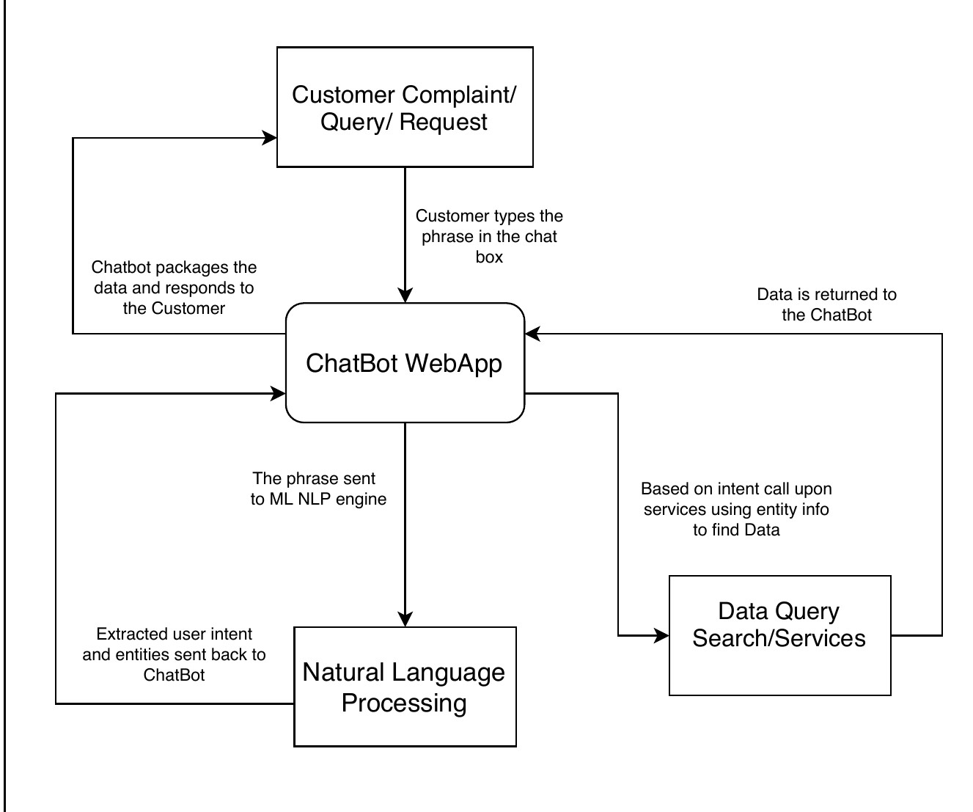
FLOW CHART:
Technology
Stack:
Platform: A desktop WebApp/ Integrated WebChat
Coding Language: Python
Framework: Django/ Flask
Database: MySQL/ SQL Alchemy
Other tools used: Dialogflow as NLP engine for Language Processing.

Slide 3
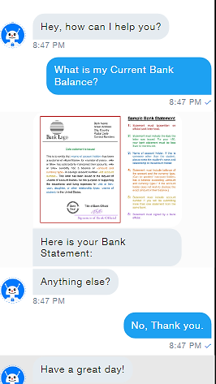

Idea / Approach details
Use Case:
Dependencies/
Show Stopper:
Datasets for creating a functioning Database.
Customer Query / Request
Prototype:
ChatBot MAIN
Customer
NLP engine
intent
entity
Resolution returns to the Chat Bot
Database
Query resolution search
Support Executive
Database update after Support Executive and Customer interaction

