Slide 1

The Longshots
Group 8 :
Murtaza Colombowala
Pratyush Gupta
Mudra Khandwala
Xin Wan
Ravi Patel
Abhijit Haridas

Slide 2

TABLE OF CONTENTS
01
Background
02
Objectives
03
Soccer teams' spending conventions
Performance comparison between different teams
04
05
Predicting player’s market value
06
Key Takeaways

Slide 3

INTRODUCTION
Our initiative focuses on English Premier League.
The league is made up of 20 clubs, each of which plays typically 38 games per season.
The Scoring rules include:
3 points : when a team wins
1 point : when two teams are tied in a game
0 point : when the team is defeated
The ranking of each team in the league is determined by their score at the end of each season.

Slide 4
Types of Transfers
Permanent Transfer
Academy Graduate
Loan Transfer

Slide 5
Our Objectives
Analysing Spending Patterns of soccer clubs
Evaluate correlation between player performance and their market value
Determining impact of financial spending on club’s performance
Proposing strategies to improve performance of average performing clubs
Compare performances of top 5 teams with next 5 teams

Slide 6
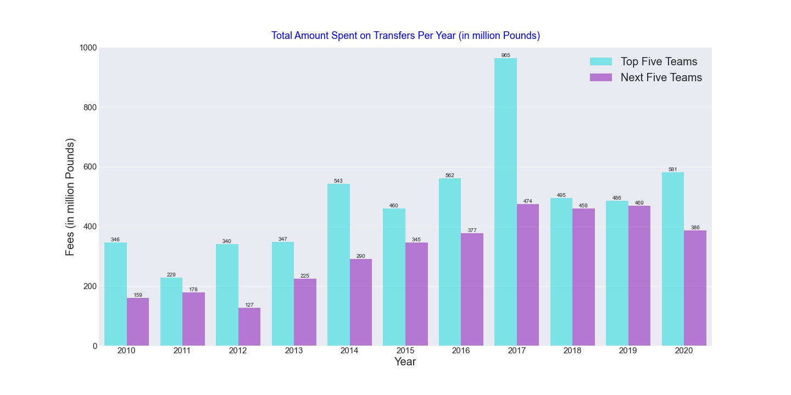
Soccer teams' spending conventions
Soccer teams' spending conventions

Slide 7
Transfer Spending by Position
 | Top 5 Teams | Next 5 Teams
Attack | 35.6% | 42.7%
Defense | 32.9% | 22.4%
Midfield | 31.6% | 34.9%
Counter-Attack?

Slide 8
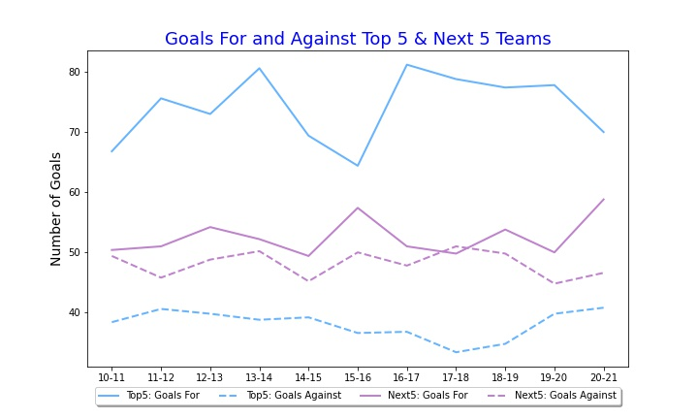
Crunching Goal Numbers

Slide 9
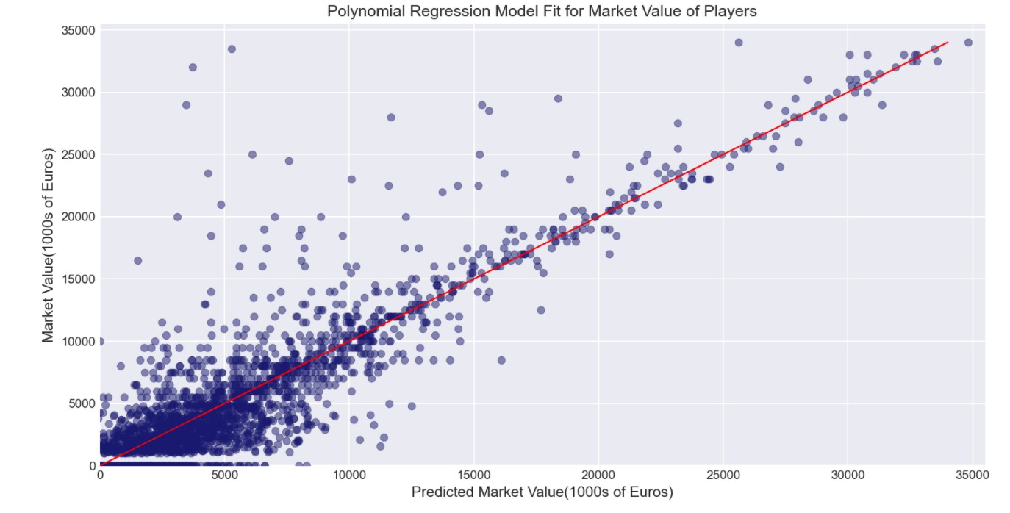
Does performance impact market value of a player?

Slide 10
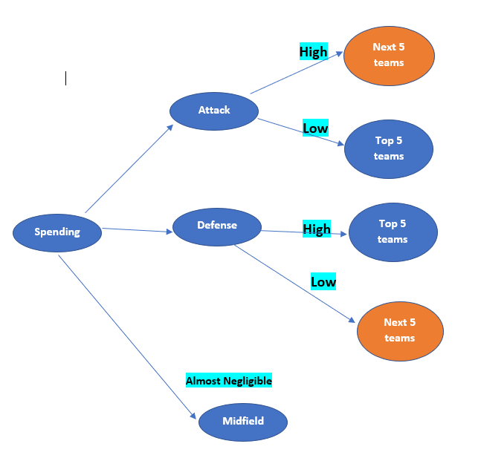
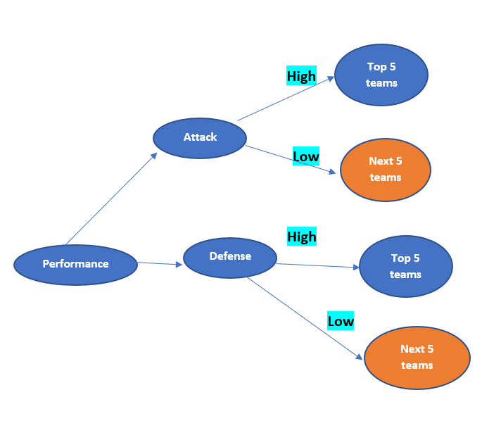
Bringing it all together.

Slide 11
Why is Transfer spending not translated into performance?
Bigger budgets?
Overvalued purchases?
Counter attack as a strategy?

Slide 12

THANKS!
Any Questions?

