Slide 1
CS 6349
Network Security
BGP Security

Slide 2
BGP security
Internet – a network of autonomous networks
Intra-domain routing (RIP, OSPF, IS-IS, etc)
Inter-domain routing – BGP v4
  Good for satisfying policy routing needs
  Lacks necessary security as with many other Internet protocols
  April 1997 incident – a small ISP BGP router in Florida claimed optimal connectivity to all Internet destinations, causing a big harm (2 hr disruption) to the rest of the Internet

Slide 3
Attacks w/ BGP or on BGP
Erroneous routing advertisements as in 1997 Florida incident
E-mail spammers introducing false info into BGP to enable them exchange e-mails w/ e-mail servers using unallocated IP addresses – difficult to trace
Introducing false info into BGP also helps divert traffic to self to
  Snoop traffic,
  Impersonate web sites (e.g., a Bank web site) or
  Block access to certain sites
Net effect – from annoyance to devastating losses
Since BGP is glue holding the Internet together, need to improve on its security

Slide 4






































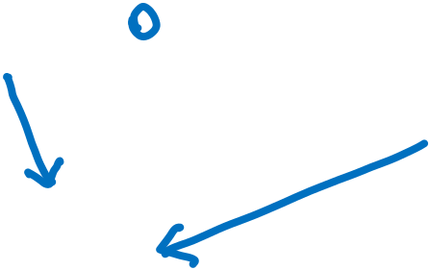























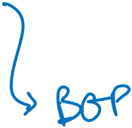

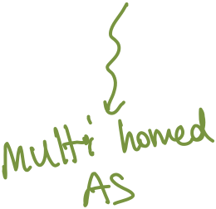



BGP overview
Notes:
Talk about provider-customer and peer-to-peer relations; stub, multi-homed and transit Ases, IP address prefixes and AS numbers, IGP routers and BGP routers, IP prefix and its sub-prefixes and ISP and its clients with hierarchical IP address assignments, longest prefix matching; public AS numbers 1-64511 and private AS numbers 64512-65535

Slide 5
BGP overview
BGP provides
  Inter-domain reachability in a scalable way
  Enables ISPs to implement various policies
  Helps ISPs to cooperate under competitive circumstances
Inter-domain routing is hard
  Due to its large scale – (as of October 26, 2021)
    ~900K prefixes (aggregated to 483K+) and 72K+ ASes
  Due to autonomous nature of ASes
    Cost metrics may be different in different ASes
  Due to trust issues
  Due to the need to support various types of policies

Slide 6
Path selection
Suppose AS3 sends its-path-to-AS1 (AS3,AS2,AS1) to its peer AS4
  AS4 may or may not select the path offered by AS3
    Cost, policy (don’t route via competitors AS), loop prevention reasons
  If AS4 selects the path, then
    Path (AS4,AS1) = AS4, Path(AS3,AS1)
  AS3 can control incoming traffic by controlling its route advertisements
    E.g., don’t want to route traffic to AS1, then don’t advertise any routes to AS1 to neighbor AS4
AS1
AS2
AS4
AS3

Slide 7
A Sample BGP table
router> show ip bgp
next hop AS path
* 12.104.140.0/22 213.200.87.254 0 3257 1239 701 6985 i
* 209.123.12.51 0 8001 7911 701 6985 i
* 203.62.252.26 0 1221 4637 701 6985 i
64.50.230.1 0 4181 3356 701 6985 i
* 12.104.147.0/24 213.200.87.254 0 3257 7132 21744 i
* 209.123.12.51 0 8001 1784 7132 21744 i
* 64.50.230.1 0 4181 7132 21744 i
* 216.191.65.118 0 15290 7132 21744 i
* 213.140.32.146 0 12956 7132 21744 i
* 12.104.244.0/24 213.200.87.254 0 3257 1239 701 15343 i
* 64.50.230.1 0 4181 3356 701 15343 i
* 209.123.12.51 0 8001 7911 701 15343 i
* 157.130.182.254 0 19092 701 15343 i
* 203.62.252.26 0 1221 4637 701 15343 i

Slide 8
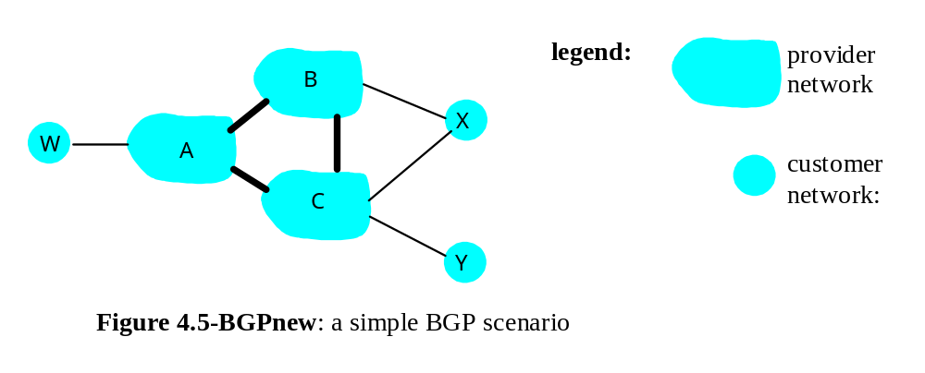
BGP: controlling who routes to you
A,B,C are provider networks
X,W,Y are customers (of provider networks)
X is dual-homed: attached to two networks
  X does not want to route from B via X to C
  .. so X will not advertise to B a route to C

Slide 9
BGP-4
BGP (Border Gateway Protocol)
  Current standard protocol for interdomain routing
Each AS has
  One or more border routers
    Connects an AS to the Internet
    Used for default external route
  One or more BGP routers (BGP speakers)
    Routers that participate in the interdomain routing
BGP routers
  Receive, filter route advertisements from neighbor BGP routers
  Perform route selection
    To route to destination X, which path (of several advertised) will be taken
  Send route advertisements to neighbors
BGP is a Path Vector protocol
  Similar to distance vector protocol
  BGP routes to networks, not individual hosts
  BGP advertisements include complete path
    Complete path: list of ASes to reach a particular network
    Why? What is the utility of including the complete path?

Slide 10
BGP overview
BGP communicates route info among ASes
  Explicitly adds a route – UPDATE msg
  Explicitly removes one – WITHDRAW msg
BGP is a path-vector protocol
  Includes the path that the routing advertisements take within the update msg -> in ASPATH attribute
BGP runs on top of TCP
  BGP routers use TCP based sessions to exchange BGP protocol msg reliably
BGP has two modes
  eBGP – BGP routers in neighboring domains use this
  iBGP – BGP routers within a domain use this
  Difference is in deciding which msgs to relay to others

Slide 11
BGP overview
A BGP router
  May receive UPDATEs from multiple peers
  Uses various rules configured by network admin on selecting one UPDATE over the other
  Use various rules to decide which other neighbors to forward an UPDATE and how to modify it before forwarding

Slide 12
BGP Security
Sources of security issues for BGP
  Physical attacks
  TCP related attacks
  Attacks on BGP protocol
    Uncertainty about which AS has the right to originate an announcement for an IP prefix,
    i.e. which AS owns which IP prefix
    Potential to tamper with route announcements to subvert BGP routing policy

Slide 13
TCP related attacks
Attacks against confidentiality
  Eavesdropping to learn about business relationship or peering info
Attacks against msg integrity
  Insertion of forged BGP msgs – may cause session abortion
  Selective deletion of msgs – cause session abortion
  Modify msgs to cause inconsistent view of the network
  Replay msgs

Slide 14
TCP related attacks, cont’d
Denial-of-service (DoS) attacks
  Cause connections to reset
  TCP SYN flooding attacks – cause peers to drop BGP connection resulting in route flapping
  Link cutting attacks – swamp link w/ traffic to cause BGP traffic to suffer

Slide 15
Attacks on BGP Protocol
Route hijacking
  Prefix hijacking
  Sub-prefix hijacking
Route leaks

Slide 16
Modern solutions to BGP attacks
Prefix filtering
RPKI: Crypto based origin validation
BGPSEC: Crypto based path validation
Papers for the discussion:
  Why is it taking so long to secure Internet routing? by Sharon Goldberg, ACM Queue 2014.
  Are we there yet? On RPKI’s deployment and security, Gilad at al., NDSS 2017.

Slide 17
Goldberg, ACM Queue 2014 paper
Prefix hijacking
  AS a originates routes to a prefix p that it does not own
    Some ASes out there may take this route and start forwarding data destined to p to AS a

Slide 18
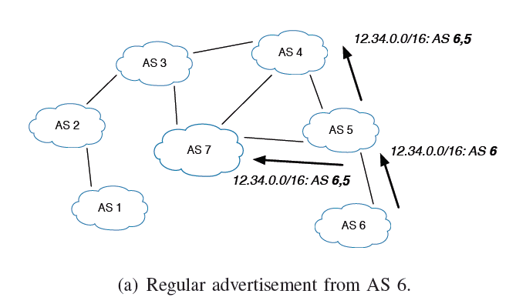
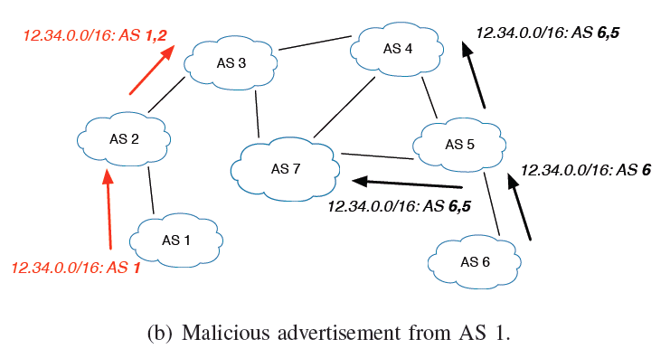
Prefix hijacking

Slide 19
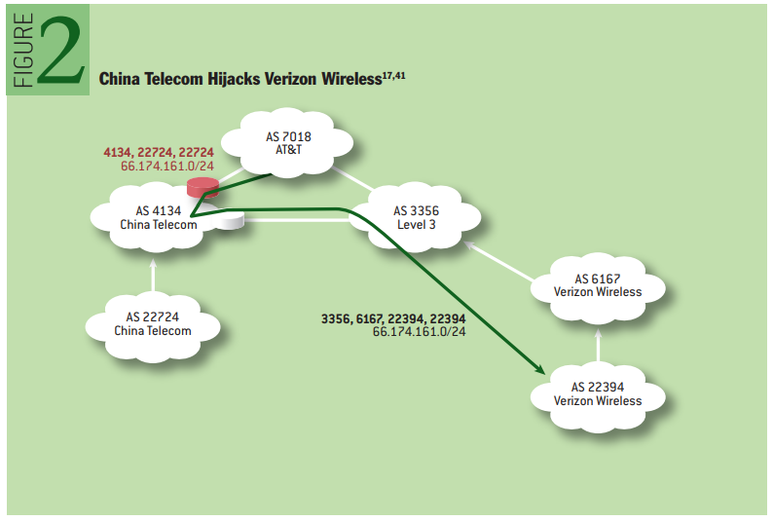
Goldberg, ACM Queue 2014
Prefix hijacking example
How effective prefix hijacking is?
Verizon Wireless owns
66.174.161.0/24

Slide 20
Goldberg, ACM Queue 2014
Sub-prefix hijacking
  AS a wants to attract traffic for prefix p
  AS a originates routes for sub-prefixes p₁ and p₂ such that p₁+p₂ = p
    Ex: p = 129.110.0.0/16
    p₁ = 129.110.0.0/17
    p₂ = 129.110.128.0/17
  Potentially attracts traffic from all ASes
    Routing prefers longest prefix match

Slide 21
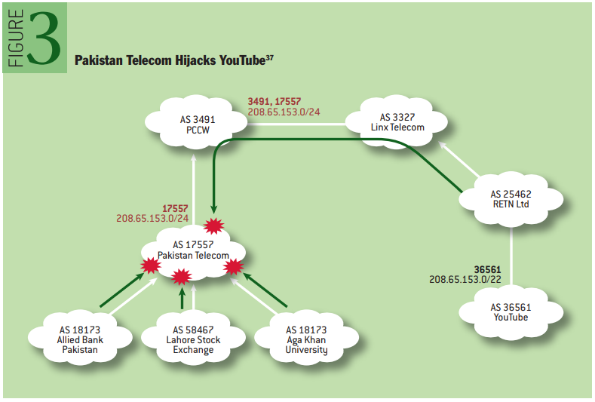
Goldberg, ACM Queue 2014
Sub-prefix hijacking example
How effective sub-prefix hijacking is?

Slide 22
Goldberg, ACM Queue 2014
Why route hijacking?
  Attraction attack
    Black hole traffic
  Interception attack
    Eavesdrop or alter traffic before forwarding on
  Which one is easier to execute and why?
Can multiple ASes originating a prefix?
  Yes…
  helps with load balancing and e2e performance
Notes:
In an interception attack, the attacker AS needs to ensure that it has a route to victim AS for forwarding traffic. If it sends bogus routes to all its neighbors, it may not have a route to victim…

Slide 23
Goldberg, ACM Queue 2014
Route leaks
  AS a announces a legit route to prefix p to neighbor AS b unexpectedly
  Why?
    Attract traffic from AS b to prefix p that would not otherwise go thru AS a

Slide 24
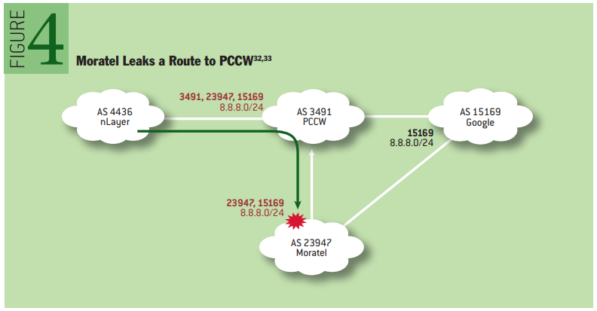
Goldberg, ACM Queue 2014
Route leak example
Moratel forwards peer-learned route to a provider

Slide 25
Goldberg, ACM Queue 2014
Defenses
  Prefix Filtering
  RPKI – Resource Public Key Infrastructure
  BGPsec
  SBGP - expensive
  SoBGP – similar to RPKI

Slide 26
Goldberg, ACM Queue 2014
Prefix filtering
  A customer AS can announce to its provider routes that are
    for its own allocated prefixes, or
    prefixes of its own customers
  A provider can
    keep list of these prefixes for the customer
    discard routes for any other prefixes coming from the customer

Slide 27
Goldberg, ACM Queue 2014
Prefix filtering
  Pros:
    If every ISP with 25 or more customer ASes deploy this, a large fraction of route leaks and hijacks can be prevented
  Cons:
    Works only on customer links
    Lopsided incentives… helping others not self!

Slide 28
Goldberg, ACM Queue 2014
RPKI
  Cryptographic origin validation
  Resource Certificates (RCs)
    Signed document establishing that Organization A (owner of AS A) owns prefix p
  Route Origin Authorization (ROA)
    Signed documents mapping prefix p to AS A
  Route Origin Validation (ROV)
    Checking prefix ownership of arrived BGP update using ROA database

Slide 29
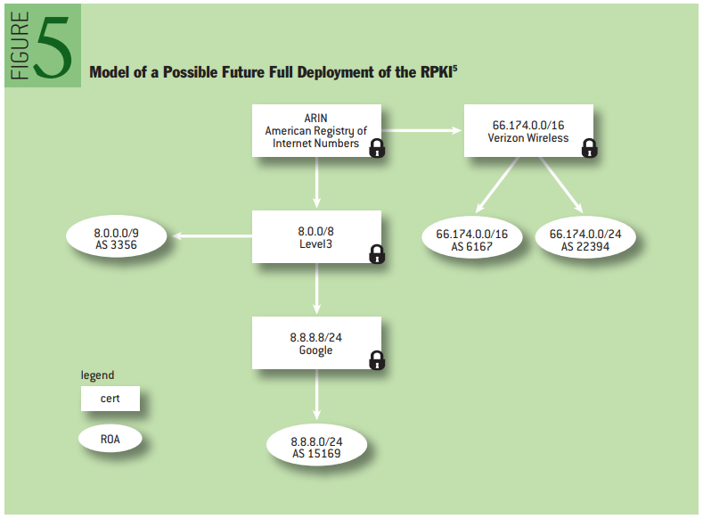
Goldberg, ACM Queue 2014
RPKI

Slide 30
Goldberg, ACM Queue 2014
RPKI benefits
  Offline crypto to verify ROA chain
  Use whitelist to filter hijacked BGP routes
  More effective then prefix filtering
    PF is on customer prefixes, RPKI is on neighbors
  More incentives to avoid prefixes being hijacked

Slide 31
Goldberg, ACM Queue 2014
RPKI challenges
  Can be misconfigured
  Partial deployment of ROV related issues
    See the NDSS 2017 paper
  Can be circumvented
    Route leaks
    Path alteration/shortening attacks

Slide 32
Goldberg, ACM Queue 2014
BGPsec
  Provides path validation
  ASes on the path sign outgoing BGP updates
  Signature covers
    prefix, ASPATH, ASN of neighbor receiving this update
  BGP update also includes all signatures accumulated on the path

Slide 33
Goldberg, ACM Queue 2014
BGPsec example
BGP updates carry accumulated signatures
[66.174.161.0/24: 7018;3356;6167;22394]₃₃₅₆
[66.174.161.0/24: 3356;6167;22394]₆₁₆₇
[66.174.161.0/24: 6167;22394]₂₂₃₉₄
[66.174.161.0/24: 3356;6167;22394]₆₁₆₇
[66.174.161.0/24: 6167;22394]₂₂₃₉₄
[66.174.161.0/24: 6167;22394]₂₂₃₉₄

Slide 34
Goldberg, ACM Queue 2014
BGPsec benefits
  No path alteration/shortening attacks
BGPsec challenges
  Require online crypto to produce/verify signatures
  Transition to BGPsec
    Full path verification requires all ASes on the path to sign the BGP update
    Incentive challenge: Given an expensive BGPsec-secured path vs a cheap non-secured path, which one to choose?

Slide 35
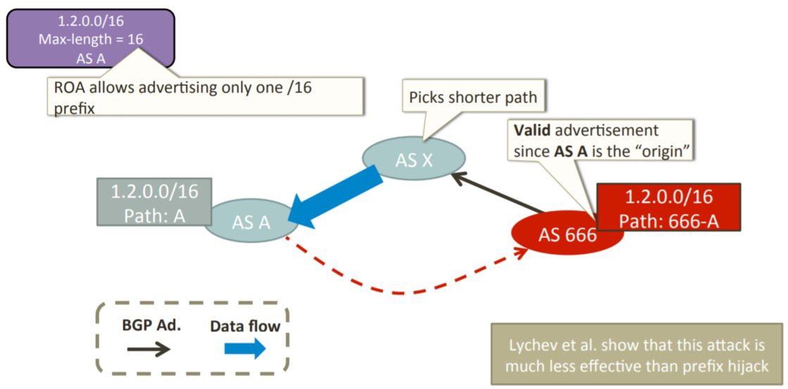
RPKI deployment challenges
ASPATH manipulation more difficult to succeed
  The attacker ASPATH likely to be longer than the authentic ASPATH
Figure from https://ripe74.ripe.net/presentations/61-RACI.pdf

Slide 36
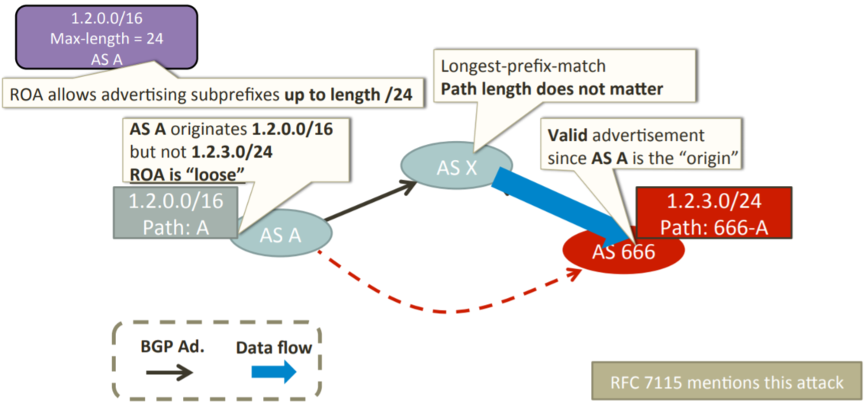
RPKI deployment challenges
Loose ROAs could be a problem
Figure from https://ripe74.ripe.net/presentations/61-RACI.pdf

Slide 37
RPKI – Route Origin Validation (ROV)
RPKI enforcing AS uses RPKI caches to
  Obtain RCs and ROAs
  Validate them and pass the info to BGP speakers
ROV partial adaption challenges
  Not all ASes enforce ROV… introducing additional challenges/problems

Slide 38
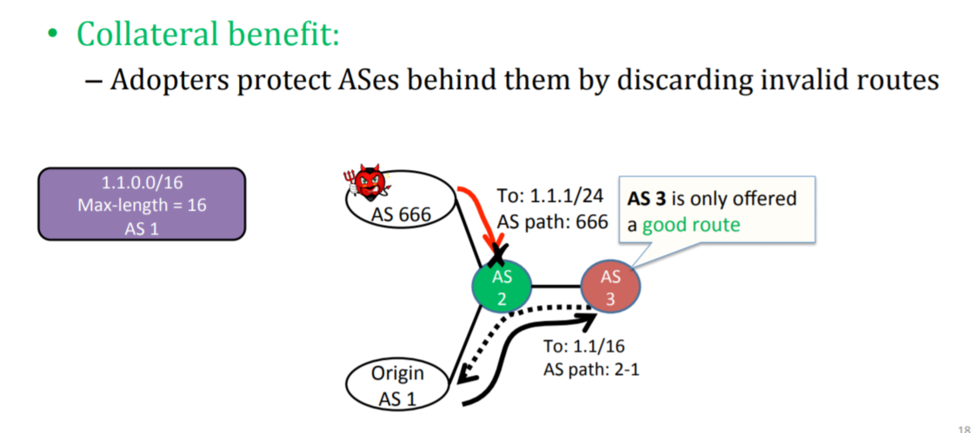
Impact of partial ROV adaption
Figure from https://ripe74.ripe.net/presentations/61-RACI.pdf

Slide 39
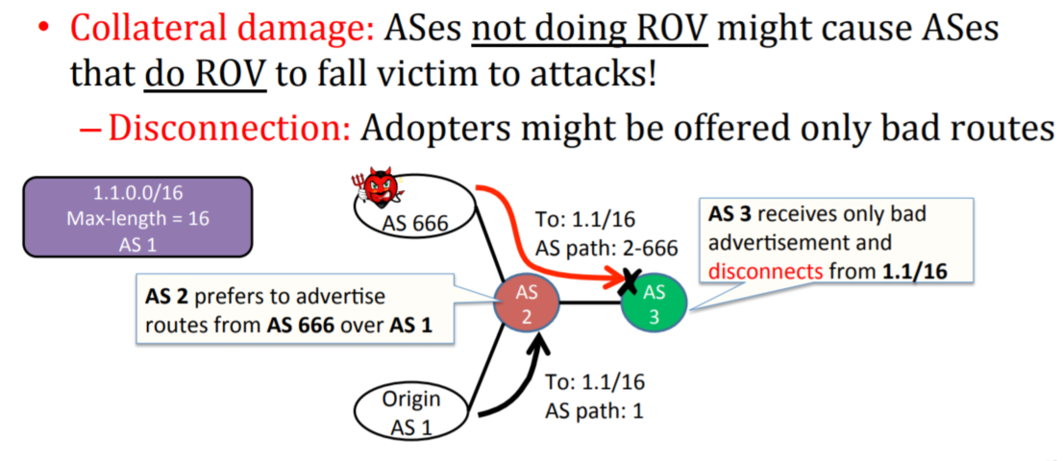
Impact of partial ROV adaption
Figure from https://ripe74.ripe.net/presentations/61-RACI.pdf

Slide 40
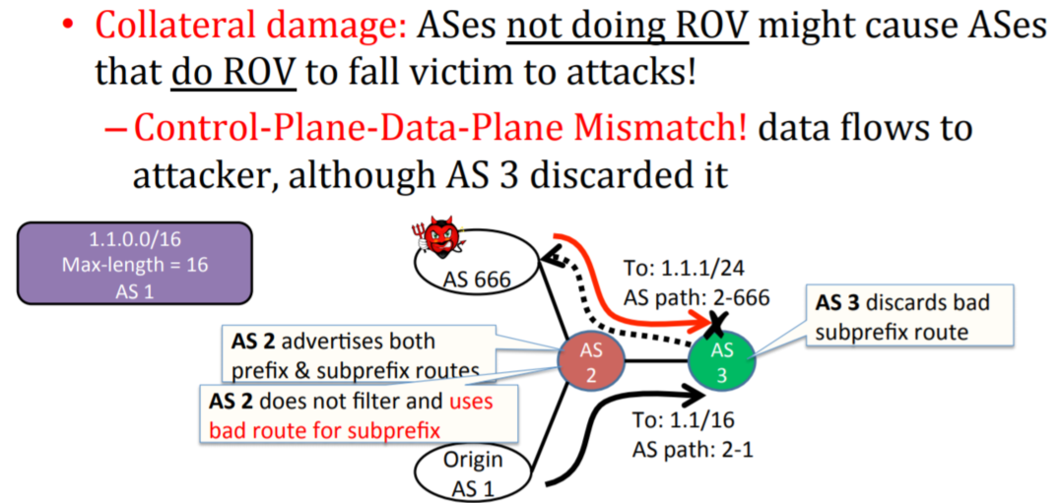
Impact of partial ROV adaption
Figure from https://ripe74.ripe.net/presentations/61-RACI.pdf

Slide 41
RPKI deployment challenges
For a more complete discussion on this, see
Yossi Gilad NDSS’17 presentation

