Slide 1
CS 6349 Network Security
Denial of Service Attacks & Defense
Source: Dan Boneh

Slide 2
What is network DoS?
Goal: Take out a large site with little computing work
How: Amplification
  Small number of packets ⇒ big effect
Two types of amplification attacks:
  DoS bug:
    Design flaw allowing one machine to disrupt a service
  DoS flood:
    Command bot-net to generate flood of requests

Slide 3
A Sample Design Flaw (DoS Bug)
A law passed by the Kansas legislature in early 20th century:
“When two trains approach each other at a crossing, both shall come to a full stop and neither shall start up again until the other has gone.”

Slide 4
DoS can happen at any layer
This lecture:
  Sample DoS at different layers (by order):
    Link
    TCP/UDP/ICMP
    Application
    Payment
  Some generic DoS solutions
  Some network DoS solutions
Sad truth:
  Current Internet not designed to handle DoS attacks

Slide 5
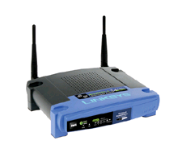
Warm up: 802.11b DoS bugs
Radio jamming attacks: trivial, not our focus.
Protocol DoS bugs: [Bellardo, Savage, ’03]
  NAV (Network Allocation Vector):
    15-bit field. Max value: 32767
    Any node can reserve channel for NAV seconds
    No one else should transmit during NAV period
    … but not followed by most 802.11b cards
  De-association bug:
    Any node can send disassociate packet to AP
    Disassociate packet unauthenticated
    … attacker can repeatedly disassociate anyone

Slide 6

Amplification DoS Attacks: Smurf
1 ICMP Echo Req
Src: DoS Target
Dest: 192.168.1.255
3 ICMP Echo Reply
Dest: DoS Target
Send ping request to broadcast addr (ICMP Echo Req)
Lots of responses:
  Every host on target network generates a ping reply (ICMP Echo Reply) to victim
gateway
DoS
Target
DoS
Source
192.168.1.0/24
Prevention: reject external packets to broadcast address

Slide 7
Amplification DoS Attacks: DNS Based
DNS Amplification attack: ( ×100+ amplification )
DNS Query
SrcIP: DoS Target
(60 bytes)
DNS Response
(3000 bytes)
DoS
Source
DNS
Server
DoS
Target
20+ million open resolvers on Internet
Prevention: reject DNS queries from external addresses ?
Notes:
Other measurements: (MeasurementFactory):
There are an estimated 7.5 million external DNS servers on the public Internet. Over 75% of domain
name servers (of roughly 1.3 million sampled) allow recursive name service to arbitrary queriers.

Slide 8
Review: TCP Header format
TCP:
  Session based
  Congestion control
  In order delivery
0
31
Source Port
Dest port
SEQ Number
ACK Number
U
R
G
A
C
K
P
S
H
P
S
R
S
Y
N
F
I
N
Other stuff

Slide 9
Review: TCP Handshake
C
S
SYN:
SN_{C}←rand_{C}
AN_{C}←0
Listening
SN_{S}←rand_{S}
AN_{S}←SN_{C}+1
Store SN_{C} , SN_{S}
SYN/ACK:
Wait
SN←SN_{C}
AN←SN_{S}+1
ACK:
Established

Slide 10
TCP SYN Flood I: low rate (DoS bug)
C
S
Single machine:
SYN Packets with
random source IP
addresses
Fills up backlog queue
on server
No further connections
possible
SYN_{C1}
SYN_{C2}
SYN_{C3}
SYN_{C4}
SYN_{C5}

Slide 11
SYN flood defenses
Non-solution:
  Increase backlog queue size or decrease timeout
Correct solution:
  Syncookies: remove state from server
  Small performance overhead
Notes:
Syncache: global hash table for all half open connections on all sockets.

Slide 12
Syncookies
[Bernstein, Schenk]
Idea: Remove SYN state from server
Server responds to Client with SYN-ACK cookie:
  T = 5-bit counter incremented every 64 secs.
  M= 3-bit encoding of MSS
  L = F_{key} (SAddr, SPort, DAddr, DPort, T) + SN_{C}
    In practice, F_{key}(X) = MD5( key || X || key)
    Key: picked at random during boot
  SN_{S} = (T || M || L)
  Server does not save state
Honest client responds with ACK(AN=SN_{S}+1)
  Server allocates space for socket only if valid SN_{S}.
Notes:
T guarantees that old SYN-ACK Cookies cannot be used

Slide 13
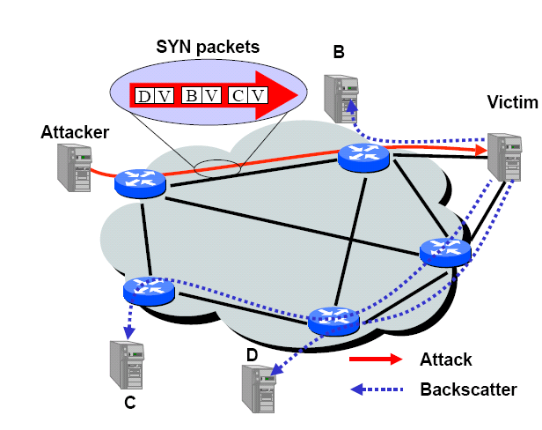
SYN floods: backscatter [MVS’01]
SYN with forged source IP ⇒ SYN/ACK to random host

Slide 14
Backscatter measurement [MVS’01]
Listen to unused IP address space (darknet)
Lonely SYN/ACK packet likely to be result of SYN attack
In 2001: 400 SYN attacks/week
In 2013: 773 SYN attacks/day (arbor networks ATLAS)
/8 network
0
monitor
2³²
Notes:
Savage used /8 network: 44.x.y.z.

Slide 15
SYN Floods II: Massive flood (e.g BetCris.com ‘03)
Command bot army to flood specific target: (DDoS)
  20,000 bots can generate 2Gb/sec of SYNs (2003)
  At web site:
    Saturates network uplink or network router
    Random source IP ⇒
    attack SYNs look the same as real SYNs
Notes:
Gambling site in Costa Rica. Defended using PureGig ISP that has 10Gb/sec link.
20,000 bots → 1.5 to 3 Gb/sec flood
Note: NetScalar boxes process SYN packets in HW.

Slide 16
Massive floods (on Brian Krebs in 2016)
Command bot army to flood specific target: (DDoS)
Flood with SYN, ACK, UDP, and GRE packets
623 Gbps (peak) from ≈100K compromised IoT devices
At web site:
  Saturates network uplink or network router
  Random source IP ⇒
  attack SYNs look the same as real SYNs
What to do ???

Slide 17
Google Project Shield & Prolexic (Akamai)
Idea: only forward established TCP connections to site
Lots-of-SYNs
Web
Proxy
Lots-of-SYN/ACKs
Few ACKs
Web
site
Forward
to site
Notes:
Note: web site is only accessible through prolexic proxy via leased line

Slide 18
Obvious next step: TCP con. flood
Command bot army to:
  Complete TCP connection to web site
  Send short HTTP HEAD request
  Repeat
Will bypass SYN flood protection proxy
… but:
  Attacker can no longer use random source IPs.
    Reveals location of bot zombies
  Proxy can now block or rate-limit bots.
    How to tell if bot or legitimate client? (May not be easy)

Slide 19
DNS DDoS Attacks
DNS runs on UDP port 53
  DNS entry for victim.com hosted at victim_isp.com
DDoS attack:
  flood victim_isp.com with requests for victim.com
  Random source IP address in UDP packets
Takes out entire DNS server: (collateral damage)
  bluesecurity DNS hosted at Tucows DNS server
  DNS DDoS took out Tucows hosting many many sites
Notes:
TLD DNS servers: each root server on 200 machines. Requests use IP any cast.

Slide 20
DNS DDoS Attacks
Feb. 6, 2007:
  Botnet attack on the 13 Internet DNS root servers
  Lasted 2.5 hours
  None crashed, but two performed badly:
    g-root (DoD), l-root (ICANN)
    Most other root servers use anycast
October 21, 2016:
  DYN DNS server attack by IoT devices used as zombies
    10s of millions of discrete IP addresses associated with the Mirai botnet that were part of the attack
    Up to 100,000 malicious endpoints
  http://hub.dyn.com/dyn-blog/dyn-analysis-summary-of-friday-october-21-attack
Notes:
Root servers specify where the TLDs are (.com, .net, …)
f-root is supported by 42 different locations.
Only one root server is sufficient to make the Internet work.
From http://hub.dyn.com/dyn-blog/dyn-analysis-summary-of-friday-october-21-attack
During a DDoS which uses the DNS protocol it can be difficult to distinguish legitimate traffic from attack traffic. For example, the impact of the attack generated a storm of legitimate retry activity as recursive servers attempted to refresh their caches, creating 10-20X normal traffic volume across a large number of IP addresses. When DNS traffic congestion occurs, legitimate retries can further contribute to traffic volume. We saw both attack and legitimate traffic coming from millions of IPs across all geographies. It appears the malicious attacks were sourced from at least one botnet, with the retry storm providing a false indicator of a significantly larger set of endpoints than we now know it to be. We are still working on analyzing the data but the estimate at the time of this report is up to 100,000 malicious endpoints. We are able to confirm that a significant volume of attack traffic originated from Mirai-based botnets.
Early observations of the TCP attack volume from a few of our datacenters indicate packet flow bursts 40 to 50 times higher than normal. This magnitude does not take into account a significant portion of traffic that never reached Dyn due to our own mitigation efforts as well as the mitigation of upstream providers. There have been some reports of a magnitude in the 1.2 Tbps range; at this time we are unable to verify that claim.

Slide 21
DoS at higher layers: Memcached attack
Memcached: Database cache for speeding up web sites
Works over TCP 11211, and also on UDP 11211
Feb 2018 incident
  87,000 exposed memcached servers
  Attacked using spoofed UDP
  1.35 Tbps attack on Github
  Solution: disable UDP support

Slide 22
DoS at higher layers: SSL/TLS
SSL/TLS handshake [SD’03]
  RSA-encrypt speed ≈ 10× RSA-decrypt speed
  ⇒ Single machine can bring down ten web servers
Similar problem with application DoS:
  Send HTTP request for some large PDF file
  ⇒ Easy work for client, hard work for server.
Client Hello
Web
Server
Server Hello (pub-key)
RSA
Encrypt
Client key exchange
RSA
Decrypt

Slide 23
Payment DDoS
Acquiring
Bank
Low rate at each Merchant
High rate at Acquiring bank
Merchant A
Merchant B
Merchant C
Dummy
purchase
requests

Slide 24
DoS Mitigation

Slide 25
1. Client puzzles
Idea: slow down attacker
Moderately hard problem:
  Given challenge C find X such that
  LSB_{n} ( SHA-1( C || X ) ) = 0^{n}
  Assumption: takes expected 2^{n} time to solve
  For n=16 takes about .3sec on 1GHz machine
  Main point: checking puzzle solution is easy.
During DoS attack:
  Everyone must submit puzzle solution with requests
  When no attack: do not require puzzle solution

Slide 26
Examples
TCP connection floods (RSA ‘99)
  Example challenge: C = TCP server-seq-num
  First data packet must contain puzzle solution
    Otherwise TCP connection is closed
SSL handshake DoS: (SD’03)
  Challenge C based on TLS session ID
  Server: check puzzle solution before RSA decrypt.
Same for application layer DoS and payment DoS.
Notes:
For SYN floods: include puzzle solution in every SYN packet. Example: challenge C = source-IP.

Slide 27
Benefits and limitations
Hardness of challenge: n (the number of bits)
  Decided based on DoS attack volume.
Limitations:
  Requires changes to both clients and servers
  Hurts low power legitimate clients during attack:
    Clients on cell phones, PDAs cannot connect

Slide 28
Memory-bound functions
CPU power ratio:
  high end server / low end cell phone = 8000
  ⇒ Impossible to scale to hard puzzles
Interesting observation:
  Main memory access time ratio:
    high end server / low end cell phone = 2
Better puzzles:
  Solution requires many main memory accesses
    Dwork-Goldberg-Naor, Crypto ‘03
    Abadi-Burrows-Manasse-Wobber, ACM ToIT ‘05

Slide 29
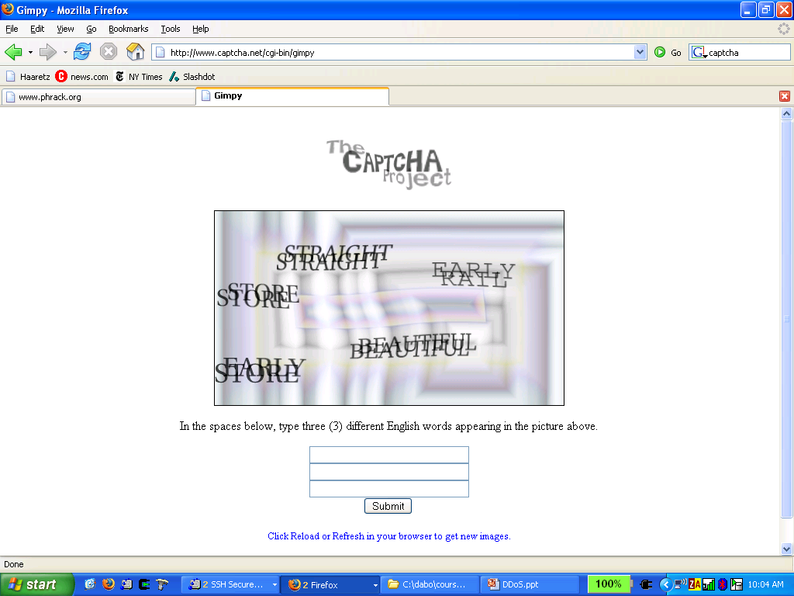
2. CAPTCHAs
Idea: verify that connection is from a human
Applies to application layer DDoS [Killbots ’05]
  During attack: generate CAPTCHAs and process request only if valid solution
  Present one CAPTCHA per source IP address.

Slide 30
3. Source identification
Goal: identify packet source
Ultimate goal: block attack at the source

Slide 31
1. Ingress filtering (RFC 2827, 2000)
Big problem: DDoS with spoofed source IPs
Question: how to find packet origin?
Ingress filtering policy: ISP only forwards packets with legitimate source IP.
ISP
Internet
Notes:
Other methods to block spoofed source IP: SAVE (Infocomm’02)

Slide 32
Implementation problems
ALL ISPs must do this. Requires global trust.
  If 10% of ISPs do not implement ⇒ no defense
  As of 2017 (spoofer.caida.org)
    33% of ASes are fully spoof-able
    23% of announced IP address space is spoof-able
Another non-solution: enforce source IP at peer AS
Can transit AS validate packet source IP? No …
R₁
R₃
R₂
R₄
dest
Source AS
Transit AS
Dest AS

Slide 33
2. Traceback [Savage et al. ’00]
Goal:
  Given set of attack packets
  Determine path to source
How: make routers record info in packets
Assumptions:
  Most routers remain uncompromised
  Attacker sends many packets
  Route from attacker to victim remains relatively stable
Paper: Practical Network Support for IP Traceback, Savage et al., SIGCOMM 2000.

Slide 34
Simple method
Write network path into packet
  Each router adds its own IP address to packet
  Victim reads path from packet
Problem:
  Requires space in packet
    Path can be long
    No extra fields in current IP format
      Changes to packet format too much to expect

Slide 35
Better idea
DDoS involves many packets on the same path
Store one node/edge in each packet
  Each router probabilistically stores own address
  Fixed space regardless of path length
What to store?
  node or edge?
  What’s the difference?
A₁
A₂
A₃
A₄
A₅
R₆
R₇
R₈
R₉
R₁₀
R₁₂
V

Slide 36
Edge Sampling
Data fields written to packet:
  Edge: start and end IP addresses
  Distance: number of hops since edge stored
Marking procedure for router R
  if coin turns up heads (with probability p) then
  write R into start address
  write 0 into distance field
  else
  if distance == 0 write R into end field
  increment distance field

Slide 37
Edge Sampling: picture
Packet received
  R₁ receives packet from source or another router
  Packet contains space for start, end, distance
packet
s
e
d
R₁
R₂
R₃

Slide 38
Edge Sampling: picture
Begin writing edge
  R₁ chooses to write start of edge
  Sets distance to 0
packet
R₁
0
R₁
R₂
R₃

Slide 39
Edge Sampling
Finish writing edge
  R₂ chooses not to overwrite edge
  Distance is 0
    Write end of edge, increment distance to 1
packet
R₁
R₂
1
R₁
R₂
R₃

Slide 40
Edge Sampling
Increment distance
  R₃ chooses not to overwrite edge
  Distance > 0
    Increment distance to 2
packet
R₁
R₂
2
R₁
R₂
R₃

Slide 41
Path reconstruction
Extract information from attack packets
Build graph rooted at victim
  Each (start,end,distance) tuple provides an edge
# packets needed to reconstruct path
  E(X) <
  where p is marking probability, d is length of path
  ln(d)
  p(1-p)^{d-1}
Notes:
Prob that a packet has a mark from any of the d routers on the path is d.p.(1-p)^(d-1). Num trials required to select one of each of d equi-probable items is given (from coupon collector problem) as d(ln(d) + O(1)). Hence, number of packets X needed to construct the entire path is given by E(X)=ln(d)/p(1-p)^(d-1).

Slide 42
Node Sampling?
Less data than edge sampling
  Each router writes own address with probability p
Infer order by number of packets
  Router at distance d has probability p(1-p)^{d} of showing up in marked packet
p
1-p
1-p
1-p
R
V
d
Problems
  Need many packets to infer path order
  Does not work well if many paths

Slide 43
Reduce Space Requirement in Edge Sampling
XOR edge IP addresses
  Store edge as start + end
  Work backwards to get path:
  (start + end) + end = start
Sample attack path
a + b
b + c
c + d
d
a
b
c
d
V

Slide 44
Details: where to store edge
Identification field
  Used for fragmentation
  Fragmentation is rare
  16 bits
Store edge in 16 bits?
  Break into chunks
  Store start + end
Version
Header Length
Type of Service
Total Length
Identification
Identification
Flags
Fragment Offset
Time to Live
Protocol
Header Checksum
Source Address of Originating Host
offset
distance
edge chunk
0 2 3 7 8 15
Destination Address of Target Host
Options
Padding
IP Data

Slide 45
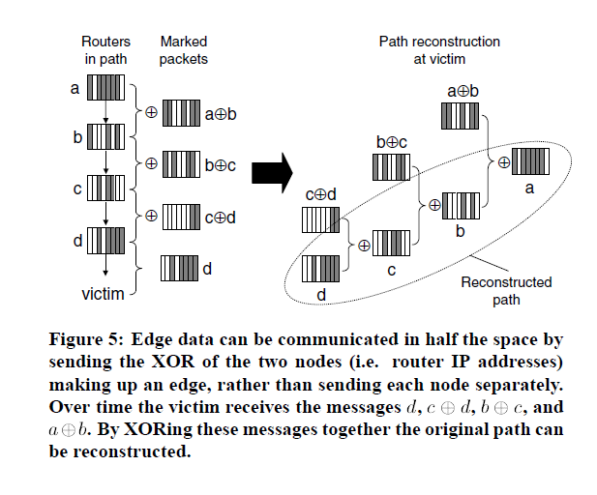

Slide 46
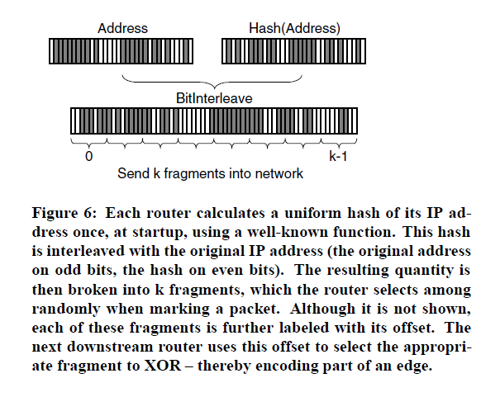

Slide 47
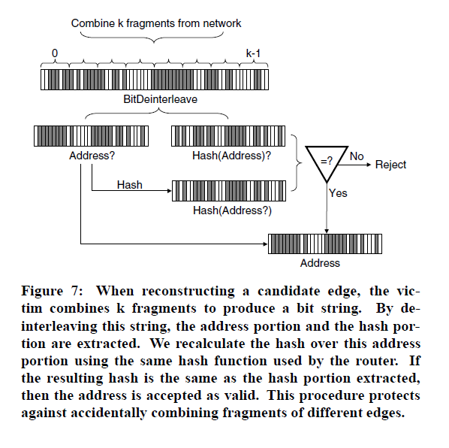

Slide 48
More traceback proposals
Advanced and Authenticated Marking Schemes for IP Traceback
  Song, Perrig. IEEE Infocomm ’01
  Reduces noisy data and time to reconstruct paths
An algebraic approach to IP traceback
  Stubblefield, Dean, Franklin. NDSS ’02
Hash-Based IP Traceback
  Snoeren, Partridge, Sanchez, Jones, Tchakountio,
  Kent, Strayer. SIGCOMM ‘01
Hybrid IP Traceback
  Gong, Sarac, ICC 2005

Slide 49


Hash-based IP Traceback
Sender
Recall: Marking-based IP traceback
Main idea: Store path state in packet
  Router marks forwarded packet with its identification information
Probabilistic Packet Marking (PPM)
  Probabilistically mark forwarded packets
  Reconstruct path by combining enough packets containing mark
  Pros: little overhead on router
  Cons: Trace traffic of large volume of packets
R8
R6
R6
R7
R4
R4
R6
R4 R6
R3
R6
R5
R3 R4 R6
R3
R2
R2
R2 R3 R4 R6
R3
R1
R2
R1 R2 R3 R4 R6
R3
Receiver
R1 R2 R3 R4 R6
R2
R3

Slide 50
Hash-based IP Traceback
Sender
Main idea: Store path state on router
  Router logs forwarded packets for a period of time
Hash-based IP Traceback (SPIE)
  Store packet digest in a table
  Digest Table: Bloom filter, space-efficient
  Reconstruct path by querying routers in Reverse-Path Flooding (RPF) manner
  Pros: trace single packet
  Cons: storage & access time overheads
R8
L
R6
R7
L
R4
R3
L
R5
L
R2
R1
L
Receiver
Notes:
Explain storage and access time overheads
SPIE: Source Path Isolation Engine

Slide 51
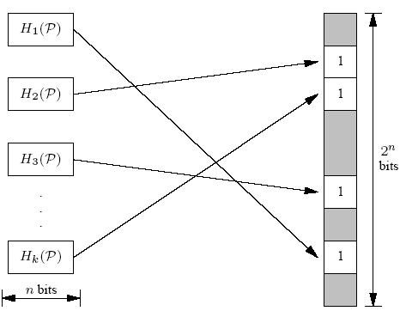
Bloom Filters - 1
A technique that simply stores the digests
For each packet arrived
Step-1 Use k different hash function computes k independent n-bits digests
Step-2 Set the corresponding bits in the bits digest table

Slide 52
Bloom Filters - 2
If any one of them is zero
  The packet was not stored in the table
If all the bits are one
  It is highly likely the packet was stored
  It is possible that some set of other insertions caused all the bits to be set
Restriction
  Can only store a limited number of digests
  Saturated filters can be swapped out for a new, empty filter
  Change to a new filter→ lose the previous digest information

Slide 53
IP Traceback Limitations
Not effective against reflector attacks [Paxson’01]
Reflector:
  A network component that responds to packets
  Response sent to victim (spoofed source IP)
Examples:
  DNS Resolvers: UDP 53 with victim.com source
    At victim: DNS response
  Web servers: TCP SYN 80 with victim.com source
    At victim: TCP SYN ACK packet
  Gnutella servers

Slide 54
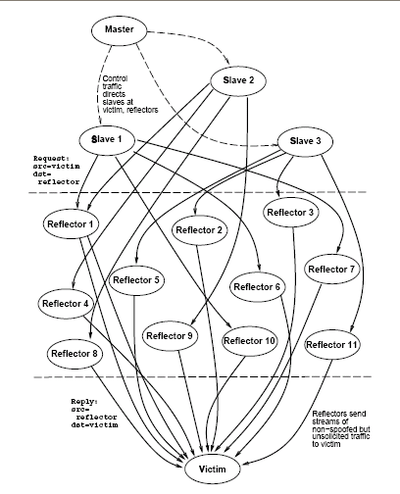
DoS Attack
Single Master
Many bots to
generate flood
Zillions of reflectors to hide bots
  Kills traceback and pushback methods

Slide 55
Capability based defense

Slide 56
Capability based defense
Basic idea:
  Receivers can specify what packets they want
How:
  Sender requests capability in SYN packet
    Path identifier used to limit # reqs from one source
  Receiver responds with capability
  Sender includes capability in all future packets
  Main point: Routers only forward:
    Request packets, and
    Packets with valid capability
Notes:
Capabilities can be revoked in case of attack

Slide 57
Capability based defense
Capabilities can be revoked if source is attacking
  Blocks attack packets close to source
R₁
R₃
R₂
R₄
dest
Source AS
Transit AS
Dest AS
Attack packets
dropped

Slide 58
Overlay level solutions to DoS
SOS – Secure Overlay Services

Slide 59
Take home message:
Denial of Service attacks are real.
Must be considered at design time.
Sad truth:
  Current Internet is ill-equipped to handle DDoS attacks
Many good proposals for core redesign.

