Slide 1
Customer Data Analysis – PRDA 05
Shopping Behaviour in Istanbul (2021–2023)
Presented by:
Ambarapu Ravi
Sai Sahithya V
Neeharika B

Slide 2
Objective
- Analyze customer shopping patterns by gender, age, category, and payment method
- Identify key revenue drivers
- Provide actionable insights to improve sales and customer engagement

Slide 3
Dataset Overview
Data from 10 shopping malls in Istanbul (2021–2023)
Covers different age groups and genders
Includes details on customer info, products, payments, and malls
Key fields: Invoice No, Customer ID, Gender, Age, Category, Quantity, Price, Payment Method, Invoice Date, Mall
Derived fields: Revenue (Quantity × Price), Age Groups

Slide 4
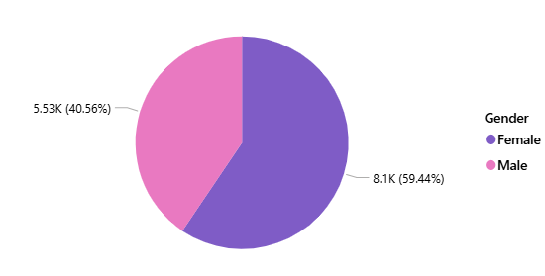
Shopping Distribution by Gender
The shopping distribution shows that female customers contribute a higher share of purchases compared to males. This highlights women as the more active shoppers, making them a key target group for marketing strategies.

Slide 5
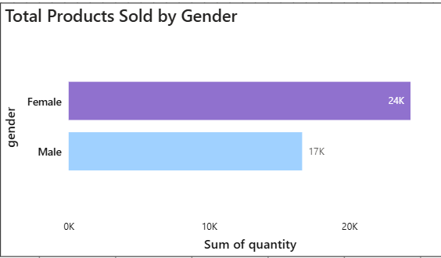
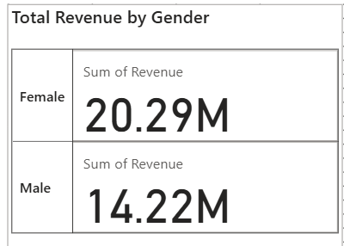
Sales & Revenue by Gender
Female customers purchased a higher number of products (24K) compared to male customers (17K), showing stronger buying participation from females.
Female customers generated higher revenue (₹20.29M) than male customers (₹14.22M), indicating that females not only buy more but also contribute more significantly to overall sales revenue.

Slide 6
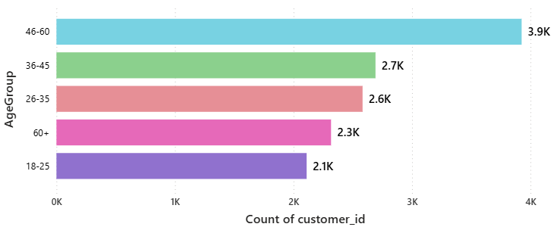
Shopping Distribution by Age
The 35-44 age group has the highest number of customers, making it the largest customer base. The distribution is also strong for the 25-34 and 45-54 age groups. The number of customers is significantly lower for the youngest (15-24) and oldest (65+) age groups, indicating that they are not the primary customer demographic.

Slide 7
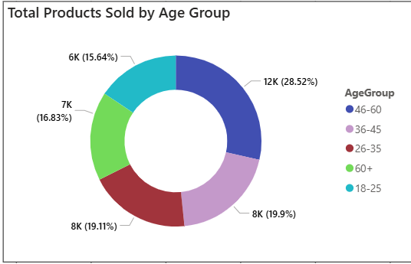
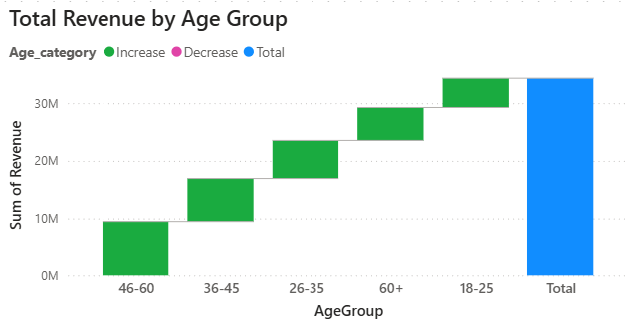
Sales & Revenue by Age Group
The chart shows that the 35-44 age group purchased the highest quantity of products. The number of products sold is consistently strong for the middle-aged groups, while it is significantly lower for the youngest (15-24) and oldest (65+) demographics.
This chart indicates that the 35-44 age group generates the most total revenue for the business. This finding confirms that the age group responsible for buying the most products is also the most profitable.

Slide 8
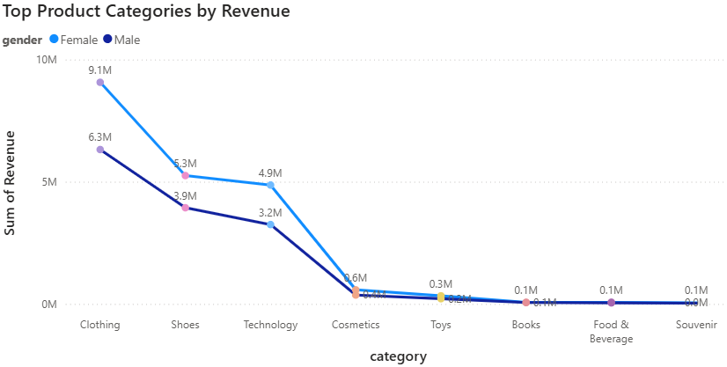
Purchase Category Analysis
The Clothing category generates the most revenue overall, with female customers consistently outspending male customers across all product categories. The data shows that while both genders contribute to sales, female shoppers are the primary drivers of revenue across the entire product range.

Slide 9
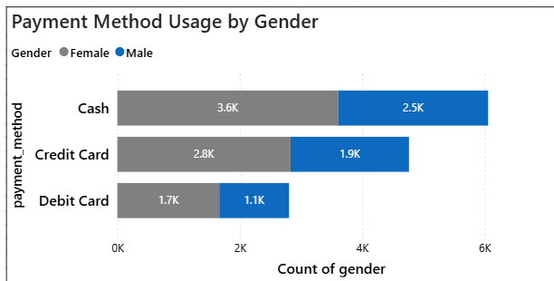
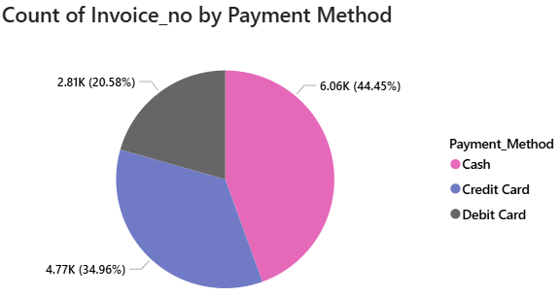
Payment Method Distribution
Both male and female customers show a strong preference for using Cash, making it the most popular payment method. Female customers, however, have a higher number of transactions across all payment types when compared to male customer.
The overall payment method distribution is dominated by Cash transactions, which are used by more than half of all customers. Credit Card are the second most preferred method, while Debit Card is the least used option for payments.

Slide 10
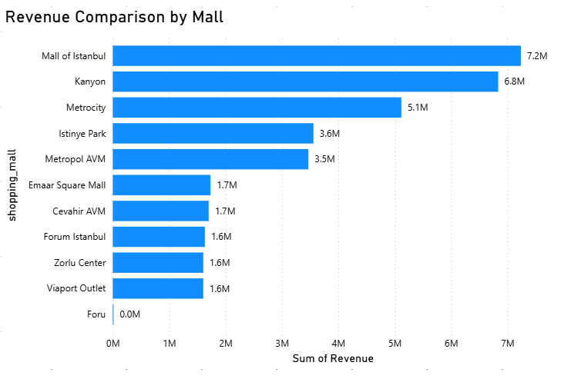
Shopping Mall Insights
Based on the provided chart, Mall of Istanbul generates the most revenue at 7.2M, followed by Kanyon with 6.8M. The data shows a significant drop-off in revenue for the other malls, with Metrocity generating 5.1M and the rest falling well below that mark.

Slide 11
Key Insights
✅ Primary customers: Females → focus on promotions, loyalty, Cosmetics & Clothing.
✅ High-value age group: 36–65 → retention strategies, offers, targeted campaigns.
✅ Top revenue: 36–50 → upsell premium products; 51–65 → slightly higher units.
✅ Payment: Heavy cash use → promote digital/card payments.
✅ Low youth activity (<18): Only target if kids’ products are relevant.

Slide 12
Recommendations
Target Female Customers: Launch female-focused promotions, loyalty programs, and expand product assortments in popular categories like Cosmetics and Clothing.
Retain High-Value Customers: Prioritize customer retention strategies like offers and targeted email campaigns for the 36-65 age band.
Develop Upsell Strategies: Create upsell bundles and premium product promotions aimed at the 36-50 age group to capitalize on their higher spending habits.
Promote Digital Payments: Consider offering card-based incentives or upgrading point-of-sale (POS) systems to encourage the use of digital payments.
Tailor Marketing Campaigns: Use the insights on category and demographic preferences to create more effective and targeted marketing campaigns.
Prioritize Segments: Focus marketing efforts on the most profitable age and gender groups, and avoid prioritizing the under-18 segment unless a youth-focused product line is planned.

Slide 13
Conclusion
The analysis highlights females and the 36–65 age group as key revenue drivers, with 36–50 contributing the highest-value purchases. Strategic focus on targeted promotions, premium product upselling, and digital payment adoption will enhance revenue and customer loyalty. Demographic-based marketing ensures campaigns are relevant and effective, while low-activity youth segments can be deprioritized unless kids’ products are targeted.

