Slide 1
HARDWARE IMPLEMENTATION OF HOPFIELD NEURAL NETWORK

Slide 2
Points in favor of hardware implementation
Inherent parallelism and connectionist model of ANN’s which find a natural application through hardware. General purpose processors operate sequentially.
Simple ANN models require simple, low precision computations which can be performed faster on cheap and low precision hardware.
Also since hardware is getting cheaper by the day, custom hardware can be built to perform complex computations.

Slide 3
Why FPGA?
FPGAs are a form of programmable logic, which offer flexibility in design like software, but with performance speeds closer to Application Specific Integrated Circuits (ASICs).
With the ability to be reconfigured an endless amount of times after it has already been manufactured

Slide 4
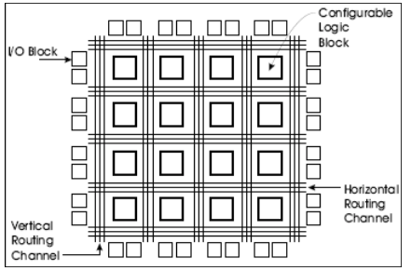
XILINX FPGA
Xilinx has traditionally manufactured SRAM-based FPGAs; so- called because the programmable resources3 for this type of FPGA are controlled by static RAM cells.
It consists of Configurable Logic Blocks (CLBs)
General Architecture of Xilinx FPGAs.

Slide 5
A SURVEY OF HARDWARE IMPLEMENTATIONS OF ARTIFICIAL NEURAL NETWORKS

Slide 6
Comparison between analog and digital implementations of ANNs
People are more familiar with digital design now i.e. analog design is an uncommon capability.
Most applications comprise of digital systems and a digital neural network will provide ease in integration with these systems.
Signal interconnection is also a problem.
The solution has to be multiplexing of connections i.e. multiple synaptic connections share the same wire.
Analog designs are hard to multiplex.

Slide 7
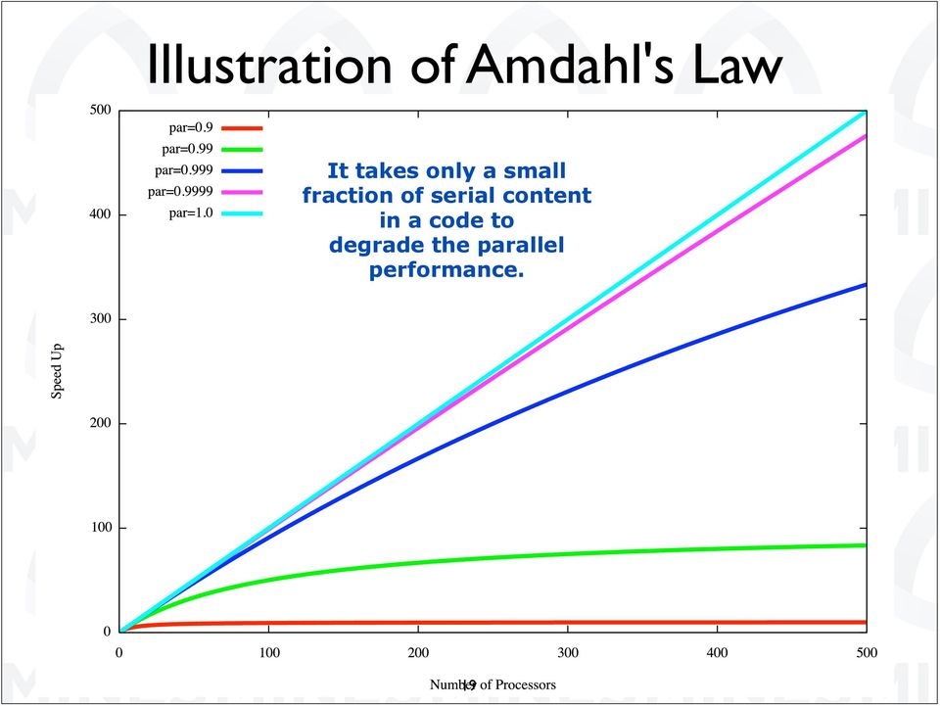
Amadahl’s law

Slide 8
Hardware implementations using FPGAs
Why Reconfiguration?
- To exploit concurrency and rapidly reconfigure for weight and topology adaptation.

Slide 9
Different implementation approaches possible due to Reconfiguration
Prototyping and simulation
to test various ANN implementations and learning algorithms.
Density enhancement
increase in the functional capacity per unit area of the chip
-Time multiplex an FPGA chip
-Dynamic constant folding
Topology adaptation

Slide 10
FPGA IMPLEMENTATION ISSUES

Slide 11
FPGA implementations of neural networks can be classified on the basis of:
1. Learning Algorithm
2. Signal representation
3. Multiplier reduction schemes

Slide 12
Learning algorithm
The type of neural network used in FPGA-based implementations is an important feature used in classifying such architectures. The type of neural network applied depends on the intended application used to solve the problem at hand.
Various types of Neural Networks
Back propagation Algorithm
Ontogenic Neural Networks
Cellular Automata based neural networks
Modular Neural Networks

Slide 13
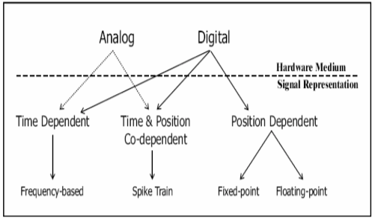
Signal Representation
Frequency-based
Spike Train
Floating-point
Fixed-point

Slide 14
Fixed Point is most popular signal representation used among all the surveyed FPGA-based (i.e. digital) ANN architectures.
Merits:
-more area efficient than floating-point
-is not as severely limited in range-precision as both, frequency and spike-train signal representations
Issues:
-Overflow and underflow -Convergence rates -Quality of generalization
Solution:
-Determining the minimum allowable precision and minimum allowable range
-Holt and Baker showed that 16-bit fixed- point was the minimum allowable range-precision for the back propagation algorithm

Slide 15
Multiplier Reduction Schemes
Use of bit-serial multipliers
bit-serial can scale up to a signal representation of any range-precision
Reduce range-precision of multiplier
this is not a feasible approach as it has a negative effect on convergence rates
Signal representations that eliminate the need for multipliers
using a stochastic-based spike train signal
Implementation of variant of REMAP for use with Sparse Distributed Memory (SDM) ANN types

Slide 16
IMPLEMENTATION APPROACHES

Slide 17
Iteration
Reiterate the Forward and Backward Computations for each training example in the epoch. The trainer can continue to train the ANN using one or more epoch until some stopping criteria (eg. low error) is met.
Once training is complete, the ANN only needs to carry out the Forward Computation when used in application.

Slide 18
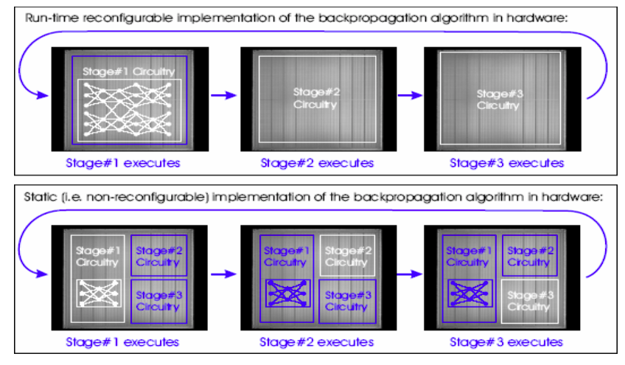
Implemenation approaches
Basically when implementing the back propagation algorithms on FPGAs there are two approaches
Non-RTR Approach
RTR (Run-Time-Reconfiguration) Approach

