Slide 1
Customer Churn Analysis
Portfolio Project
by
Neehanth Reddy, Maramreddy

Slide 2


Tech Stack & Data Details
Dataset overview:
Total Records: 7,043 customer entries
Total Features: 23 columns covering customer demographics, service details, account information, and churn status
Key fields include:
customerID: Unique customer identifier
Demographics: gender, SeniorCitizen, Partner, Dependents
Service Information: PhoneService, InternetService, StreamingTV, etc.
Account Details: tenure, Contract type, PaymentMethod, MonthlyCharges, TotalCharges
Support Tickets: numAdminTickets, numTechTickets
Target Variable: Churn (Yes/No)
Source: https://github.com/DataVisualizationExpert/Customer-Churn-Analysis-using-Power-BI/blob/main/
Tools & Technologoies:
Data Cleaning & Preparation: Python 3.12.5 (pandas)
Power BI: Data visualization & dashboard creation

Slide 3
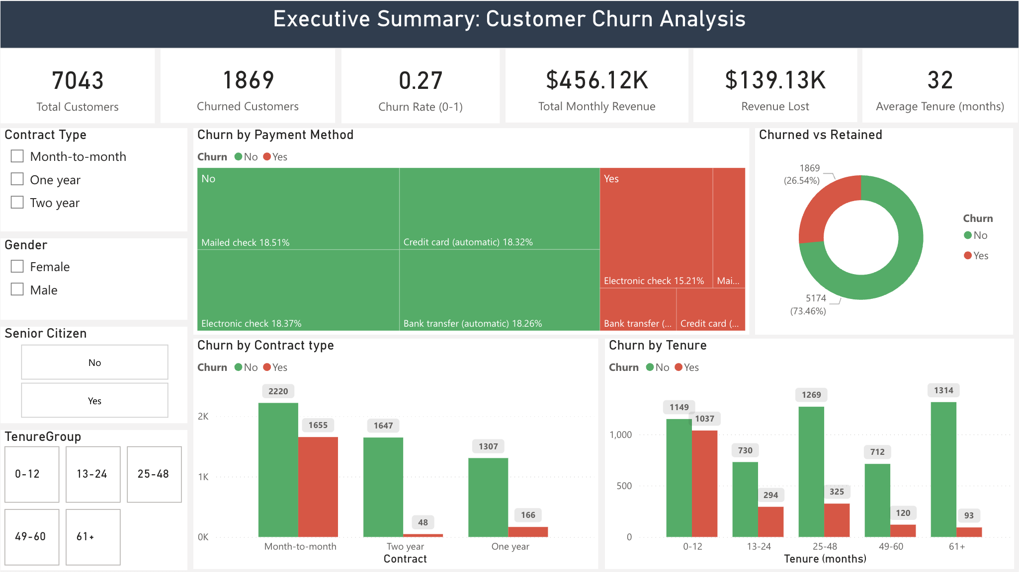
Executive Summary
Churned Customer Count: 1869 out of 7043
Churn Rate (0-1): 0.27
Monthly Revenue: $456.12K
Revenue lost: $139.13K
Average Tenure: 32 months
26.54% of customers are churning.
Month-to-month contracts have the highest churned customers compared to One year and Two year.
"0-12 months" tenure group has the highest number of churned customers. This suggests that new customers are more likely to churn within their first year.
Electronic check has the highest percentage of churned customers. This suggests that customers using electronic checks are more prone to churn compared to other payment methods.

Slide 4
Customer Demographics & Profiles
Findings:
Seniors appear to be churning more
Non-Seniors: 23.61% churn
Seniors: 41.68% churn
Having a partner does not necessarily reduce churn
Customers without a Partner: 32.96% churn & 67.04% retained.
Customers with a Partner: 19.66% churn & 80.34% retained.
New customers churn the most
Dependents | Churn
 | No | Yes | Total
No | 3390 | 1543 | 4933
Yes | 1784 | 326 | 2110
Total | 5174 | 1869 | 7043
Churn | 0-12 months | 13-14 months | 25-48 months | 49-60 months | 60+ months
No (%) | 16.31 | 10.36 | 18.02 | 10.11 | 18.66
Yes(%) | 14.72 | 4.17 | 4.61 | 1.70 | 1.32

Slide 5
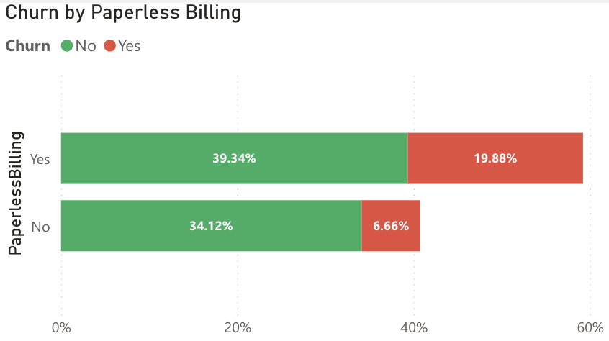
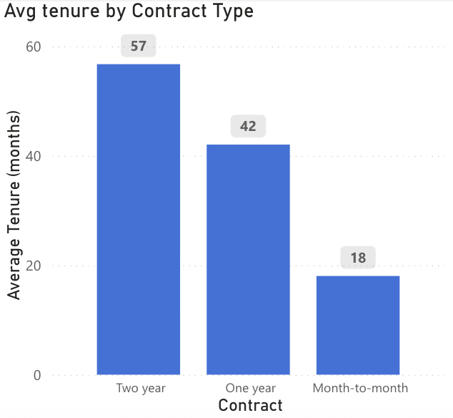
Impact of Contracts & Payment Methods on Churn
Findings:
Churn rates are significantly different, with month-to-month contracts having a much higher churn rate compared to longer-term contracts.
Customers with paperless billing churn more.
Paperless Billing (Yes): 19.88% of these customers churn.
Paperless Billing (No): 6.66% of these customers churn.
Electronic check and Mailed check appear to have higher churn rates compared to automatic payment methods.
Two year contract: Has an average tenure of 57 months.
One year contract: Has an average tenure of 42 months.
Month-to-month contract: Has a much lower average tenure of 18 months.

Slide 6
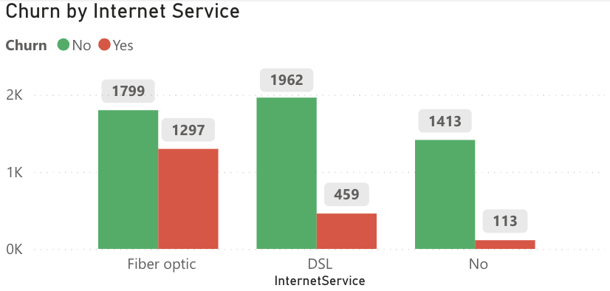
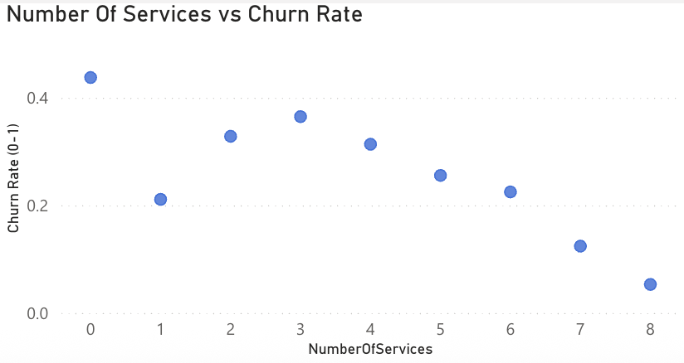
Services & Churn: Impact of Product Subscriptions
Findings:
Fiber Optic internet service has the highest number of churned customers.
Customers with multiple lines appear to be more loyal (i.e., less likely to churn)
Multiple Lines (No): 14.47% churn.
Multiple Lines (Yes): 12.07% churn.
Both Online Security and Online Backup services appear to help retain customers.
As the number of services a customer subscribes to increases, their churn rate generally decreases.
Online Backup | Churn
 | No | Yes | Total
No | 3268 | 1346 | 4614
Yes | 1906 | 523 | 2429
Total | 5174 | 1869 | 7043
Online Security | Churn
 | No | Yes | Total
No | 3450 | 1574 | 5024
Yes | 1724 | 295 | 2019
Total | 5174 | 1869 | 7043

Slide 7
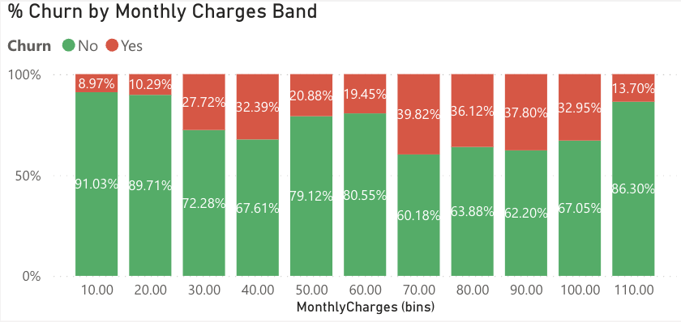
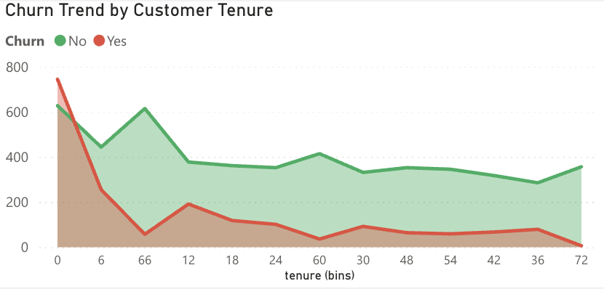
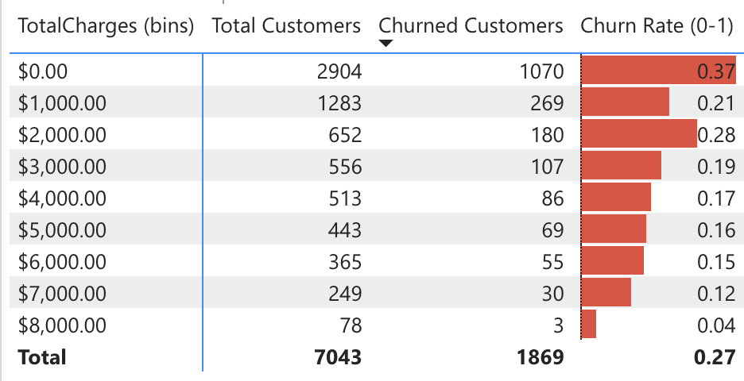
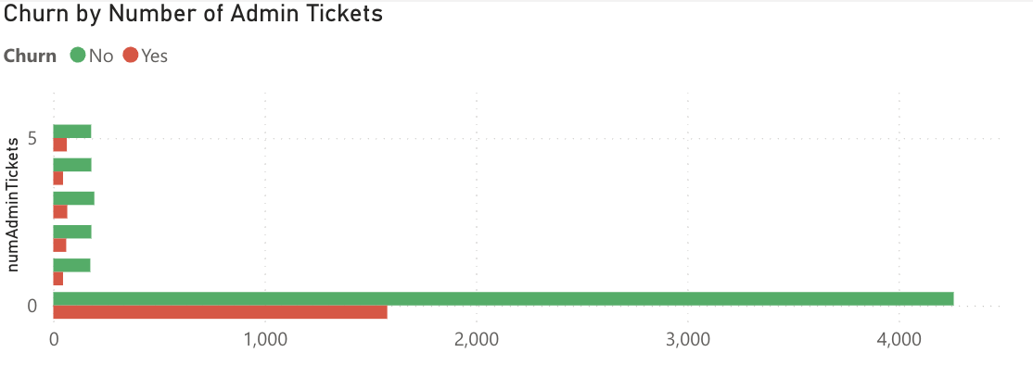
Financial & Support Drivers of Churn
Findings:
Higher monthly charges generally lead to a higher churn rate.
New customers churn significantly more than long-tenure customers.
Customers who open more support tickets (specifically Admin Tickets) are more likely to churn.
Total charges correlate with churn, but the relationship is not linear; there's a peak churn in lower total charge bands and then churn decreases as total charges increase.

