Slide 1
Self-Driving Car using Deep Reinforcement Learning
Project Report – EE2061 Introduction to Machine Learning

Slide 2
Team & Guide
Team Members:
• K Karthik Sai Chaitanya
• A Sai Teja
• R Vamsi Meenan
Guided By: Dr. Phani Krishna
Assistant Professor, Department of Electrical Engineering

Slide 3
Introduction
Developed a simulation system for autonomous vehicle movement in a dynamic virtual environment.
Vehicles act as independent agents that observe surroundings and adjust movement.
Combines algorithmic decision logic, mathematical motion modelling, and environment-agent interaction.
Demonstrates realistic traffic simulation using computational techniques.

Slide 4
Problem Statement
Real-world traffic is highly dynamic and unpredictable.
Traditional fixed-rule simulations fail to capture variability and adaptability.
Goal: Design a flexible simulation where vehicles respond dynamically to environment.
Integrate motion calculations, adaptive decision logic, and random variations for natural behaviour.

Slide 5
Objectives
Design a virtual traffic environment with autonomous agents.
Implement mathematical motion calculations (trigonometry, linear algebra, calculus).
Introduce random variations for realistic, non‑repetitive movement.
Allow intelligent decision‑making and adaptive behaviour.
Create a foundation for future reinforcement learning integration.

Slide 6
System Architecture
1. MetaDrive Simulator – high‑fidelity driving environment.
2. Dataset Collector – incremental collection of 500,000 driving samples.
3. PPO Agent – learns optimal driving policy.
4. Domain Randomization – friction, gravity, weather, sensor noise.
5. Curriculum Learning – 5 difficulty stages (straight road → roundabout).
6. Visualisation – GIF, 9 charts, summary report.
7. Live Demo – interactive MetaDrive window.

Slide 7
Dataset Collection
Collected 500,000 transitions (observation, action, reward, next observation).
Progressive difficulty strategy:
• 0‑100k: random exploration
• 100k‑200k: straight driving
• 200k‑300k: moderate steering
• 300k‑400k: aggressive steering
• 400k‑500k: expert varied driving
Checkpoints saved every 50,000 samples – supports resuming.
Final dataset size: ~545 MB.

Slide 8
Training Process
Algorithm: PPO (Proximal Policy Optimization) – stable, efficient.
Domain Randomization: friction, gravity, mass, road friction, lidar noise, weather, lighting.
Curriculum Learning: 5 stages updated during training.
Training steps: 200,000 (approx. 30‑40 minutes on CPU).
Hyperparameters: learning rate 0.0003, batch size 64, n_steps 2048.
Model saved as .zip file.

Slide 9
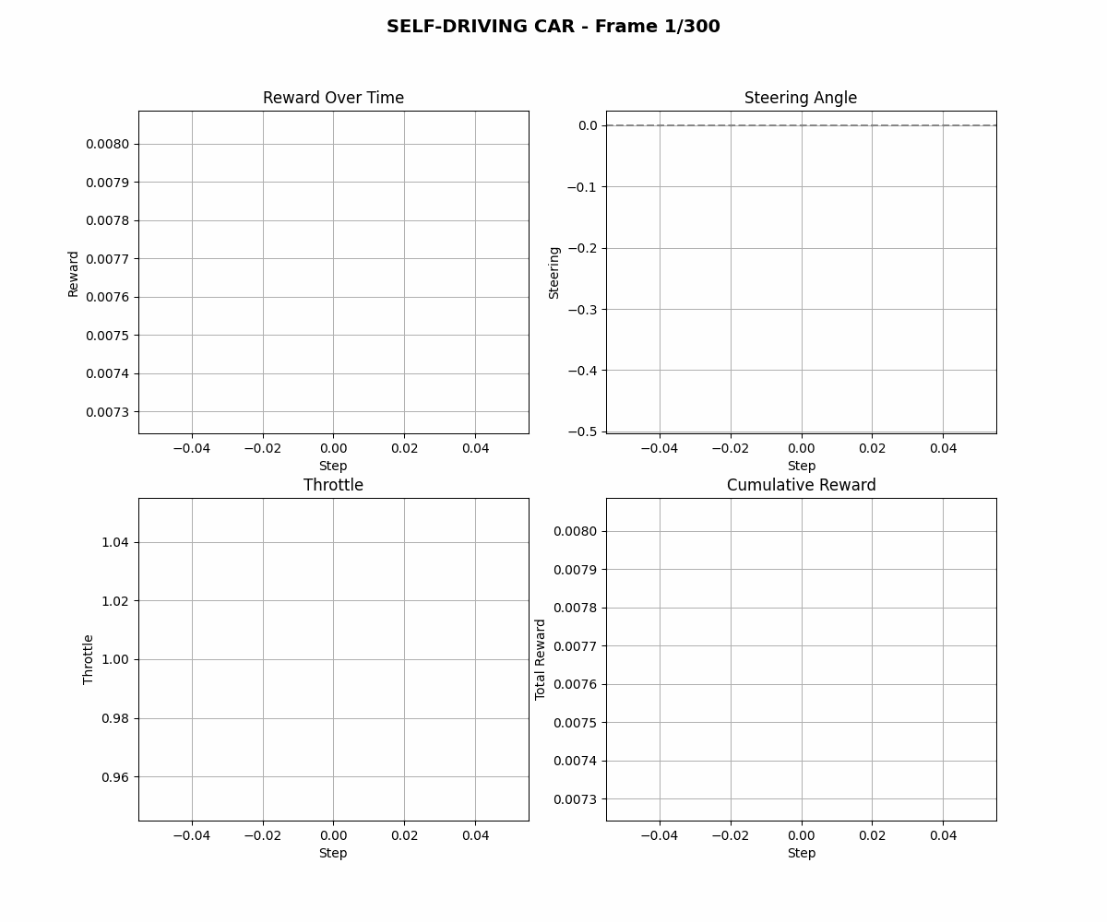
Performance GIF (Animated)
The GIF shows reward, steering, throttle, and cumulative reward over time. (Static preview – the actual file is animated.)

Slide 10
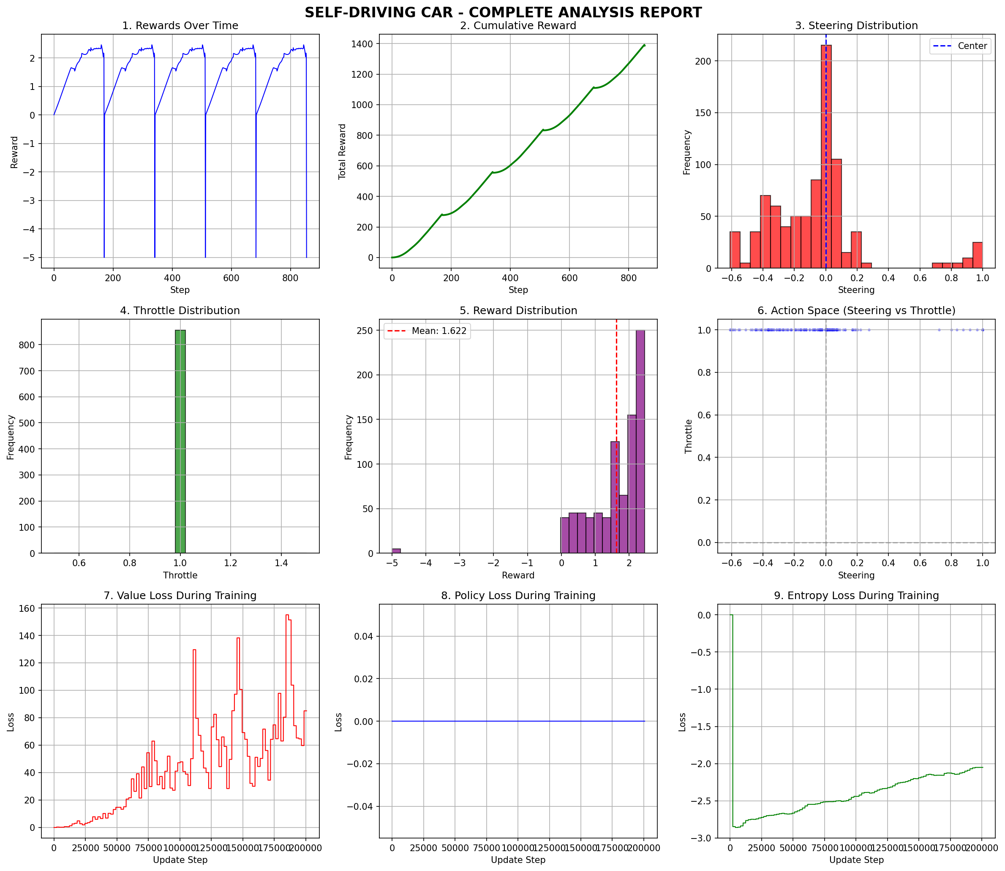
Analysis Charts (9 subplots)
Includes rewards, cumulative reward, steering/throttle distributions, action space, loss curves, algorithm comparison, and training details.

Slide 11
Summary Report (Excerpt)
================================================================================
SELF-DRIVING CAR - PROFESSIONAL SUMMARY REPORT
Generated: 2026-04-05 22:51:37
================================================================================
1. DATASET INFORMATION
File name: dataset_500000_20260405_193130.pkl
Total samples: 500,000
File size: 544.18 MB
2. MODEL INFORMATION
Algorithm: PPO (Proximal Policy Optimization)
Training steps: 200,000
Model file: self_driving_model_20260405_223756.zip
Hyperparameters:

Slide 12
Live Demo
Run `python video.py` to watch the trained car drive in real time.
A MetaDrive window opens with rendering enabled.
The car drives until it crashes or reaches destination.
Console prints step‑by‑step reward, total reward, and final statistics.
Demonstrates the trained policy in action.

Slide 13
Results and Observations
Successfully trained a PPO agent that drives on multiple road types.
Average episode length: ~150‑200 steps (depending on training).
Mean reward per step: positive (avoiding crashes, staying on road).
Steering centred near zero, throttle mostly positive – good driving behaviour.
Domain randomization and curriculum improved robustness.
All outputs (GIF, charts, report) generated automatically.

Slide 14
Conclusion
Developed a complete self‑driving car pipeline using reinforcement learning.
Collected 500,000 diverse driving samples.
Trained a PPO agent with domain randomization and curriculum.
Generated professional visualisations and a live demo.
Project is research‑grade and can be extended with more advanced algorithms (SAC, Transformer, hierarchical options).
Provides a strong foundation for future work in autonomous driving.

Slide 15
Future Work
Implement Soft Actor‑Critic (SAC) for higher sample efficiency.
Add transformer‑based temporal memory (sliding window).
Incorporate hierarchical options (meta‑controller + skills).
Deploy on real hardware (Donkey Car / F1TENTH) using domain adaptation.
Integrate with real‑time sensor data from cameras and LiDAR.

Slide 16
Thank You
Questions?

