Slide 1
Stock Price Prediction Using LSTM, ARIMA and SVR
Neeharika Yeluri
016680508

Slide 2
Introduction
The stock market is an essential part of the global financial system.
With the advent of machine learning and deep learning models, stock price prediction has become an increasingly popular research area.
We used Long Short-Term Memory (LSTM) model, for stock price prediction and compares its performance with traditional methods such as Autoregressive Integrated Moving Average (ARIMA) and Support Vector Regression (SVR).
Collected real-world stock price data from various sources, preprocessed the data, trained and evaluated the models, and compared the results with traditional methods.
Our goal was to develop a model that accurately predicts future stock prices and outperforms traditional methods in terms of RMSE and MAE.

Slide 3
Datasets
Webscraped from https://in.finance.yahoo.com using selenium and BeautifulSoup.
Datasets contain stock market data for each company from the period starting from years like 1987, 2004 to 2021-02-26.
Apple - 9800 rows and 7 columns.
Google - 4162 rows and 7 columns.
Microsoft - 8890 rows and 7 columns.
Amazon - 5989 rows and 7 columns.
Attributes: Date, Open, High, Low, Close, Adj. Close, Volume.

Slide 4
Data Preprocessing
Removed missing values from the dataset.
The "Open" and "Volume" columns are cleaned by removing commas.
The dataset is sorted by the "Date" column.
Rows with dates earlier than January 1, 2015.
These cleaning and preprocessing steps help ensure that the data used for analysis is accurate and consistent.

Slide 5
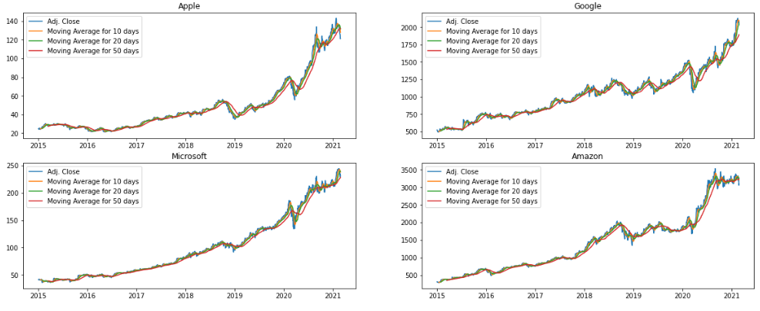
Exploratory Data Analysis
We can see from the graph that Apple shares have tremendous growth in the 2020-2021 period.
It can be due to COVID-19 which is the primary factor affecting the 2020-2021 period.

Slide 6
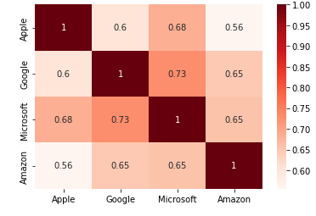
EDA contd..
From the plot, we can see that Microsoft and Google had the strongest correlation in stocks daily returns.
correlation between stocks daily returns

Slide 7
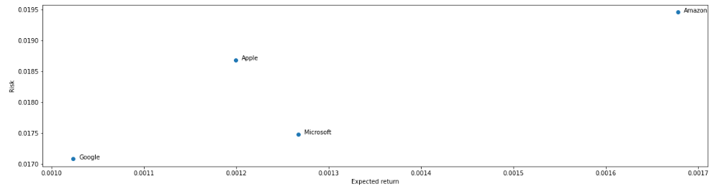
EDA Contd..
From the above graph, we can see that Amazon has the highest expected returns and the highest risk factor.
Google has the lowest expected returns and the lowest risk factor.

Slide 8
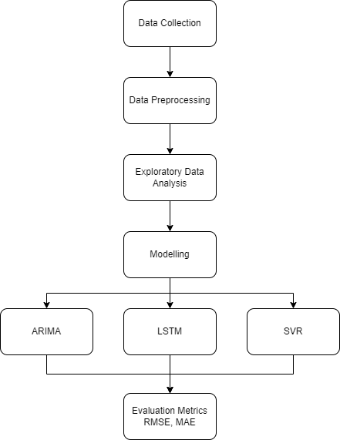
Methodology
The model is trained using the training data from 2015-01-02 to 2020-09-30 and tested using the testing data from 2020-10-01 to 2021-02-26.

Slide 9
LSTM
LSTM is a type of recurrent neural network (RNN) that is well-suited for time series prediction tasks.
Used to predict the stock prices of four technology companies: Apple, Google, Microsoft, and Amazon.
The model is trained using 200 epochs for Amazon and 1000 epochs for the rest of them.
Early stopping is applied using a callback function during the training process.
The model is then used to predict the adjusted closing price of the stock for the testing period.
A walk-forward validation mode is used throughout the multi-step forecasting process.
ADAM is used as the optimizer with a unique learning rate, and MSE is used as the loss function.
The LSTM model was able to achieve a lower RMSE and MAE compared to other models.

Slide 10
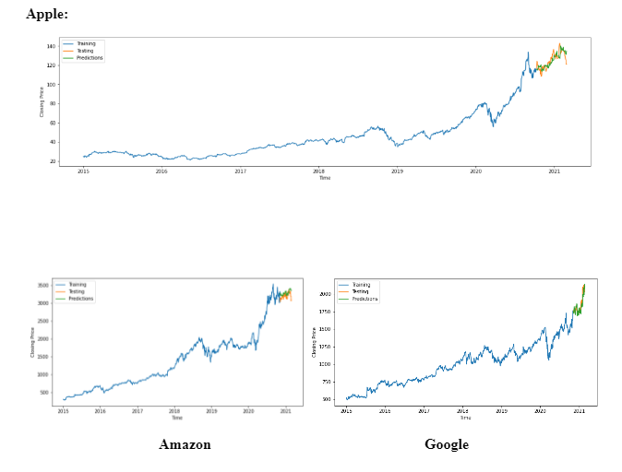
Predictions:

Slide 11
ARIMA
ARIMA is a popular time series forecasting method that combines three components - auto-regression, differencing, and moving average - to model and predict future values of a time series based on its past behavior.
Used historical stock prices from 2010 to 2021 for Apple, Google, Microsoft, and Amazon obtained from Yahoo Finance.
Checked stationarity of time series using Dickey-Fuller test and applied log transformation to reduce trend and stabilize variance.
Used Auto ARIMA algorithm to find best parameters for ARIMA model, which were identified as (1, 1, 0) and fit into the model.
Model performance was evaluated using RMSE and MAE as evaluation metrics.
Model was able to capture the general trend and seasonal fluctuations in the data but failed to predict the sudden drop in prices in September 2020, indicating that the model might not be able to predict extreme events.

Slide 12
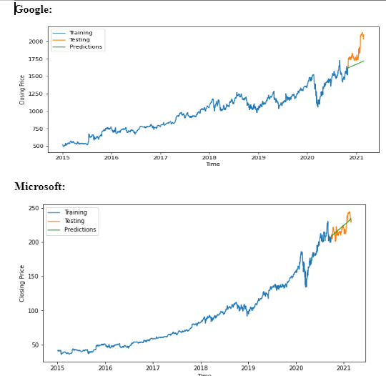
Predictions:

Slide 13
SVR
SVR aims to find the best fit line or hyperplane that has the maximum margin from the actual data points.
It can handle both linear and non-linear data and work well in high dimensional space.
The algorithm tries to minimize the error between predicted values and actual values while also maximizing the margin.
SVR is used to predict the stock prices of Apple, Google, Microsoft, and Amazon.
The training and testing data are split and reshaped to fit the model's requirements and the performance is evaluated using RMSE and MAE metrics.
The predicted stock prices follow the actual stock prices closely for each company.
SVR performed the least , however the prediction accuracy depends on many factors, and one should not rely solely on these results to make financial decisions.

Slide 14
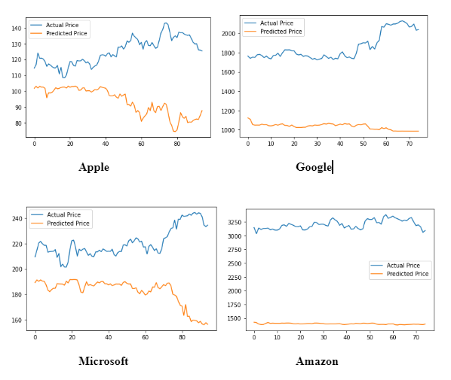
Predictions:

Slide 15
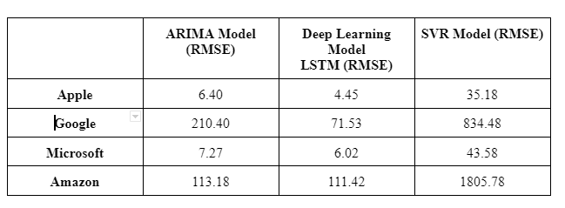
Results

Slide 16
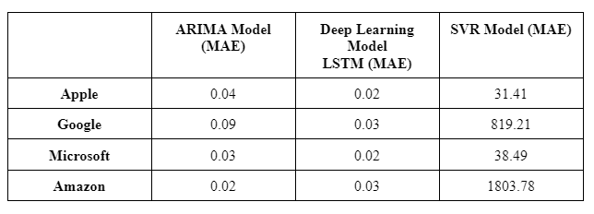
Results contd…

Slide 17
Conclusion:
The study proposed a novel approach using the LSTM model for stock price prediction and compared its performance with traditional methods such as ARIMA and SVR.
The study also performed exploratory data analysis and provided insights into the stock prices of the four companies.
The visualizations and correlation plots provided a better understanding of the companies' historical stock prices, daily returns, and correlation between stocks' closing price and daily returns.
The LSTM model achieved a lower RMSE and MAE than ARIMA and SVR for all four companies, indicating its superiority in predicting stock prices.

Slide 18
Thank You

